Slide 1
Machine Learning Applications in Credit Risk Modeling
by Yuwei Wang, Viraj Thakkar, Ashwin Siripurapu and Steven Dornberg
October 13th, 2020

Slide 2

Agenda
A structured approach to creating a model
Business Problem Statement
Data Description
Description of variables
Data Preparation
Feature Importance
Model Description
Model Introduction
Model Evaluation
Further Discussion
Presented by Steven Dornberg

Slide 3
Counterparty Risk Assessment Models
Why Machine Learning?
Business Problem Statement: How can we effectively and efficiency measure Counterparty Risk utilizing a risk model?
Factors and goals to consider in Counterparty Risk Modeling
Thoroughly evaluate a company’s financial metrics to determine variable importance
Outputting a default risk decision based on systematically analyzing a combination of multiple variables
Additionally, sometimes we rather know the probability of a default, rather than yes/no, to stratify risk
Benefits of Machine Learning in Evaluating Credit Risk
ML models can determine which financial metrics weigh most heavily in determining default risk in the dataset
Machine Learning models hold a distinct advantage over if-else models (static deterministic environment)
Utilizing past data to assign weights to financial metrics, we can output a probability likelihood that a company defaults
Presented by Steven Dornberg

Slide 4
Dataset Description & Features
The data that drives the machine learning model determines its effectiveness
Data Insights for Credit Risk Modeling
In order to make future predictions, a machine learning model requires a past dataset to learn from
Models are only as good as the data they learn from, regardless of the algorithm
Can the magnitude of a company’s financial assets and liabilities, as well as their YoY change, help predict risk?
Dataset Features
Contains ~4,200 past samples of a company’s financial metrics, and whether they defaulted
Various metrics (features), such as yearly data (ie 2016 TDE), as well as Year-over-Year metrics
Additional features that were engineered as a result of data preparation and imputing missing values
Presented by Steven Dornberg

Slide 5




Data Preparation
Preprocessing steps of data to enter machine learning models
Create missing indicators
Fill in missing values
Fix questionable variables
Standardization
Create missing indicators: add an indicator for each existing variable, to indicate whether the original value was missing (1) or not (0). The missing indicators will be included in model training as features
Fill in missing values: Since most variables are highly skewed, we fill missing values with medians of each variable, rather than mean
Fix questionable variables: All yoy variables are obviously wrongly calculated (negative sign missing and decimals misplaced), so we recalculated yoy variables defined by var_17 - var_16
Standardization: Scaled all variables to [0,1], to fit the requirements of certain models (for example, logistic regression)
Presented by Yuwei Wang

Slide 6
ML Models Implemented
Generating novel statistical insights from data
Classification models
Logistic Regression
Decision Tree
Random Forest (best performance)
Gradient-Boosted Random Forest
Presented by Ashwin Siripurapu

Slide 7
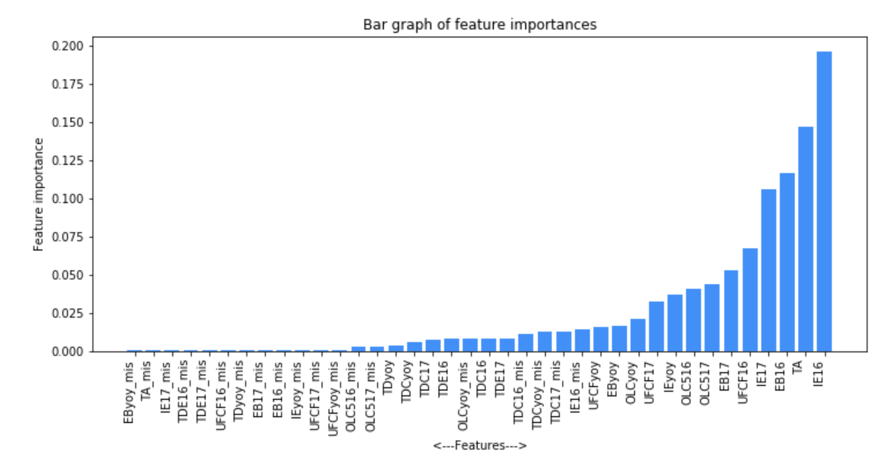
Feature Importance
Gauging the most predictive features
Interest expenses dominate
Debt-to-capital and debt-to-equity less important than total assets
Presented by Ashwin Siripurapu

Slide 8
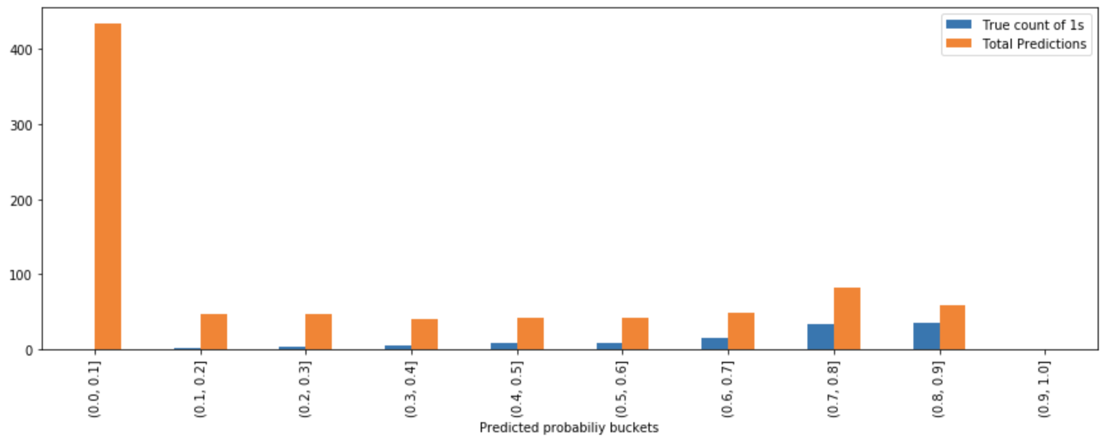
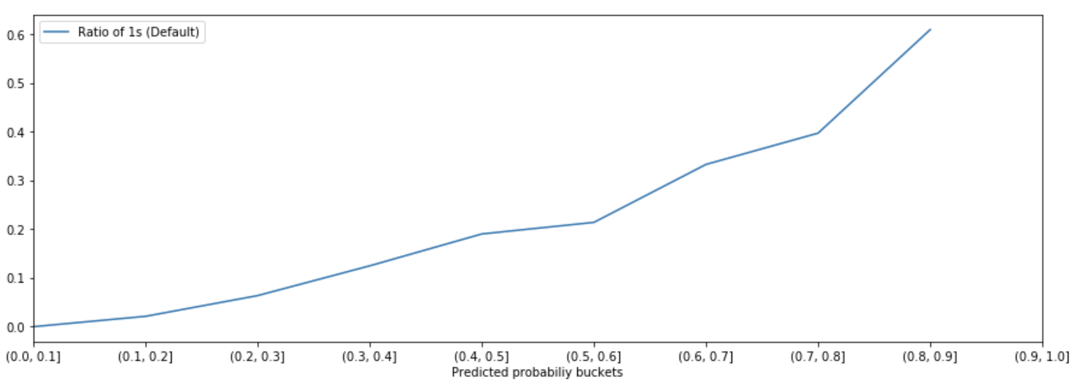
Predictions and Probabilistic Insights
Analyzing outcomes of probabilistic models
Predicted probabilities of Default by RF model
Presented by Viraj Thakkar
Notes:
YW

Slide 9
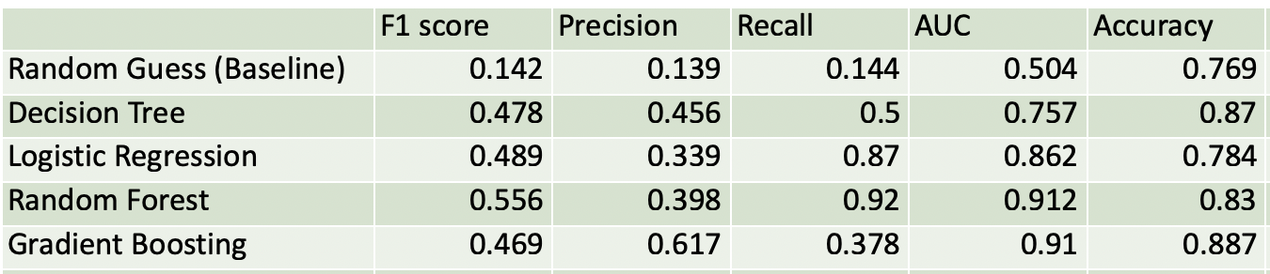
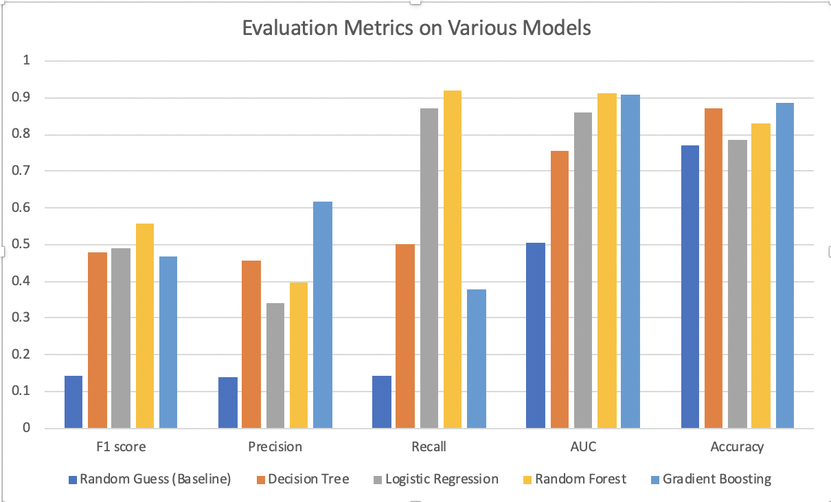
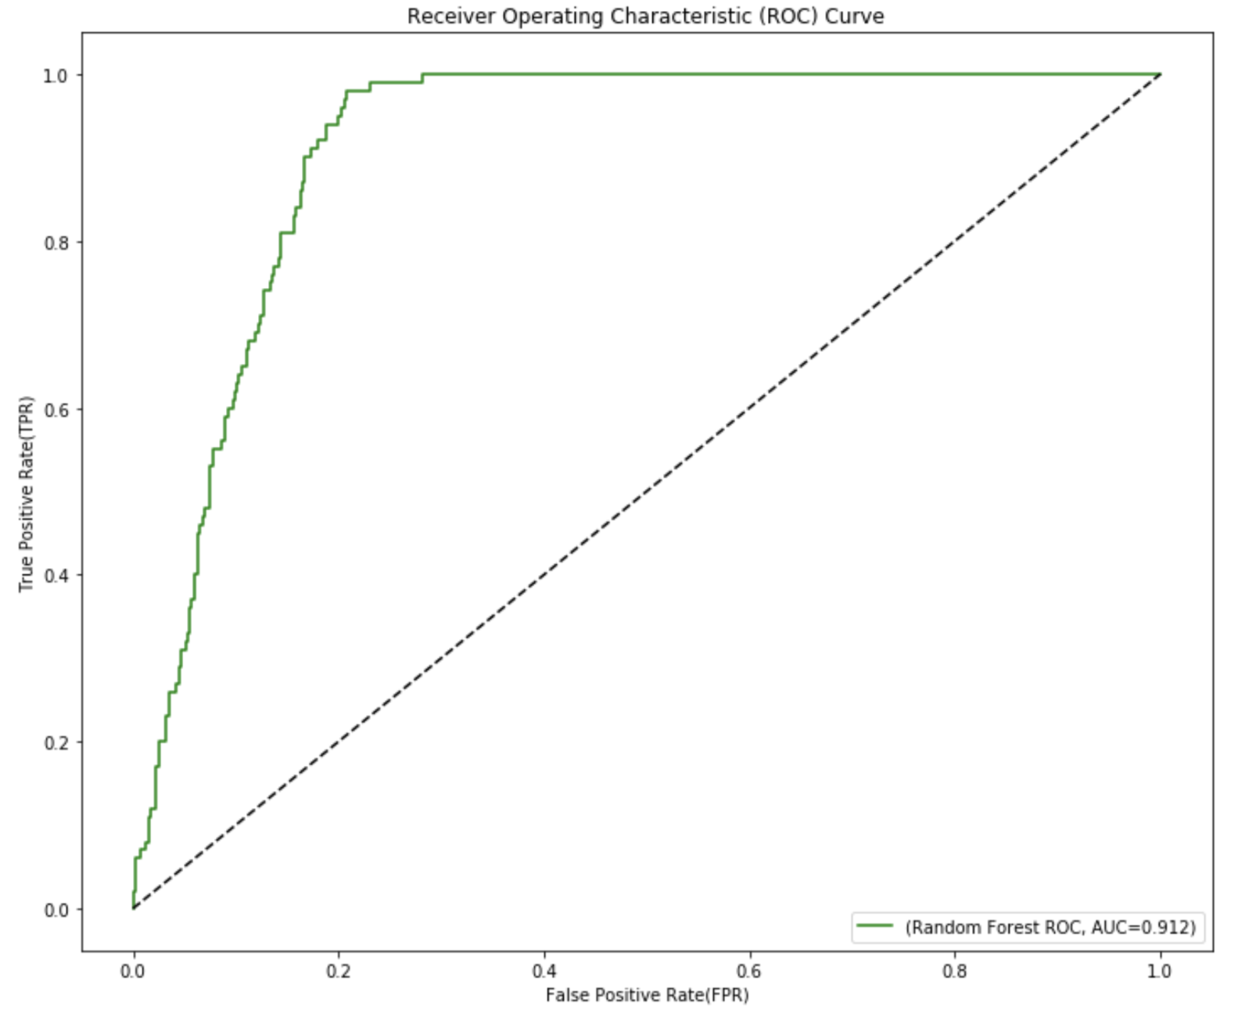
Model Evaluation
Which model to choose?
Precision: proportion of real positive among all predicted positive
Recall: proportion of predicted positive among all real positive
F-1 score: harmonic mean of precision and recall
Accuracy: proportion of correctly assigned observations
AUC: area under receiver operating characteristics curve
Presented by Yuwei Wang
Notes:
YW

Slide 10
Further Work
Paths forward and areas of improvement
Data Improvements
More and better data
Company size, growth, history data
Sectors, industries, and exposure to global macro events
Longer history to train on
Modeling Considerations
How frequently to re-train?
On what time horizon should we predict default?
Presented by Ashwin Siripurapu

