Slide 1
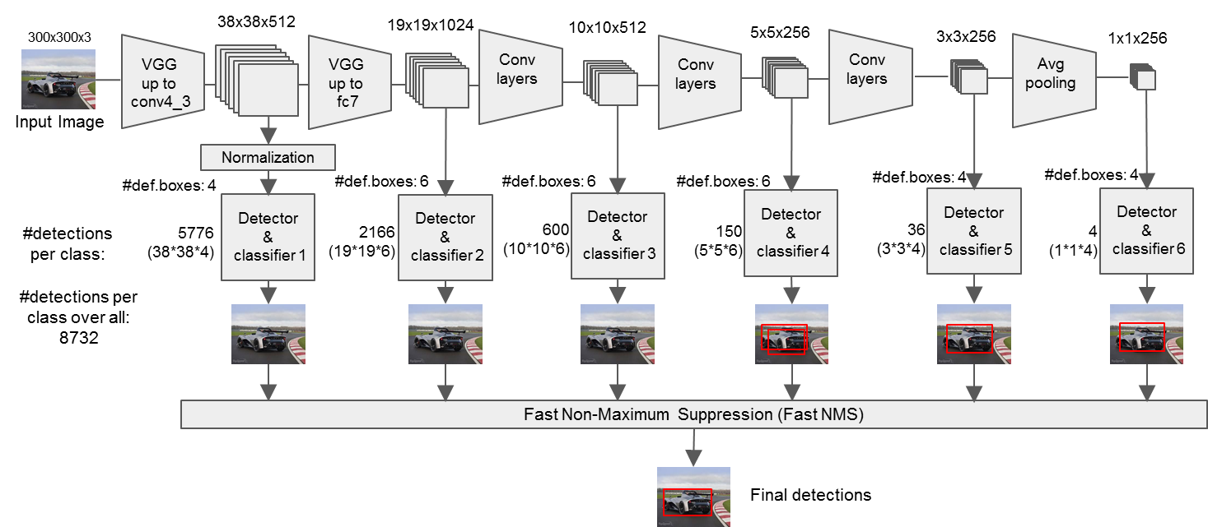
負責辨識影像中的
遠物
(小物體)
近物
(大物體)
Backbone CNN
最重要的三路(尺寸最廣泛)

Slide 2
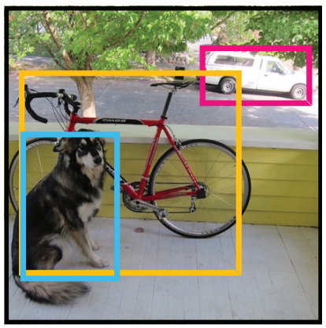
sorting
bb47
bb20
bb15
bb7
bb1
bb4
bb8
bb98
Class:
dog
0.5 | 0.3 | 0.2 | 0.1 |  |  |  |  | 0 | 0 | 0 | 0
(1x98)

Slide 3
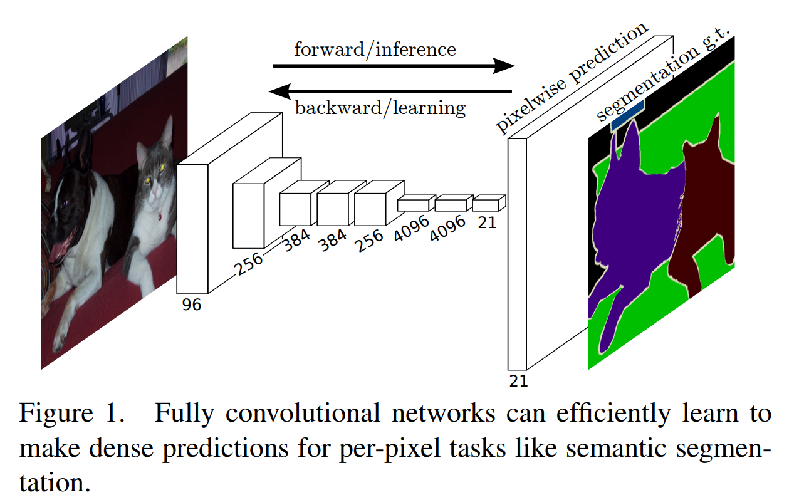
PASCAL
20 +1
最後一層softmax出來有21層的深度
每一層就是每一個類別的在每個pixel上的機率

Slide 4
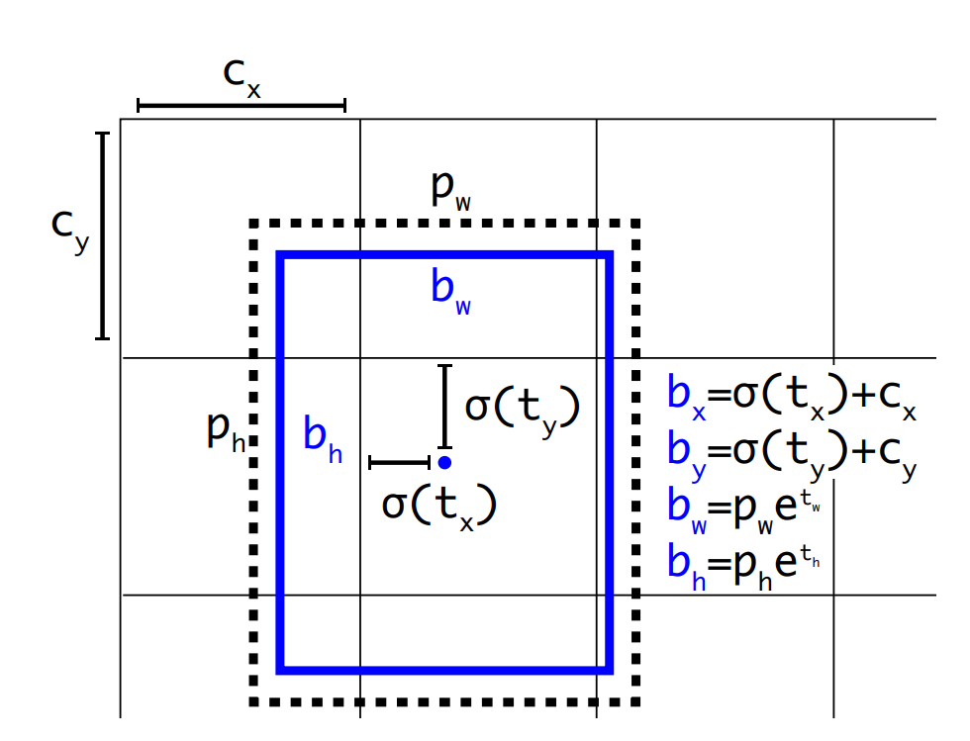
b_{y}
Feature Map
b_{x}
←(b_{x}, b_{y})

Slide 5
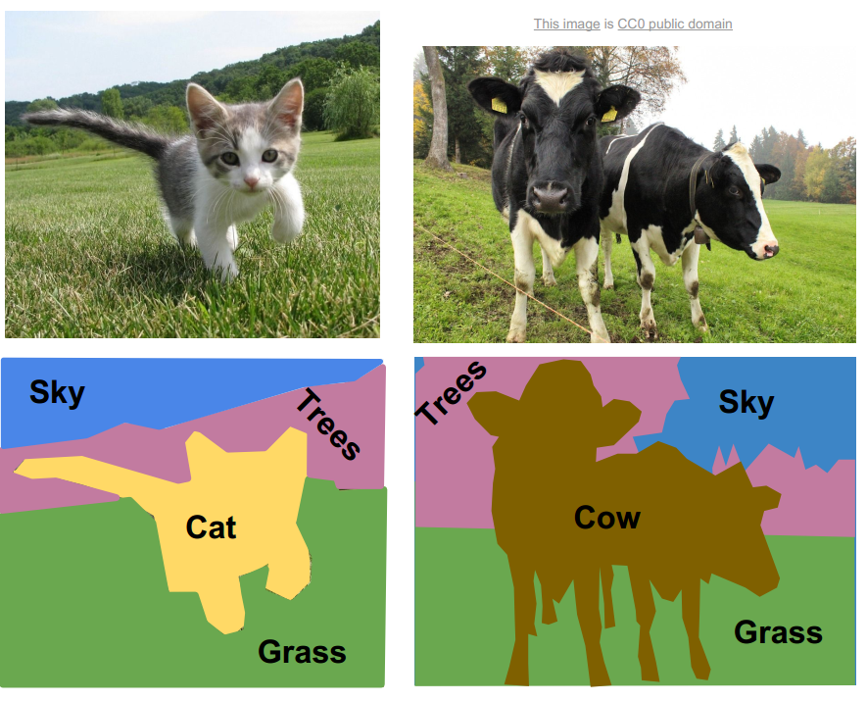
pixel-wise
softmax
Channel-wise
argmax
conv.
de-conv.
H x W x 3
H x W x C
H x W x 1

Slide 6
Conv. Net

Slide 7
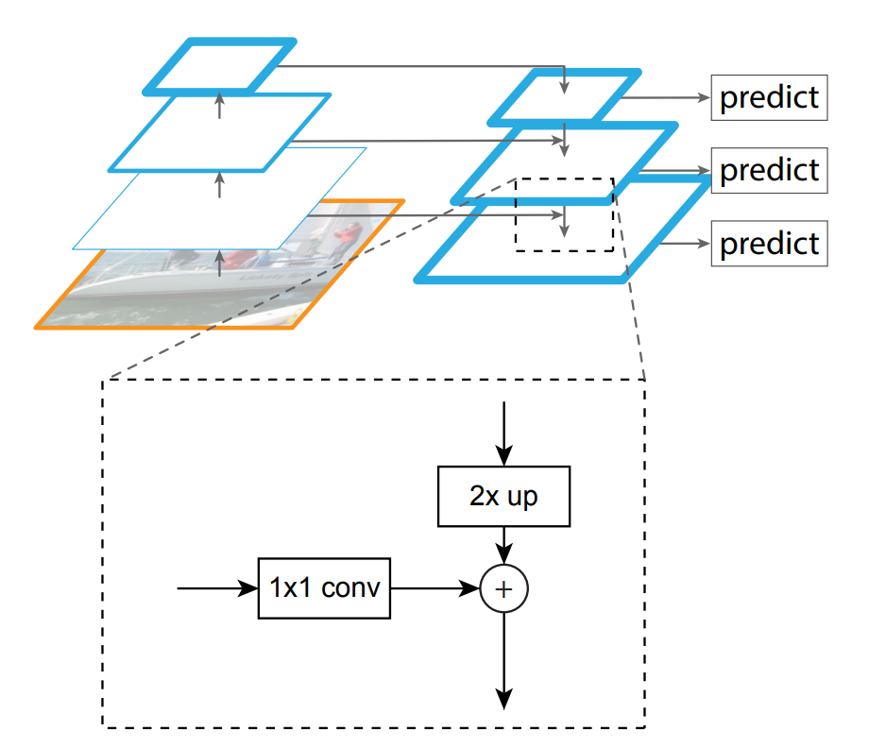
C3
P3
C2
P2
C1
P1
C0
Notes:
<編號>

Slide 8
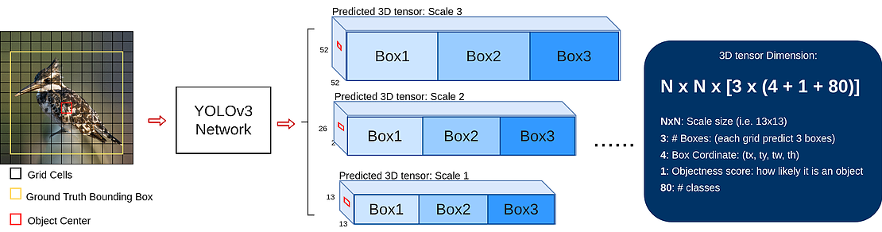
80 class in COCO
bbox
confidence
N × N grid
小物體
大物體
Notes:
<編號>

Slide 9
P6
RPN
C5
M5
P5
C4
+
Class
M4
P4
BBox
ROI Align
ResNet/ResNeXt
C3
+
Mask
M3
P3
FCN
C2
+
M2
P2
conv. 3×3, Relu
2×2
pooling
C1
FPN
1×1
sigmoid
Input Image
upsampling

Slide 10
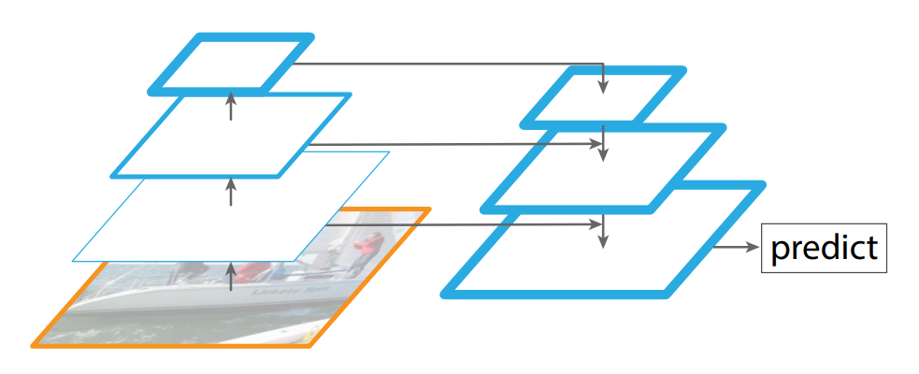
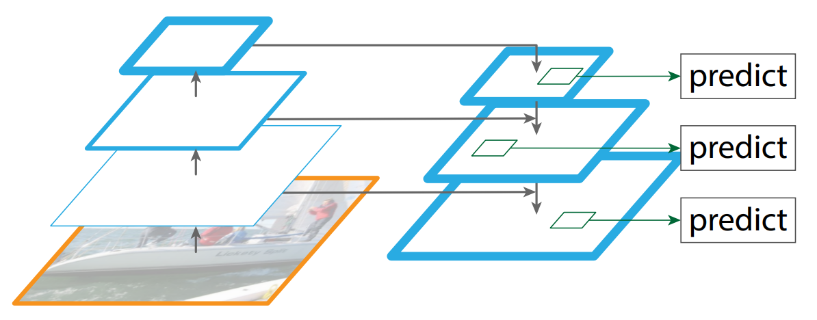
(a)
(b)

Slide 11
P6
RPN
C5
M5
P5
RPN
C4
+
M4
P4
RPN
ResNet 50/101
C3
+
M3
P3
RPN
C2
+
M2
P2
RPN
C1
FPN
Input Image
conv. 3×3
1×1
pooling
upsampling

Slide 12
P6
C5
RPN
M5
P5
RPN
Class
C4
+
BBox
M4
P4
RPN
ROI Align
ResNet 50/101
Mask
C3
+
RPN
M3
P3
FCN
C2
+
RPN
M2
P2
conv. 3×3, Relu
C1
2×2
pooling
FPN
1×1
sigmoid
Input Image
upsampling

