Slide 1
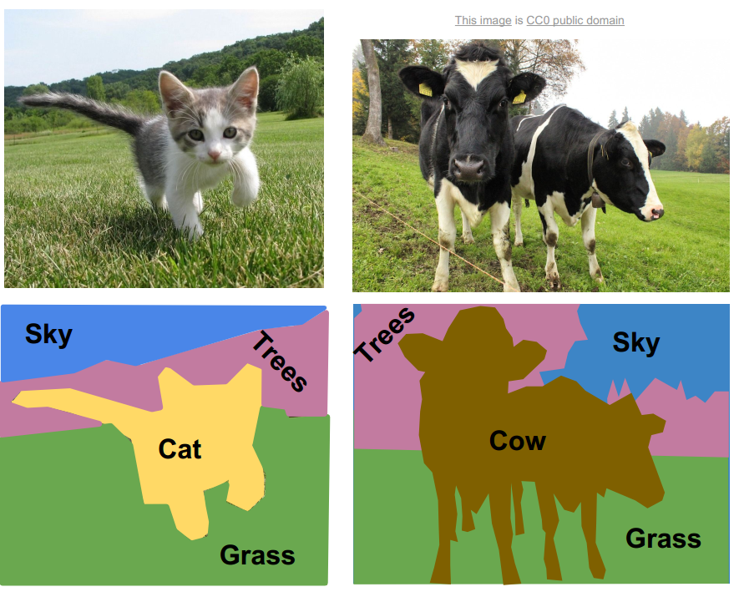
Image
Sliding-window

Slide 2
Image
Region proposals

Slide 3
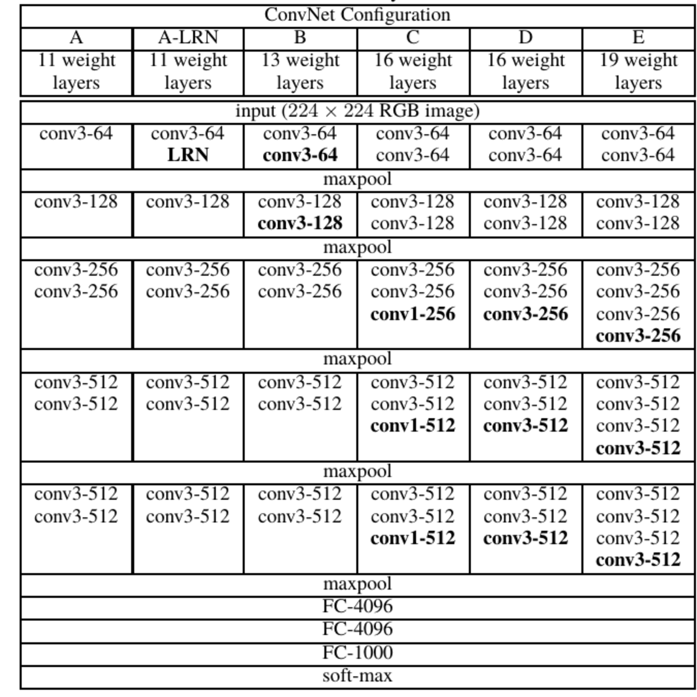

Slide 4
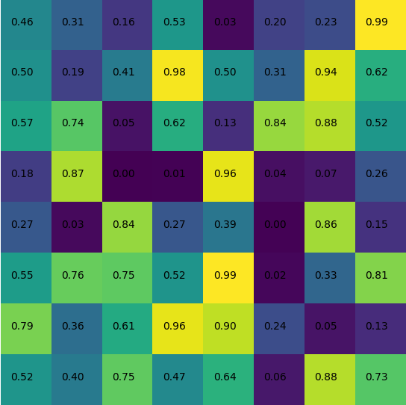

Slide 5
7×7×512
Softmax
Class pred.
ROI Pooling
conv5_3
BBox pred.
RPN
For
object
1×1×18
7×7×9×2
7×7×18
Reshape
Softmax
Reshape
Conv. Layers
Proposals
3×3×512
7×7×36
1×1×36
For
offsets
Conv. 7×7
Dense
Conv. 3×3
Relu
Conv. 1×1
Pooling

Slide 6
Feature map

Slide 7
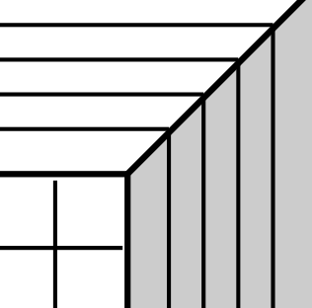
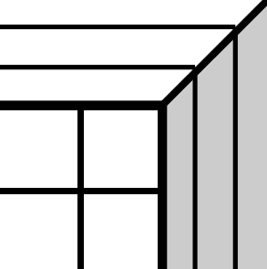
k
i
j
7
0.2
0.8
dx
dw
7
dy
dh
4×9=36
2×9=18
7
7
For Object
For Offsets

Slide 8
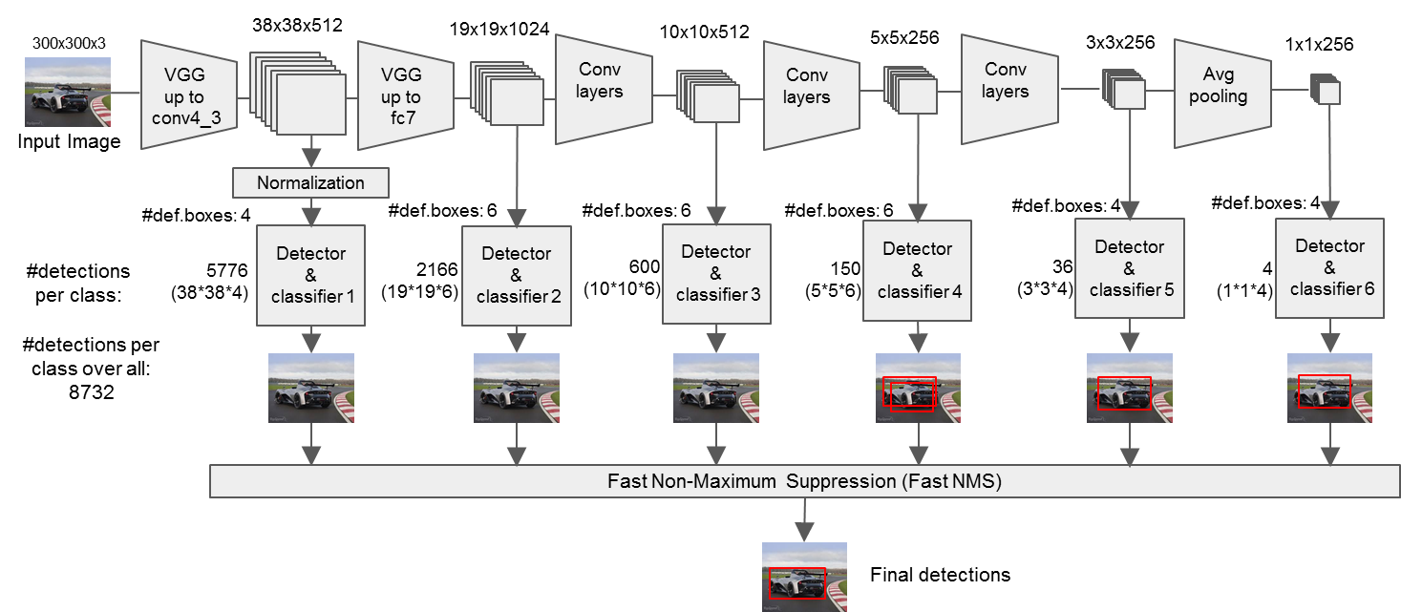
負責辨識影像中的
遠物
(小物體)
近物
(大物體)
Backbone CNN
最重要的三路(尺寸最廣泛)

Slide 9
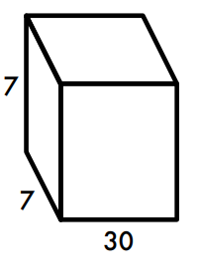
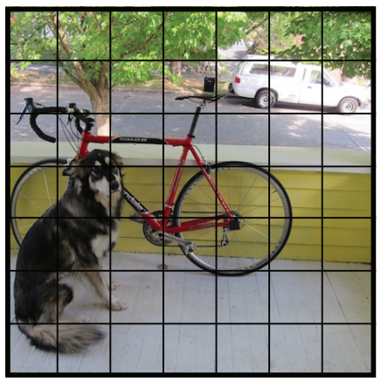
x₁ | y₁ | w₁ | h₁ | C₁ | x₂ | y₂ | w₂ | h₂ | C₂ | P_{c1} | P_{c2} | P_{c3} | ……………… | P_{c19} | P_{c20}
BBox 1
BBox 2

Slide 10
BBox 1
BBox 2
x₁ | y₁ | w₁ | h₁ | C₁ | x₂ | y₂ | w₂ | h₂ | C₂ | P_{c1} | P_{c2} | P_{c3} | ……………… | P_{c19} | P_{c20}
Multiply
Class
………
20×1
20×1
20×98
BBox

Slide 11
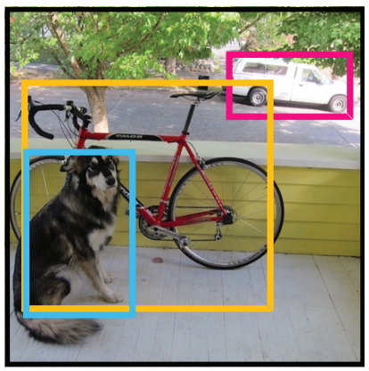
sorting
bb47
bb20
bb15
bb7
bb1
bb4
bb8
bb98
Class:
dog
0.5 | 0.3 | 0.2 | 0.1 |  |  |  |  | 0 | 0 | 0 | 0
(1x98)

Slide 12
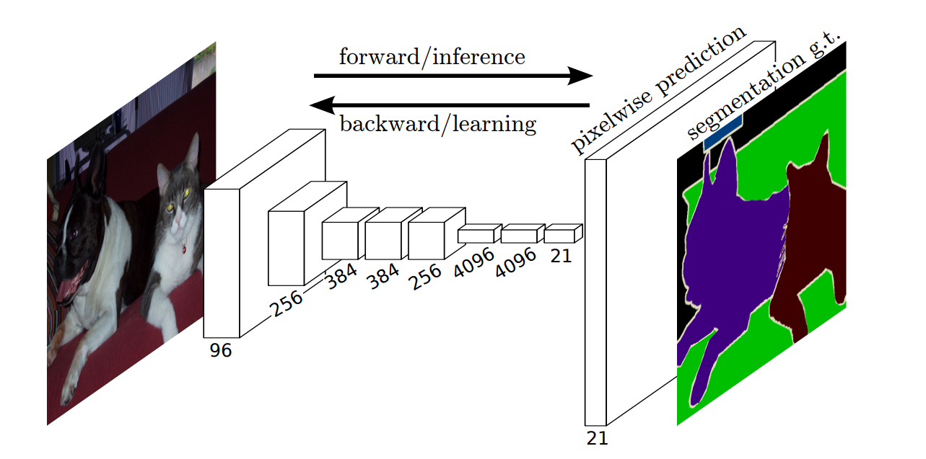
PASCAL
20 +1
最後一層softmax出來有21層的深度
每一層就是每一個類別的在每個pixel上的機率

Slide 13
Pixel-wise
Softmax
Channel-wise
Arg. max
conv.
de-conv.
H x W x 3
H x W x C
H x W x 1

Slide 14
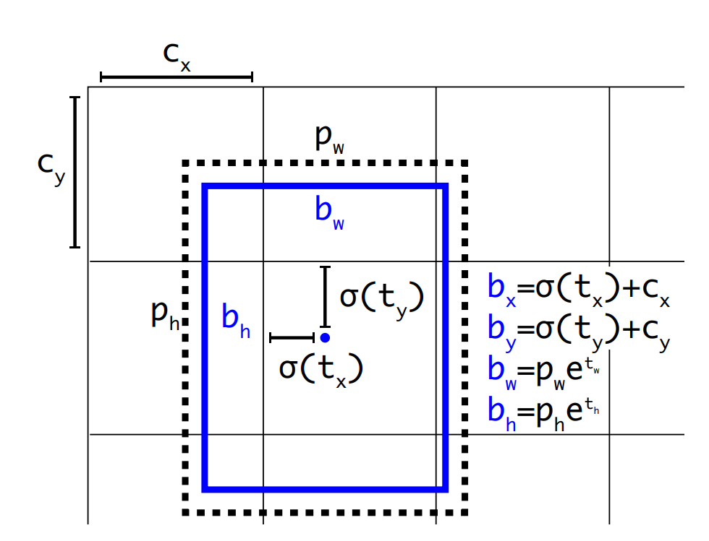
b_{y}
Feature Map
b_{x}
←(b_{x}, b_{y})

Slide 15
Conv. Net

Slide 16
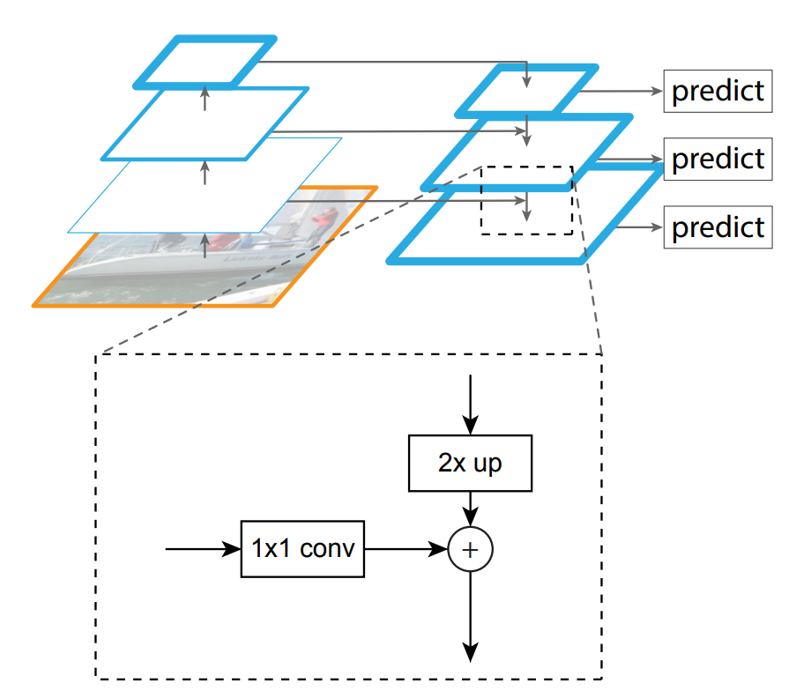
C3
P3
C2
P2
C1
P1
C0
Notes:
<編號>

Slide 17
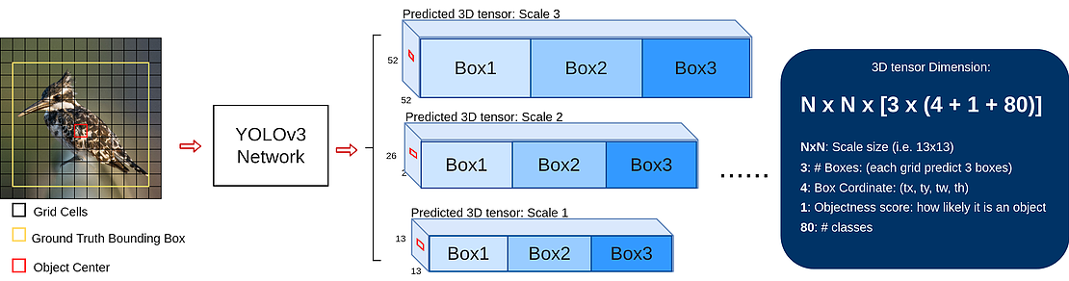
80 class in COCO
bbox
confidence
N × N grid
小物體
大物體
Notes:
<編號>

Slide 18
P6
RPN
C5
M5
P5
C4
+
Class
M4
P4
BBox
ROI Align
ResNet/ResNext-101
C3
+
Mask
M3
P3
FCN
C2
+
M2
P2
conv. 3×3, Relu
2×2
pooling
C1
FPN
1×1
sigmoid
Input Image
upsampling

