Slide 1

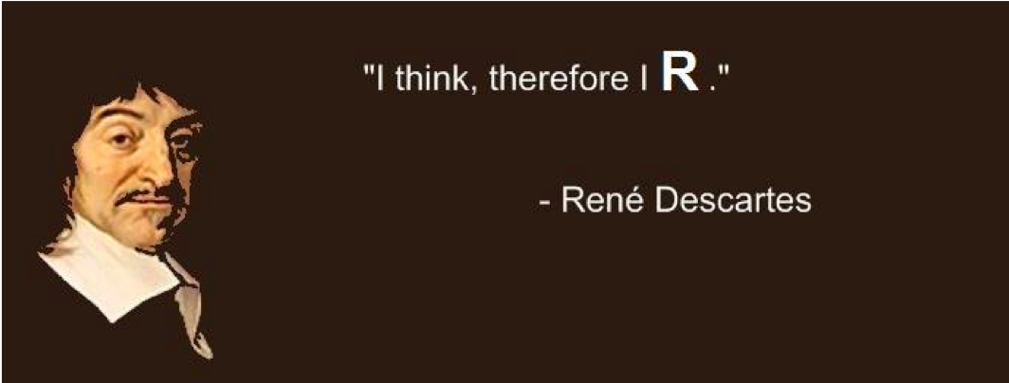
introduction
Huitian Diao (Yolanda)
”You think, therefore you R.”
- René Descartes
References:
Quick-R by DataCamp
R for Beginners by Emmanuel Paradis

Slide 2

Using sticky notes for feedback
“I’ve got a good handle on things…”
“I think I understand but I’m still working through things…”
“I’m not understanding and I’m a little lost right now...”

Slide 3
Get course material
Github
Applied-Bioinformatics
Github
HW
git pull
git push
copy
My local:
Applied-Bioinformatics
My local:
Applied-Bioinformatics

Slide 4

Type codes, not copy & paste
I just copy-pasted those codes …
What did
you say?

Slide 5
Contents
R basic syntax
Object
Data types
Vectors
Matrices
Arrays
Data frames
Lists
Factors
Data type conversions
Basic function for objects
Basic data operations
Arithmetic operators
Logical operators
Common math built-in functions
Control structure
More data operations
Import data
Data frame operations
User defined functions
lapply

Slide 6
Practice 2.1 !
Commends:
<-
print()
getwd()
setwd()
matrix() # Matrix
c() # Vector
factor()
data.frame() # Data frame
str()
class()
Objectives:
Check your working directory, change directory to Unit1-module2-R, and list the files in the folder
Create a vector containing names of 5 states and print it.
Create a matrix with 100 numbers, with 10 column and 10 rows, and print it.
Create a dataframe for experiment animals to record their information.
Name the dataframe's columns.
Make gender of animals a nominal variable and summarize the gender.
Check the structure of your dataframe and the type of elements in your dataframe
#Animal info:
#Names: Fluf1, Fluf2, Fluf3, Fluf4, Fluf5, Fluf6, Fluf7, Fluf8
#Number: 7103, 7104, 7105, 7106, 7107, 7108, 7109, 7110
#Weight: 19, 18, 23, 22, 17, 18, 21, 20
#Treated: TRUE, TRUE, FALSE, FALSE, TRUE, FALSE, TRUE, FALSE
#Gender: Female, Female, Male, Male, Female, Female, Male, Male

Slide 7
Basic data operations
Arithmetic operators
+ | addition
- | subtraction
* | multiplication
/ | division
** or ^ | exponentiation
%% | modulus
%/% | integer division
Logical operator
> >= | Greater Greater or equal
< <= | Less Less or equal
== != | Equal to Not equal to
! | NOT
| | OR
& | AND
isTrue() | If … is true

Slide 8
Common math built-in functions
abs() | Absolute value
sqrt() | Square root
ceiling() | Ceiling(3.457) is 4
floor() | Floor(3.457) is 3
trunc() | Trunc(5.99) is 5
round() | Round(3.457, digits=2) is 3.48
signif() | Signif(3.475, digits=2) is 3.5
sin() cos() tan() | Trigonometric functions
log() log10() | Natural logarithm or commom logarithm
exp() | e^

Slide 9
Control structures: If else
If (condit) {
}
else {
}
If (condit1) {
}
else if (condit2) {
}
else {
}
init
init
condit
FALSE
condit1
FALSE
TRUE
TRUE
If
body
Else body
If
body
condit2
FALSE
TRUE
Else if
body
Else body

Slide 10
Control structures: For and while
for (i in c()) {
…
}
while () {
…
…
}
init
init
i in c()
FALSE
condit
FALSE
TRUE
TRUE
…
…
…

Slide 11
Practice 2.2 !
Commends:
c()
toupper()
class()
logical() # Initialize charcter vector with certain length
for
if... else…
Objectives:
Build a vector containing characters a to e, and another vector containing number 1-6.
Convert the first vector to all upper case.
Concatente the two vectors and check the element type of the all the vectors created.
Use a while loop to print out all the numbers that can be divided by 3 from 1 to 100 and count how many of them exist.
3. Nutella needs to be fed with 5 grams of rodent diet everyday.
Please create a for loop that will take a vector containing the weight of food that is given, and print out if the food is enough / more than enough / too little.
Create a vector with TRUE or FALSE for the output, if the food is enough or more then TRUE, else FALSE.
# Initialize empty vector of certain length -- e.g.: character(10) # create a empty vector of 10 elements with data type character
# Weight of rodent diet given to Nutella this week
food.weight <- c(7,3,5,6,10,5,6)

Slide 12
Import data
Before
Now
Function | Setting
read.table() | Default delimiter “”; decimal “.”
read.csv() | Default delimiter “,”; decimal “.”
read.csv2() | Default delimiter “;”; decimal “,”
read.delim() | Default delimiter ”\t”, decimal “.”
read.delim2() | Default delimiter ”\t”, decimal “,”
read.xlsx() | Require library(xlsx)

Slide 13
Data frame operations
Veiwing data
str() | Structure of data
dim() | Dimensions
head() | First few rows
tail() | Last few rows
Sort
X[order(X$Col)] | Sort data frame X by column
X[sort.list(X)] | Sort a vector
sort(X) | Sort a vector
* sort.list() only sorts vector, it does not sort a list!
Don’t ask me why… Let me know if you have an answer…
Subsetting / Merging
df[c(“col1”, “col2”)] | Subset by column name
cbind() | Merging by column
rbind() | Merging by row
subset() | Subset dataframe
Export data
write.table() | Sort data frame X by column
write.xlsx() | Require library(xlsx)
colnames() | Set column names

Slide 14
User-defined function
Function declaration
Call a function
myFunction <- function(arg1, arg2, …) {
statements
return(object)
}
myFunction(value1, value2, …)
requestFood <- function(x) {
requested <- paste(x, " please!", sep="")
print(requested)
}
requestFood("Cheese")

Slide 15
lapply
lapply(list.x, functionA)
list.x
 |  |  | …
functionA
lapply
 |  |  | …
output.list

Slide 16
Practice 2.3 !
Commends:
read.csv()
order()
df[]
head()
dim()
X <- function() {}
cbind()
subset()
factor()
summary()
write.table()
Objectives:
Import NAV-D14_DEseq2.csv to a dataframe, sort according to padj
Check the first 7 rows and last 8 rows of dataframe. Check the dimensions of the dataframe.
Create a self defined function that evaluate p-value, use lappy to apply function to all the pvalues, and use summarize p-value types.
# p-value types
# p > 0.05: n.s.
# 0.05 >= p > 0.01: *
# 0.01 >= p > 0.001: **
# 0.001 >= p > 0.0001: ***
# 0.0001 >= p: ****
Add list of p-value type to dataframe, subset dataframe to exclude p-value that is not significant, and write the dataframe into a csv file.

Slide 17
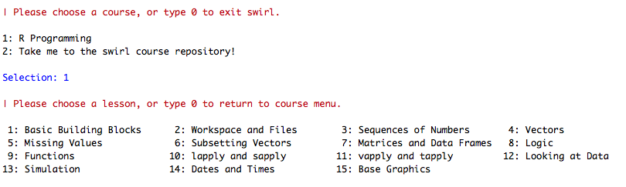
Assignment: Learn R by your self with Swirl
https://swirlstats.com/students.html
Review

