Slide 1
Software Guard Extension

Slide 2
Presentation Topic
Trusted Execution Environment (TEE)
Privilege Level (Rings) in x86 Architecture
Why aren’t Compute Devices Trustworthy?
What is SGX
Why use it?
How does it work?
What is it used for (real-world application)?
What problems does it have?
SGX setup and specifics

Slide 3
Trusted Execution Environment (TEE)
Implemented inside the secure area of a processor
To run in parallel of the operating system in an isolated environment
Ensure that code outside of the TEE cannot be compromised by:
Operating system
Hypervisor
BIOS
Other applications
Notes:
Developed in the mid 2000s as a security concept in modern-day computing devices as a security standard
ARM brought forth the first commercialized variation of TEE called TrustZone in 2006 and further research was started by Intel around the same time until their variation of TEE called SGX released in 2015
Implemented in the secure area of a device’s processor to have hardware-level protection
Goal is to have the TEE run in parallel alongside the operating system in an isolated environment that cannot be affected by:
Operating system
Hypervisor
BIOS
Other applications
Stays true to the name of creating an environment where executing code can have high levels of confidentiality and trust
Would provide isolated processes
Secure storage

Slide 4
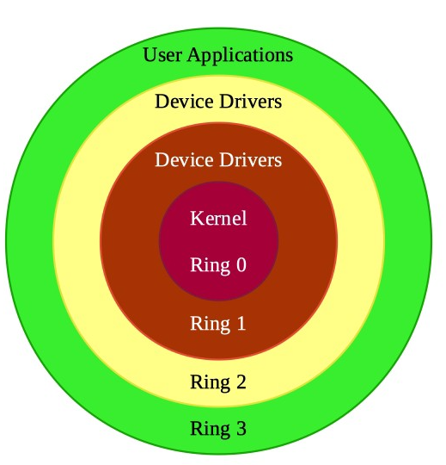
Privilege Level (Rings) in x86 Architecture
Split into four rings from 0 through 3
Inner rings to have levels of privilege to each successive outer ring:
Ring 0: Kernel
Ring 1: Device Drivers
Ring 2: Device Drivers
Ring 3: User Applications
Only Ring 0 and Ring 3 are used in most OS
Notes:
Setup to establish a strict hierarchy to restrict lower privileged processes to potentially affect higher privileged processes (user application interfering with OS code in memory)
Designed in a manner that inner rings have authority over its outer rings while outer rings cannot access inner rings except through established method such as system calls from user applications to kernel for certain library functions
Ring 1 and Ring 2 are not used in modern day operating systems but designed mainly for drivers to have higher level of authority than the user space but lower than kernel
In some operating systems or programs run in ring 1 or ring 2 but not that popular at the moment
Also exist the negative ring concept for cloud computing

Slide 5
Why aren’t Compute Devices Trustworthy?
x86’s rings was able to protect the OS from applications in the earlier days (back in the 1980s)
Reasons why rings were enough:
The computer development and research was more collaborative
Code was mainly sourced from reputable vendors/developers
Current day issue:
Ease of obtaining malicious code from either the internet or other sources by accident
Compromise of a high privilege ring can start a domino effect
Notes:
The ring architecture system was effective in the early days primarily due to the lack of malicious intent
Main issue contemplated by system designers was to figure out how to protect the operating system from applications within the computing environment
Kernel space and user space
Code was sourced from known vendors and development was no poised to damage each other
Rings are no longer enough to protect a system because:
Ease of obtaining potentially malicious code
Compromising a single layer can effectively cause lower privilege level layers to also be affected

Slide 6
Why aren’t Compute Devices Trustworthy?
APP
X
X
MALICIOUS APP
APP
X
BAD CODE
INFO
OK
BAD CODE
BAD CODE
PRIVILEGED CODE
PRIVILEGED CODE
ATTACK

Slide 7
What is Intel’s SGX?
Released in Fall 2015 for most of Intel’s CPU
An implementation of TEE on Intel CPUs that adds an instruction set extension that allows creating enclaves that can:
Provide protection from hardware and software attacks
Reduces attack surface
Hardware-level support to enforce the security of an application’s data
The created enclave stores data securely and cannot be read or written to from outside the enclave regardless of privilege level
E.g., Operating system, BIOS, VMM
Notes:
Released by Intel in 2015 as their approach to establishing a trusted execution environment on Intel CPUs
The addition of the SGX instruction set allowed users to setup more secure computing environments through enclaves and brought about many benefits such as:
Protection against hardware and software attacks
Reduced the overall attack surface area of the computer system design
Provided hardware-level protection with trusted hardware and software attestation to verify and doublecheck
Higher levels of security and privacy
And more -> not mentioned
The enclave created can securely store data and cannot be accessed by entities that should not have proper access to said data
Do not trust other parts of the system in the event of it being compromised

Slide 8
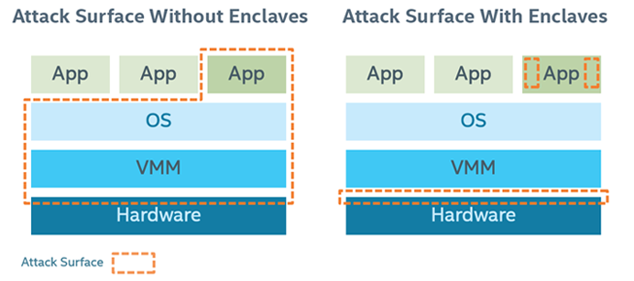
Why use SGX?
Compare the following two scenarios:
Notes:
Without enclaves, the attack surface is substantially bigger than a system with enclaves
Refer to a few slides ago, if we did not use enclaves, an attack can be targeted at any part between VMM, OS, to the application while a system protected with an enclave effectively reduces the potential attack surface
This is because SGX is built with the mentality that the entire system is compromised and trusts no one besides the process that owns the data

Slide 9
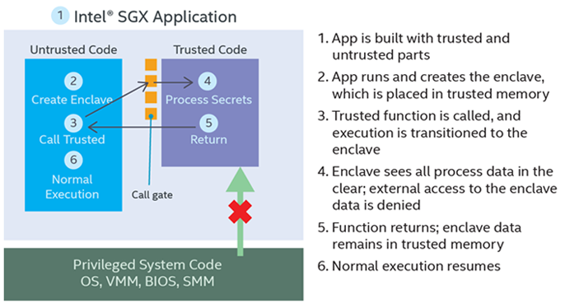
How does SGX work?
Notes:
During the runtime, the application is split into two parts:
A secure portion that is trusted and saved in the enclave. The code within is trusted and can have access to the application’s secrets
A non-secure portion that is untrusted and consists of the rest of the application
App after creating the enclave can then operate on process secrets in the enclave by calling the trusted function
Enclave portion’s code can access its own secrets and run (can also see data outside enclave in the app)
When function returns, enclave data remains in trusted memory
Normal execution resumes

Slide 10
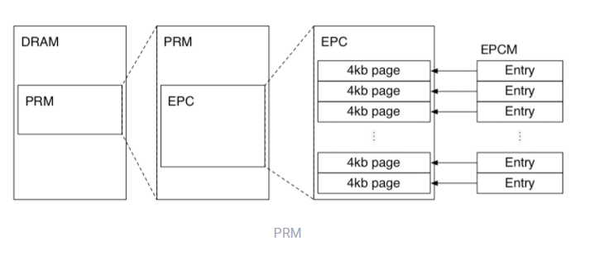
How does SGX work? (cont.)
Notes:
Enclave’s code and data is stored in the processor reserved memory and is created during boot-time by the BIOS
PRM is essentially a reserved space in DRAM that cannot be accessed by the OS or other higher hierarchy code
Seen as a blank space in memory by the OS and will not assign anything to this space
Within the PRM, enclave page caches store the associated contents of the enclaves
Further broken down into 4KB size pages so that an EPC can be assigned to different enclaves
Enclave page cache map as an array to keep track of each EPC
Records information regarding the EPC pages to ensure security checks are done
Tracks ownership of pages

Slide 11
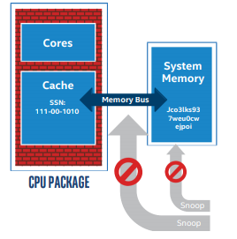
How does SGX work? (cont.)
Enclave code and data are executed in the clear within the CPU
Outside of the CPU, enclave data is encrypted to prevent snooping
Encrypted by the Memory Encryption Engine
Keys generated at boot-time and stored in CPU
Upon exiting the process, enclave is destroyed
Data will be lost unless saved
Notes:
As all data and code within an enclave is confidential and secret, to prevent leaking information or snooping, all information is encrypted when moving between CPU and memory and when stored in RAM
Only when in the CPU and being processed would the information be in the open
Encryption is facilitated by a new hardware chip on intel processors the Memory Encryption Engine that generates keys at boot-time specific for the CPU
This is also why migrating enclaves is not very practical due to the specific CPU and key
As enclaves are stateless (stored in RAM), they are deleted when:
Destroyed by user
Application exits
Device shutdown

Slide 12
How does SGX work? (cont.)
Enclave can be saved outside of the enclave through the sealing process
SGX encrypts the enclave data block using an encryption key derived from the CPU on the system
There are two key policies used to derive the key for sealing the data block
MRENCLAVE: Key is specific to the enclave on that system
MRSIGNER: Key is specific to the developer’s signing key on that system
Notes:
Encrypting enclave secrets for persistent storage in disk
MRENCLAVE: Only the exact enclave on that computer can unseal the data
MRSIGNER: Can be sealed by one enclave and be unsealed by another enclave by the same software vendor on the same system
Different key policy will be used depending on the requirements of the developer

Slide 13
How does SGX work? (cont.)
Attestation is a mechanism of SGX used to prove the trustworthiness of an enclave to a local or remote party
Two types of attestation:
Local attestation
When two enclaves are running on the same platform
Remote attestation
When enclave is trying to gain the trust a remote service provider
Only after successful attestation in both cases would communication happen
Notes:
Attestation as a method of exchanging information between different parties to ensure that they can be trusted
Used to ensure that enclaves are running on a real hardware that is following up-to-date trusted execution environment with the expected initial state
There are two types of attestation:
Local attestation: Same platform (example would be when trying to collaborate)
Remote attestation: Client proving to the provider that it fulfills the enclave and trust requirements

Slide 14
What is it used for?
Ensuring data security when saving information on untrusted cloud providers
Reducing overhead for traditional security measure such as oblivious ram algorithms
Confidential computing at edge
Strengthen personal data privacy
Fighting financial crime
Notes:
Through the encryption of data clunks prior to storage on untrusted platforms, there is much smaller chance of leaking any information to either the platform or any middle man between the user and platform
An example would be how current strategies for preventing a pattern in how RAM assess is through randomly shuffling and sending false requests
SGX can remove the need by creating a locked box where you cannot break into easily
Remove the private data and keep in enclave while only sending general information such as sharing logistic data from self driving cars
Personal privacy is enhanced by increasing the integrity and confidentiality of personal information such as patient records by:
Increasing security and integrity of data
Establish secure data transfer
Crime can be fought by observing patterns in the movement of data/money in the financial world
The ability to share information between different financial institutions while hiding confidential information in enclaves to keep privacy rights allows this to happen

Slide 15
What problems does it have?
Side channel attacks
Cache attacks
Example: PLATYPUS
Physical attacks
VoltPillager
Supply chain attacks
Malware in the hardware
Notes:
Cache attacks through shared caches
PLATYPUS
Exploit the running average power limit of hardware to leak crypto keys from SGX
VoltPillager both a physical attack
Undervolting but has been patched
Supply chain attack is addressed by Intel through their transparent supply chain that allows component level traceability

Slide 16
SGX Setup and Specifics
Intel consumer processors support from 6th generation to 10 generation
BIOS and motherboard needs to be compatible

Slide 17
Thank you

