Slide 1


Slide 2


Tornado, Friendfeed'in kullandığı non-blocking (bkz:non blocking) ve ölçeklenebilir web araçlarının adıdır.
Facebook, Friendfeed'i satın aldıktan Apache lisansı ile açık kaynak olarak dağıtılmaya başlandı.

Slide 3
| Kurulum
wget -c http://github.com/downloads/facebook/tornado/tornado-1.0.tar.gz
tar xvzf tornado-1.0.tar.gz
cd tornado-1.0
python setup.py build
sudo python setup.py install
Veya
apt-get install pyton-tornado (debian sid)

Slide 4
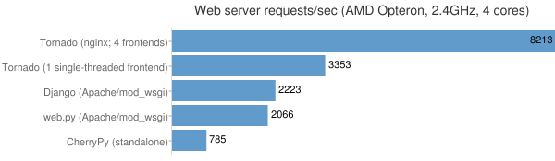
| Performans
'Hello world' performansı

Slide 5
| Modüller
High Level Modüller
web
escape
database
template
httpclient
auth
locale
options
Low level modüller
httpserver
iostream
İoloop
epoll

Slide 6
| web
Friendfeed'in üzerine kurulduğu, başlıca ana parçaları içeren modül

Slide 7
| escape
XHTML, JSON ve URL encode/decode işlemleri için modüller

Slide 8
| database
MySQLdb modülü üzerine geliştirilmiş bir wrapper

Slide 9
| template
Şablon motoru

Slide 10
| auth
3. parti kimlik doğrulama kütüphaneleri
(Google OpenID/OAuth, Facebook Platform, Yahoo BBAuth, FriendFeed OpenID/OAuth, Twitter OAuth)

Slide 11
| locale
Yerelleştirme desteği için modül

Slide 12
| options
Komut satırından veya yapılandırma dosyasından yapılandırma almak için modül (optparser)

Slide 13
| low level
Bunların altında ise esas non-blocking işlemleri yapan
httpserver : non-blocking http sunucu
iostream : non-blocking socketleri okumak için geliştirilmiş bir modül
ioloop : ana i/o modülü
Bir de amazon s3 simüle eden bir sunucu modülü var.

Slide 14
| kod örnekleri
http://github.com/yuxel/snippets/tree/master/python/tornado/

Slide 15
| hello world
#!/usr/bin/python
import tornado.httpserver
import tornado.ioloop
import tornado.web
class HelloHandler(tornado.web.RequestHandler):
def get(self):
self.write("Hello World")
application = tornado.web.Application([
(r"/", HelloHandler),
])
if __name__ == "__main__":
http_server = tornado.httpserver.HTTPServer(application)
http_server.listen(8888)
tornado.ioloop.IOLoop.instance().start()
http://github.com/yuxel/snippets/blob/master/python/tornado/helloWorld.py

Slide 16
| request handling
.....
# handles pages matches URI /another/someUriParam
class AnotherHandler(tornado.web.RequestHandler):
def get(self,uriParam):
self.write("This is another page with URI parameter = " + uriParam)
application = tornado.web.Application([
(r"/another/([^/]+)", AnotherHandler),
])
....
http://github.com/yuxel/snippets/blob/master/python/tornado/requestHandling.py

Slide 17
| request handling
...
# handles pages matches /postTest/ and demonstrate getting request parameter
class PostSomethingHandler(tornado.web.RequestHandler):
def get(self):
form = """<form method="post">
<input type="text" name="something"/>
<input type="submit"/>
</form>"""
self.write(form)
def post(self):
postedValue = self.get_argument("something") # get request argument
self.write("You've postted 'something' as : " + postedValue)
application = tornado.web.Application([
(r"/postTest/", PostSomethingHandler),
])
...
http://github.com/yuxel/snippets/blob/master/python/tornado/requestHandling.py

Slide 18
| request handling
...
# demonstrates an HTTP response error
class ResponseErrorHandler(tornado.web.RequestHandler):
def get(self):
# send a 403 forbidden error
raise tornado.web.HTTPError(403)
application = tornado.web.Application([
(r"/someError/", ResponseErrorHandler),
])
...
http://github.com/yuxel/snippets/blob/master/python/tornado/requestHandling.py

Slide 19
| cookie
...
# demonstrates cookie usage
class MainHandler(tornado.web.RequestHandler):
def get(self):
cookieName = "pyist";
cookieValue = self.get_cookie(cookieName)
currentTimestamp = str(time.time())
if not cookieValue:
self.set_cookie(cookieName, currentTimestamp)
self.write("I've just set your cookie, refresh!")
else:
self.write("Cookie value : " + cookieValue)
...
http://github.com/yuxel/snippets/blob/master/python/tornado/cookie.py

Slide 20
| secure cookie
...
# demonstrates secure cookie example
class SecureCookieHandler(tornado.web.RequestHandler):
def get(self):
cookieName = "pyist_secure";
cookieValue = self.get_secure_cookie(cookieName)
currentTimestamp = str(time.time())
if not cookieValue:
self.set_secure_cookie(cookieName, currentTimestamp)
self.write("I've just set your cookie, refresh!")
else:
self.write("Cookie value : " + cookieValue)
...
http://github.com/yuxel/snippets/blob/master/python/tornado/cookie.py

Slide 21
| template
...
<!DOCTYPE html>
<html>
<head>
<title>{{ title }}</title>
<meta charset="utf-8" />
</head>
<body>
{% if userLogged %}
Hi {{ userLogged }}
{% else %}
You need to log in to see this page
{% end %}
</body>
</html>
...
http://github.com/yuxel/snippets/blob/master/python/tornado/templates/main.html

Slide 22
| template
...
# handles main page
class MainHandler(tornado.web.RequestHandler):
def get(self):
#we demonstrate this using a ?userLogged=userName parameter
switchLoggedFromGet = self.get_argument("userLogged", False)
#remove html entities
switchLoggedFromGet = tornado.escape.xhtml_escape(switchLoggedFromGet)
self.render("templates/main.html", title="Pyist.net", userLogged=switchLoggedFromGet)
...
http://github.com/yuxel/snippets/blob/master/python/tornado/template.py

Slide 23
| locale
...
class TRHandler(tornado.web.RequestHandler):
def get(self):
tornado.locale.set_default_locale('tr_TR')
self.render("templates/translation.html")
# English page
class ENHandler(tornado.web.RequestHandler):
def get(self):
tornado.locale.set_default_locale('en_US')
self.render("templates/translation.html")
...
if __name__ == "__main__":
#set path for location dir
translationsPath = os.path.join(os.path.dirname(__file__), "translations")
tornado.locale.load_translations(translationsPath)
...
http://github.com/yuxel/snippets/blob/master/python/tornado/translation.py

Slide 24
| locale
tr_TR.csv
"Hello World!","Merhaba dunya!"
"This is another test","Bu bir test"
en_EN.csv
"Hello World!","Hello, world!"
"This is another test","This is another test"
http://github.com/yuxel/snippets/blob/master/python/tornado/translations

Slide 25
| xsrf koruması
...
# handles main page
class MainHandler(tornado.web.RequestHandler):
def get(self):
self.render("templates/xsrf.html")
# if _xsrf value doesnt match xsrf cookie value, this will return 403
def post(self):
postedValue = self.get_argument("something") # get request argument
self.write("You've postted 'something' as : " + postedValue)
application = tornado.web.Application([
(r"/", MainHandler),
], cookie_secret="SomeSecret",xsrf_cookies=True)
...
http://github.com/yuxel/snippets/blob/master/python/tornado/xsrf.py

Slide 26
| xsrf koruması
<!DOCTYPE html>
<html>
<head>
<title>Pyist Tornadoweb</title>
<meta charset="utf-8" />
</head>
<body>
<form action="" method="post">
{{ xsrf_form_html() }}
<div>
Write something: <input type="text" name="something"/>
<input type="submit" value="Try"/>
</div>
</form>
</body>
</html>
http://github.com/yuxel/snippets/blob/master/python/tornado/templates/xsrf.html

Slide 27
| asenkron istekler
import tornado.httpclient
...
class MainHandler(tornado.web.RequestHandler):
@tornado.web.asynchronous
def get(self):
http = tornado.httpclient.AsyncHTTPClient()
url = "http://api.eksigator.com/demo/demo/getList"
http.fetch(url, callback=self.async_callback(self.on_response))
def on_response(self, response):
items = tornado.escape.json_decode(response.body)
for item in items:
self.write( item["title"] + "<br/>" )
# this will end async requst
self.finish()
...
http://github.com/yuxel/snippets/blob/master/python/tornado/async.py

Slide 28
| database
import tornado.database
...
class DBHandler(tornado.web.RequestHandler):
def get(self):
db = tornado.database.Connection(
host="localhost", database="pyist",
user="root", password="12345678")
datas = db.query("select name_surname from pyist")
# print datas
for data in datas:
self.write(data["name_surname"])
self.write("<br/>")
...
http://github.com/yuxel/snippets/blob/master/python/tornado/database.py

Slide 29
| static dosyalar
...
application = tornado.web.Application([
(r"/", MainHandler),
], static_path = os.path.join(os.path.dirname(__file__), "static"))
...
{{ static_url(“hello.txt”) }}
http://github.com/yuxel/snippets/blob/master/python/tornado/translation.py

Slide 30
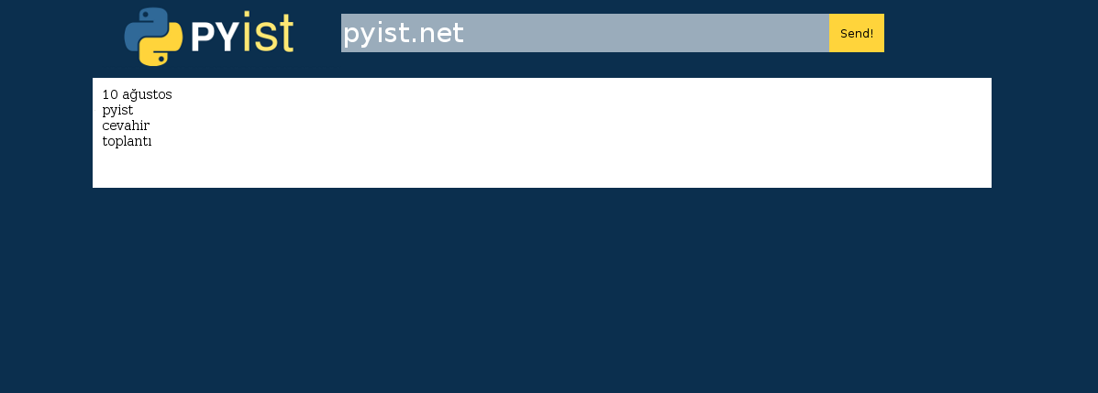
| chat demo
Chat demosunu sadeleştirilmiş hali
http://github.com/yuxel/snippets/blob/master/python/tornado/chat/

Slide 31
| proje
http://github.com/yuxel/feedget
http://feedget.net/ (alpha)

Slide 32
| kaynaklar
http://www.tornadoweb.org/
http://github.com/facebook/tornado
irc://irc.freenode.net/tornado

Slide 33
| iletişim
Osman Yüksel
yuxel |ET| sonsuzdongu {DAT} com
http://yuxel.net

