Slide 1
Grief
汇报人：毛儒林 王雯影 诸葛昱滢 吴昌鸾 胡逢彬 王钰杰

Slide 2
目 录
CONTENTS
Introduction of grief
The effects of grief
How to reduce grief

Slide 3
The introduction of grief
Introduction of grief

Slide 4


What is grief？
Grief is thought to be an emotional response to separation, loss, and failure.

Slide 5

The introduction of grief
Grief can be triggered by external events such as separation, loss and failure. However, due to the influence of different individuals’ evaluation criteria, such as personality characteristics, the same event or situation can cause sadness, or the degree and duration of sadness caused by different individuals vary.

Slide 6
The introduction of grief
Levinson's core emotion theory
The cause of grief
James and Grouse's theory of emotional production process
Izard's Theory of Emotional Differentiation

Slide 7
Levinson’s core emotion theory
根据莱文森的核心情绪理论，悲伤最初是由原型事件触发的，在持续感知的事件中，当原型满足失去的条件时，悲伤的情绪就会被触发。
According to Levinson's core emotion theory, grief is initially triggered by an archetypal event, and in an event of constant perception, when the archetypal satisfies the condition of loss, the emotion of grief is triggered.
01
02
（archetypal event）原型事件是什么？
简单点说，人在生理上会有相同的器官，有手有脚，有眼睛。一样的，人的心理也有一些共同的特征，有想做父亲（母亲）的倾向特征，有想做英雄的倾向。这些倾向储藏在每一个人心中。这就是心理上的原型。
03
04

Slide 8
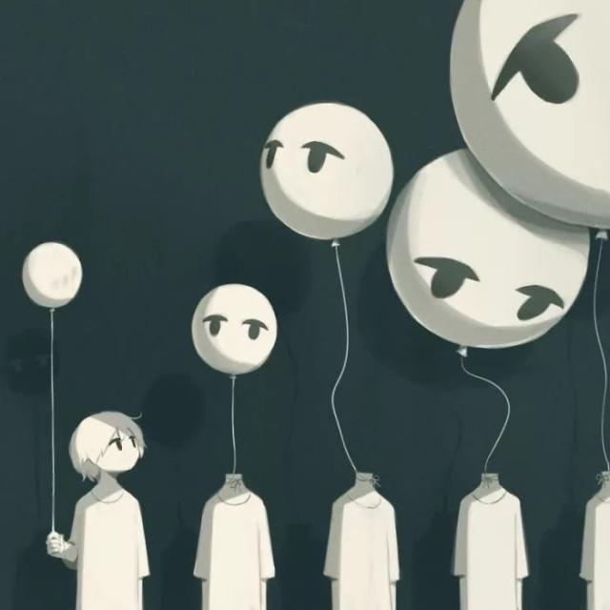
James and Grouse’s theory of emotional
production process
James believes that the pattern of autonomic nervous changes in the process of emotional occurrence is the cause of subjective experience. According to Grouse's theory of emotional production process, the experience of sadness is the result of the evaluation of emotional cues.
Notes:
模板来自于 http://docer.wps.cn

Slide 9
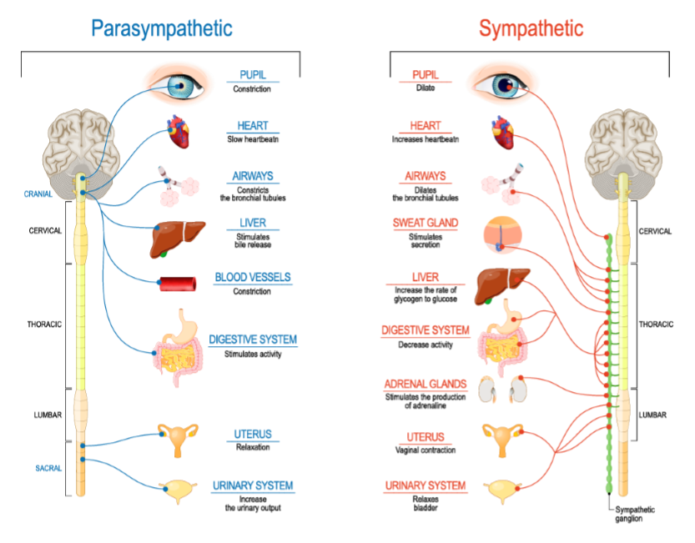
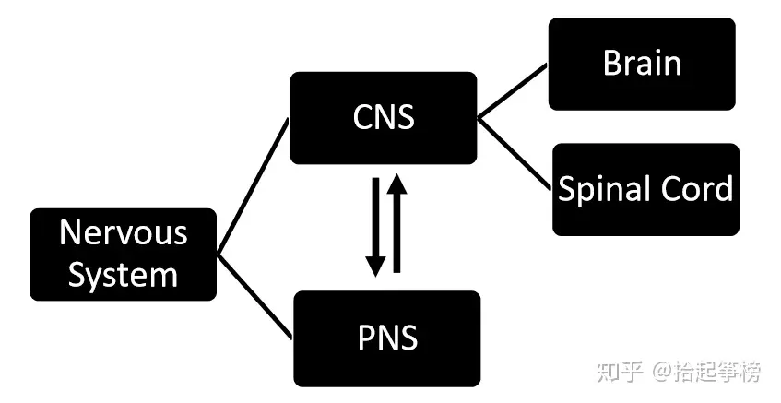
James认为，情绪发生过程中自主神经变化的模式是主观体验的原因。根据Grouse的情绪生产过程理论，悲伤的体验是对情绪线索的评估的结果。
（Autonomic Nervous Changes）自主神经变化
任何情绪体验都伴随着一系列的生理唤醒（也称之为生理激活），并且这种生理唤醒会反过来增强我们的情绪体验。这种生理唤醒包括外周自主神经系统的反应、大脑脑区的活动变化以及体内一些神经化学物质的改变。

Slide 10
Izard’s Theory
Izard (1991), on the other hand, believes that the generation of grief experiences depends on the unrescuable activities and emotional events on the face of grief, which act on the emotions activated by individuals and stored in the hypothalamus. The information from the inborn unerotic program produces a pattern of facial muscles that activate the facial muscles. Friends feel that feedback enters the limbic cortex, allowing emotions to enter consciousness and thus form an emotional experience
01
02
03
04

Slide 11
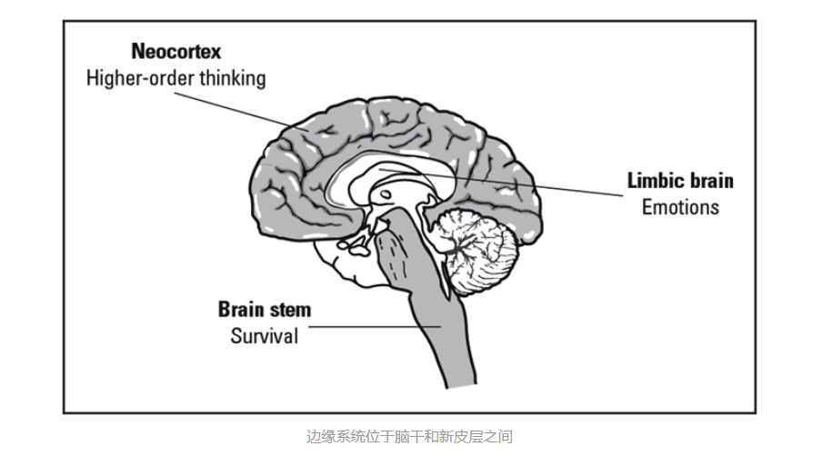
limbic lobe 边缘皮层
neocortex 新皮层
hypothalamus 下丘脑
consciousness 意识
brain stem 脑干
另一方面，Izard（1991）认为，悲伤体验的产生取决于悲伤面前无法挽救的活动和情绪事件，这些活动和情绪事件作用于个人激活并储存在下丘脑中的情绪。来自天生存在的、而且与性无关的信息会产生一种面部肌肉的模式，从而激活面部肌肉。反馈进入边缘皮层，让情绪进入意识，从而形成情绪体验

Slide 12
The effects of grief
The effects of grief

Slide 13

The effects of grief
The influence of grief
Depression
Excessive sadness and grief will lead to long-term depression, negative sadness, and the probability of suffering from depression will also increase.

Slide 14

The effects of grief
Cardiovascular and cerebrovascular injury
Excessive sadness and grief for a long time may harm the cardiovascular system of the body, such as causing transient coronary spasm, etc. It can cause the heart to fail to supply blood and oxygen normally, which can further induce acute angina pectoris, acute myocardial infarction, acute heart failure, acute arrhythmia and other diseases.
Notes:
模板来自于 http://docer.wps.cn

Slide 15
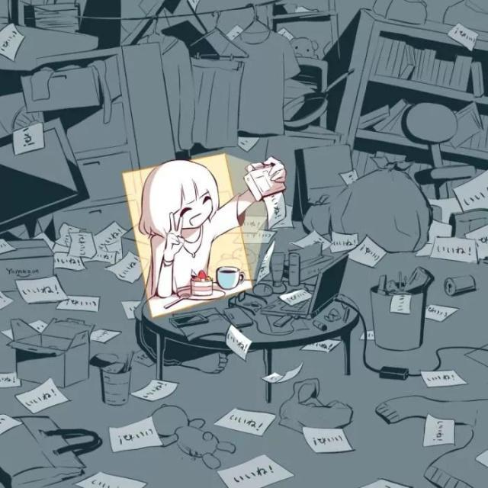
How to reduce grief
How to reduce grief?
Notes:
模板来自于 http://docer.wps.cn

Slide 16
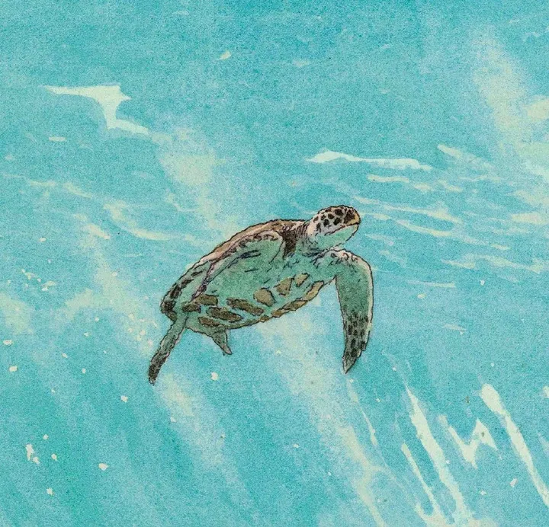
How to reduce grief
Make a positive review
Positive re-evaluation is mainly a cognitive reorganization of the problem situation with a more positive perspective. Through positive re-evaluation, people turn their eyes to the good aspects of what is currently happening or has happened, so the meaning of the situation is changed and people experience more positive emotions.
Notes:
模板来自于 http://docer.wps.cn

Slide 17
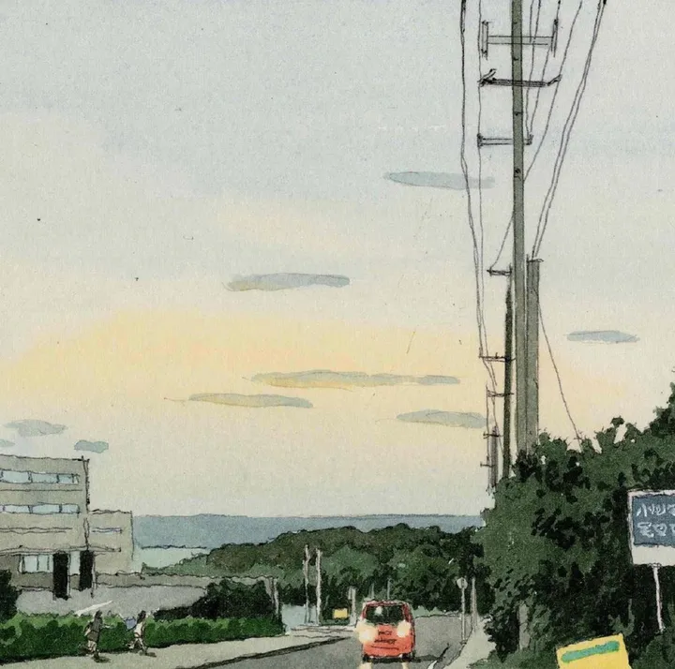
How to reduce grief
Shift your attention
Attention transfer mainly involves playing other social roles and doing things that increase positive emotions. In sad situations, individuals intentionally or unintentionally do things that increase positive emotions, which can supplement their psychological resources and improve coping ability.
Notes:
模板来自于 http://docer.wps.cn

Slide 18

How to reduce grief
Solve the problem
Problem solving involves taking measures to deal directly with the problem. It includes any behaviors and perceptions that directly point to the stressor, such as making a list of things to do, drawing up plans, studying the pros and cons of various problems, etc.
单击添加文
Notes:
模板来自于 http://docer.wps.cn

Slide 19
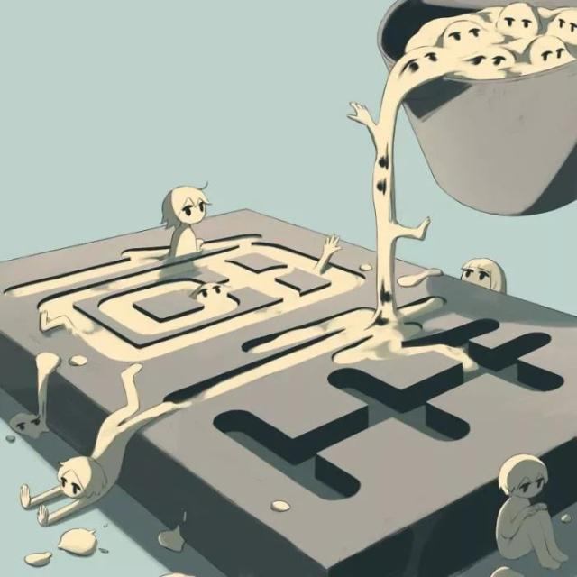
How to reduce grief
Reaction adjustment
Reaction adjustment refers to the individual's influence on emotional response trends such as psychological experience, behavioral expression, and physiological response after the sadness emotion has been stimulated, mainly manifested as behavioral expression that reduces the sadness emotion response, and more optimistic and humorous emotional expression methods are used.
单击添加文
Notes:
模板来自于 http://docer.wps.cn

Slide 20
Quotation
The literature cited in the above four methods is indicated here：
单击添加文
[1] Jiang Changhao, Zhao Lun. Research progress on sadness and its coping [J]. Journal of Capital Normal University (Social Sciences Edition), 2006 (02): 108-114
Notes:
模板来自于 http://docer.wps.cn

Slide 21


THANKS FOR LISTENING
汇报人：毛儒林 王雯影 诸葛昱滢 吴昌鸾 胡逢彬 王钰杰

