Slide 1
C++ requirement
1. fluent in basic C. Can write simple class. Understand class inheritance.
2. Can write simple C++ template.
3. Understand some advanced C++ features: shared_ptr, unique_ptr, auto, lambda…
4. Strongly recommend going through the FAQs in : https://isocpp.org/wiki/faq
5. Find some useful tips in SWMF/PC/FLEKS/Coding_standards.md
If no preference, I recommend VSCode for C++ development.

Slide 2
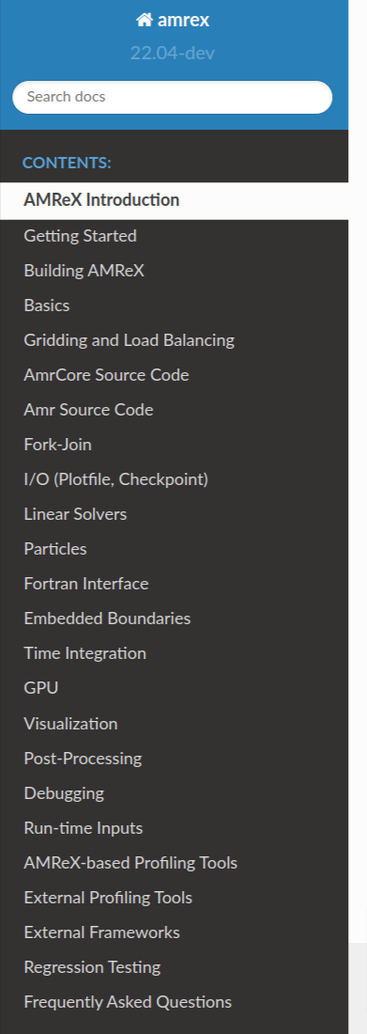
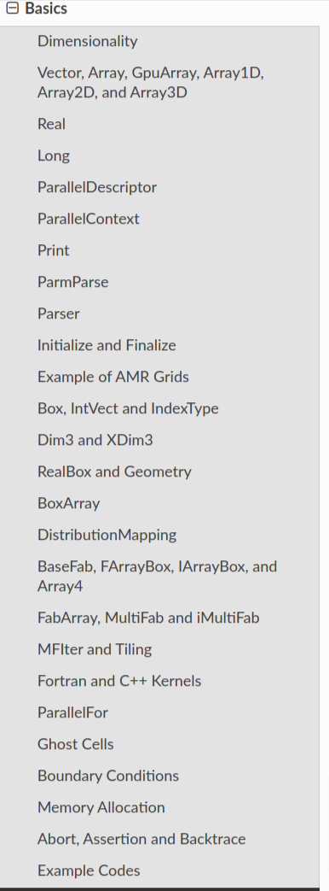
https://amrex-codes.github.io/amrex/docs_html/
Important chapters:
Introduction
Getting Started
Building AMReX
Basic
AmrCore
Amr
Particles
Visualization
Debugging
Important concepts:
1. Basic data types: Real, long, Vector, Array….
2. Box, RealBox, BoxArray
3. BaseFab, FabArray, MultiFab…
4. Geometry
5. DistributionMapping

Slide 3
Goals:
1. First 2~4 weeks: Learn AMReX. Compile and study a few examples in AMREX/Tutorials/Basic
2. First 4~6 weeks: Try to build a 2-level AMR grid.
3. First 2 months: Learn basic knowledge about particle-in-cell:
4. Understand how the interpolations between different levels work.
5. Load balancing?
6. How particles are handled?
7. Then we can start modifying FLEKS.

