Slide 1
EARLY CLINICAL DRUG DEVELOPMENT
WP7a Use case 2
AstraZeneca & Ontotext

Slide 2
OUTLINE
Introduction
Drug development
Use case challenge and objectives

Slide 3
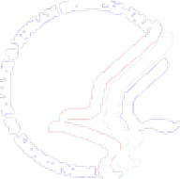
Innovation or Stagnation,
What’s the Diagnosis?
Investment & progress in basic biomedical science has for surpassed investment and progress in the medical product development process
The development process – the critical path to patients – becoming a serious bottleneck to delivery of new products
We are using the evaluation tools and infrastructure of the last century to develop this century’s advances
From FDA presentation on Critical Path for Science Board by Janet Woodcock, 2004-04-26

Slide 4
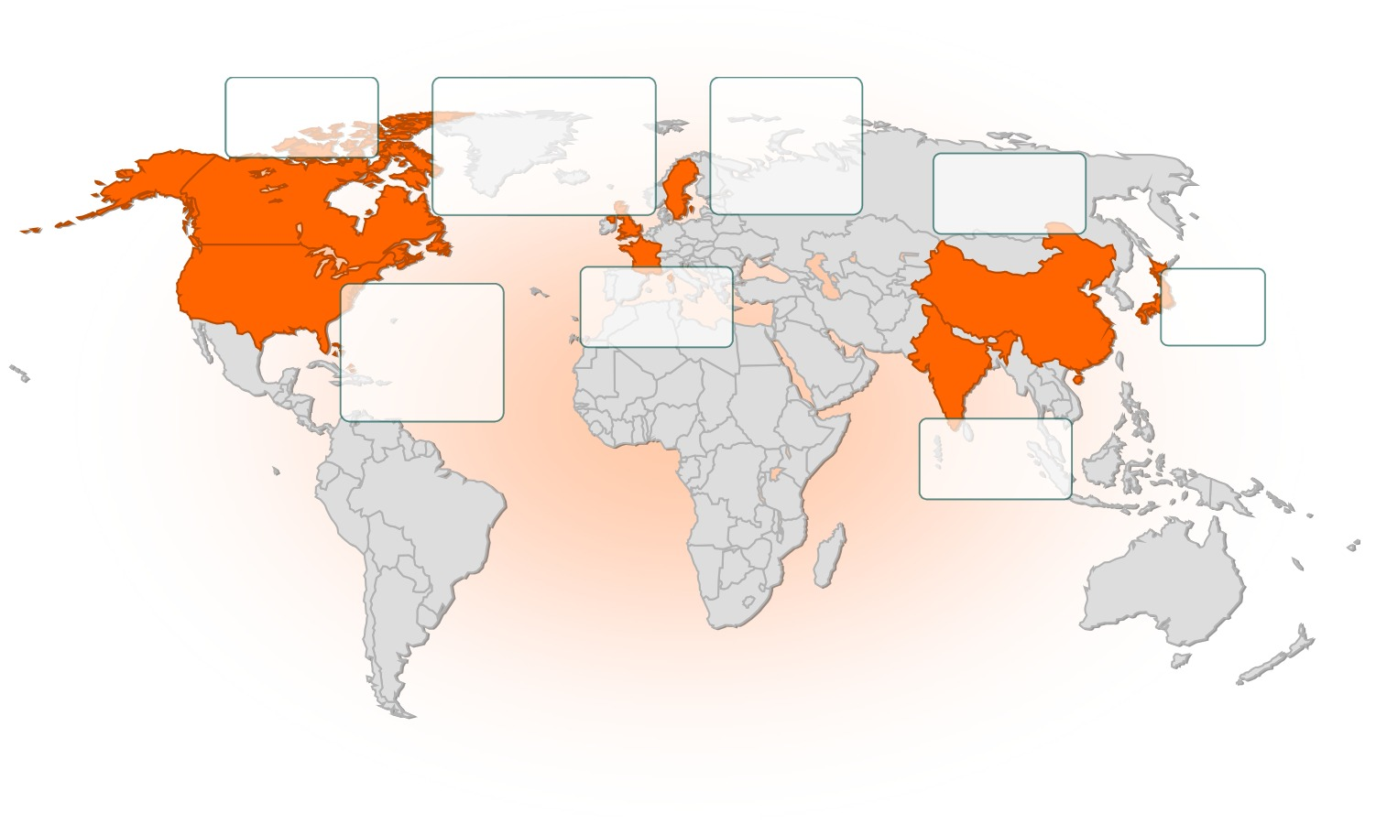

ASTRAZENECA HAS 12000 PEOPLE WORKING IN 16 R&D CENTRES IN EIGHT COUNTRIES
Canada
Montreal
UK
Alderley Park
Charnwood
Cambridge
Sweden
Södertälje
Mölndal
Lund
China
Shanghai
US
Boston
Wilmington
Hayward
France
Reims
Japan
Osaka
India
Bangalore
Notes:
AstraZeneca conducts research at 16 units in eight countries. Approximately 12,000 people work at these centres. Number 6 in sales 2006 ($26 Billon)
Montreal, Canada – pain control
Boston, USA – infection, oncology
Wilmington, USA – psychiatry, neurology and pain control
Hayward, USA – DMPK (Drug Metabolism Pharmacokinetics).
How biological pharmaceuticals are metabolised in the
body and what the body does with biological
pharmaceuticals
Södertälje, Sweden – neuroscience, pain control
Mölndal, Sweden – gastrointestinal, cardiovascular
Lund, Sweden – respiratory disease
Alderley, UK – oncology (cancer)
Charnwood, UK – respiratory disease
Cambridge, UK – antibodies
Reims, France – oncology, collaboration with Alderley
Bangalore, India – tuberculosis
Shanghai, China – clinical research, studies of medicines to be used
by Chinese patients
Osaka, Japan – clinical research

Slide 5
THE R&D PROCESS
Development
Preclinical studies
Clinical studies
Discovery
Early Clinical
Development
CHEMISTRY/
PHARMA-
COLOGY
IND*
PHASE I
PHASE II
PHASE III
NDA**
PHASE IV
Search for active substances
Toxicology, efficacy studies on various types of animals
Regulatory review
Efficacy studies on healthy volunteers
Clinical studies on a limited scale
Comparative studies on a large number of patients
Regulatory review
Continued comparative studies
*Investigational
New Drug
Application for permission to administer a new drug to humans
KNOWLEDGE
LEVEL
50–150
persons
100–200
patients
Registration, market introduction
500–5,000
patients
KNOWLEDGE
LEVEL
**New Drug Application
Application for permission to market
a new drug
TIME SPAN
2–4 yrs.
2–6 months
3–6 yrs.
1–3 yrs.
Approximately 10–15 years from idea to marketable drug
Notes:
There are various ways of illustrating the R&D process – this is one. We see, among other things, how knowledge about a drug increases during the course of the process, but that upon market introduction, there is still a great deal to be learned about how the drug works in the body. Developing a new drug is a complex and costly process.
If everything goes according to plan, a new drug will be ready approximately ten years after the work was first begun. We are working to shorten this time to eight years.
Pharmaceutical companies are constantly striving to shorten the time from idea to finished pharmaceutical product. At the same time, the demands on documentation continue to rise.

Slide 6

Early Clinical Drug Development (1)
PRECLINICAL DEVELOPMENT
Key Activities:
Toxicology
Formulation work
Safety pharmacology
Drug Metabolism and PharmacoKinetics (DMPK)
Regulatory
Planning
Preclin.
Dev.
9-12 months
MS
1
2
3
4
5
FTIM
5.5
6
7
8
9
Target
Id.
Hit
Id.
Lead
Id.
Lead
Opt.
Pre-
nom.
Preclin.
De.v
Principle
Testing
Concept
testing
Dev. for Launch
Launch and PLC
Prod.
Maint.
TG
1
1.5
2
2.5
3
4
5

Slide 7
Early Clinical Drug Development (2)
PRINCIPLE TESTING
Key Activities:
Submission
Single Ascending Dose study
Multi Ascending Dose study
Proof of Principle studies
Manufacture route identification
Dev. formulation for concept testing & onwards
Dev. Patient Risk Management Plans
Achieved Objectives:
Safety
Effectiveness
Business Plan
Dose
Principle
Testing
1-3 years
MS
1
2
3
4
5
FTIM
5.5
6
7
8
9
Target
Id.
Hit
Id.
Lead
Id.
Lead
Opt.
Pre-
nom.
Preclin.
Dev.
Principle
Testing
Concept
testing
Dev. for Launch
Launch and PLC
Prod.
Maint.
TG
1
1.5
2
2.5
3
4
5

Slide 8
Challenges and opportunities in
Early Clinical Drug Development
Understand the drug in context of;
the disease
  How to measure
  The chemistry/pharmacology
  What causes the disease
  How does the disease evolve
the patient
  What different phenotypes exists
  Are there different Genetic profiles
This is Translational Medicine
The "translation" of basic research into real therapies for real patients

Slide 9
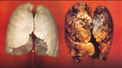
DISEASE IN FOCUS FOR THE USE CASE IS
CHRONIC OBSTRUCTIVE PULMONARY DISEASE
A new definition of COPD has recently been adopted by GOLD:
a disease state characterized by airflow limitation that is not fully reversible.
The airflow limitation is usually progressive and associated with an abnormal inflammatory response of the lungs to noxious particles and gases.
(GOLD: Global Initiative for Chronic Obstructive Lung Disease)

Slide 10













NEED TO KNOW MORE ABOUT...
Pathophysiology?
Phenotypes?
Targets?
Biomarkers?
Costs?
QoL?
Outcomes?

Slide 11
WHAT WE KNOW?
Cigarette smoking is the cause of many diseases, e.g. Lung Cancer, COPD and Ischaemic Heart disease (IHD)
Patients with COPD have a greater risk of IHD and Lung Cancer, the greater the degree of loss of FEV1, the greater the risk (especially in women)
A measure that reflects acute phase response, the CRP, when raised predicts risk of IHD and Lung cancer and is in COPD patients with respiratory failure a predictor of survival as important as BMI and hypoxia
Treatments that lower CRP in COPD patients reduce the risk of dying from IHD and may reduce the risk of dying from Lung Cancer (Statin reduces the risk for Lung Cancer

Slide 12
OTHER POTENTIAL CONTRIBUTORS
Autoimmunity
Eg anit-elastin
Genes
Thrombosis
Not one phenotype but several phenotypes
Hypoxia
Oxidative
stress
Neurohumoral
Disturbance
Neutrophil/
MPO
Notes:
Since smoking remains the major risk factor for the development of COPD and of the associated systemic inflammation [72], the study of the effects of smoking represents the best model for unravelling the underlying mechanisms of COPD and the consequences of systemic inflammation induced by smoking. In fact, cigarette smoke may cause systemic inflammation irrespective of COPD [73], and systemic inflammation in smokers may contribute significantly to the development of cardiovascular diseases, particularly atherosclerosis [74].
Hemostasis and thrombotic pathways may also play relevant roles in COPD and ischemic heart disease [Wu and Thiagarajan, 1996].
Excess sympathetic nervous activity is significantly related to cardiovascular disease [Mancia et al. 1999]. In advanced COPD, patients demonstrate excess adrenergic activity. Using microneurography of the peroneal nerve, Heindl and colleagues showed that patients with respiratory failure have a marked increase in peripheral sympathetic
discharge compared to controls [Mancia et al. 1999].
Oxidative stress induces endothelial dysfunction [Elahi and Matata, 2006].
Tissue hypoxia is another mechanism that can contribute to systemic inflammation.
Bone marrow response to smoking, immature neutrophils – MPO, alveolar wall damage
Furthermore, recent evidence that COPD may have an autoimmune component characterized by an abnormal immune response to elastin (44) is of interest, as an autoimmune mechanism linking arterial stiffness to emphysema might be amenable to therapeutic intervention. We have shown for the first time that, in patients with COPD,
severity of emphysema correlates with a measure of arterial stiffness. This association may be due to the systemic effects of COPD (inflammation, oxidative stress, and hypoxia), to environmental factors such as pollution, or to a shared susceptibility to degradation of elastin and other components of the extracellular matrix in both systemic arteries and the lung.

Slide 13
WHAT WE WANT TO KNOW?
Which phenotypes exist among susceptible smokers, ~ are there characteristics we can define?
Is there a non-susceptible phenotype to smoking diseases ~ are there characteristics we can define?
Do the diseases have different times of onset in smokers?
Which phenotype among these is driving the costs
  What is the pathophysiology
  What is the population size of this phenotype
Protein-to-Pathway-to-Disease-Drug-to-Patient connection

Slide 14
The use case challenge and objective
We need to integrate (not complete) data from different sources and domains;
  Proteomics and Genetics data (Biology)
  Pre-clinical data (Animal models)
  Clinical data (Study data and documents)
  Health Care data (Patient Records, register data)
  Publications
To improve our knowledge about;
  The disease COPD
  Patients with COPD
To provide scientists with computational support to conceptualize the breath and depth of relationships between data

Slide 15
PHARMACEUTICAL INDUSTRY IS FACING A TREMENDOUS CHALLENGE
“ … scientists are unable to conceptualize the breath and depth of relationships between relevant databases without computational support.”
  Muggleton Nature, 440, 409, 23 March 2006

Slide 16
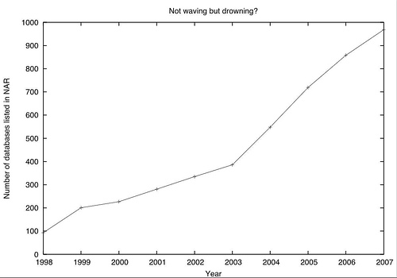
PLEASE TAKE YOUR TIME TO GUESS
Mar, 2008

Slide 17
HOW TO DO KNOWLEDGE DISCOVERY IF...
The data is supported by different organizations
The information is highly distributed and redundant
There are tons of flat file formats with special semantics
The knowledge is locked in vast data silos

Slide 18
WHY THE SEMANTIC DATA INTEGRATION MAKES THE DIFFERENCES?
To interlink datasets
To describe different objects to appear in different formats as truly equivalent and create non-redundant datasets based on flexible rules
To maintain complex relationships between objects in a standardized declarative formalism

Slide 19
WHY THE SEMANTIC DATA INTEGRATION MAKES THE DIFFERENCES?
To handle inconsistencies problems related to incomplete data or different versions
To unlock the R&D data stored in distributed silos
To provide better abstraction of data model than data schema or Object-Relational Mapping (ORM) solutions
To unlock the data stored in silos and overcome container-reference dichotomy – data once stored and connected is hard to rearrange and connect in new ways

Slide 20
SEMANTIC DATA INTEGRATION BENEFITS
urn:uniprot:Protein
urn:biogrid:Interaction
urn:uniprot:Q7A567
rdf:type
urn:biogrid:FBgn0068575
sameAs
rdf:type
rdf:seeAlso
urn:pubmed:15904
rdf:type
urn:uniprot:Q709356
urn:intact:Interaction
hasParticipant
interactsWith
rdf:type
sameAs
interactsWith
urn:biogrid:15904
hasParticipant
urn:uniprot:P104172
urn:intact:1007
rdf:seeAlso
sameAs
urn:biogrid:FBgn00134235
urn:uniprot:P7653A
Mar, 2008

Slide 21
CONCLUSION
LarKC need to easily integrate data from different sources and domains
LarKC should provide scientists with computational support to conceptualize the breath and depth of relationships between data

Slide 22
CONCLUSION 2
Use LarKC to better understand the disease
  Identify causes the disease
  Learn how does the disease evolve
  Protein-to-pathway-to-disease-drug-to-patient connections
Use LarKC to better understand the patient
  Identify different phenotypes
  Learn the different Genetic profiles

