Slide 1

Korean participation in the
Large Knowledge Collider
(LarKC)
Creative Commons License:
allowed to share & remix,
but must attribute & non-commercial

Slide 2

The Large Knowledge Collider
10M€ budget
7M€ EU contribution
3.5 years
80 person years
3 case studies
14 partners,
12 countries,
3 continents
project nr. FP7 – 215535

Slide 3
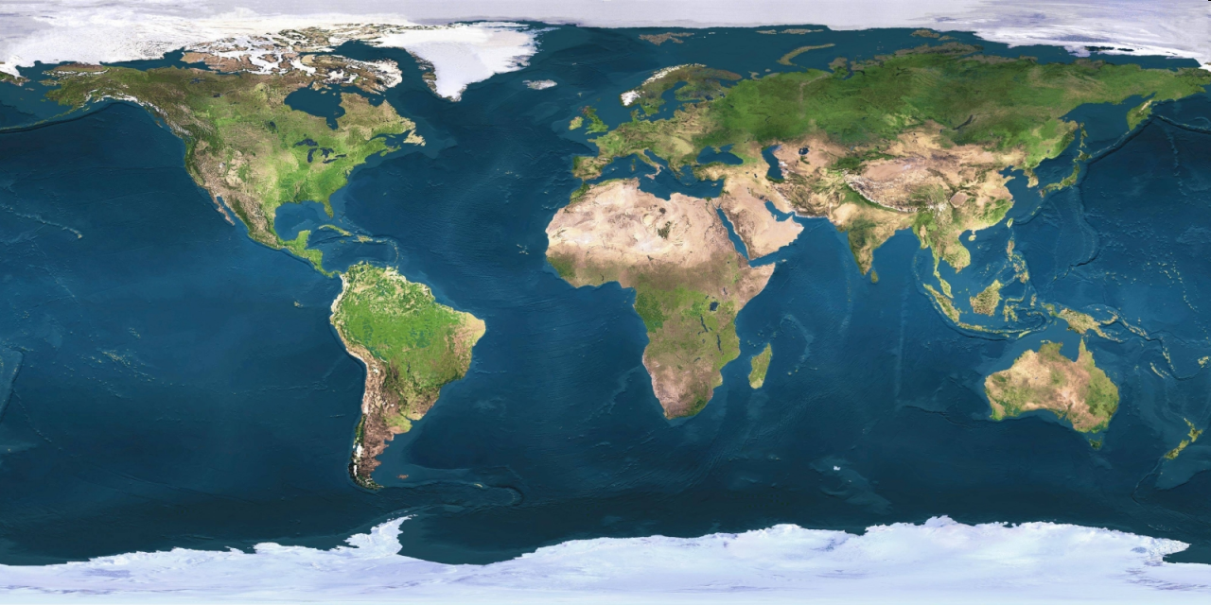
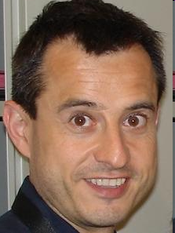













The consortium

Slide 4
Why would EU projects need Korean partners?
Partners from Korea provide an opportunity to play a key role in developing, disseminating and exploiting leading-edge technologies derived from EU projects.
This collaboration can facilitate the creation of industrial relationships between Asia, EU and beyond.
European projects can take advantage of worldwide information infrastructures, with a Korean domestic market of 40 million Internet subscribers, 40 million cellular phone users and advanced ubiquitous information services
Korea has the ability to provide an ideal environment to demonstrate the added value of technologies developed in Europe and applied to the resolution of a wide variety of problems associated with current IT systems.

Slide 5

LarKC is already cooperating with a Korean partner:
and the main reason is that...
Saltlux is a leading Korean company in ontology and Semantic web technologies.
Saltlux delivered many ontology-based products and many national projects in this area.
Saltlux is a key partner with major telecom companies in Korea (KT and KTF).
Saltlux has experience with several projects which require very large scale reasoning facilities

Slide 6
What is LarKC about?
European is leading the world in research on
the Next Generation Internet
This Next Generation Internet is characterised by computers that can process the meaning of information
on the Internet.
(Currently, all the information on the web is only interpreted by people, who read text and understand pictures.)
Such a more "semantic" Next Generation Internet will require facilities for very large scale manipulation of information ("semantic computing at web scale").
LarKC aims to develop the
"Large Knowledge Collider" (LarKC),
a platform for massive distributed reasoning that will remove the scalability barriers of existing systems.

Slide 7
What is the role of SaltLux in LarKC?
LarKC is building new infrastructure for very large scale reasoning on the Web
the Saltlux case-study aims at providing information to mobile phone users based on personalised data
(= matching data against personal profiles).
Saltlux will test the limits of what can be achieved
by the consortium
Saltlux provides LarKC with an ideal environment to demonstrate the real added value, by resolving problems of current IT systems for telecommunications
Saltlux provides a global dimension to LarKC's dissemination programme

Slide 8
What is the role of SaltLux in LarKC?
Saltlux already has experience with delivery of personalised and contextualised information and personalised and contextualised services
to mobile phone users,
based on
  their personal preferences,
  their current location,
  the time of day,
  the location of their social contacts, etc.
This requires reasoning about
the profiles, preferences, locations and contacts
of millions of mobile phone users.
This will push the the performance of the LarKC platform to the limits.

Slide 9
How can any other interested
Korean party contribute?
The Large Knowledge Collider is an
open, and configurable platform.
The first public version of the Large Knowledge Collider will be available in a year from now.
Organisations from outside the consortium
can use the LarKC platform for their own purposes,
LarKC will form an "early adapters group".
  LarKC will actively support this group in use the Large Knowledge Collider platform.
  This group will be given
  access to a high-performance computing-cluster
  in Germany for running LarKC on their own problems.
Korean parties (both academic and commercial) are welcome to contact us on this opportunity.

Slide 10






How to find out more?
How to contact us?
website
  project flyer
  mission and vision paper
  RSS feed
contacts:
  project coordinator: Dieter Fensel
  scientific director: Frank van Harmelen
  project manager: Alice Carpentier
Korean students: take part in the European Master Programme in Semantic Web
Korean researchers: become visiting researchers at any of the LarKC participating academic groups

