Slide 1
Berry Assignment
Yuxin Zeng

Slide 2
Introduction
The NASS website has a large amount of berries data from many states in recent years, but these data are very messy, with mixed variables and different dimensions. After some simple cleaning and organization, I chose blueberry for EDA and present it in a shiny app.

Slide 3
Data Peparation
Remove meaningless columns
Filter berries
Organize the columns

Slide 4
Remove meaningless columns
The berries data had only 8 out of 21 columns containing meaningful data.

Slide 5
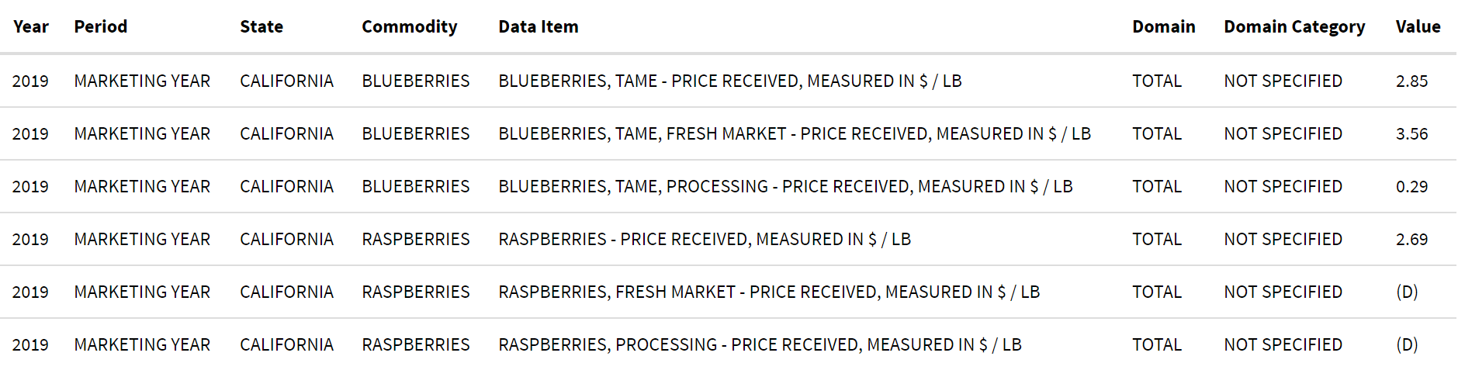
columns

Slide 6
Filter berries
Period: Since the definition of “Marketing year” varies by commodity, we only consider the “Year” period.
Value: D, withheld to avoid disclosing data for individual operations. NA, not available.
Commodity: Divide the berries data into blueberries, raspberries, and strawberries. My EDA is based on blueberries.

Slide 7
Organize the columns
Separate multiple variables from the same column, merge variables of the same type into a new column, and delete duplicate columns. Organize columns containing variables that are not properly separated. Rename and joint all the columns in blueberries.
## [1] "BLUEBERRIES, TAME - PRICE RECEIVED, MEASURED IN $ / LB" ## [2] "BLUEBERRIES, TAME, FRESH MARKET - PRICE RECEIVED, MEASURED IN $ / LB" ## [3] "BLUEBERRIES, TAME, PROCESSING - PRICE RECEIVED, MEASURED IN $ / LB"

Slide 8
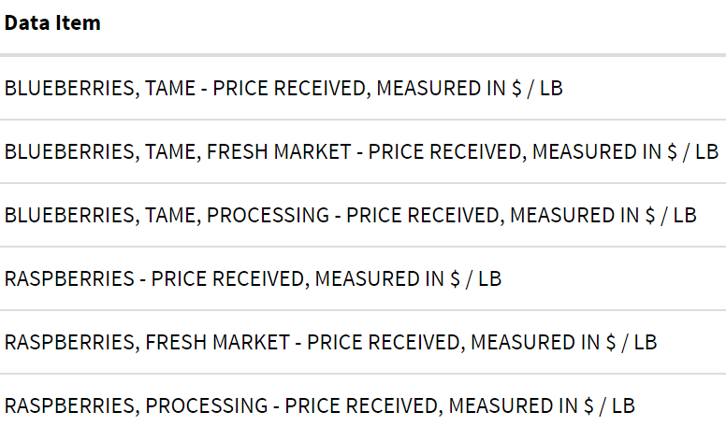
Data Item

Slide 9
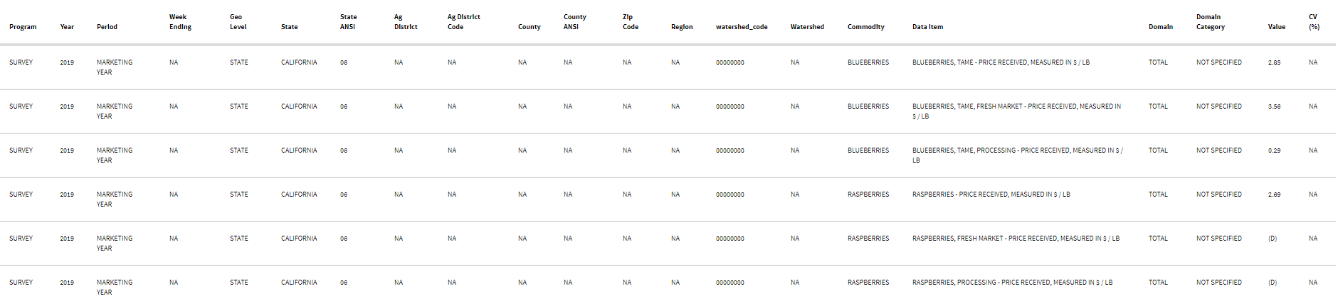
Data Preprocessing Result
Raw Data

Slide 10
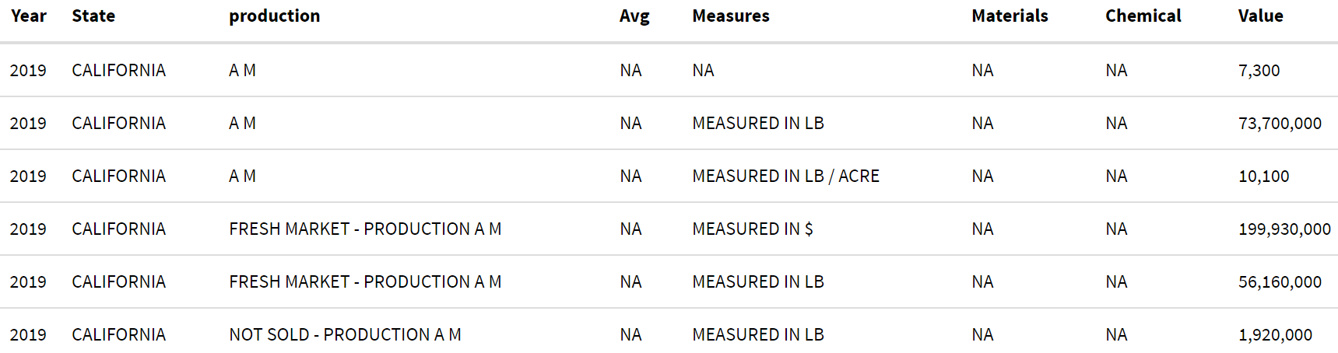
Tidy Data

Slide 11
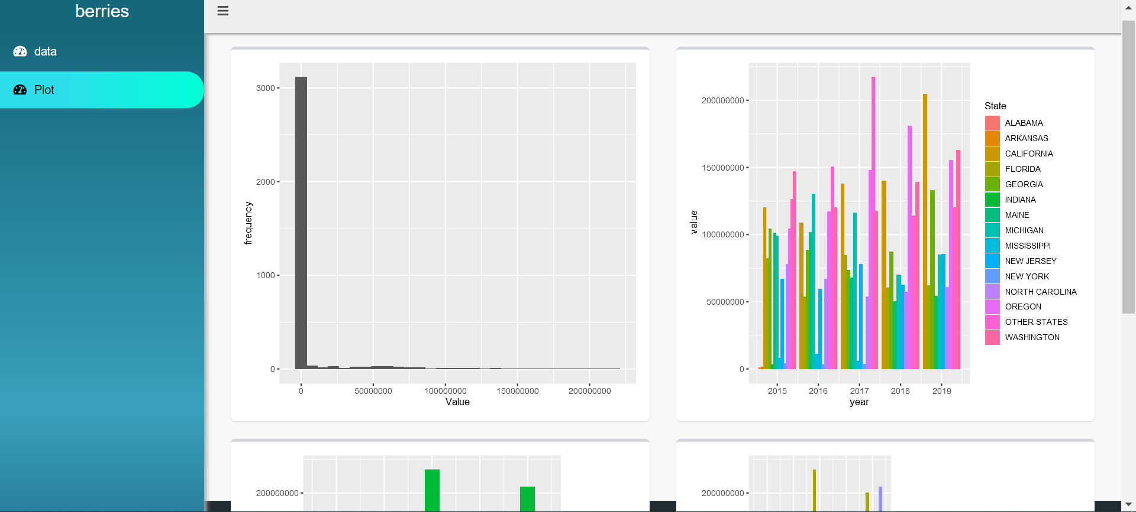
EDA
Shiny

