Slide 1
轉折
結局
意外
努力
目標
阻礙
結果
故事7步驟
自我介紹

Slide 2
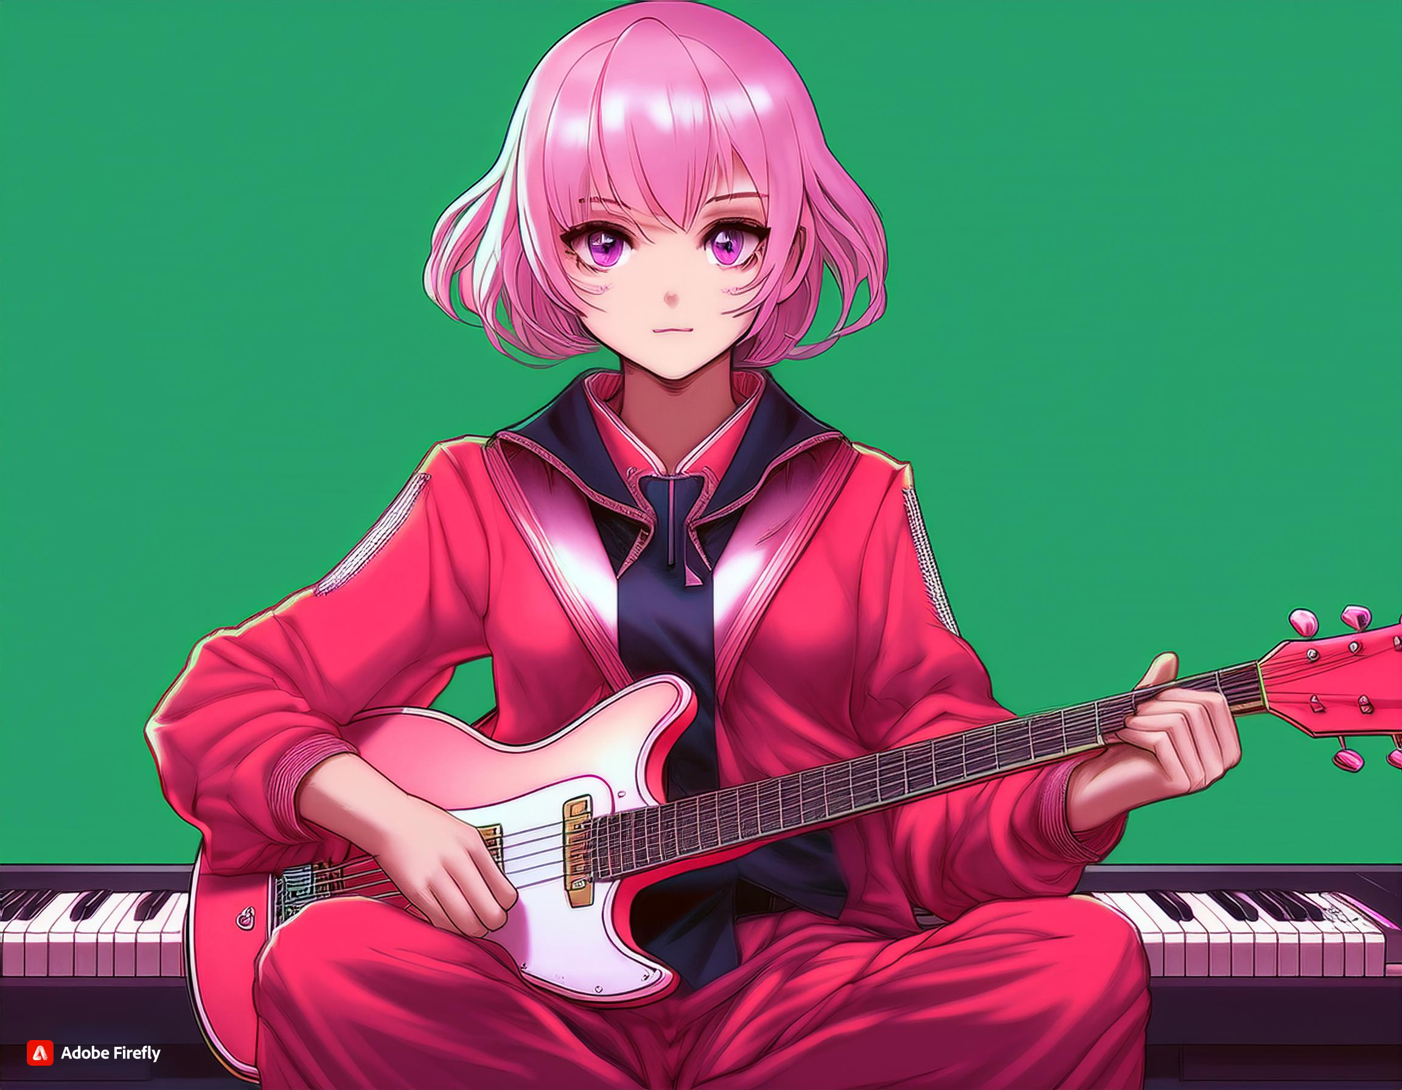
結局
阻礙
轉折
目標
意外
故事7步驟
努力
結果

Slide 3

轉折
結局
阻礙
目標
故事7步驟
意外
努力
結果
Notes:
american comic style girl in a red and white uniform , a character portrait, net art, inspired by Taro Okamoto, symmetrical fullbody rendering, soft image shading, fuschia skin, full body female, chiho aoshima color scheme, sitting on her bed playing the guitar，and there is aelectronic keyboard next to her bed .
我決定參加學校的音樂表演大賽，想要創作出一首特別的曲子，爭取“最佳表演獎”。

Slide 4
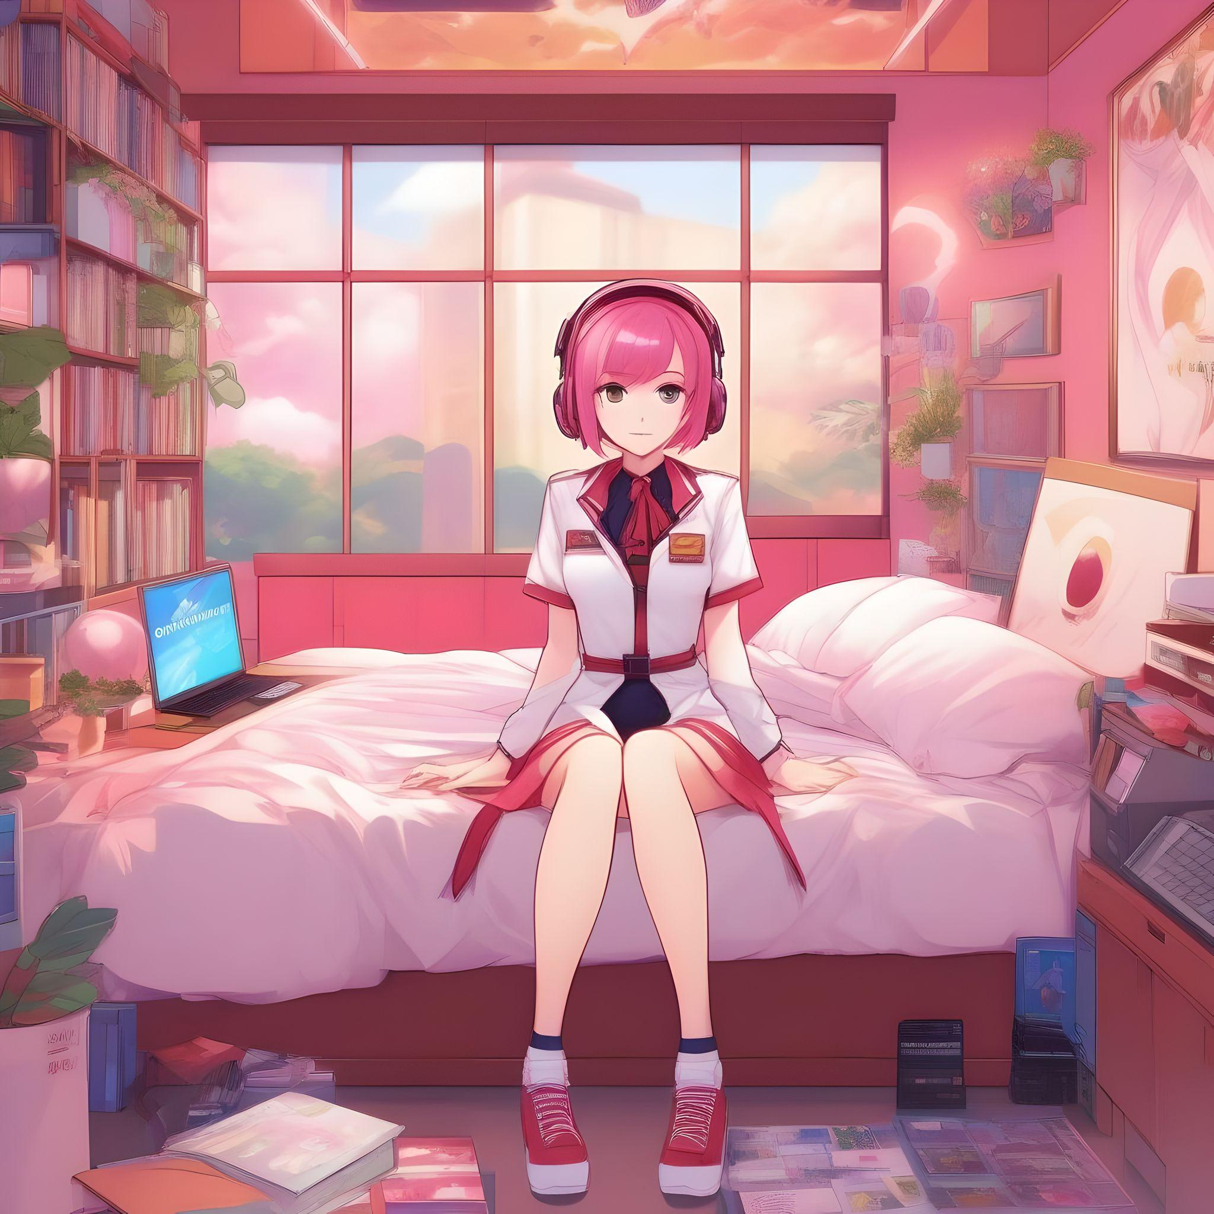
轉折
結局
目標
阻礙
故事7步驟
意外
努力
結果
Notes:
american comic style girl in a red and white uniform , a character portrait, net art, inspired by Taro Okamoto, symmetrical fullbody rendering, soft image shading, fuschia skin, full body female, chiho aoshima color scheme, sitting on her bed playing keyboard.
然而，我的樂理能力不足，對自己能否勝出產生懷疑，為了精進自己的能力，我開始學習鋼琴。

Slide 5

轉折
阻礙
結局
目標
努力
故事7步驟
意外
結果
Notes:
american comic style girl in a red and white uniform , a character portrait, net art, inspired by Taro Okamoto, symmetrical fullbody rendering, soft image shading, fuschia skin, full body female, chiho aoshima color scheme, sitting on her bed, she is live streaming.
儘管心中懷疑，我決心不放棄。我每天在家裡練習吉他和鋼琴，嘗試創作自己的曲子。也在直播中與觀眾分享自己的練習過程，獲得了大家的支持和鼓勵。

Slide 6
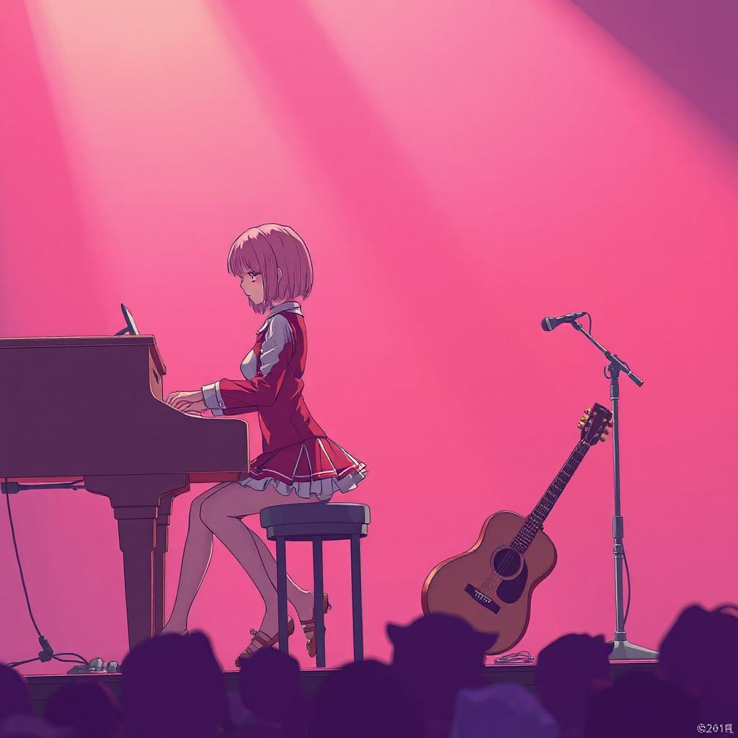
轉折
阻礙
結局
目標
結果
故事7步驟
意外
努力
Notes:
american comic style girl in a red and white uniform , a character portrait, net art, inspired by Taro Okamoto, symmetrical fullbody rendering, soft image shading, fuschia skin, full body female, chiho aoshima color scheme, playing the guitar on the stage，smiling happily.
音樂大賽的日子終於來臨。我在舞台上自信地演奏，雖然緊張，但我的音樂充滿情感，吸引了觀眾的注意。

Slide 7
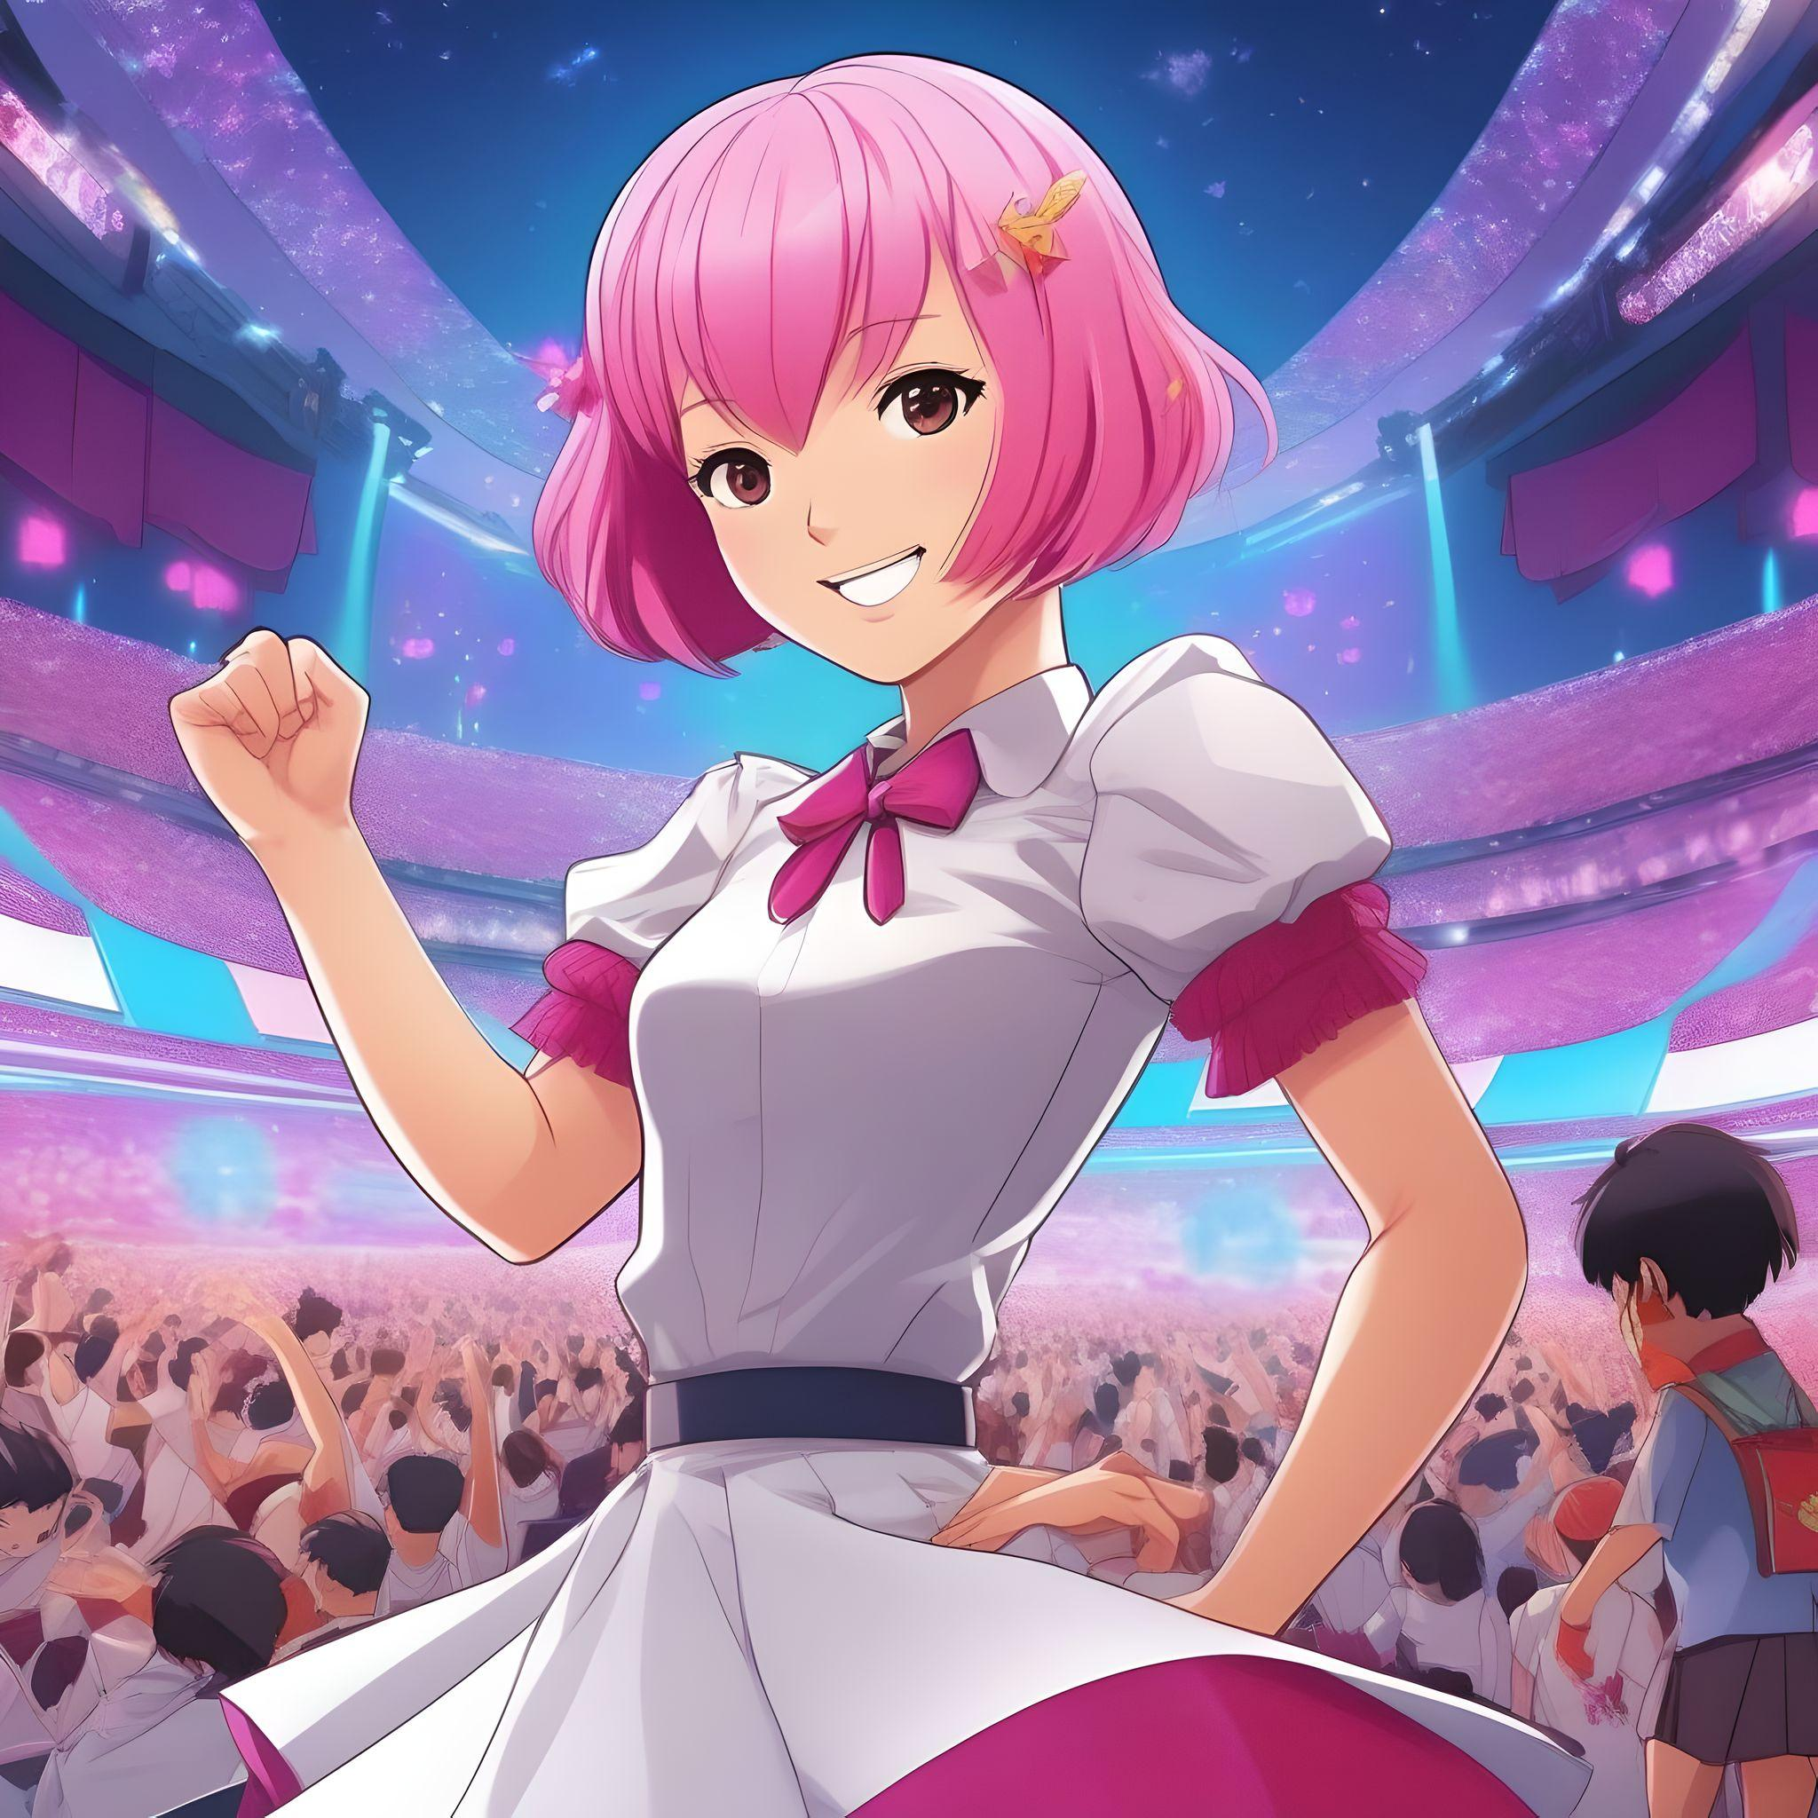
轉折
阻礙
結局
目標
意外
故事7步驟
努力
結果
Notes:
american comic style girl in a red and white uniform , a character portrait, net art, inspired by Taro Okamoto, symmetrical fullbody rendering, soft image shading, fuschia skin, full body female, chiho aoshima color scheme, playing the piano on the stage，and there is a guitar next to the girl.
就在演奏接近尾聲時，吉他弦意外斷裂，瞬間場面陷入尷尬。我感到慌亂，心中暗自沮喪。

Slide 8

阻礙
結局
目標
轉折
故事7步驟
努力
結果
意外
Notes:
american comic style girl with short pink hair ， wearing white skirt , a character portrait, net art, inspired by Taro Okamoto, symmetrical fullbody rendering, soft image shading, fuschia skin, full body female. smiling happily on the stage，and there are many audience under the stage.
但我突然想起直播中觀眾的支持，並記起自己在練習時對音樂的熱愛。決定不再害怕，開始即興演奏鋼琴，將演出轉變為一場充滿即興創作的音樂旅程。

Slide 9
轉折
阻礙
目標
結局
故事7步驟
努力
結果
意外
Notes:
american comic style girl with short pink hair ， wearing white skirt , a character portrait, net art, inspired by Taro Okamoto, symmetrical fullbody rendering, soft image shading, fuschia skin, full body female. She got a reward，holding a trophy，smiling happily on the stage，and there are many audience under the stage.
表演獲得了熱烈的掌聲，雖然沒有獲得最佳表演獎，但我在過程中收穫了許多朋友，並且結識了許多志同道合的音樂愛好者。讓我明白了，音樂不僅僅是獎項，而是與他人分享的熱情和創造力，這讓我的音樂之路更加精彩。

