Slide 1
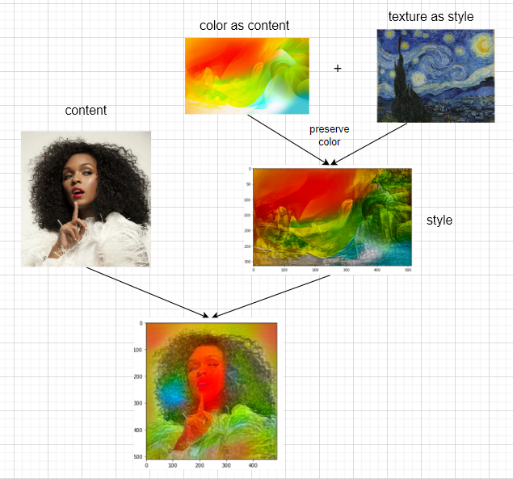
Method 1

Slide 2
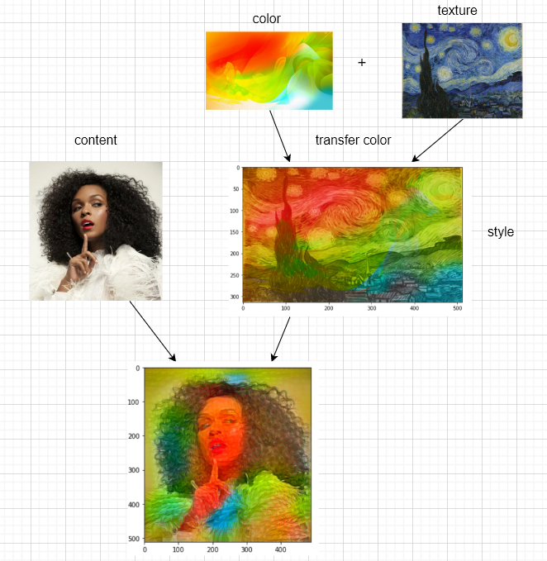
Method 2

Slide 3
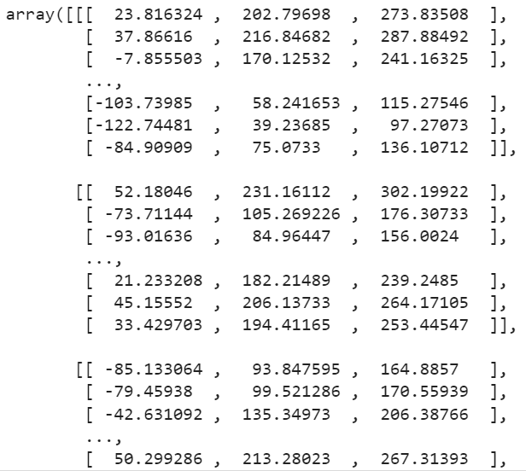
Transfer color
The result pixel matrix after preserving color style transfer
We implement this function inspired by Gatys, Leon A., et al [1].
They proposed a method that transfer style only in the luminance channel.
But the problem is the transfer of preserving color can only be implemented once. The result cannot be use in another style transfer.
[1] Gatys L A, Bethge M, Hertzmann A, et al. Preserving color in neural artistic style transfer[J]. arXiv preprint arXiv:1606.05897, 2016.

Slide 4
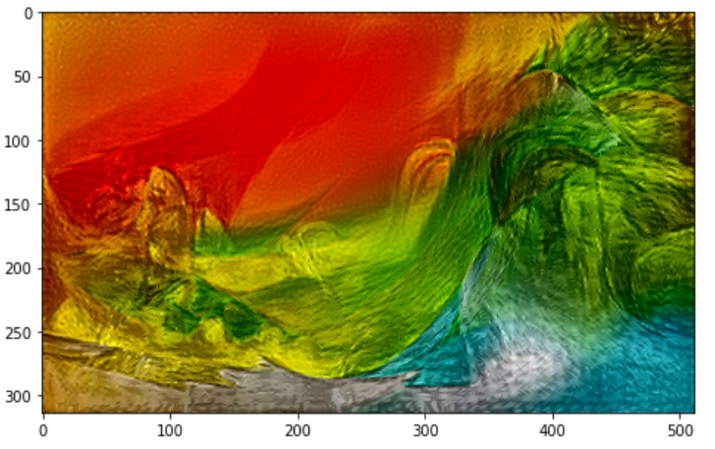
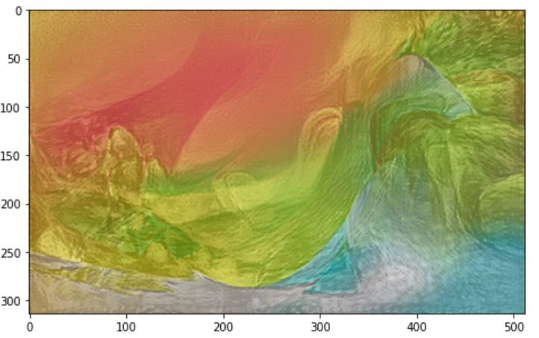
After transfer color
The result image
Images after normalization
Notes:
the type of the element in pixel matrix of the result image are float32. It is out of the range [0, 255], which can not be use in next style transfer. Then we try to normalize the matrix to fit the range [0,255]

Slide 5
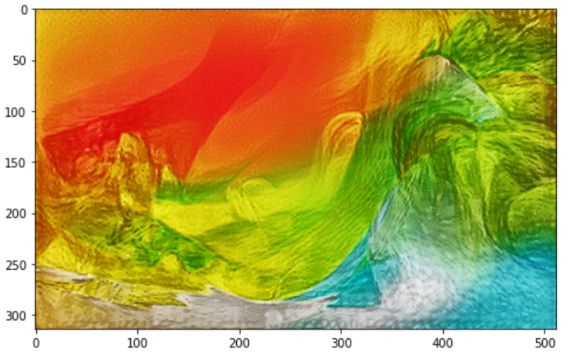
After transfer color
Images after normalization
Images after Contrast Stretching
Notes:
After we normalized the pixel matrix to [0,255], there is some loss of colour information and you can see that the colour of the image on the left will be lighter than the previous image. Then we decided to do contrast stretching to recover the color feature. The result is as in the right figure. Although there is still some difference between the original figure and processed image. With this problem solved we can perform multiple style transfers.

Slide 6
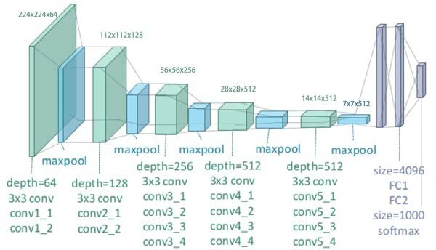
Different layer as content layer
VGG19
Notes:
Each layer extracts features differently and, as stated in the paper mentioned in the introduction, choosing a different layer as the content layer will give different results. Therefore, we would like to explore whether choosing the layer that gives the best results when two style transformations are required is the same as choosing the layer that gives the best results when only one style transformation is performed.

Slide 7
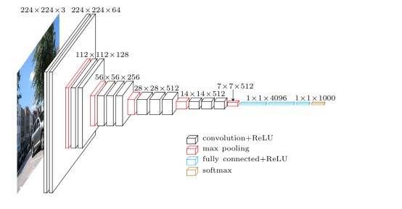
Different network
VGG19
VGG16

