Slide 1
Android Architecture Components
yuxingxin
2017.11.11

Slide 2
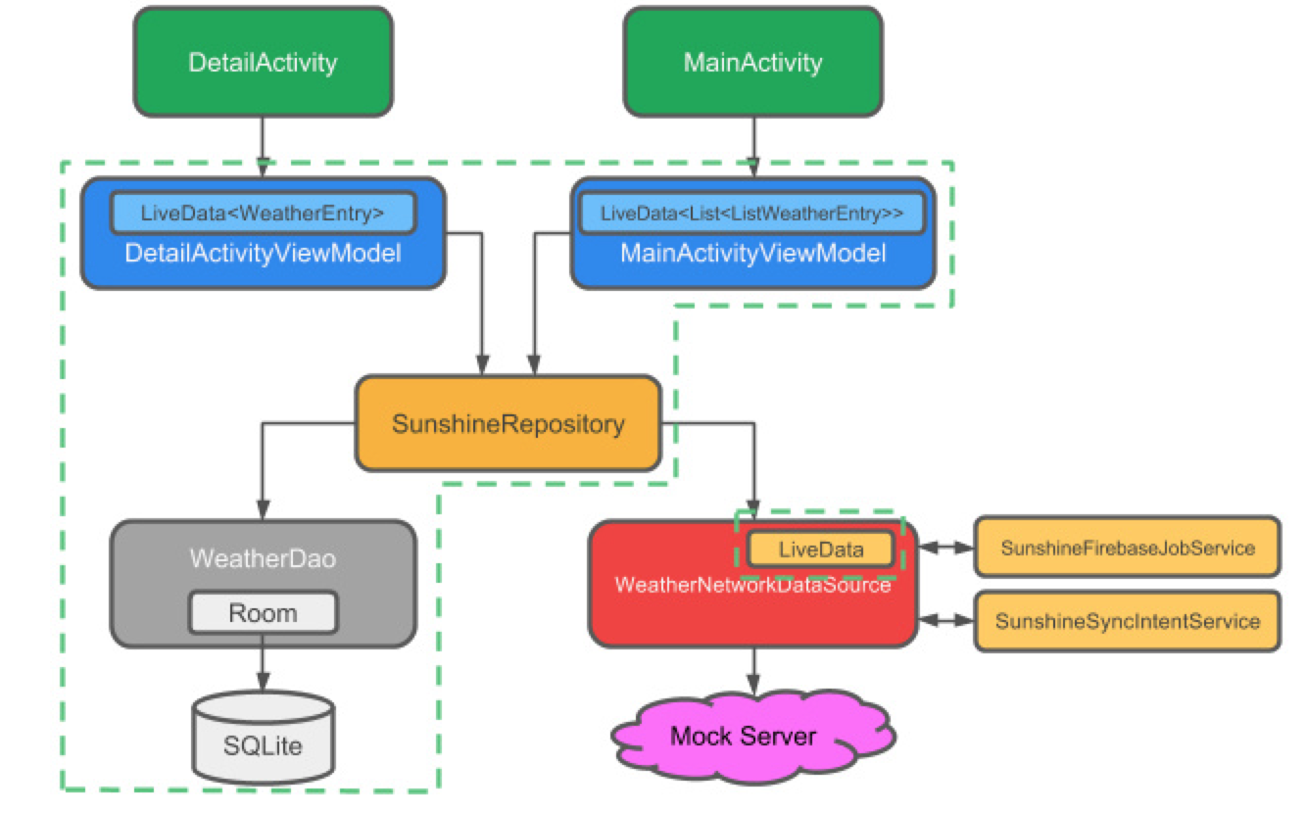
Android Architecture Components
Room
ViewModel
LiveData
Lifecycles
Paging(alpha)

Slide 3
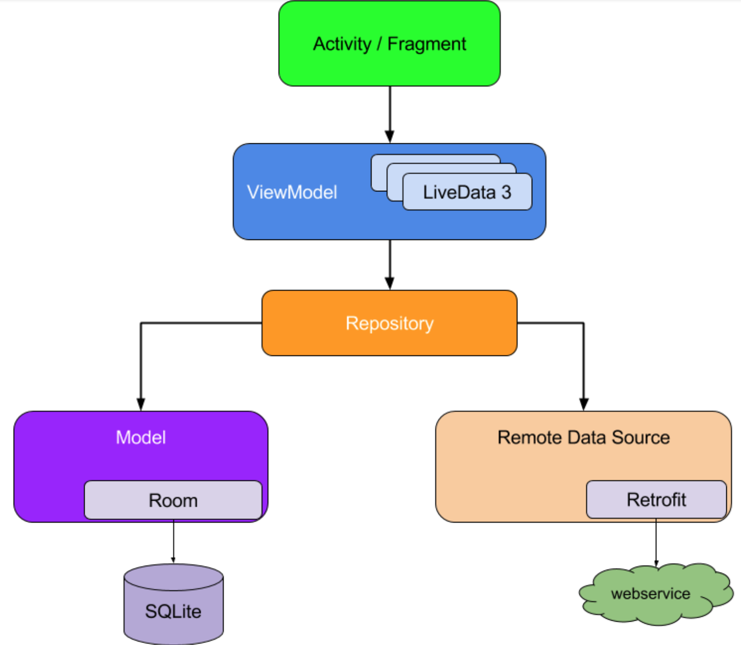
architecture components

Slide 4
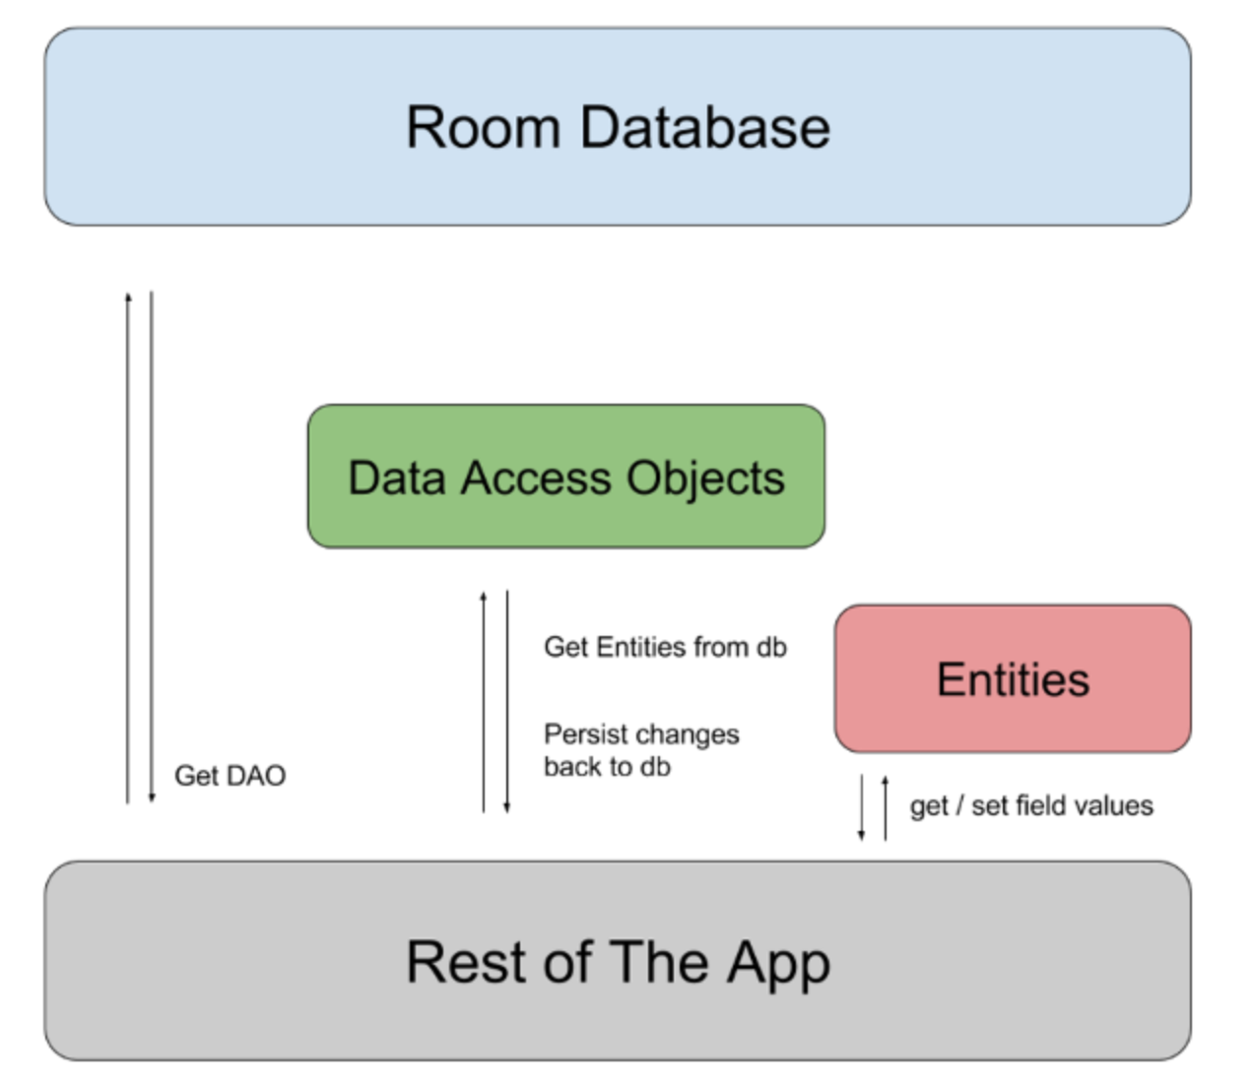
Room
Database
Entity
DAO
Room architecture

Slide 5
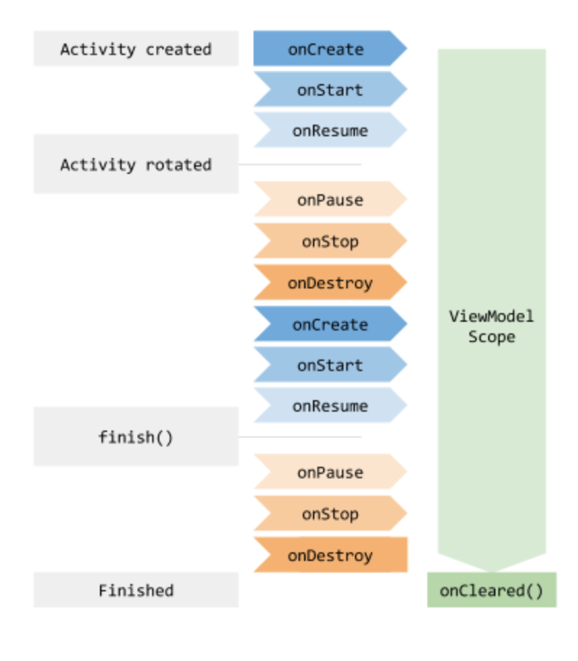
ViewModel
store and manage UI-related data in a lifecycle conscious way

Slide 6
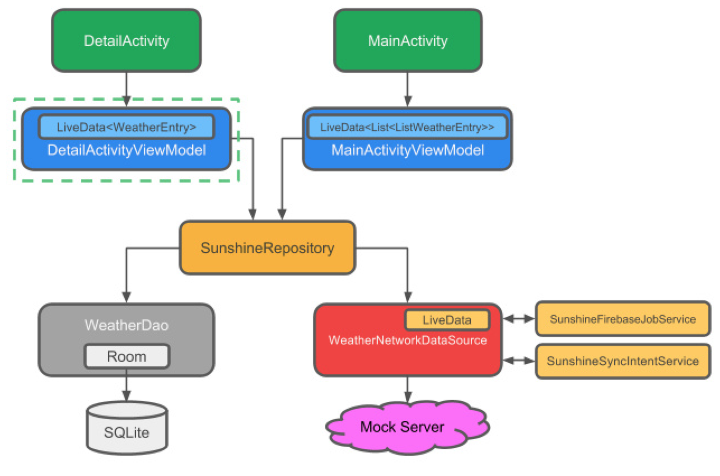
LiveData
an observable data holder class
lifecycle-aware

Slide 7
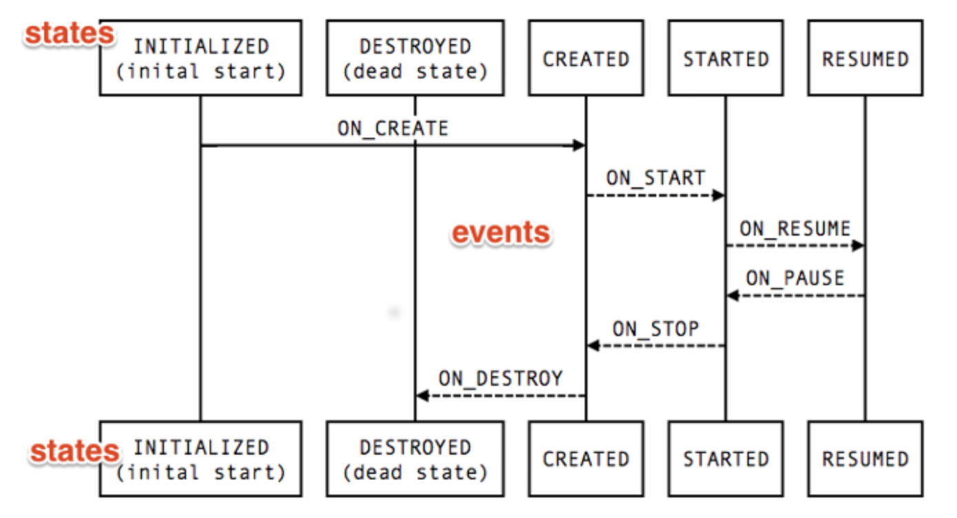
Lifecycles
holds the information about the lifecycle state of a component (like an activity or a fragment) and allows objects to observe this state.
State
Event
the lifecycle status for its associated component

Slide 8
准备工作
Android Studio 3.0
熟悉Android构建及Activity生命周期
会写基本的SQL语句
熟悉Android的异步任务

Slide 9
开始
https://github.com/yuxingxin/Architecture-Components-App
https://zhuanlan.zhihu.com/p/30722989

