Slide 1
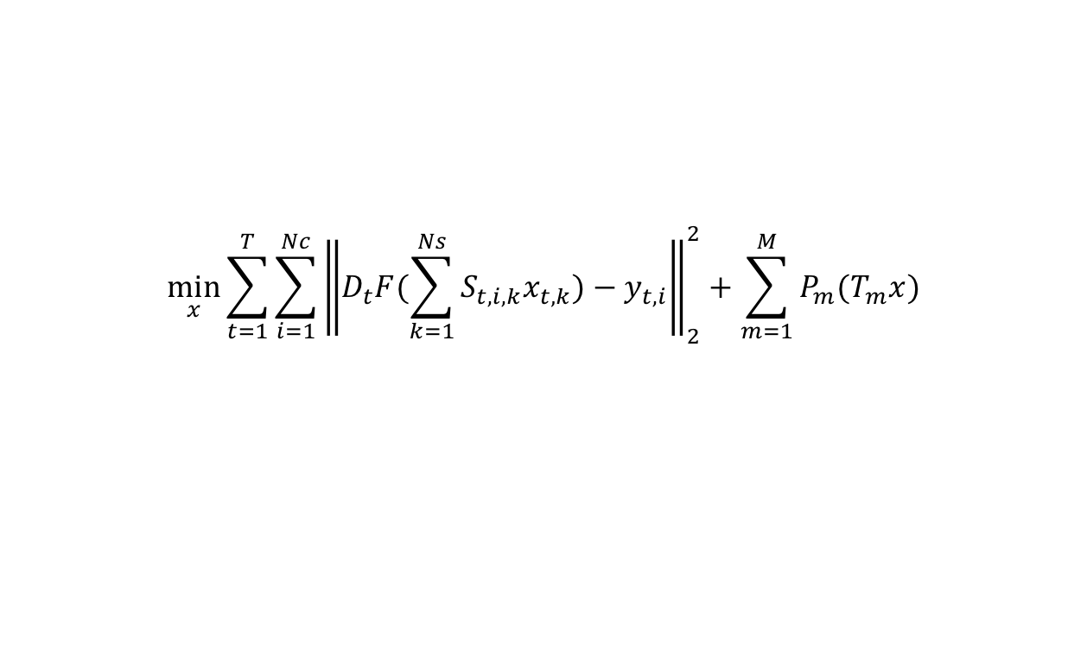
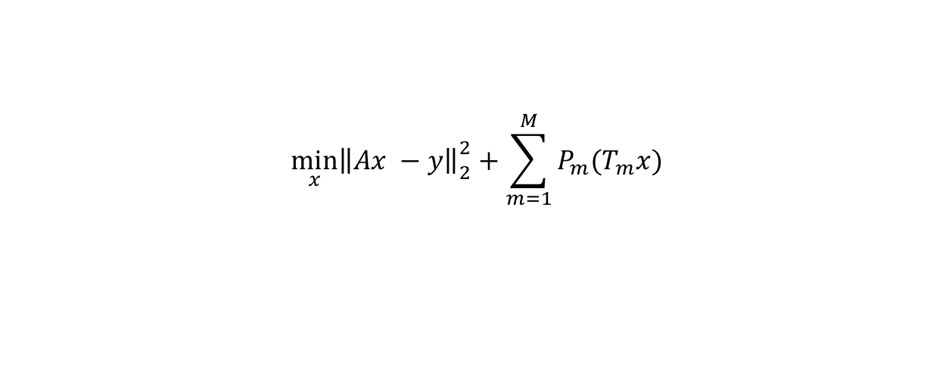
$$\min_{x}{\sum_{t=1}^{T}{\sum_{i=1}^{Nc}{{\left\|\left.D_{t}F(\sum_{k=1}^{Ns}{S_{t,i,k}x_{t,k}})−y_{t,i}\right\|\right.}_{2}^{2}}}+\sum_{m=1}^{M}{P_{m}(T_{m}x)}}$$
$$\min_{x}{{\left\|\left.Ax −y\right\|\right.}_{2}^{2}+\sum_{m=1}^{M}{P_{m}(T_{m}x)}}$$
x: Nx-Ny-Nz-Ns-T, images to be estimated
T: #frames
Nc: #coils
Ns: #maps (concept from ESPIRiT)
M: #constraints
y: Nx-Ny-Nz-Nc-T, zero-filled acquired k-space
D_{t}: sampling pattern of frame t (calibrated automatically based on y)
F: FFT or nuFFT
S: sensitivity map (Nx-Ny-Nz-Nc-Ns-T, usually T = 1, Ns = 1 or 2) (can be calibrated using ecalib)
P_{m}: constraint m
T_{m}: linear transform m
Notes:
\min_{x}||DFSx - y||_2^2 + \sum_{m = 1}^{M}P_{m}(T_{m}x)

Slide 2
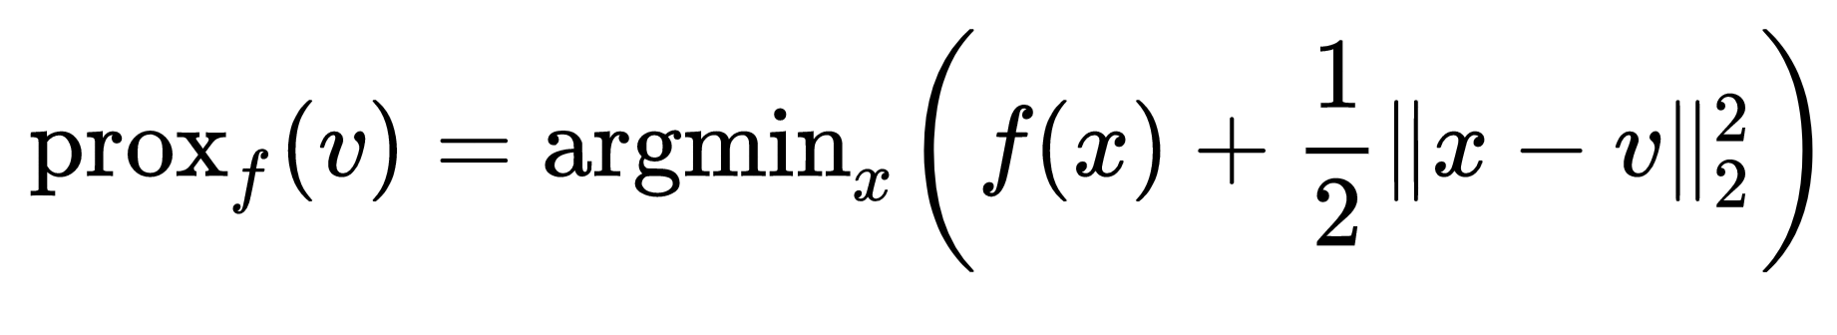
constraints | T | P | Proximal operator of P
L1-wav | Identity | Wavelet then take L1-norm | Wavelet then soft threshold
L1 | Identity | L1 norm | Soft threshold
L2 | Identity | L2 norm | Ax = b (solved by CG)
Imaginary L1 | Take the imaginary part | L1 norm | Soft threshold
Imaginary L2 | Take the imaginary part | L2 norm | Ax = b (solved by CG)
Total variation | Gradient | L1-norm | Soft threshold
Locally-low-rank | Identity | Constructing LLR matrices and nuclear norm | Constructing LLR matrices, SVD then soft threshold
Multi-scale locally-low-rank (similar to LLR)

Slide 3
Algorithms | Comments
CG | L2 of sum of L2
IST | L2 + 1 constraint (with known proximal operator)
FISTA | Same as IST, but faster
ADMM | Multiple terms with known proximal operators

