Slide 1
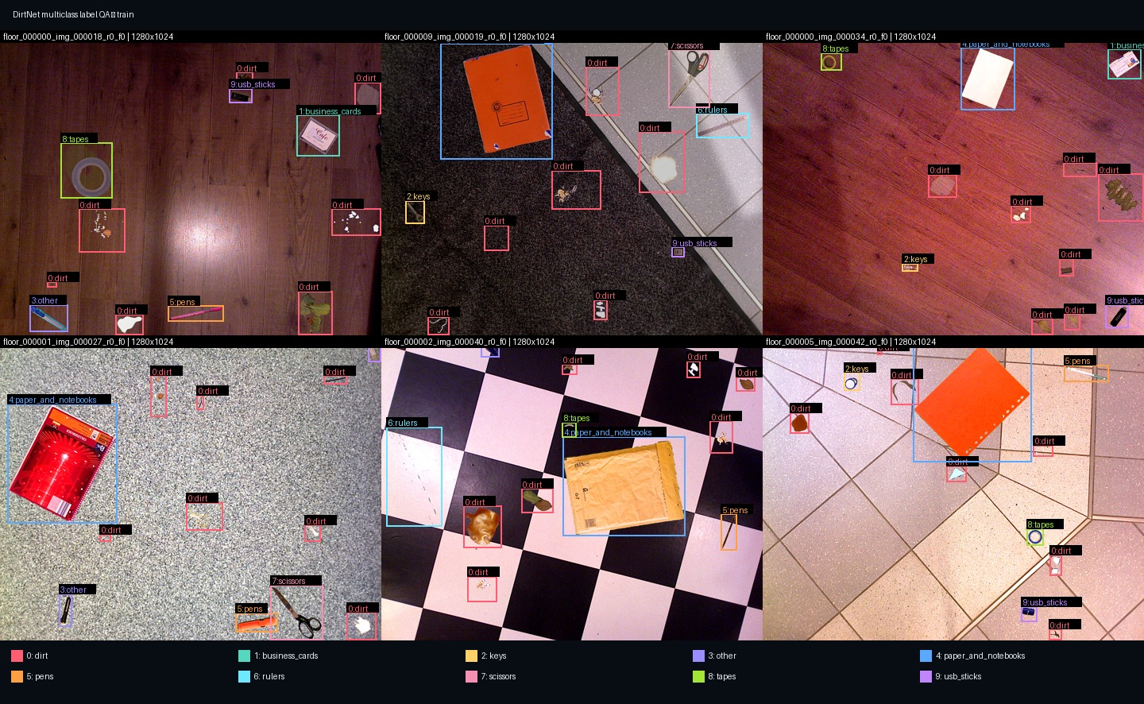
The binary DirtNet task became a 10-class detector
10 classes
dirt + 9 office-object categories
Dataset
860 training images · 8,626 boxes
296 validation images · 2,962 boxes
80 held-out real images · 644 boxes
Controlled baseline
YOLO11M · 1024 px · batch 2
30 epochs on synthetic data
Independent real-world evaluation
business cards · keys · other · paper/notebooks · pens · rulers · scissors · tapes · USB sticks

Slide 2
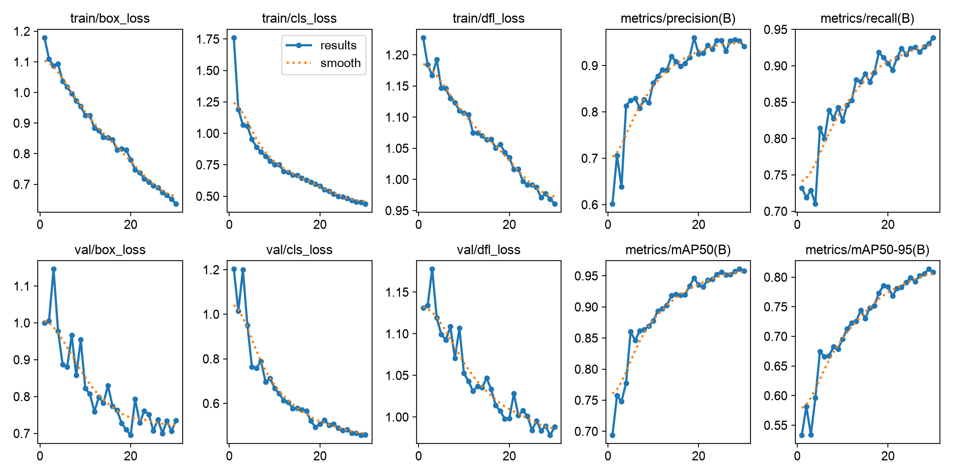
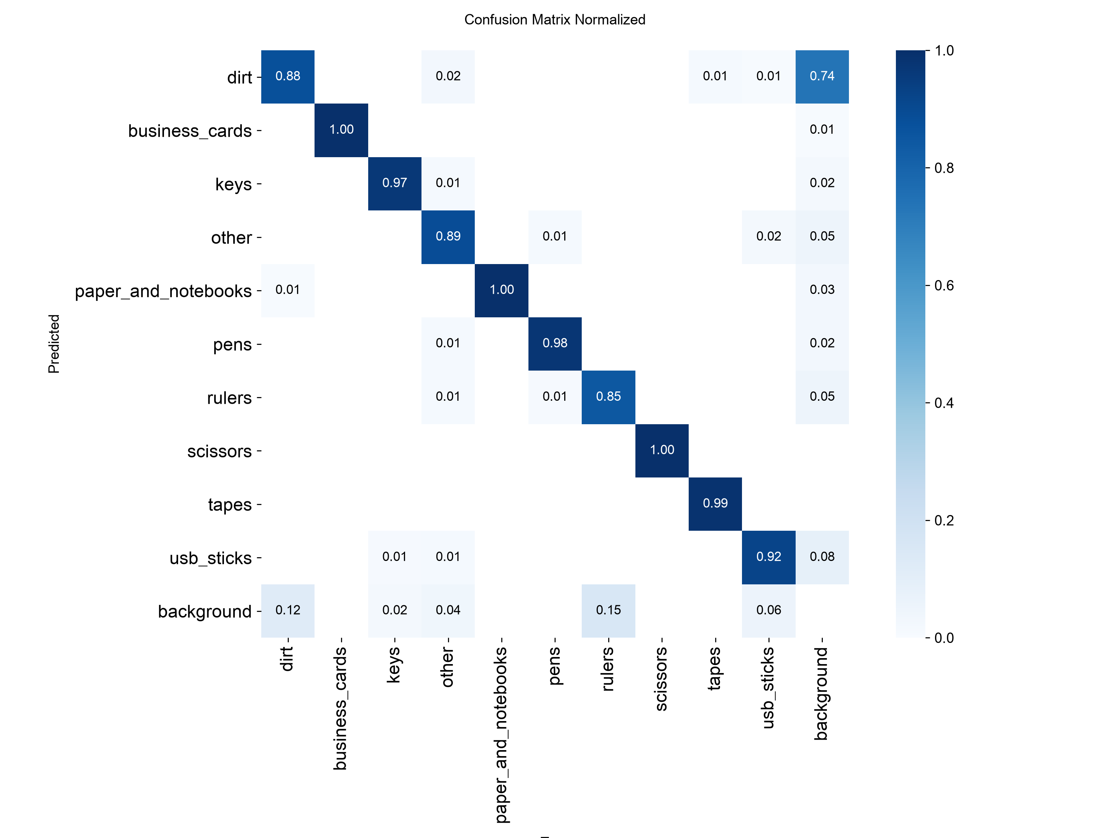
Synthetic validation confirmed a working baseline
0.953
0.930
0.961
0.814
Precision
Recall
mAP@0.5
mAP@0.5–0.95
Meaning: the 10-class labels, output head and training pipeline function correctly.

Slide 3
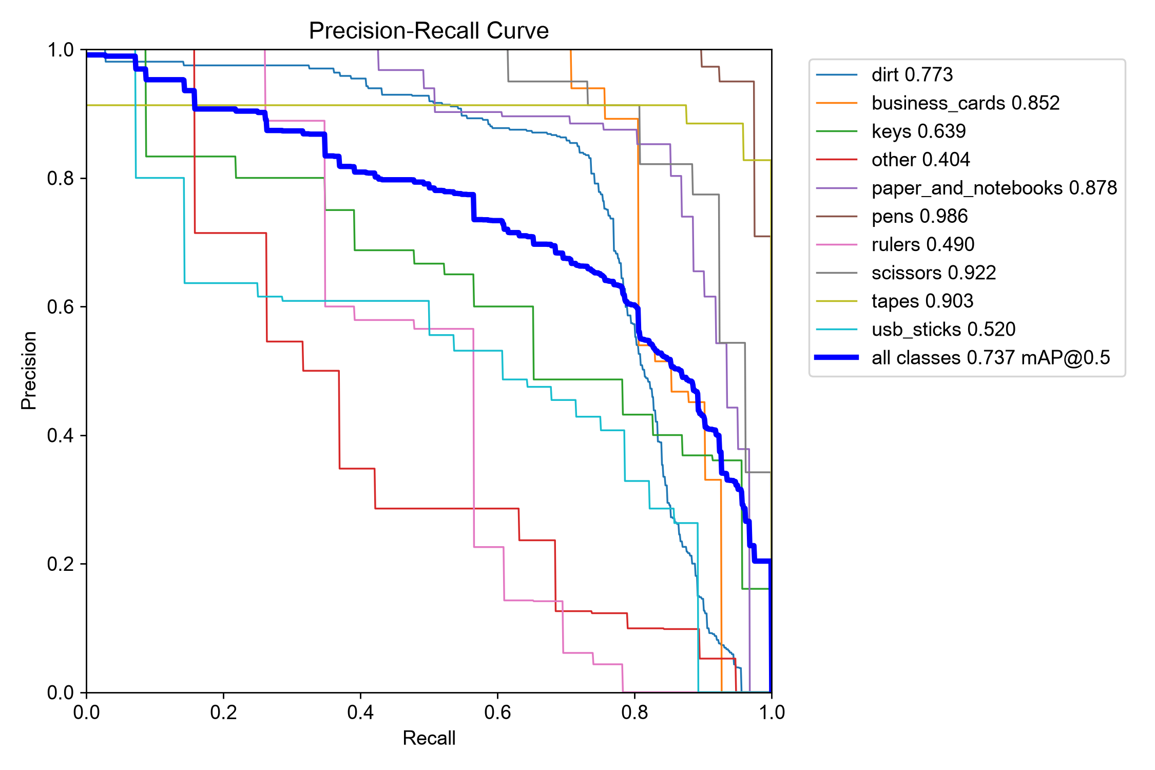
Real images exposed a clear domain gap
Synthetic validation
Independent real test
Precision
0.953
0.665
Recall
0.930
0.776
mAP@0.5
0.961
0.737
mAP@0.5–0.95
0.814
0.554
mAP@0.5 dropped by 0.224
Strong: pens, scissors, paper/notebooks
Weak: other, rulers, USB sticks
Reflections, shadows and floor texture increase false positives
The gap affects both classification and box localization.

Slide 4
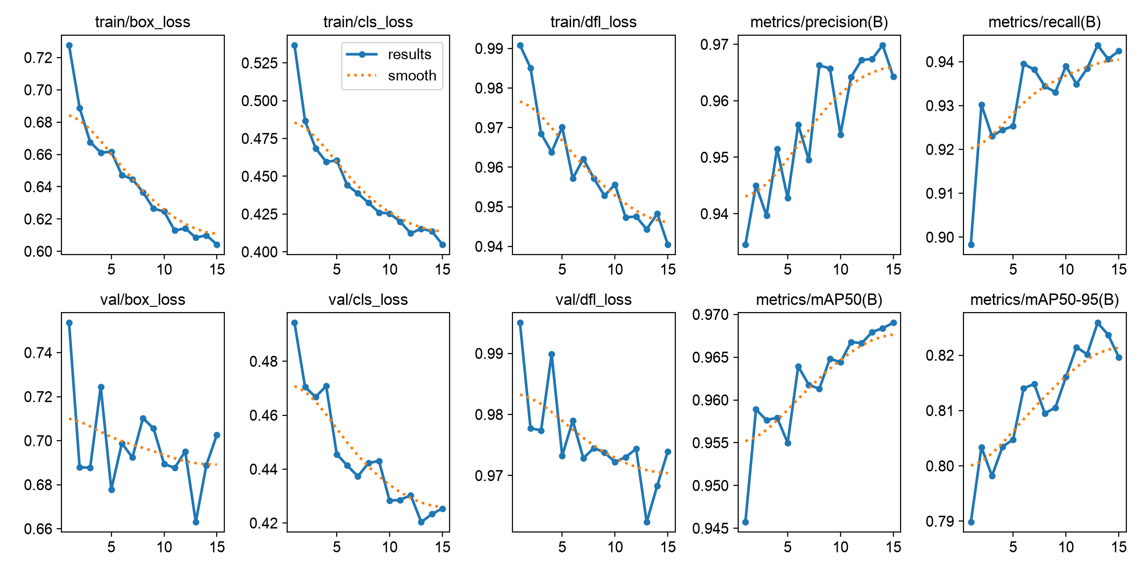
Low-rate fine-tuning did not improve real transfer
Modified parameter
Why it was changed
Baseline best.pt
Refine an already converged solution
AdamW
Adaptive steps + decoupled weight decay
lr₀ = 1×10⁻⁴
Smaller updates preserve learned features
Cosine decay → 1×10⁻⁵
Smooth convergence near the optimum
Mosaic disabled
Stabilize layout and localization
15 epochs · patience 5
Bounded refinement; stop early
Synthetic mAP@0.5
Real mAP@0.5
0.961 → 0.968
0.737 → 0.726
Further optimization fitted the synthetic domain more closely, but did not close the real-world gap.

Slide 5
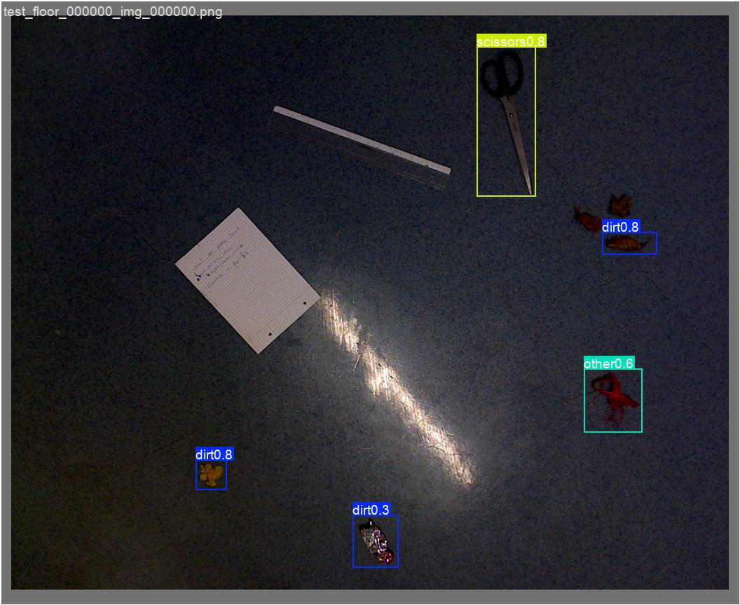
Further gains require real-world data
Critical discussion & lessons learned
High synthetic scores do not guarantee real-world performance.
More epochs and lower learning rates cannot solve domain mismatch.
Class balance, label definitions and data distribution dominate the remaining error.
The broad “other” class introduces substantial ambiguity.
Outlook and future work
Collect separate real training and validation data.
Add weak classes and difficult negative samples.
Model reflections, shadows, scratches and low light.
Redefine “other” and tune confidence for robot priorities.
Correct detections coexist with missed objects and reflective-floor ambiguity.
A functional multiclass baseline is established; real-domain adaptation is the next step.

