Slide 1
Round pipe with dielectric layer
Igor Zagorodnov
24 May 2018

Slide 2





1. Geometry
$$r$$
$a_{1}=$10mm
$$ε=11, μ=1$$
$a_{0}=5$mm
$$z$$
The simulations are done in frequency domain.
The Gaussian bunch has RMS 250µm.

Slide 3
2. ECHO1D setup
1. The setup is in directory ECHO1D. We use conductivity 1 S/m to resolve the spikes in real part of the impedance.
2. The geometry is described in file “Example1.txt”
% Nm - Number of layers
1
% boundaries
5e-3 10e-3
% Re(EpsR[i]) Im(EpsR[i]) Re(EpsFi[i]) Im(EpsFI[i]) Re(EpsZ[i]) Im(EpsZ[i]), i=1,Nm
11 0 11 0 11 0
% Re(MueR[i]) Im(MueR[i]) Re(MueFi[i]) Im(MueFI[i]) Re(MueZ[i]) Im(MueZ[i]), i=1,Nm
1 0 1 0 1 0
% Conductivity[i], Relaxation Time[i], i=1,Nm
1 0

Slide 4
3. The simulation parameters are in file “input_in.txt”.
%%%%%%%%%%%%%% geometry %%%%%%%%%%%%%%%%%%%%
Geometry_File = Example01.txt
Boundary_Condition = PEC % could be PEC/Open
Geometry_Width = 0 % 0 means round geometry
%%%%%%%%%%%%%% beam %%%%%%%%%%%%%%%%%%%%
Gamma = 1000
%%%%%%%%%%%%%% Model %%%%%%%%%%%%%%%%%%%%
Method = FM % could be FM/FD/Mix
Steps_on_Wavelength = 100 % only for FD/Mix methods
%%%%%%%%%%%%%% output %%%%%%%%%%%%%%%%%%%%
Modes = 0 1
Wavenumbers = 1 20000 0.25 % the last number is sampling step
4. Executable is “ECHO1D.exe”. It calculates impedances.

Slide 5
5. After simulation is done go to directory “PostProcessor1D\round” and run “Impedance_round.m” in Matlab. It shows the impedances.

Slide 6
6. Run “Wake_round.m” in Matlab. It shows the wakes for bunch with rms 250um. The bunch length can be changed in this script with edition of line “sigma=250e-6”.

Slide 7
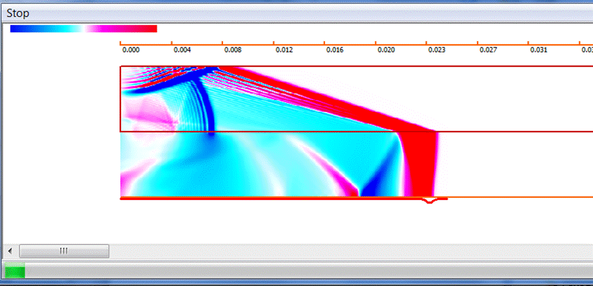
2. ECHO2D setup
1. The setup is in directory ECHO2D.
2. The simulations are done for 1 meters and 1.1 meters and subtracted to obtain “steady-state” wake.

Slide 8
3. Run “Compare_2D_vs_1D.m” in Matlab to see the comparison between ECHO1D and ECHO2D results

