Slide 1
Dielectric pipes
Simulations. ECHO vs ASTRA
Igor Zagorodnov
DESY
Hamburg
April 2017

Slide 2
Geometry
17.5
1.000
0.900
0.725
-3
0
80
200

Slide 3
Tests
Test 1. Only drift in free space without any fields.
Test 2. Drift in pipe with self-field.
Test 3. Through metallic scraper with self-field and particle loss.
Test 4. Full simulation of dielectric insert.

Slide 4
Test 1. Drift in free space without fields
Transverse phase space
Mean position
RMS size
ASTRA
ASTRA
ECHO
ECHO
Phase space emittance
RMS angle
ECHO
ASTRA
ECHO
ASTRA

Slide 5
Test 1. Drift in free space without fields
Longitudinal phase space
Mean energy
RMS size
ASTRA
ASTRA
ECHO
ECHO
Phase space emittance
Energy spread
ECHO
ASTRA
ASTRA
ECHO

Slide 6
Test 2 . Drift in pipe with self-field.
17.5
-3
0
80
200

Slide 7
Test 2 . Drift in pipe with self-field
Transverse phase space
Mean position
RMS size
ASTRA
ECHO
ASTRA
ECHO
Phase space emittance
RMS angle
ASTRA
ASTRA
ECHO
ECHO

Slide 8
Test 2 . Drift in pipe with self-field
Longitudinal phase space
Mean energy
RMS size
ECHO
ASTRA
ECHO
ASTRA
Phase space emittance
Energy spread
ASTRA
ASTRA
ECHO
ECHO

Slide 9
Test 2 . Drift in pipe with self-field
Longitudinal phase space
ECHO
ASTRA
ECHO
ASTRA

Slide 10
Test 3. Through metallic scraper
17.5
0.725
-3
0
80
200

Slide 11
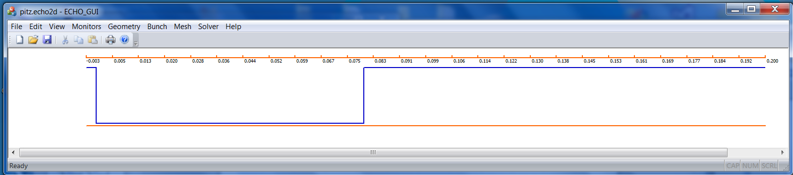
Test 3. Through metallic scraper

Slide 12
Test 3. Through metallic scraper
Transverse phase space
Mean position
RMS size
ECHO
ASTRA
ECHO
ASTRA
Phase space emittance
RMS angle
ECHO
ASTRA
ECHO
ASTRA

Slide 13
Test 3. Through metallic scraper
Longitudinal phase space
Mean energy
RMS size
ASTRA
ECHO
ECHO
ASTRA
Phase space emittance
Energy spread
ASTRA
ASTRA
ECHO
ECHO

Slide 14
Test 3. Through metallic scraper
Longitudinal phase space
ASTRA
ECHO
ASTRA
ECHO

Slide 15
Test 4. Full simulation of dielectric insert.
17.5
1.000
0.900
0.725
-3
0
80
200

Slide 16
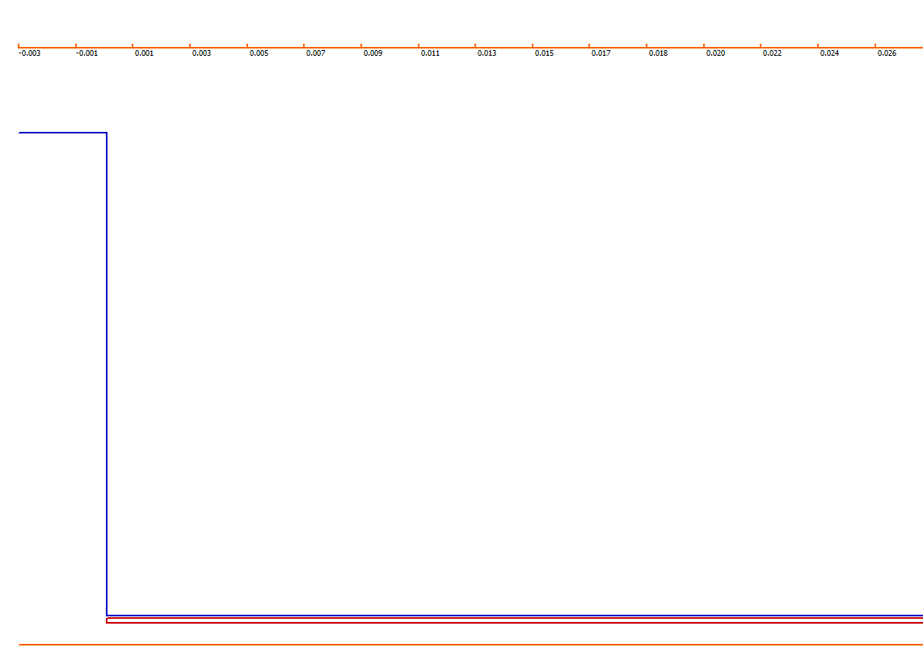
Test 4. Full simulation of dielectric insert.

Slide 17
Test 4. Full simulation of dielectric insert.
Transverse phase space
Mean position
RMS size
ECHO
ASTRA
ASTRA
ECHO
Phase space emittance
RMS angle
ECHO
ECHO
ASTRA
ASTRA

Slide 18
Test 4. Full simulation of dielectric insert.
Longitudinal phase space
Mean energy
RMS size
ASTRA
ECHO
ECHO
ASTRA
Phase space emittance
Energy spread
ASTRA
ASTRA
ECHO
ECHO

Slide 19
Test 4. Full simulation of dielectric insert.
Longitudinal phase space
ASTRA
ECHO
ASTRA
ECHO

