Slide 1
Manual of Particle Tracking
ECHO2D with m=0 mode only
Igor Zagorodnov
DESY
Hamburg
May 2019

Slide 2
Geometry
2
File pipe.txt. The format can be found in the manual on www.echo4d.de.
1.000
0.900
0.725
-0.3
0
80
200

Slide 3
Comand File
File input_in.txt. The format can be found in the manual on www.echo4d.de. Only additional critical parameters are listed below
InPartFile=InParticles/Particles.in
InFieldDir=-
Modes=0
ParticleMotion=1
ParticleField=1
CurrentFilter=1
ParticleLoss=1.
BeamMonitor=1 20000 10 500
DumpParticles=1
ParticleLoss=1 means that the particle in material will be lost.
BeamMonitor parameters mean that the beam parameters will be saved from step 1 to step 20000 with interval 10 and in the same time the particle distributions will be saved with interval 500.

Slide 4
Workflow
Start ECHOD_GUI.exe under Windows and open pitz.echo2d. Go to menu “Solver/Start”. You will see the calculation. You can go directly to the next slide or start from point 2 if you have your own input ASTRA file.
Place an input particle distribution in ASTRA format in directory ASTRA. In our case it is dlw.0166.001.
Open Matlab and add MatlabLib directory to the search paths.
Run matlab script Preprocessor/ASTRA_2_ECHO.m. It places the input particle distribution in ECHO format in directory ECHO2D/InParticles.
Start ECHOD_GUI.exe under Windows and open pitz.echo2d. Go to menu “Solver/Start”. You will see the calculation.

Slide 5
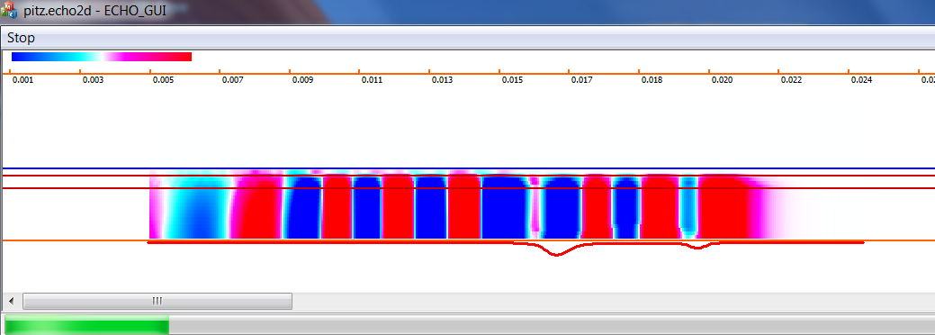
Workflow

Slide 6
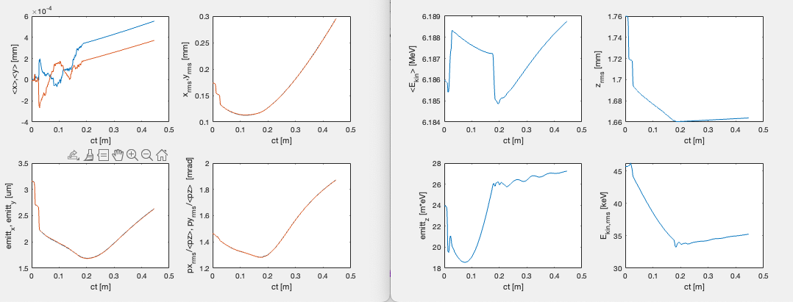
Workflow
7. Start script Postprocessor/SeeBeamMoments to see the next plots.

Slide 7
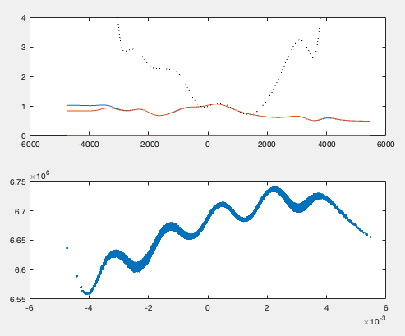
Workflow
8. Run script Postprocessor/ECHO_2_ASTRA.m to convert the output particle distribution to ASTRA format.
9. Run script Postprocessor/AnalyseParticles.m to see beam properties.

Slide 8
Workflow
10. GUI interface has bug. In order to start a new simulation close the program and start it again.
11. If the simulations with GUI is OK then you can try the console version ECHO2D.exe or linux version of ECHO2D.

