Slide 1
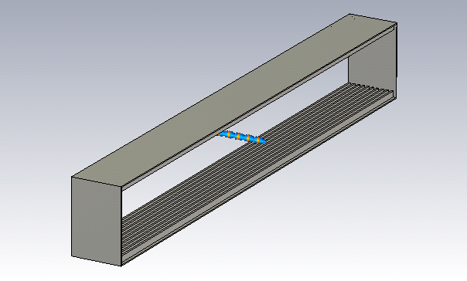
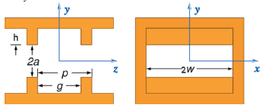

6 mm
50 mm
g = 0.3 mm
p = 0.5 mm
2w = 50 mm
2a = 6 mm
h = 0.6 mm
Length = 1 m
Gaussian bunch with RMS $σ=0.5$mm

Slide 2
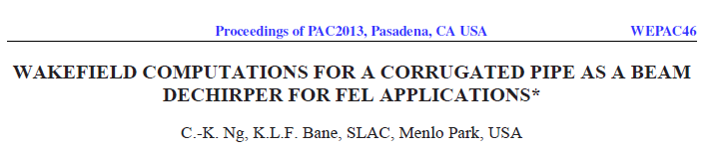



ECHO for Gaussian bunch
with RMS $σ=0.5$mm
Wake | Numerical/ Analytical
Longitudinal Loss | 0.83
Dipole Kick | 0.79
Quad Kick | 0.73
accuracy ~ 1%
(0.73+0.79)*0.5=0.76
0.76*200 pC = 152 pC – the charge in the paper!

Slide 3


$$W_{L}\left(s\right)\left[\frac{V}{pC}\right]$$
Loss factor | V/pC
Analytical | 920.47
Numerical | 760.77
Num. /Analytical | 0.83
ECHO
analytical
analytical, point charge
(Stupakov‘s slides, eps_inv=0)
$$s\left[mm\right]$$

Slide 4
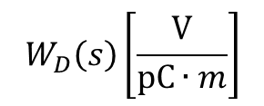
$$W_{D}\left(s\right)\left[\frac{V}{pC∙m}\right]$$
analytical, point charge
(Stupakov‘s slides, eps_inv=0)
Dipole kick factor | V/pC/m
Analytical | 73829
Numerical | 58335
Num. /Analytical | 0.79
analytical
ECHO
$$s\left[mm\right]$$

Slide 5

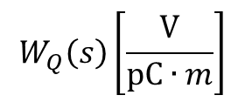
$$W_{Q}\left(s\right)\left[\frac{V}{pC∙m}\right]$$
analytical, point charge
(Stupakov‘s slides, eps_inv=0)
Quad kick factor | V/pC/m
Analytical | 72037
Numerical | 52525
Num. /Analytical | 0.73
analytical
ECHO
$$s\left[mm\right]$$

