Slide 1
Test examples with conductivity
ECHO 2.0
Igor Zagorodnov, DESY
01.07.2011

Slide 2







Steady-state wake in the pipe
Gaussian bunch with RMS length
$$κ=100000 \text{S}\text{/}\text{m}$$
$$σ=1 \text{mm}$$
$$a=1\text{cm}$$
ECHO result is a difference between the wakes for a pipe of 2 m and a pipe of 1 m.
$$W_{||} [\text{V}\text{/}\text{pC}\text{/}\text{m}]$$
$$W_{T} [\text{V}\text{/}\text{pC}\text{/}{\text{m}}^{\text{2}}\text{]}$$
analytical
ECHO
analytical
ECHO
$s$/ $σ$
$s$/ $σ$

Slide 3
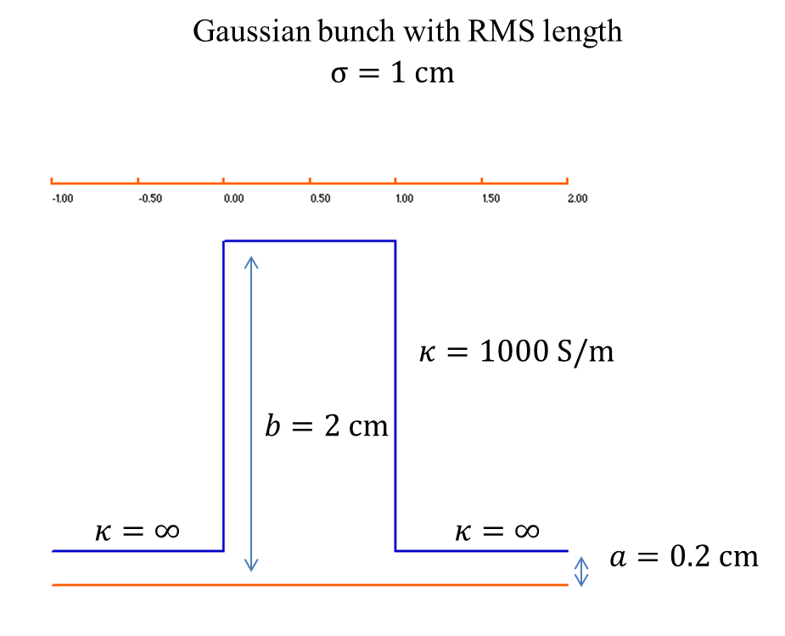
Lossy pillbox

Slide 4





Lossy pillbox
Gaussian bunch with RMS length
$$σ=1 \text{cm}$$
$$W_{||} [\text{V}\text{/}\text{pC}]$$
$$W_{T} [\text{V}\text{/}\text{pC}\text{/}{\text{m}}^{\text{2}}\text{]}$$
CST Particle Studio
CST Particle Studio
ECHO
ECHO
$s$/ $σ$
$s$/ $σ$

Slide 5
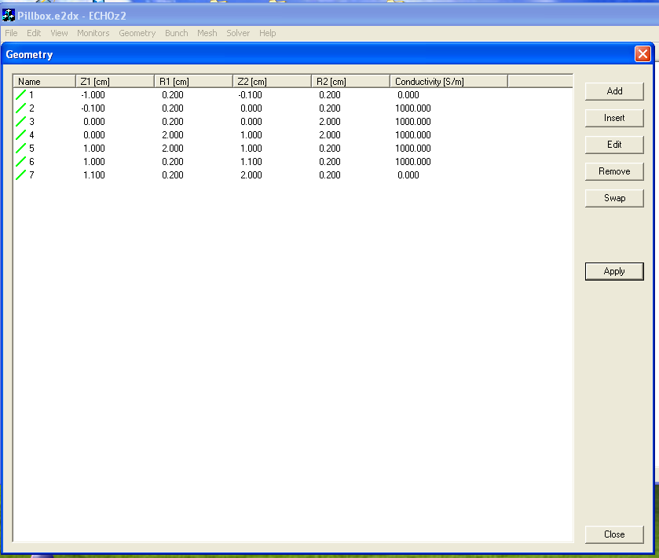
Conductivity in ECHO

