Slide 1
10/16 Presentation
Yuxin, Zhengfei, Fangyue, Vivian

Slide 2
10/09 Todos
Completed:
Read papers:
  TCI/EDDO paper
  Nature/FLIP paper
download TCI/EDDO code and run examples

Slide 3
Outline
Problem + drawback of original method (intuition)
  modeling of JWST coronograph
  simulating PSFs for JWST
proposed method (EDDO)
  Physics-Based Imaging Model
  Optimization Pipeline
  Experiments and Findings
transfer the method to real (FLIP)
  Expanded Model Parameters
  Multi-Stage Optimization and Signal Preservation
  Results on Real Observations
Code experiment
  On simulated data
  On real JWST images
Next step

Slide 4
Exoplanet Imaging
bright starlight vs faint planet light
  planet can be ~10⁵ times fainter than starlight
the starlight can hide the signal from planets closer to the star
starlight suppression through image processing techniques
difficult to model stellar PSF precisely

Slide 5
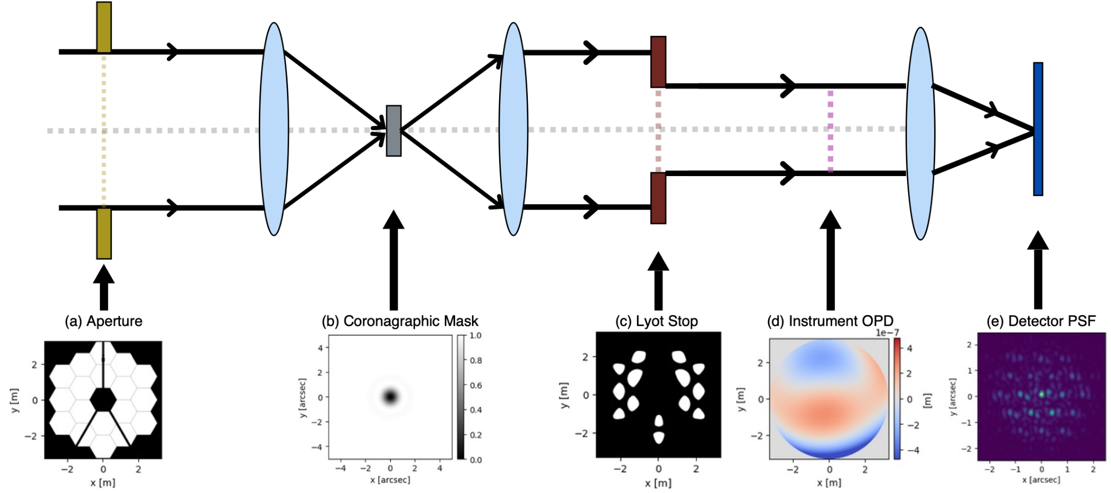
Coronograph
blocks starlight through mask and Lyot stop
leakage of light and speckles caused by wavefront aberrations
wavefront aberrations:
  off-center light
  defocus
  astigmatism
  mirror imperfections
  thermal drifts

Slide 6
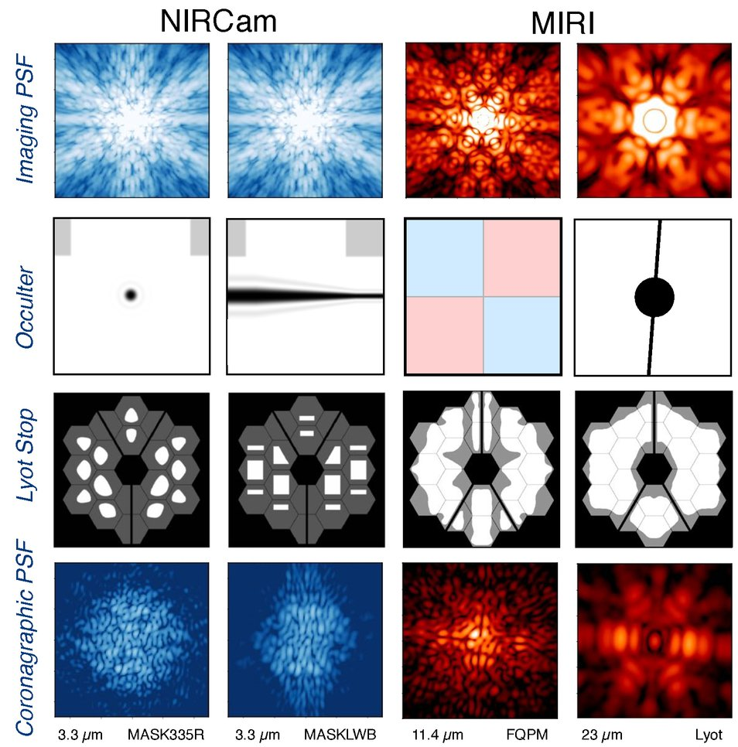
Coronograph
NIRCam
  5 band-limited Lyot-coronagraphs
  3 circular and 2 bar masks
MIRI
  3 four-quadrant phase masks
    changes phase of incoming light causing the light to interfere destructively
  1 Lyot coronagraph
WebbPSF/STPSF simulates the PSFs of both NIRCam and MIRI

Slide 7
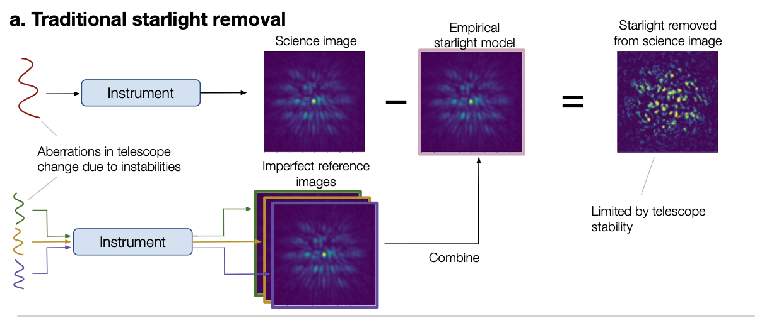
Traditional Methods
traditionally, use reference images taken at different times or wavelengths or of other stars
differences between reference image and science observation due to telescope instabilities and wavefront aberrations

Slide 8
Proposed method (EDDO)
Imaging Model——Coronagraphy
Model how light travels through the telescope
Optical system: entrance pupil → focal-plane mask → Lyot stop → instrument optics → detector
The model represents light as a wave before converting it to detector intensity.

Slide 9

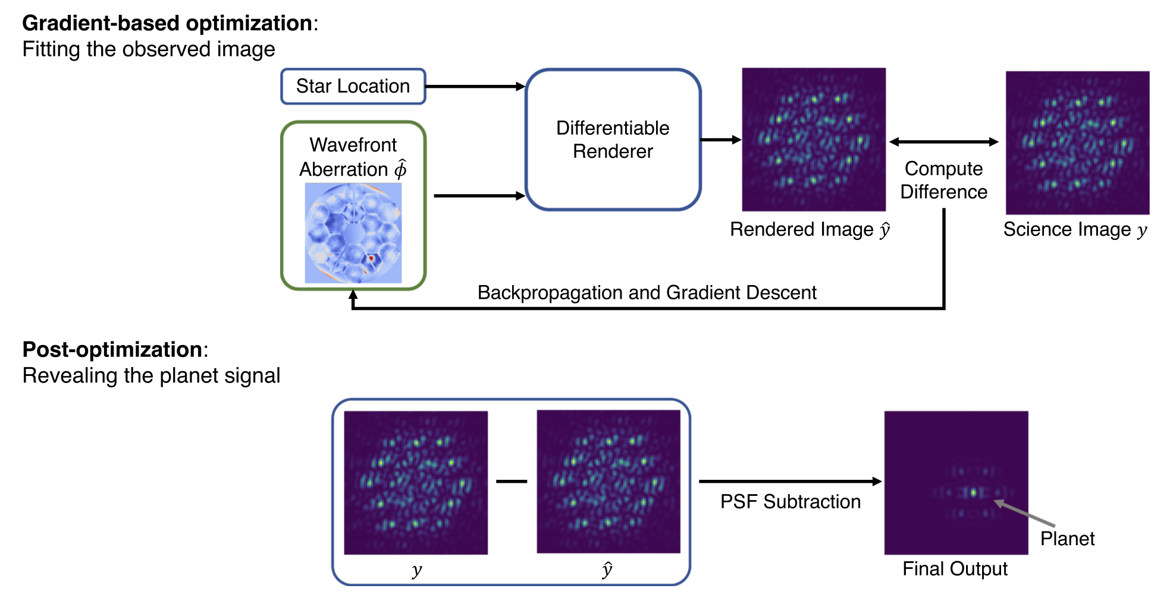
A differentiable forward model
Input: wavefront aberration + star position
Output: rendered star image / PSF

Slide 10
Optimization Pipeline
Start with the latest available wavefront measurement.
Render a star PSF from the current wavefront estimate.
Compare it with the observed science image using an L1 loss.
Backpropagate gradients to the wavefront map.
Update the wavefront estimate and repeat.
Subtract the refined star PSF.

Slide 11

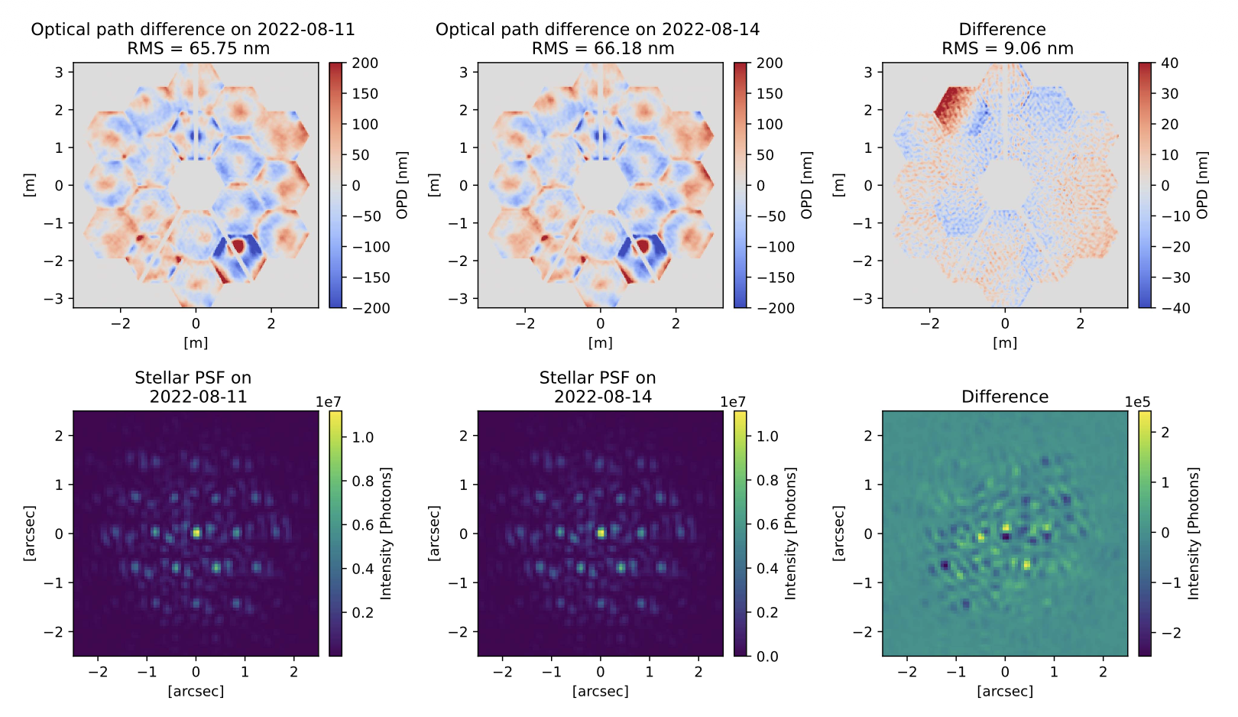
Simulation setup
Monochromatic point sources at 4.5 micrometers
Two real JWST wavefront measurements, 86 hours apart
The earlier measurement serves as the outdated estimate
Simulated shot noise and detector read noise
Adam optimizer, L1 loss, 1,000 iterations

Slide 12
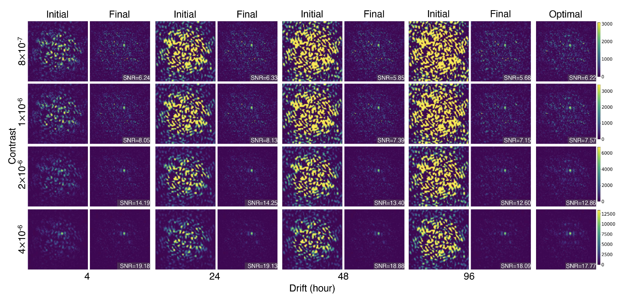
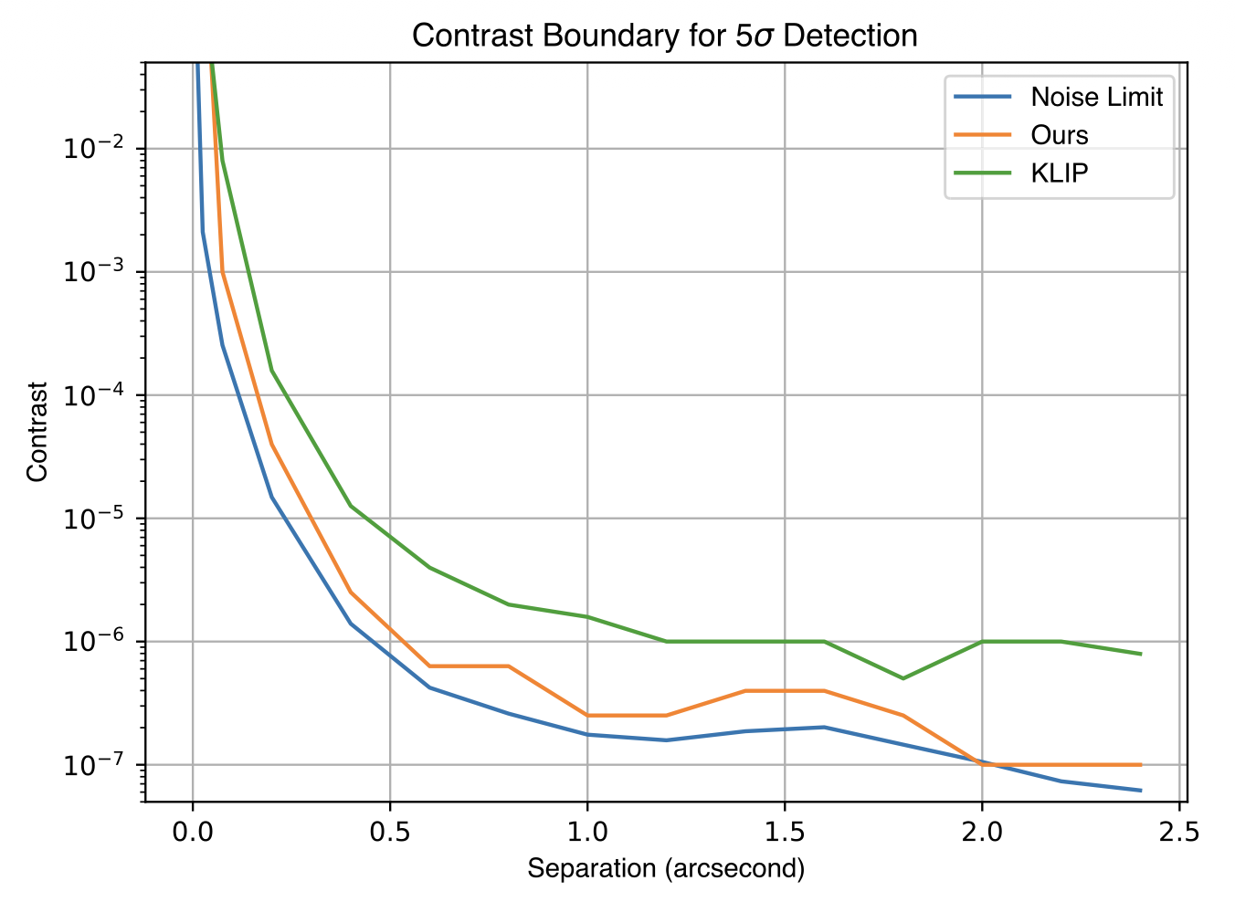
Main Findings: Better Planet Detection
The refined PSF improves detection
The method improves starlight subtraction across tested contrasts and wavefront drift levels.
Its 5σ detection boundary approaches the fundamental noise limit.
It outperforms KLIP in the reported simulations.
Planet detection becomes more difficult closer to the star.

Slide 13
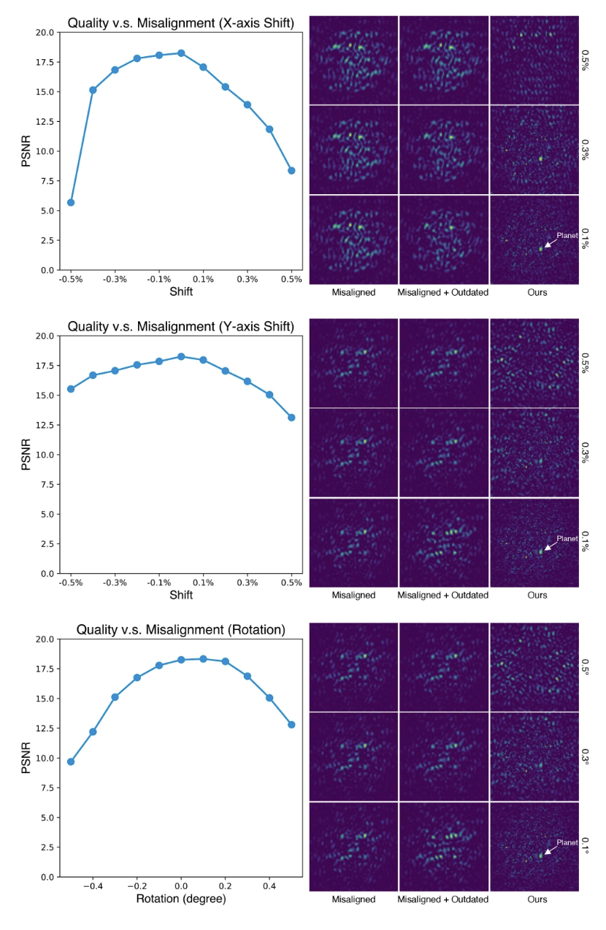
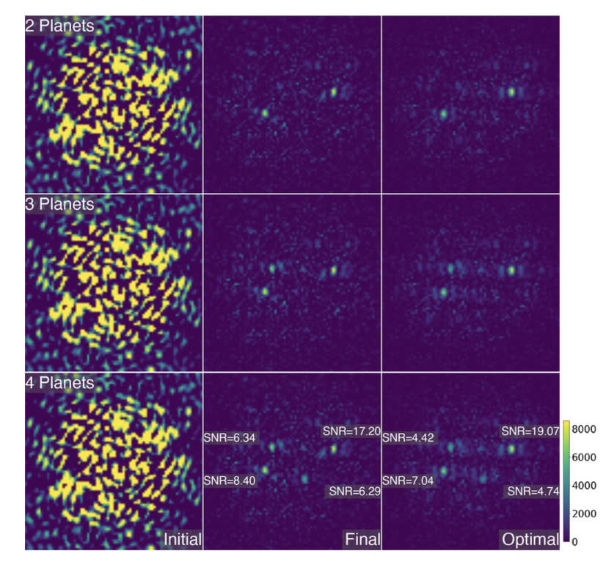
Robustness and broader findings
Works across different tested planet locations.
Reveal multiple planets without explicitly modeling them.
Additional image measurements can improve performance.
Moderate model mismatch can be partly compensated; severe mismatch still degrades results.

Slide 14
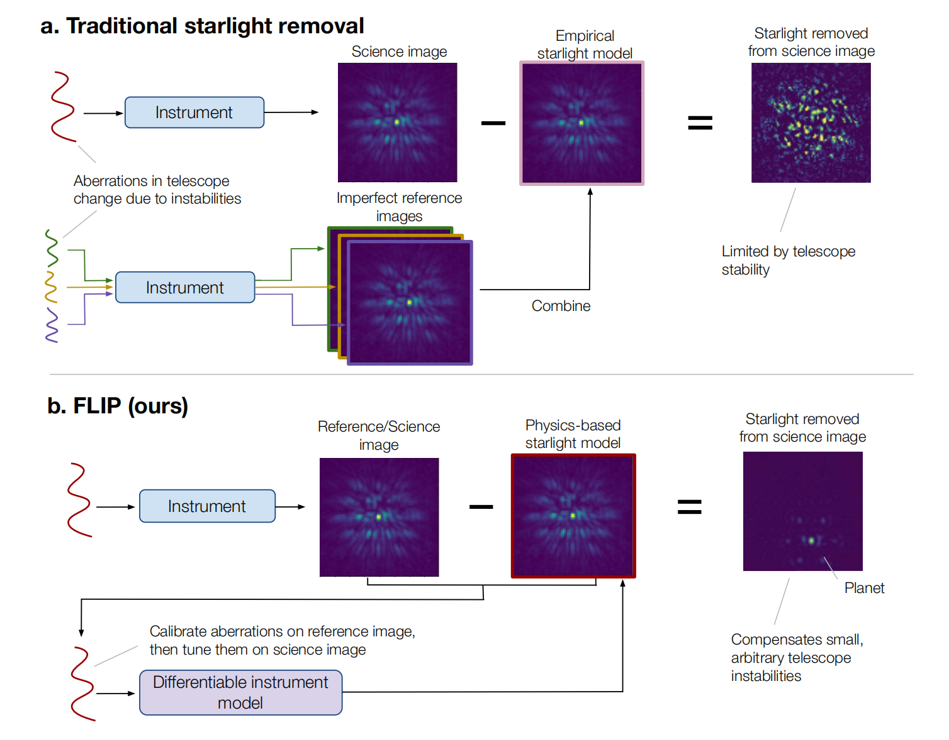
Imaging exoplanets below the telescope stability limit
Physics-based Learning for Imaging Planets (FLIP)：
From Simulated Imaging to Real JWST Observations
- Goal: Reveal faint exoplanets by accurately modeling and subtracting starlight.
- Challenge: Real observations differ from nominal optical models and reference images.
- Approach: Combine differentiable physical modeling with multi-stage optimization.
- Outcome: Improved detection sensitivity on real JWST/NIRCam observations.
Unpublished manuscript — internal group discussion only.

Slide 15
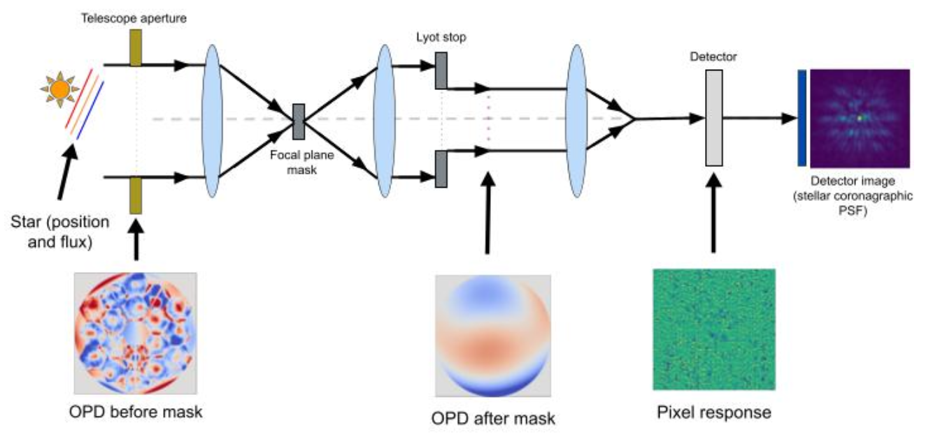
Imaging exoplanets below the telescope stability limit
Question: What does FLIP actually optimize? Why?
Optical Path Difference
Unpublished manuscript — internal group discussion only.

Slide 16
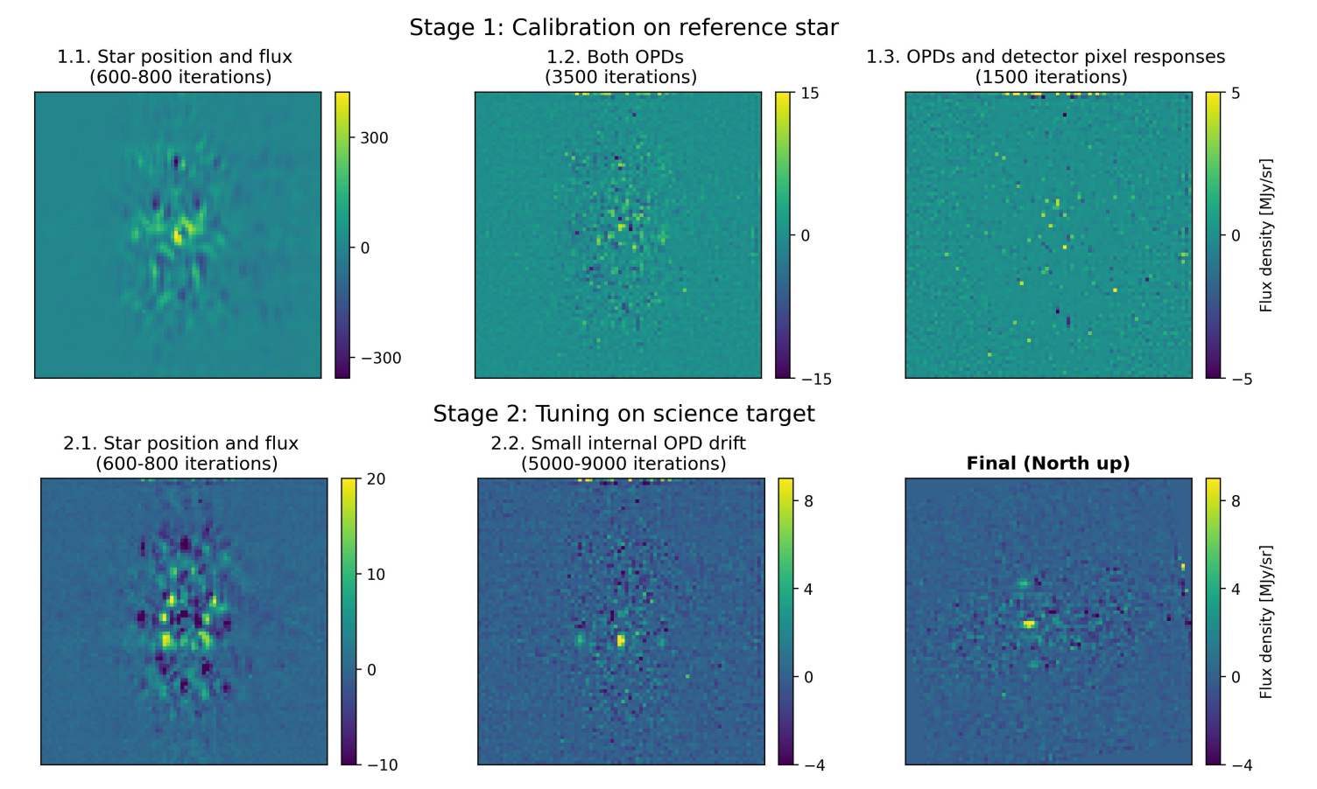
Imaging exoplanets below the telescope stability limit
Question: Greater model flexibility increases the risk of fitting and subtracting planet signals. How to deal with this?
Two optimization stages
Stage 1: Reference-Star Calibration
Fit stellar position & flux
↓
Optimize pre- and post-mask OPDs
↓
Jointly refine both OPDs & pixel responses
↓ Transfer the calibrated model
Stage 2: Science-Target Adaptation
Fit stellar position & flux
↓
Fine-tune post-mask OPD with a lower learning rate
Unpublished manuscript — internal group discussion only.

Slide 17
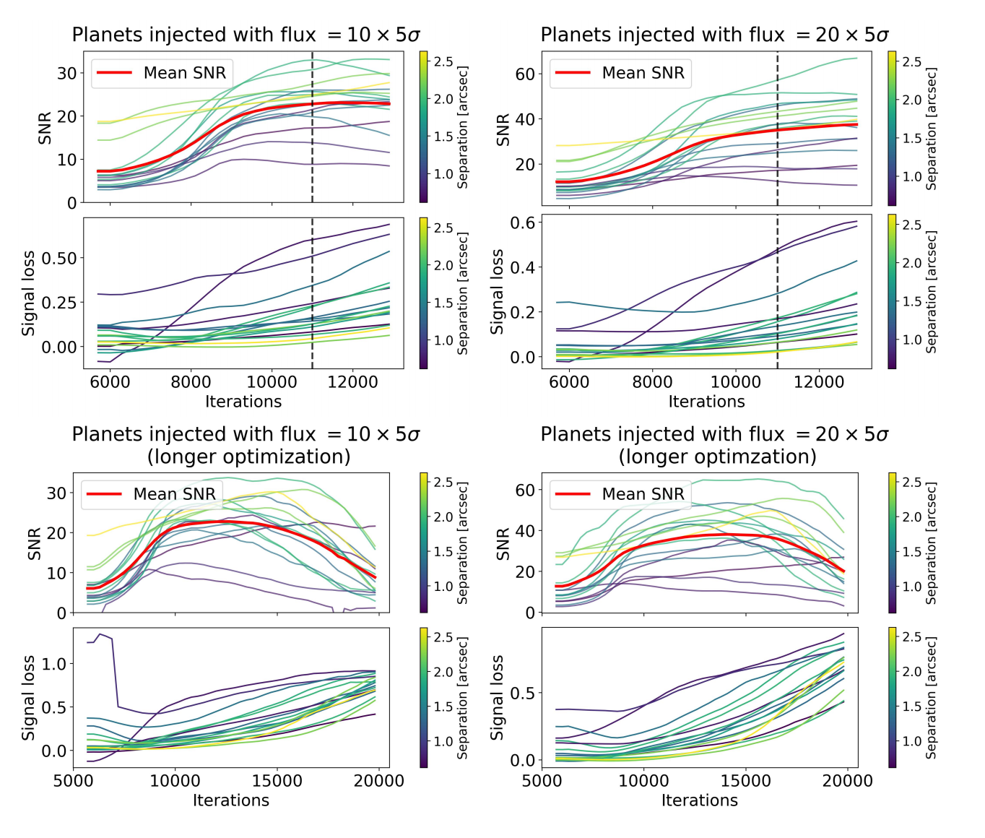
Imaging exoplanets below the telescope stability limit
Question:
When should we stop optimization?
Inject synthetic planets with known positions and fluxes.
Monitor their recovered SNR during optimization.
Prolonged optimization increases planet signal loss and can reduce SNR.
Stop near the SNR peak or plateau.
Unpublished manuscript — internal group discussion only.

Slide 18
Imaging exoplanets below the telescope stability limit
- Evaluation on Real JWST/NIRCam Data
Target | Filter | Evaluation
HIP 65426 | F444W | Known planet recovery
51 Eridani | F410M, F430M | Planet recovery in two wavelength bands
TYC 5899 | F444W | Synthetic planet injection and recovery
- Baseline: KLIP with reference and angular differential imaging.
- Metrics: Planet SNR and detection contrast curves.
- Corrections: Account for planet signal loss and coronagraph throughput.
Unpublished manuscript — internal group discussion only.

Slide 19
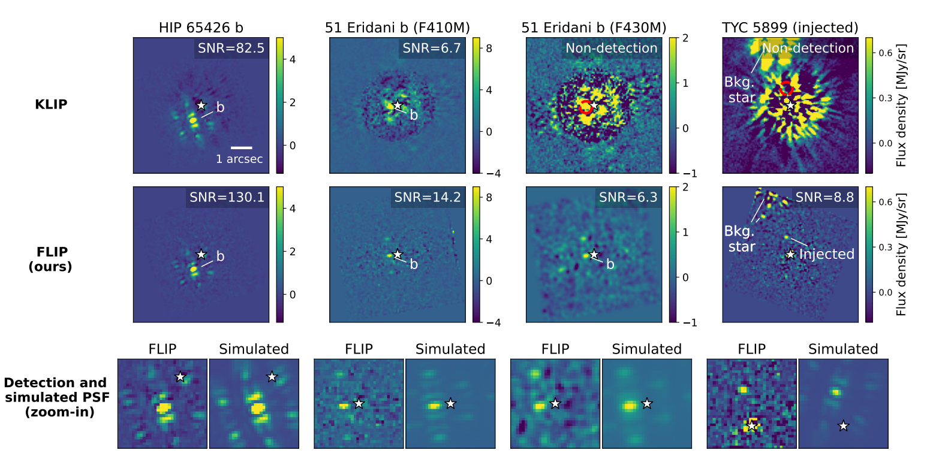
Imaging exoplanets below the telescope stability limit
Stellar PSF subtraction comparison between FLIP and standard method KLIP
Unpublished manuscript — internal group discussion only.

Slide 20
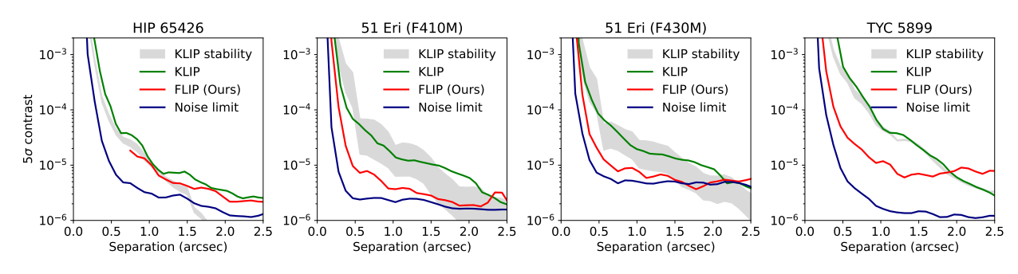
Imaging exoplanets below the telescope stability limit
Question: How faint a planet could we detect at each separation from the star?
Detection sensitivity curves for KLIP and FLIP on each on sky dataset.
Contrast curves show the detection limit at each angular separation.
FLIP achieves substantial sensitivity gains, especially near the star.
FLIP can outperform the estimated stability-limited KLIP sensitivity.
The fundamental noise limit has not yet been reached.
Unpublished manuscript — internal group discussion only.

Slide 21

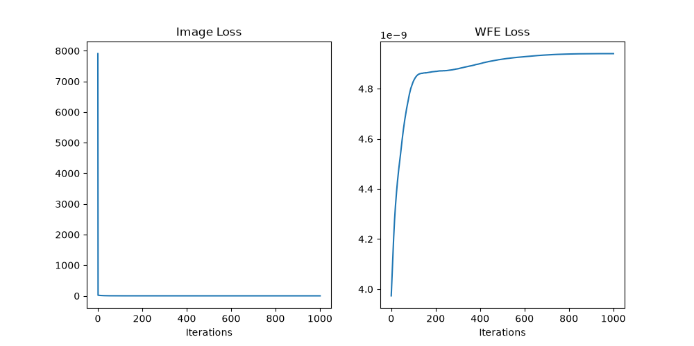

CODE: Simulated JWST Experiment
Planet/star contrast 10⁻⁶, one observation, 1,000-iteration setting
Initial residual
Residual at 1,000
Image fitting and WFE error
Residual PSNR: −16.11 to 17.73 dB
Residual SSIM: −0.002 to 0.897
Image fitting improves, while error relative to the true WFE increases.
Notes:
Source run: /Users/yuxinzhang/Desktop/simulation_20261016_031552/N1/1.0x10_-6_err_1.0_off_0.6_0.3_shot_noise_1.0. Selected original outputs: losses.png, vis_est_res_init.png, vis_est_res_1000.png. Metrics read directly from quality.npy: initial residual PSNR -16.1051724 dB, initial SSIM -0.0019793748; final residual PSNR 17.7330735 dB, final SSIM 0.897174401. The original code evaluates residual metrics on a 10x10 crop around the known planet location, relative to the reference residual including noise. These are image similarity metrics, not detection SNR. The PNG at iteration 1000 uses that loop's pre-update prediction, while final metrics are recomputed after the update. The original inclusive range runs indices 0 through 1000. The WFE error curve is an evaluation metric against the known ground truth and rises despite improved image fitting. Do not interpret the experiment as exact wavefront recovery. The script clips negative residuals and normalizes each PNG independently. Source implementation: https://github.com/brandonyfeng/EDDO/blob/main/run_JWST.py. Layout follows the white background and Arial typography of Week1_Presentation-2.pptx. Present this as a single simulated-data example, separate from the real JWST experiment.

Slide 22
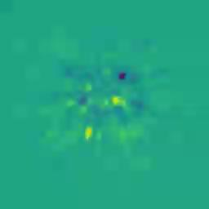

Real JWST Experiment: Optimization Progres
Stellar-image subtraction and primary-wavefront diagnostics
Residual Image During Optimization
Primary OPD Change Relative to Initialization

Slide 23
Next Step
Deepen the understanding of current model
Run the reference-star calibration and science-target fitting stages.
Compare stellar subtraction results across stages.
Evaluate the recovered planet signal in the HIP 65426 dataset.
Reproduce FLIP on Real Observations

Slide 24
THANK YOU

Slide 25
10/16 Notes
calibrate on reference star first, then finetune on science-target
bcs of using real data, FLIP has so many more parameters compared to EDDO
reference star image taken no more than a few hours before the science-target
stage 1 calibration gets model close enough so that we can use a smaller learning rate in stage 2 in order not to kill any possible planets
MIRI will have many more parameters
L1 loss more robust, will not care about small variations and loss from planet signal, L2 loss may completely erase planet signal

Slide 26
10/16 Todos
install and run submission branch of FLIP repo
should output leftmost image in figure 2 of paper (left of slide 19 and slide 22)
find which part in the code is related to NIRCam
  don’t need to understand whole code
figure out what we need to do switch out NIRCam for MIRI
(Added) run different configuration for FLIP
STPSF look at OPD for MIRI
look at pictures/3D models of JWST to understand what’s happening in diagram
try to tweak EDDO pipeline, moving the star/planet to other positions and see what happens to results

