Slide 1
10/26 Presentation
Yuxin, Zhengfei, Fangyue, Vivian

Slide 2
Outline
Introduce what have done last week + Todo from last week + EDDO demo (Vivian)
Optics (NIRCam -> MIRI) what changed inside the cam (Fangyue)
The code needed for NIRCam + how to switch to MIRI (Zhengfei)
DEMO (reproduce results) + Todo for next week (Yuxin)

Slide 3
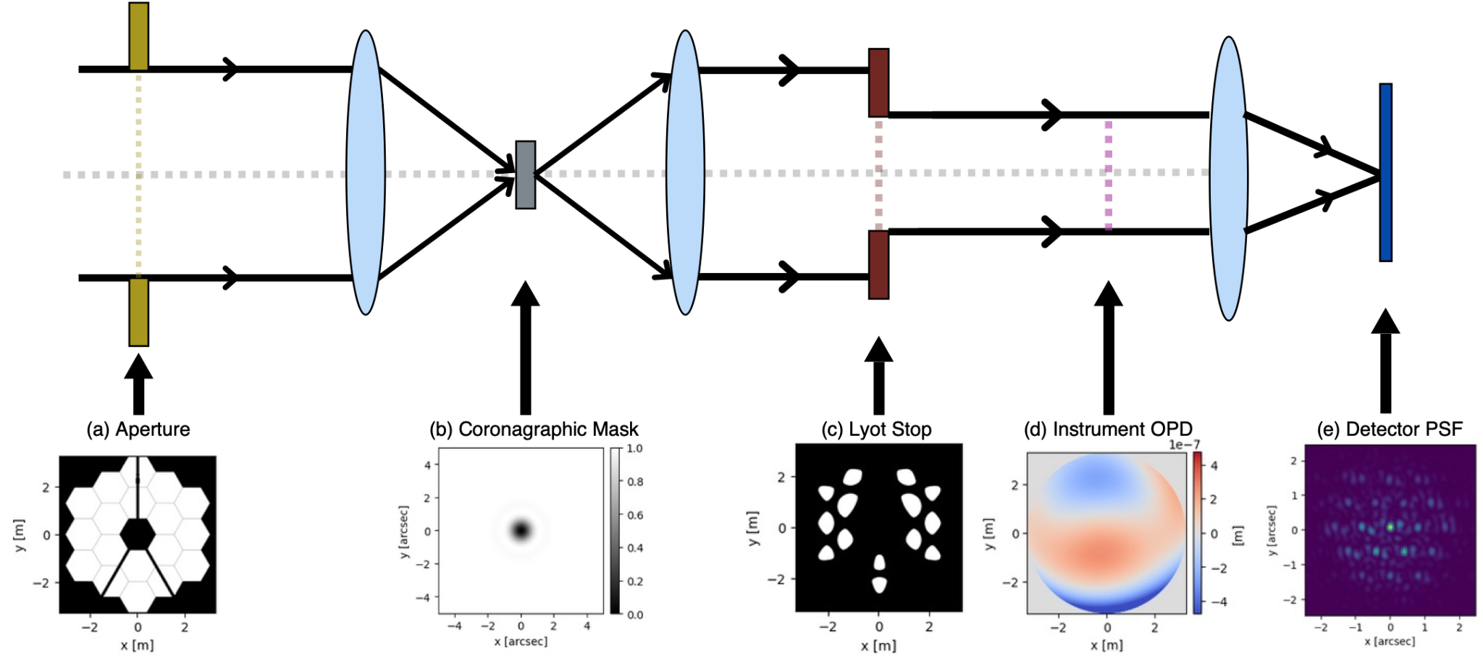
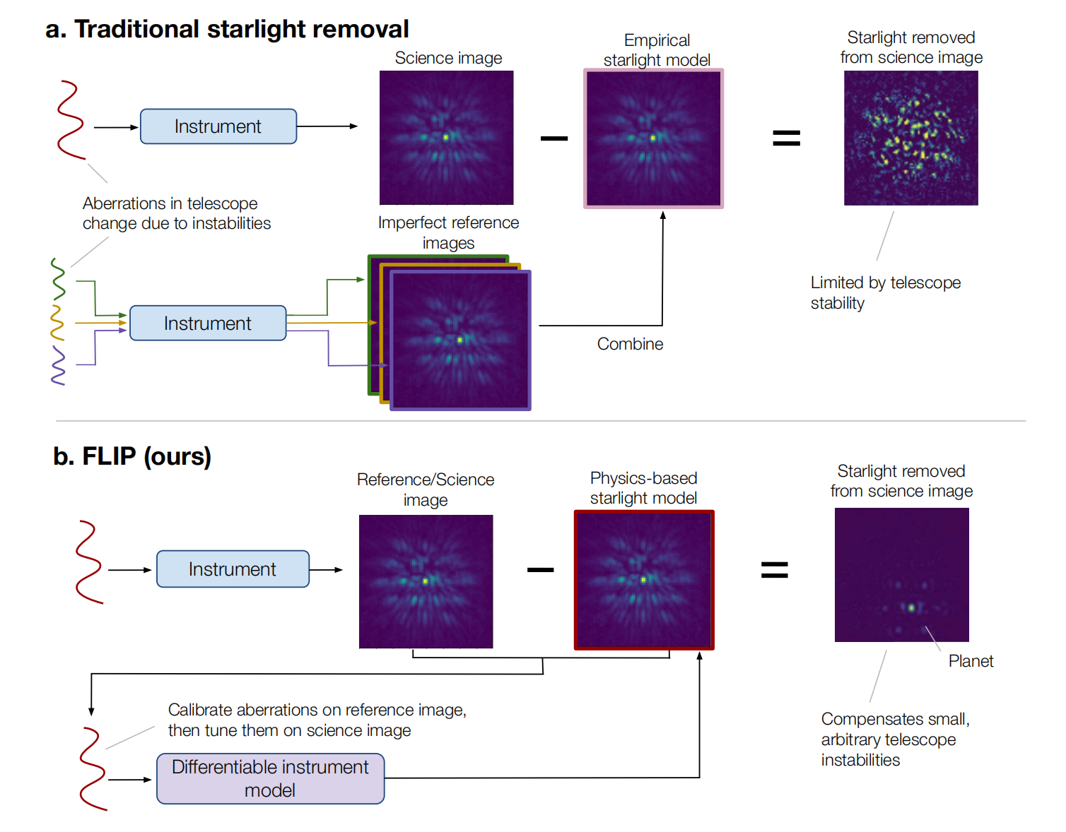
Overview
Last Week:
EDDO & FLIP papers
run EDDO demo code
This Week:
tweak EDDO pipeline
differences between NIRCam vs MIRI
run FLIP code

Slide 4



EDDO Simulation
Final Residual
(1000 iterations)
Ground Truth Residual (with noise)
Initial Residual

Slide 5
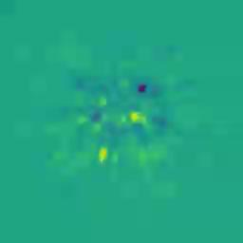



EDDO Real JWST Data - HIP 65426
Residual Change
Final Residual
(3000 iterations)
Initial Residual
OPD Change

Slide 6
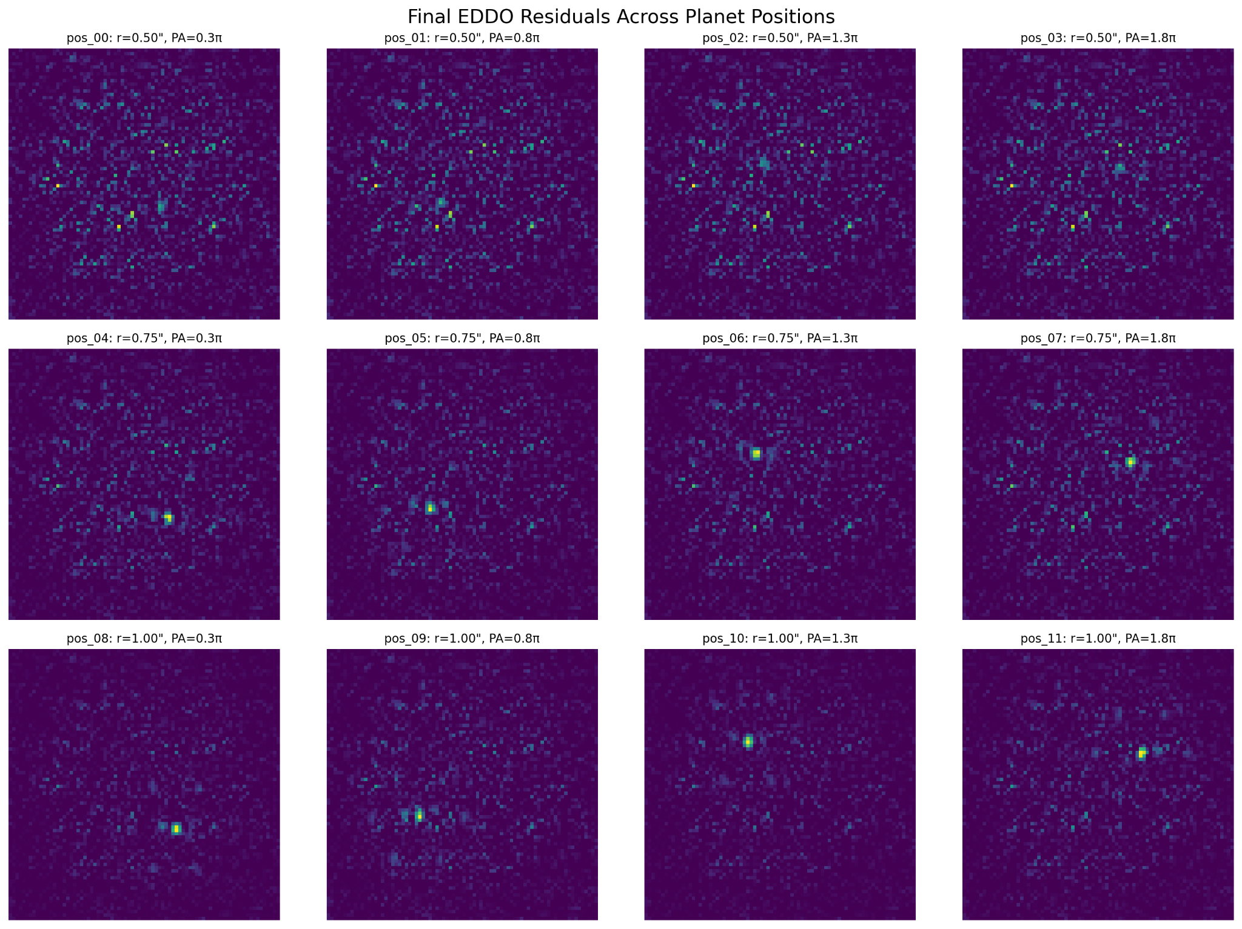
EDDO Experiments - Varying Planet Position
Planet-star separation:
  0.5, 0.75, 1.0 arcseconds
Position angle:
  0.3π, 0.8π, 1.3π, 1.8π radians

Slide 7
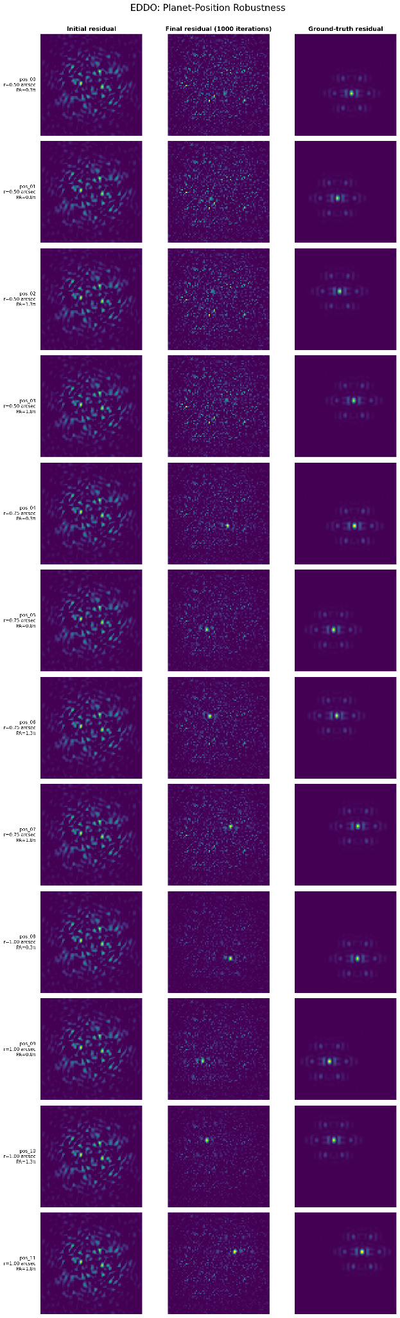
EDDO Experiments - Varying Planet Position

Slide 9



EDDO Experiments - Varying Star Position
x: 0.1 arcseconds
y: 0.1 arcseconds
x: 0.1 arcseconds
y: 0.1 arcseconds
No Offset
SNR: 0.66
SNR: 0.62
SNR: 0.59
SNR: 0.65

Slide 10
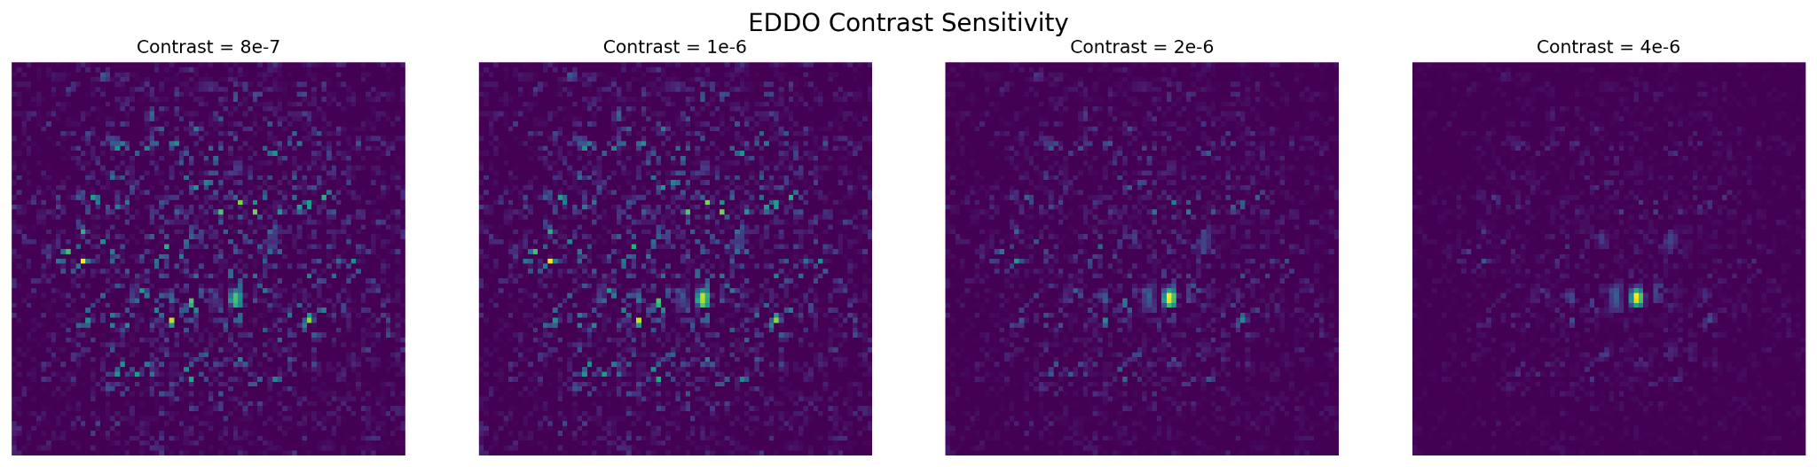
EDDO Experiments - Varying Contrast
Contrast:
  8e-7, 1e-6, 2e-6, 4e-6

Slide 11
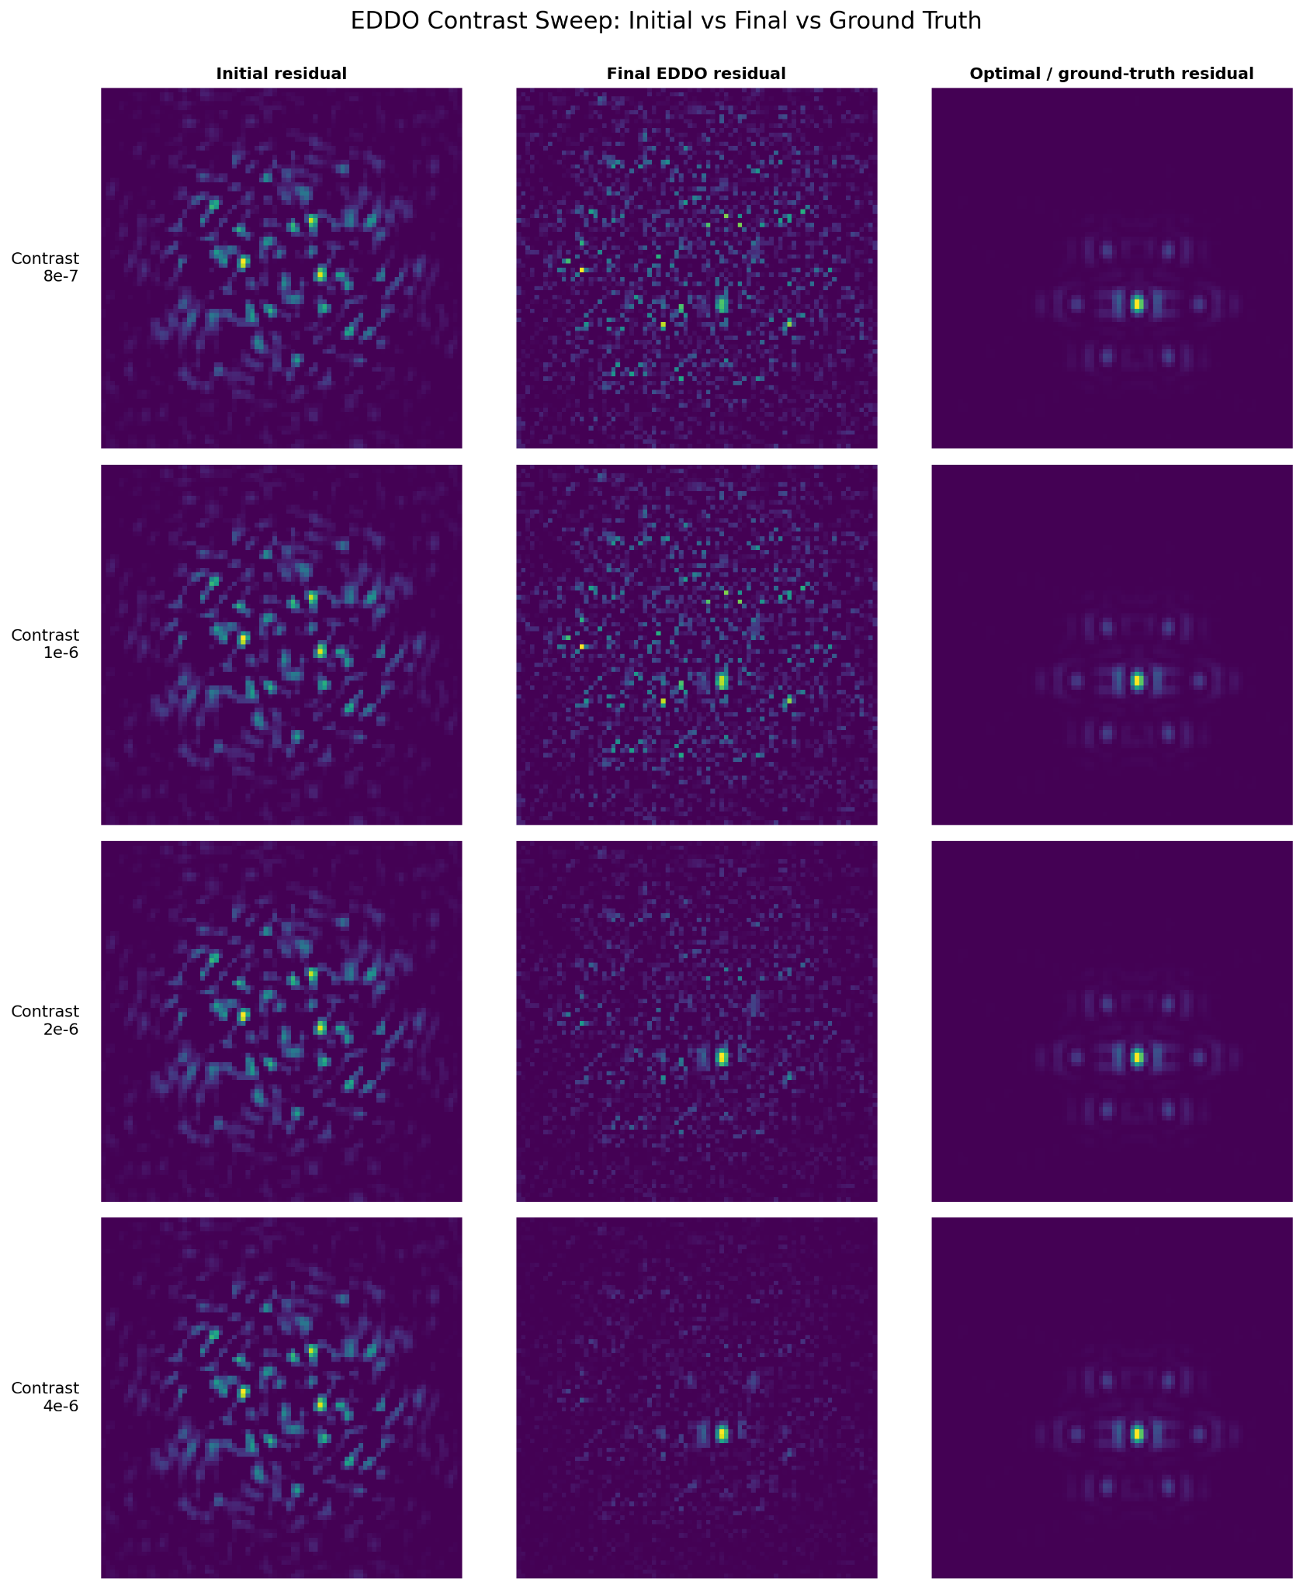
EDDO Experiments - Varying Contrast

Slide 12
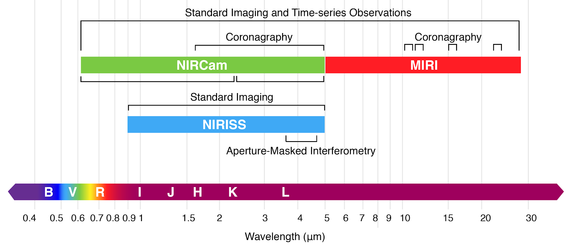
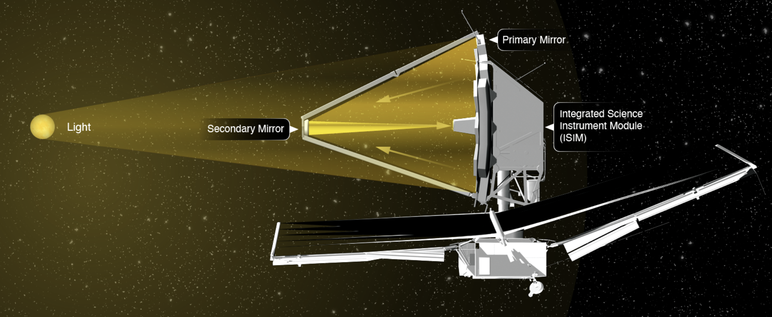
NIRCam vs. MIRI: Wavelength Coverage
NIRCam coronagraphy: approximately 1.82–5 μm
MIRI coronagraphy: approximately 10–23 μm
extend the optical modeling framework to MIRI
Different wavelength ranges require instrument-specific optical configurations and coronagraph designs.

Slide 13
What Changes Between NIRCam and MIRI?
OTE Entrance WFE (pre-mask OPD)
↓
Telescope Pupil
↓
Focal-Plane Mask (FPM)
↓
Lyot Stop
↓
Instrument Internal WFE
(post-mask OPD in the STPSF model)
↓
Detector
Can be retained
General optical propagation framework
Pre-mask and post-mask OPD representation
Needs MIRI-specific configuration
Focal-plane mask
Lyot stop and filter configuration

Slide 14
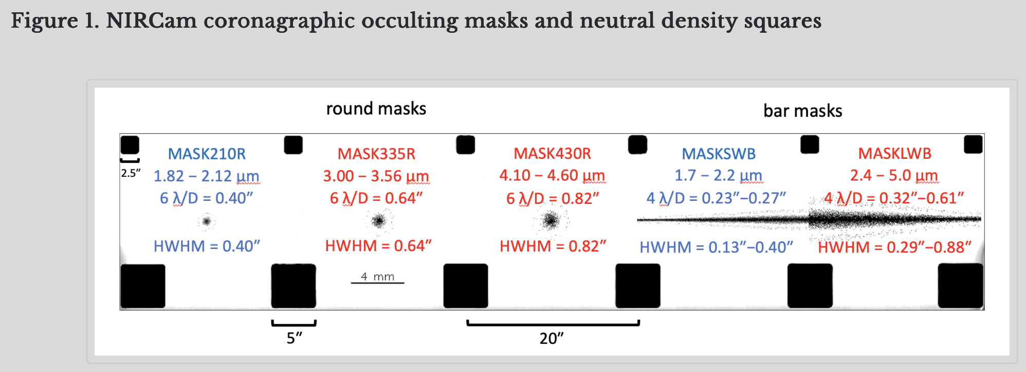
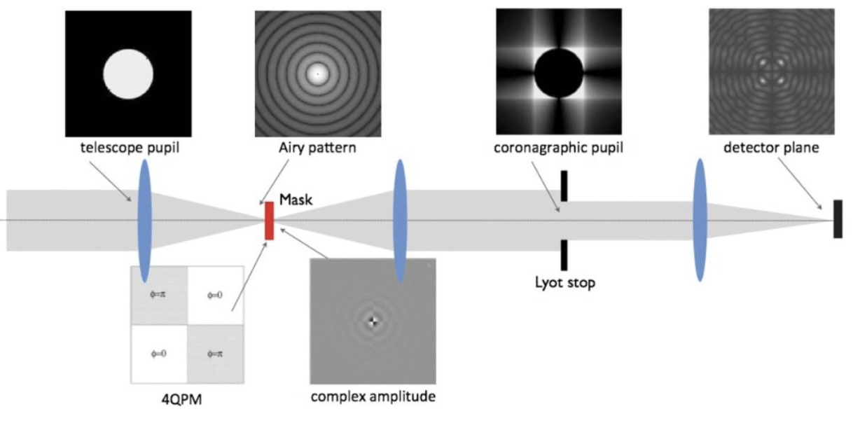
Difference: Focal Plane Masks
NIRCam
Round and bar-shaped occulting masks
Block light from a bright central source
MIRI
Three four-quadrant phase masks (4QPMs)
One classical Lyot coronagraph with a circular occulting spot
Different coronagraph designs for different wavelength bands

Slide 15
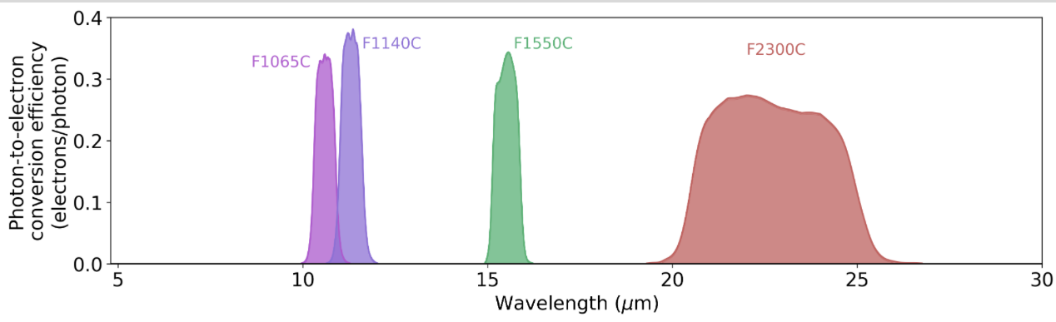
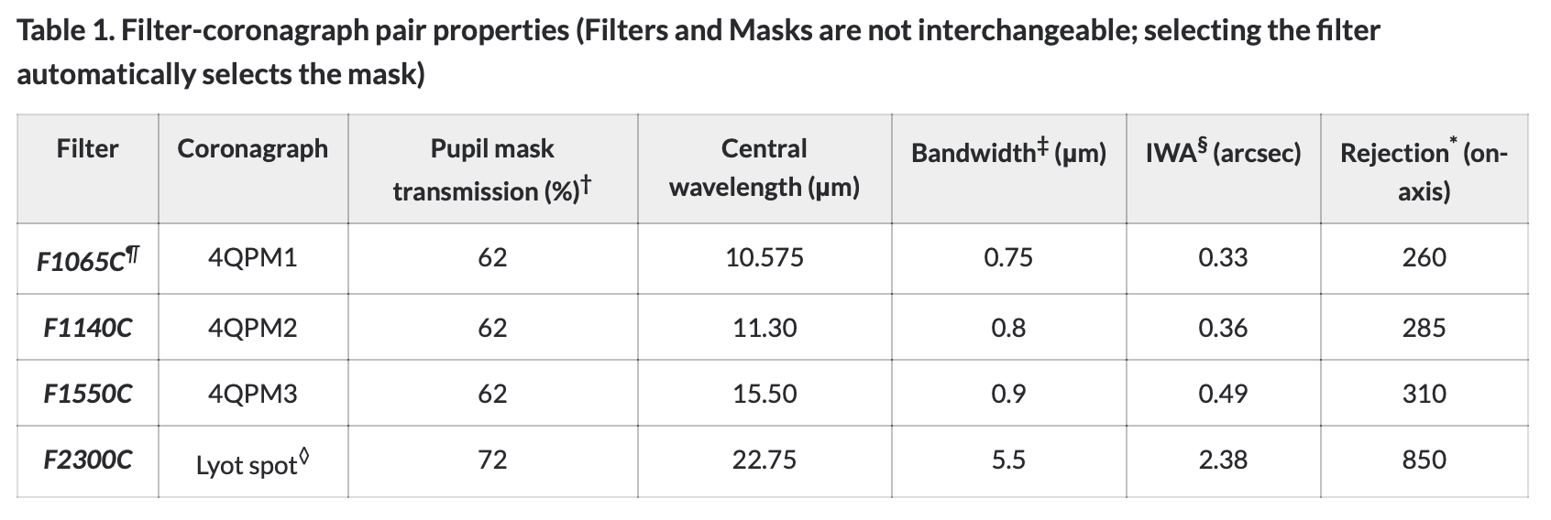
Filters and Lyot Stops
NIRCam: Occulting masks are paired with compatible Lyot stops.
MIRI: Each coronagraph has a corresponding filter configuration.
The optical model must match the selected instrument mode and coronagraph.

Slide 16
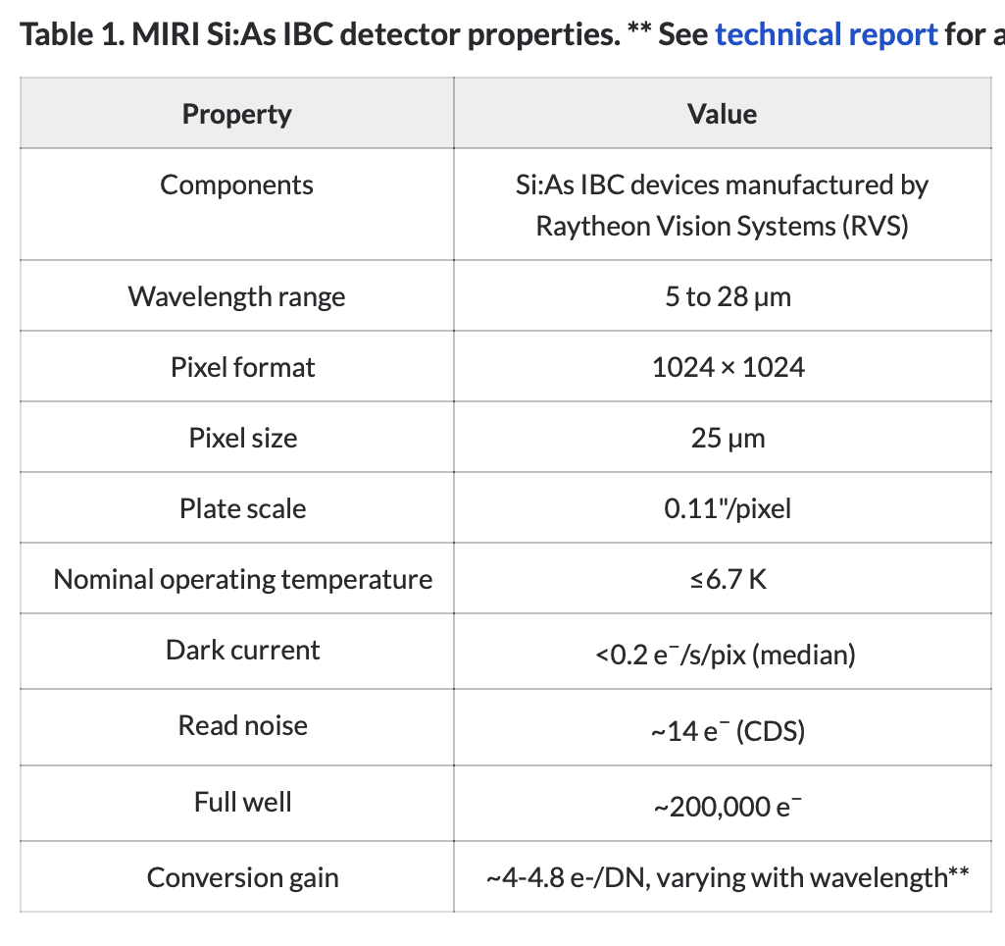
What Must Be Matched for MIRI?
• MIRI focal-plane mask and Lyot stop
• MIRI filter–coronagraph pairing
• OTE OPD and instrument-internal WFE inputs
• MIRI wavelength samples and weights
• Detector sampling and calibration

Slide 17
The code needed for NIRCam + how to switch to MIRI
FLIP Code Structure
https://github.com/rferrerc/pyflip/tree/submission
Files | Role
run_JWST_test_HIP65426.sh | Launches the demo with data paths and experiment settings.
run_FLIP.py | Sets up the model, runs optimization, and saves results.
dl_utils.py | Loads optical arrays and provides evaluation utilities.
propagation_classes.py | Implements optical propagation and PSF generation.
model_classes.py | Defines learnable corrections to the physical model.

Slide 18
FLIP Prediction and MIRI Adaptation
PointPropagate.forward() in propagation_classes.py
Step | Current implementation | Adaptation to MIRI
Incoming field | Stellar position and entrance OPD | Keep the method. Update observation inputs.
Telescope pupil | JWST pupil array | Keep the geometry. Verify sampling and orientation.
Mask and Lyot stop | MASK335R and NIRCam stop | Replace the focal-plane mask and Lyot stop with the matching MIRI configuration. Verify phase transmission.
Internal aberrations | NIRCam internal OPD | Replace OPD data. Keep the phase calculation.
Field to intensity | Squared field magnitude | Keep the same calculation.
Bandpass and detector | Current weights and detector settings | Update MIRI spectral weights, sampling, response, and calibration.
Where are these settings defined in the current code?
The optical inputs come from the data loader, while the main script sets up the observation and model.

Slide 19
NIRCam Configuration in FLIP
dl_utils.py
load_data(): loads precomputed optical arrays.
run_FLIP.py
Model and observation setup
- Pixel scale and sampling parameters
- Focal-plane mask tensor type
- Observation files and image cropping
- Flux scaling and calibration
Variable | Physical meaning
aperture | Telescope pupil transmission
lyot | Lyot stop transmission
fpm | Focal-plane mask transmission
nircam_opd | Instrument-internal optical path difference
wlens_weights | Wavelength samples and weights
MIRI Adaptation
Change above settings.
Verify the mask transmission data type.
MIRI Adaptation
Load the matching MIRI optical arrays.
Verify the pupil sampling and orientations.

Slide 20
Next Steps and Validation
Reproduce the current NIRCam demo.
Select one MIRI mode and prepare matching optical inputs.
Modify the code for MIRI and run a first test.
Compare predicted PSFs with a matching STPSF simulation.
Check PSF scale, structure, and mask alignment.
Check how much starlight is suppressed and how much planet light passes through the system. (Our goal is to reduce the starlight while preserving the faint planet signal!)

Slide 21

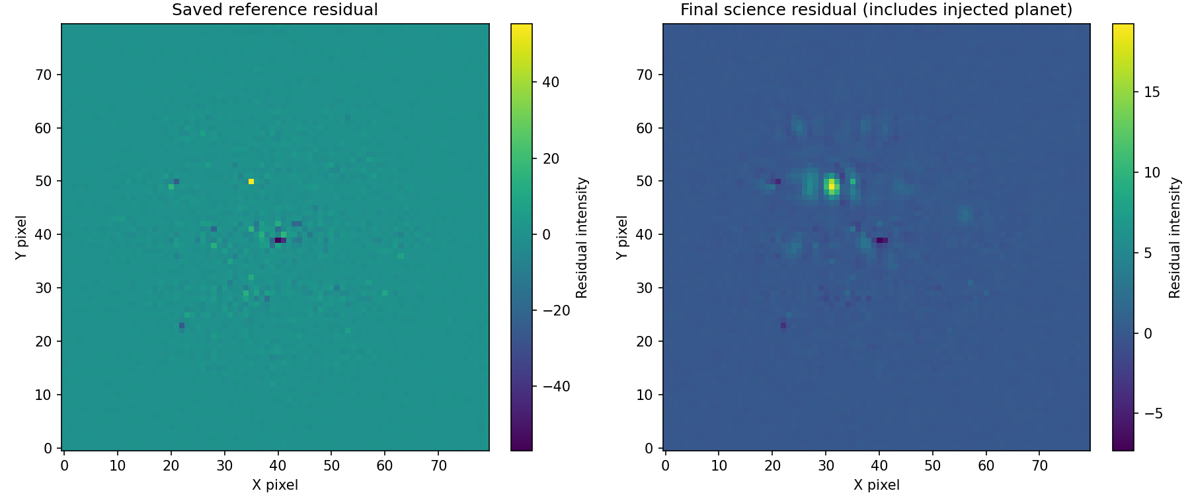
FLIP Reproduction for HIP 65426 b
Reference-star calibration
HIP 68245 observation − simulated star image
Before calibration
Saved calibration result
Calibration
Iteration 0
Iteration 3,000
Match the reference star
Position, flux, and optics
Target-Fitting
Carry over the model
Fit the science target
Diagnostic
Measure planet recovery
Compare signal with noise
Saved reference: iteration 3,000. Calibration continues to 5,499.

Slide 22


FLIP Reproduction for HIP 65426 b
Science-target fitting
HIP 65426 + injected planet − updated star model
Calibration
Iteration 6,000
Iteration 9,000
Iteration 11,000
Match the reference star
Position, flux, and optics
Target-Fitting
65426b
Injected
Carry over the model
Fit the science target
Early science fitting
Later science fitting
Diagnostic
Measure planet recovery
Compare signal with noise
The residual includes HIP 65426 b and the injected planet.

Slide 23
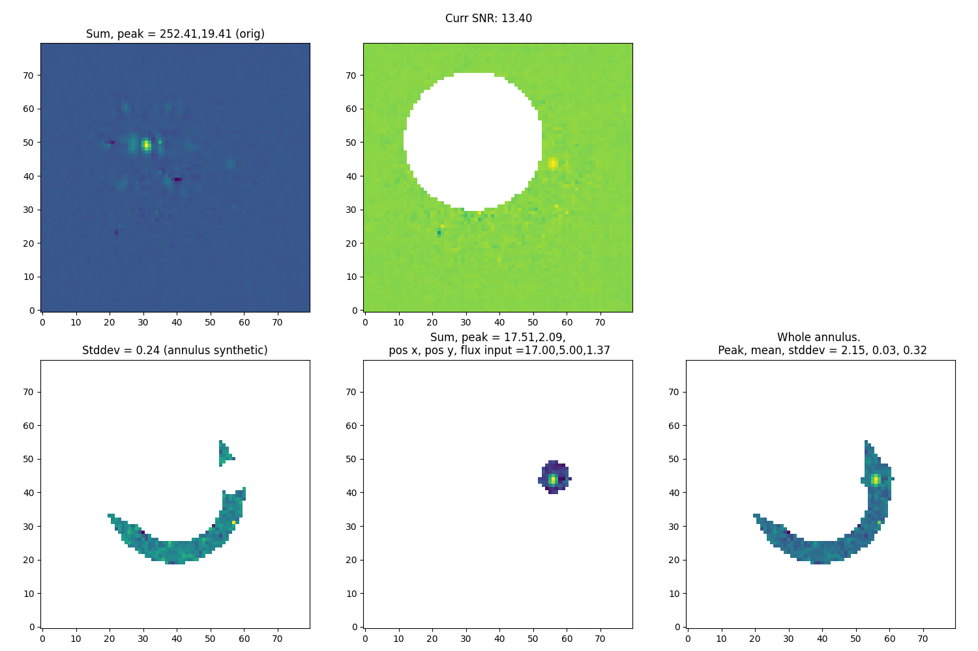
FLIP Reproduction for HIP 65426 b
Planet-recovery diagnostic at iteration 10,800
The last saved diagnostic before the 11,000-iteration stop
Calibration
Match the reference star
Position, flux, and optics
Target-Fitting
Carry over the model
Fit the science target
Diagnostic
Measure planet recovery
Compare signal with noise

Slide 24
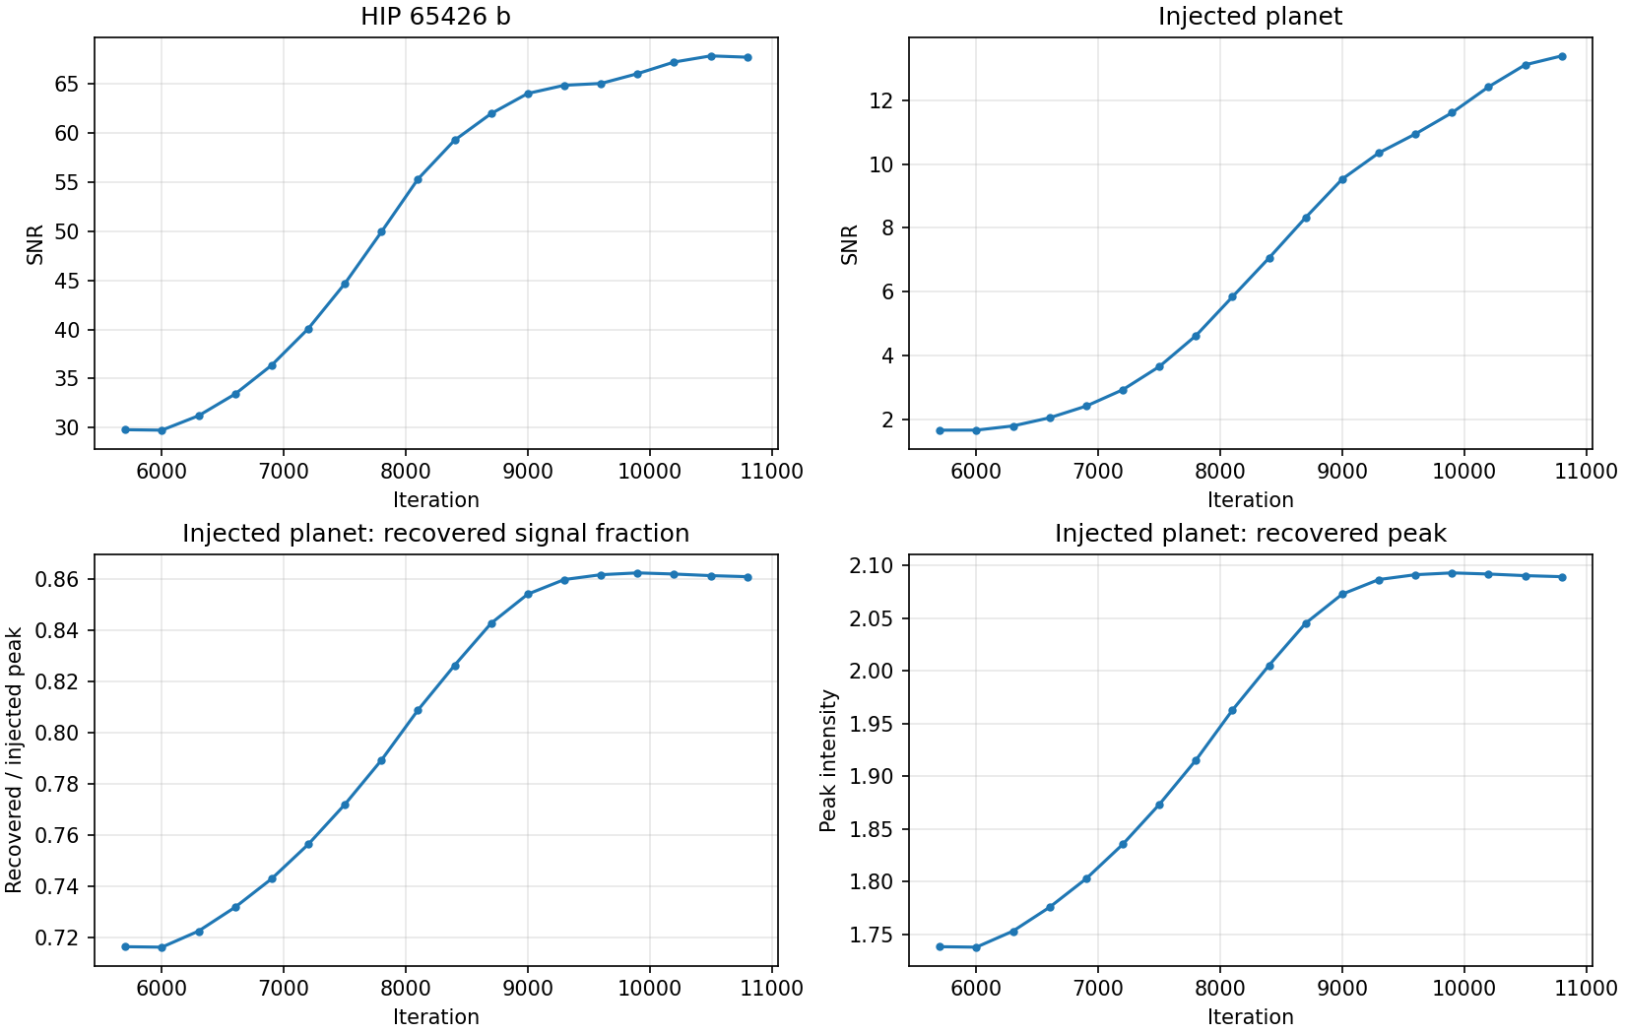
Iteration metrics
18 saved samples from iteration 5,700 to 10,800
Max SNR with value about 68

Slide 25
10/26 Todos
Investigate the SNR gap and try to recover
  Reproduced result (67.7) vs reported value in paper (130.1)
Run the other three cases in the paper
  51 Eridani b (F410M) / 51 Eridani b (F430M) / TYC 5899 (injected)
  Reproduce the value reported in the paper
Deepen understanding of MIRI coronagraphy & code
Begin adapting the code for MIRI

Slide 26
10/26 Todos
get target image from Rodrigo to try to reproduce the MIRI results
figure out specifically what we need to change
diagrams/visualizations of what is happening
  changing the MIRI OPD after the mask
  NIRCam OPD vs MIRI OPD
  pixel size difference

