Slide 1
10/30 Presentation
Yuxin, Zhengfei, Fangyue, Vivian

Slide 2
Outline
Completed:
PSF (NIRCam (STPSF) VS NIRCam (FLIP))
PSF (MIRI (STPSF))
PSF (MIRI (HIP 68425+HIP 65426))
Todo:
PSF (MIRI (FLIP))

Slide 3
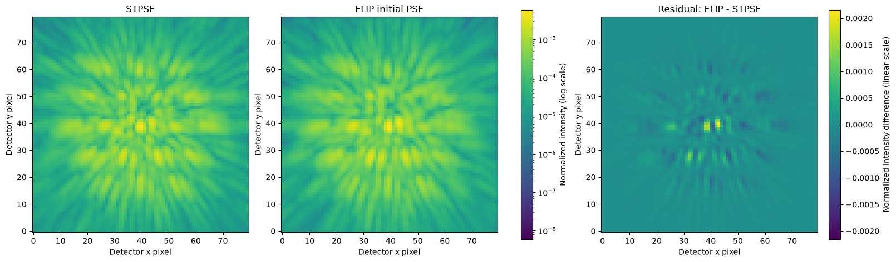
FLIP and STPSF PSF comparison
NIRCam F444W with MASK335R and CIRCLYOT
21 wavelength samples 1024 x 1024 input grid 80 × 80 detector pixels 2× oversampling
PSF shape similarity r = 0.883. A structured residual remains.
PSFs: unit total intensity and shared log scale. Residual: FLIP − STPSF on a linear scale.

Slide 4
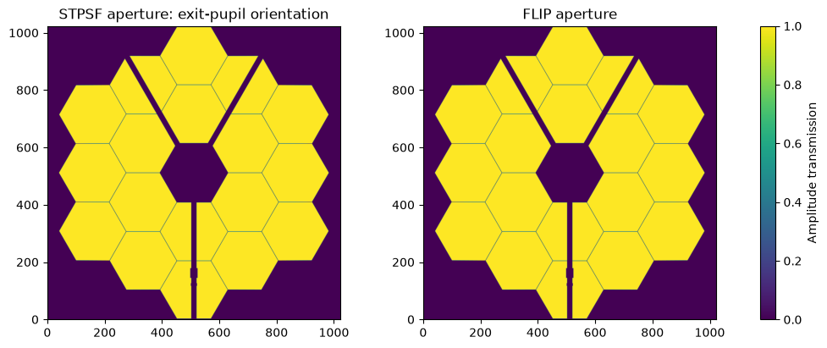
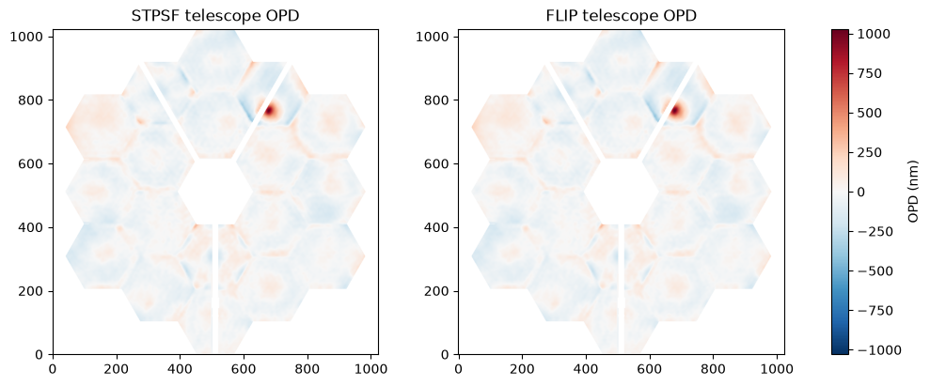
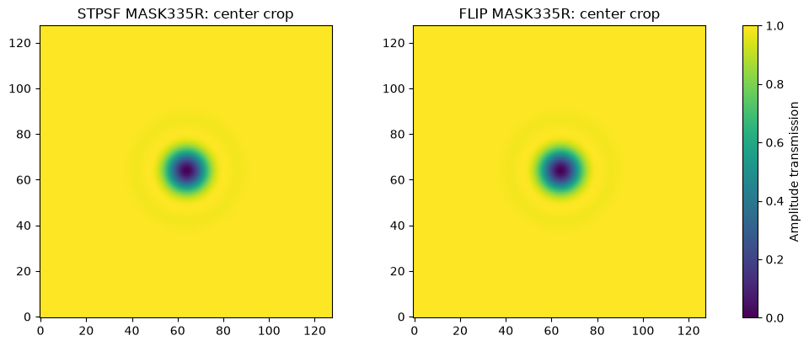
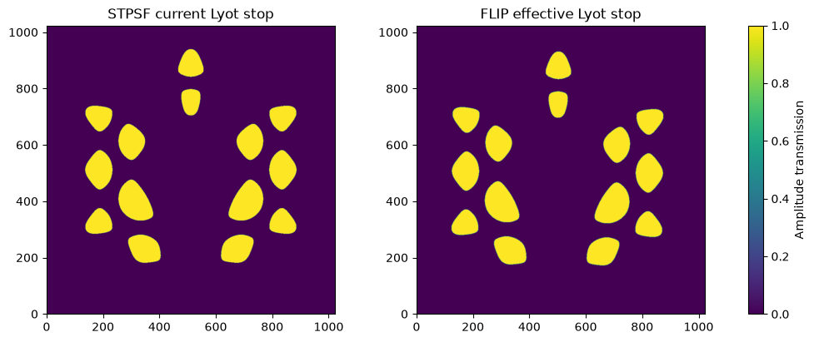
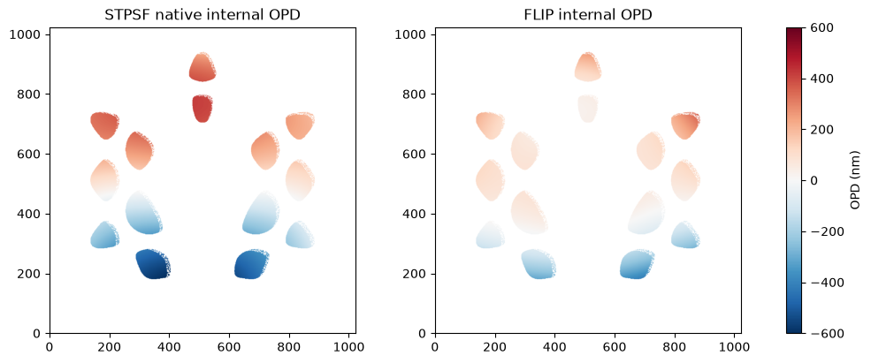
Optical component checks
Aperture
Telescope OPD
Focal-plane mask
Shape similarity r = 1.000
Shape similarity r = 1.000
Shape similarity r = 1.000
Lyot stop (CIRCLYOT)
Internal OPD at 4.455 μm
Shape similarity r = 0.799
Shape similarity r = 0.817
Pearson correlation r: 1 means the same pattern. Values round to three decimals.

Slide 5
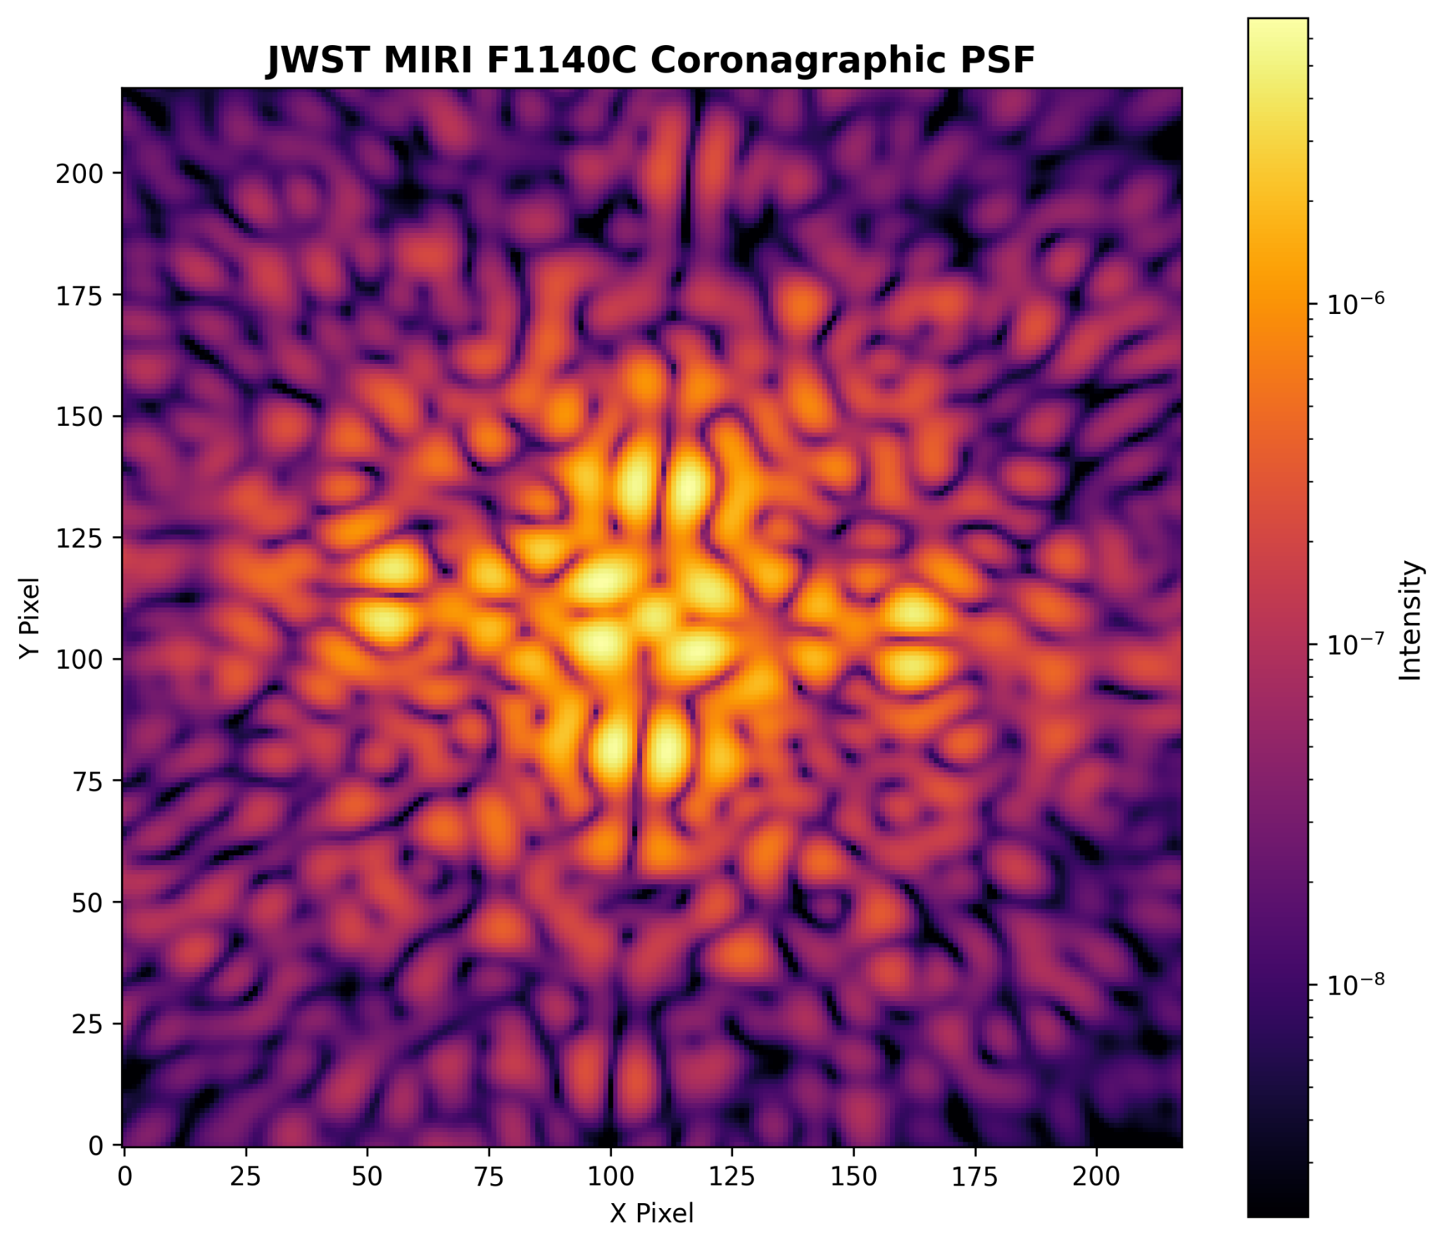
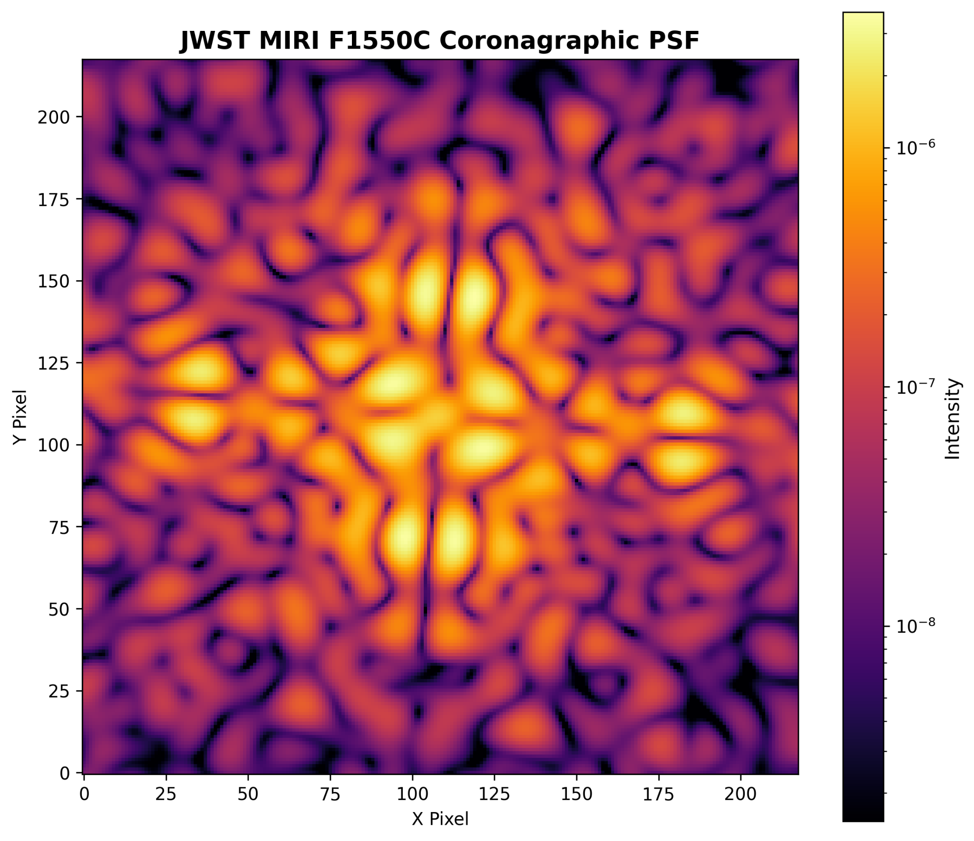
Simulating MIRI PSF with STPSF
Filter: F1140C
Image mask: FQPM1140
Pupil mask: MASKFQPM
Filter: F1550C
Image mask: FQPM1550
Pupil mask: MASKFQPM

Slide 6
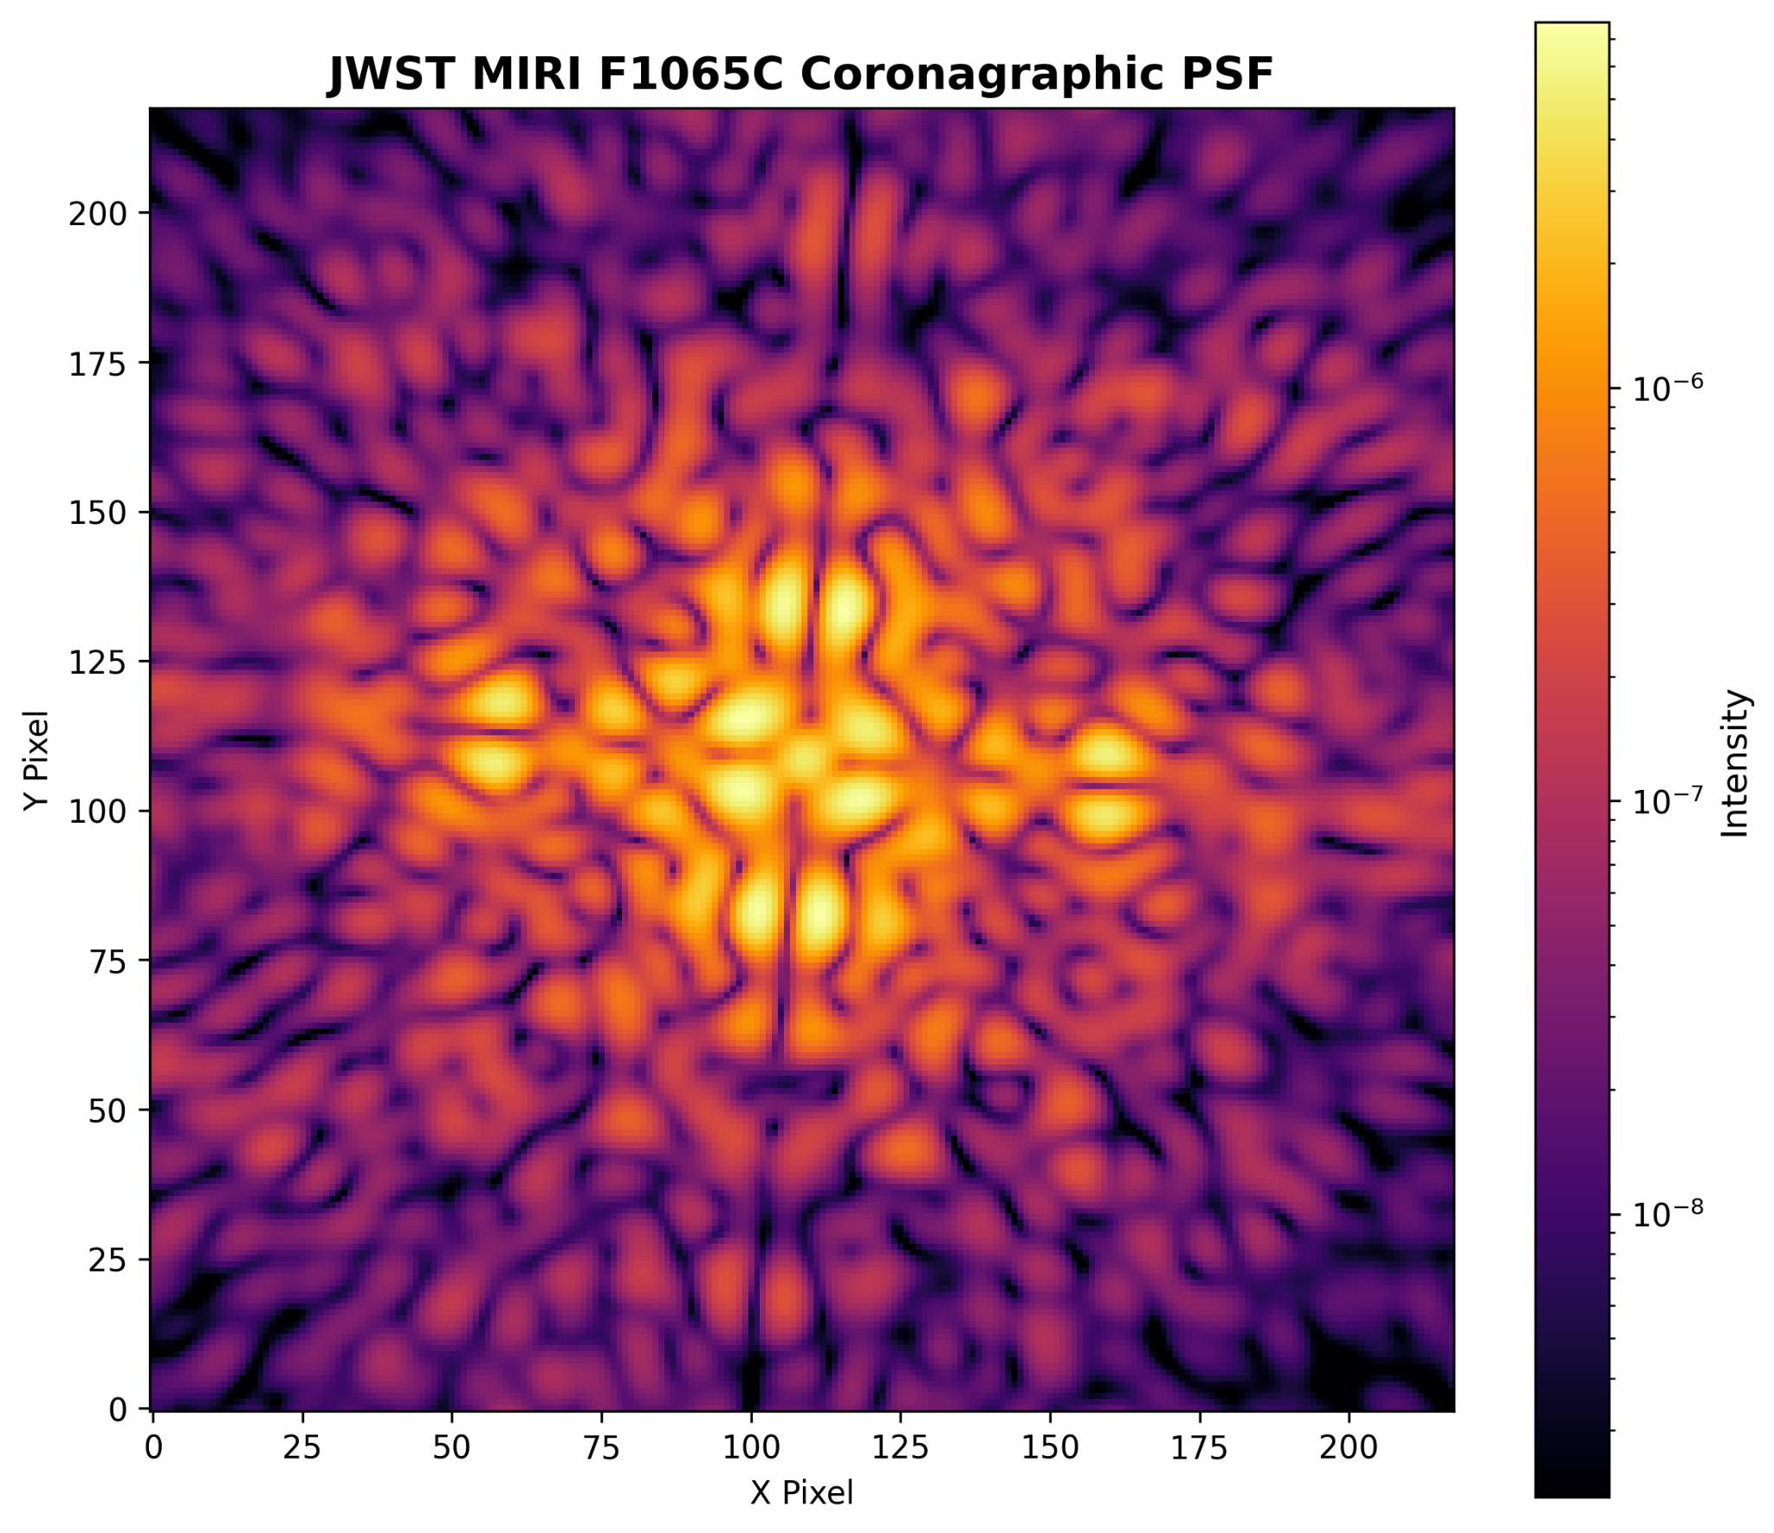
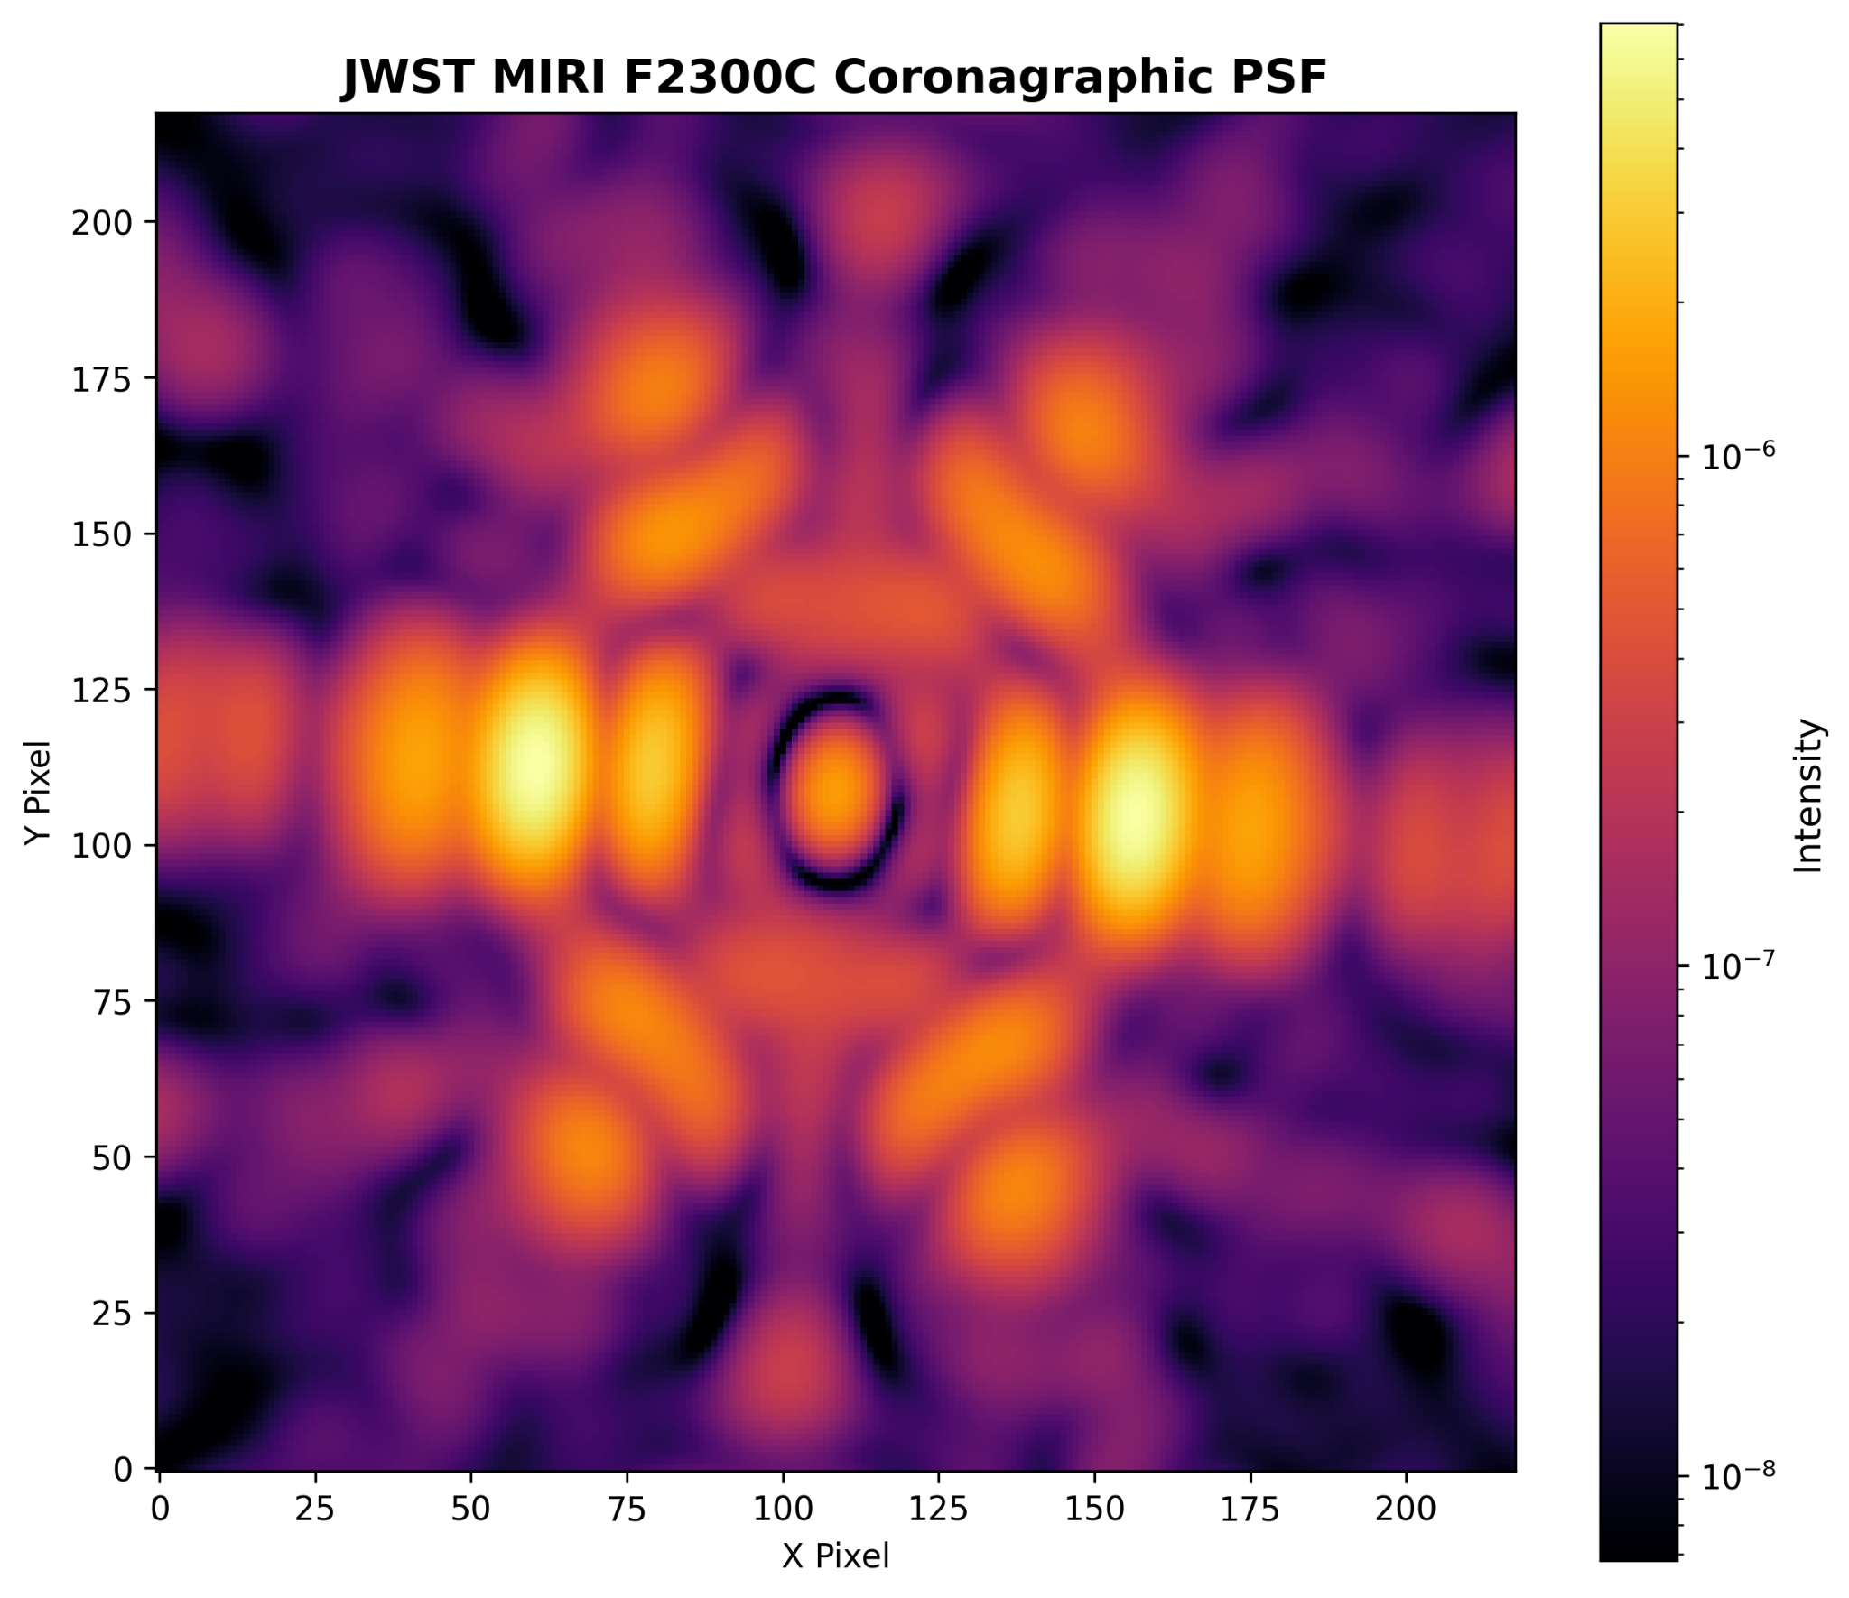
Simulating MIRI PSF with STPSF
Filter: F1065C
Image mask: FQPM1065
Pupil mask: MASKFQPM
Filter: F2300C
Image mask: LYOT2300
Pupil mask: MASKLYOT

Slide 7
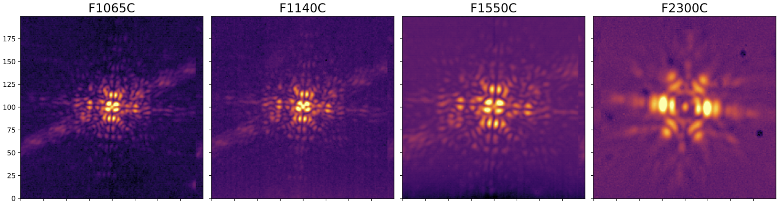
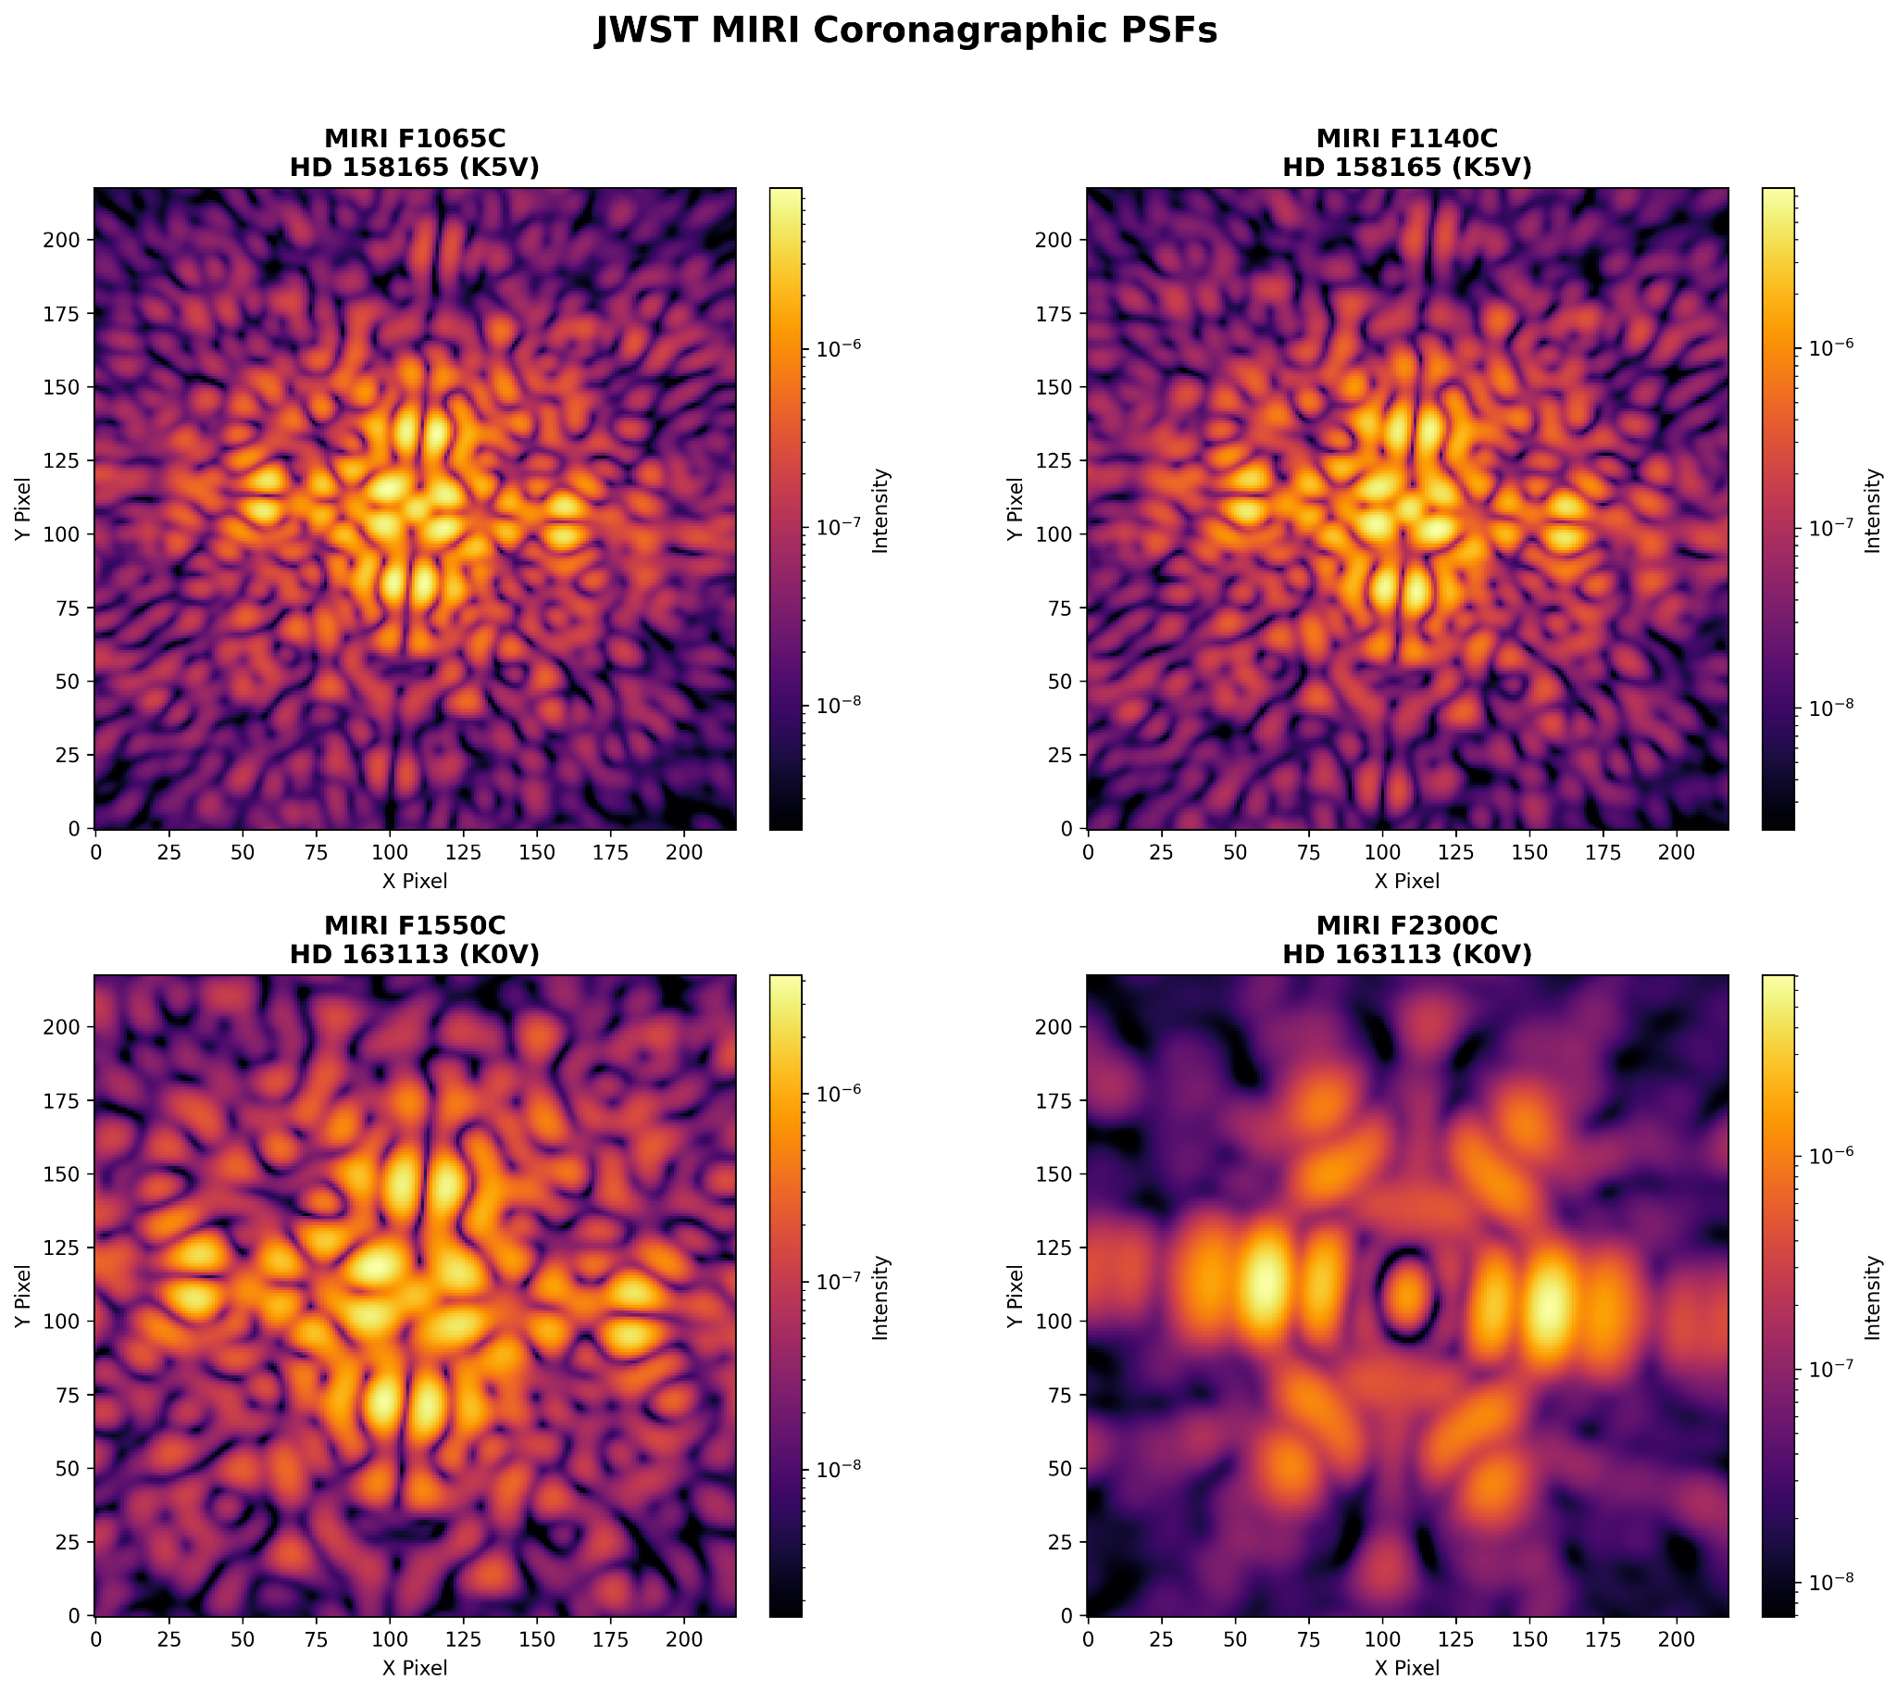
Simulating MIRI PSF with STPSF
Real Observations
(Boccaletti et al., 2022)
STPSF Simulation
HD 158165 (K5V)
HD 163113 (K0V)

Slide 8
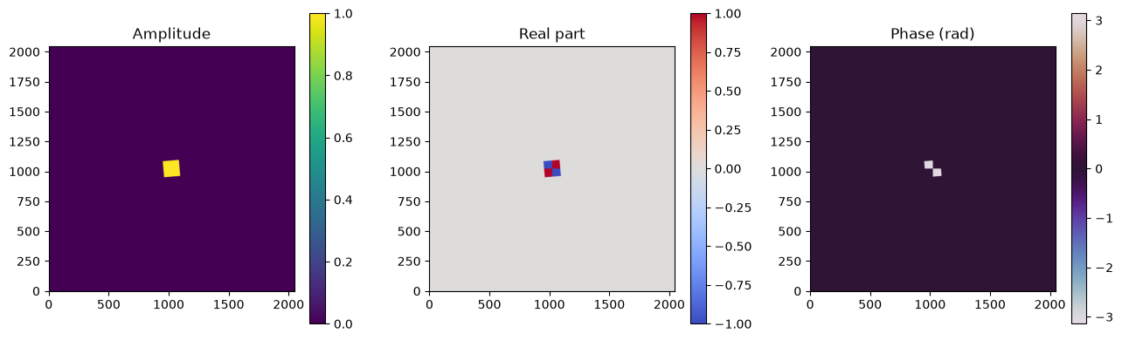
STPSF MIRI F1140C coronagraph mask
Filter: F1140C
Image mask: FQPM1140
Pupil mask / Lyot stop: MASKFQPM
Monochromatic wavelength: 11.3169 μm
Complex transmission: amplitude, real part, and phase

Slide 9
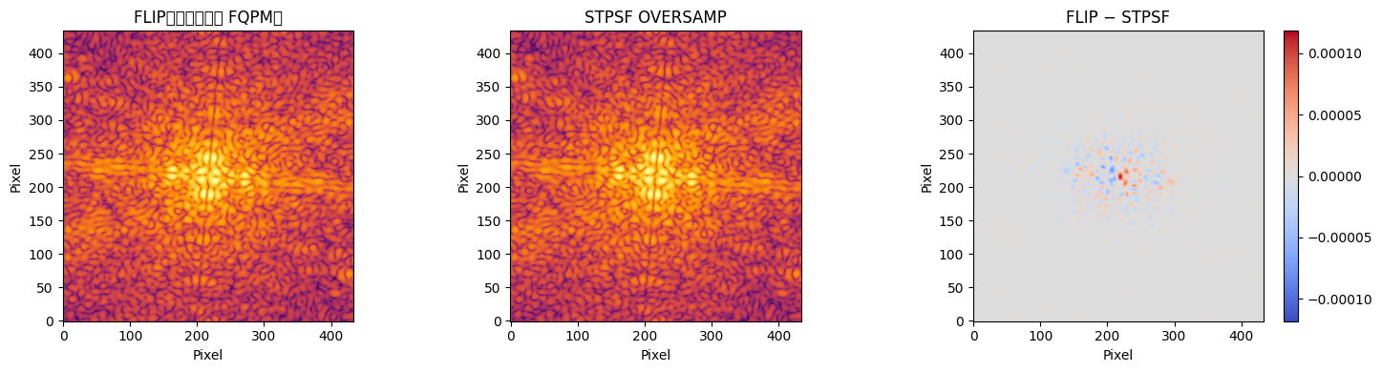
MIRI Coronagraph: STPSF and FLIP Comparison
FLIP forward model vs. STPSF OVERSAMP
Configuration: F1140C / FQPM1140 / MASKFQPM
Wavelength: 11.3169 μm
Image size: 434 × 434 oversampled pixels
Single-wavelength simulation; no optimization

Slide 10
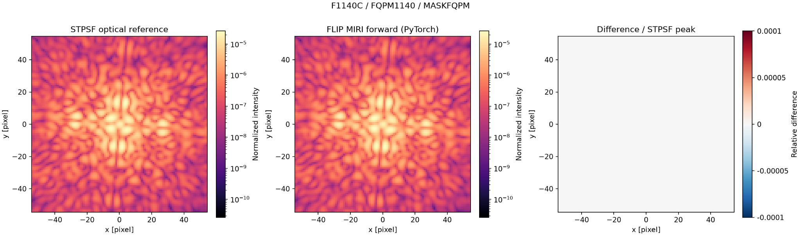
STPSF & FLIP (MIRI – HIP 65426)
Filter: F1140C
Focal-plane mask: FQPM1140
Lyot stop: MASKFQPM
Detector: MIRIM
Aperture: MIRIM_CORON1140

Slide 11
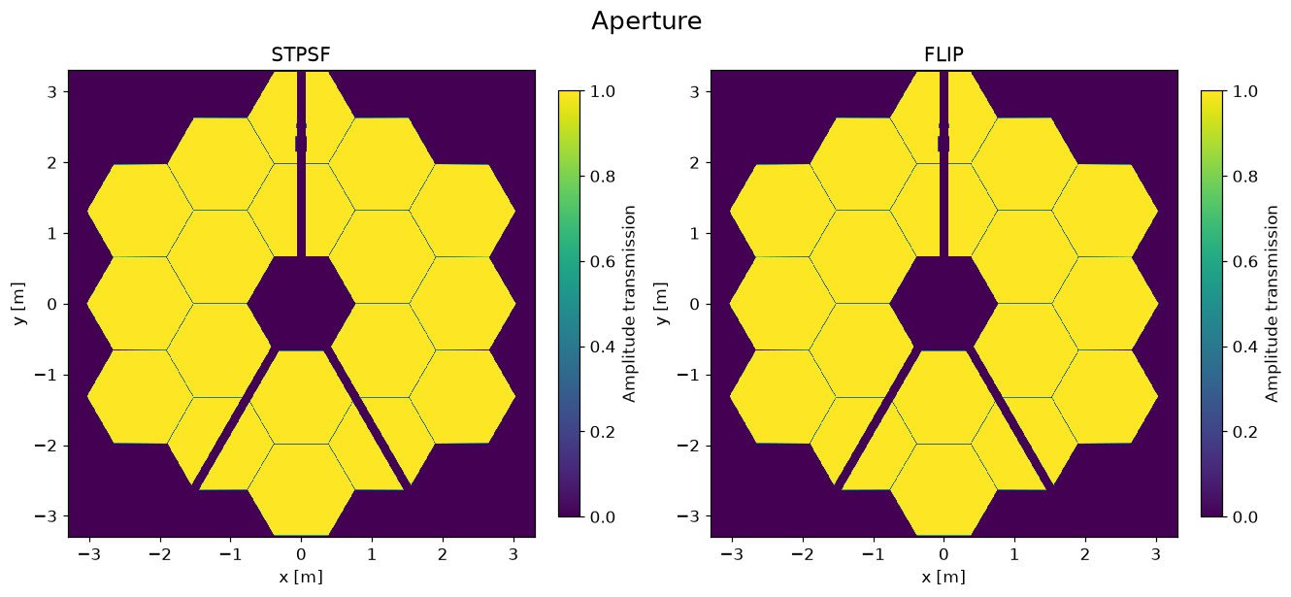
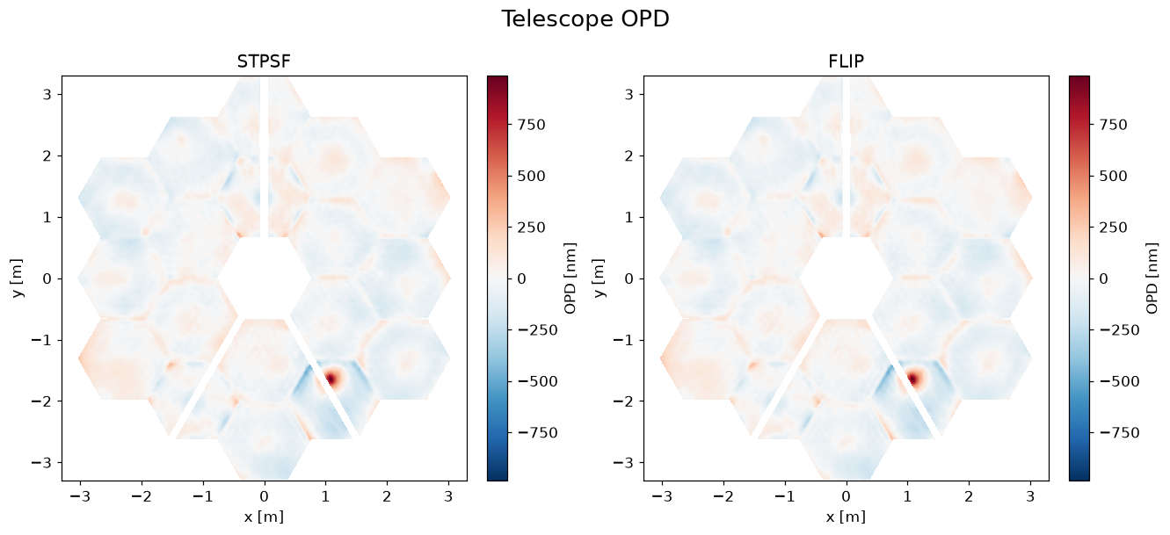
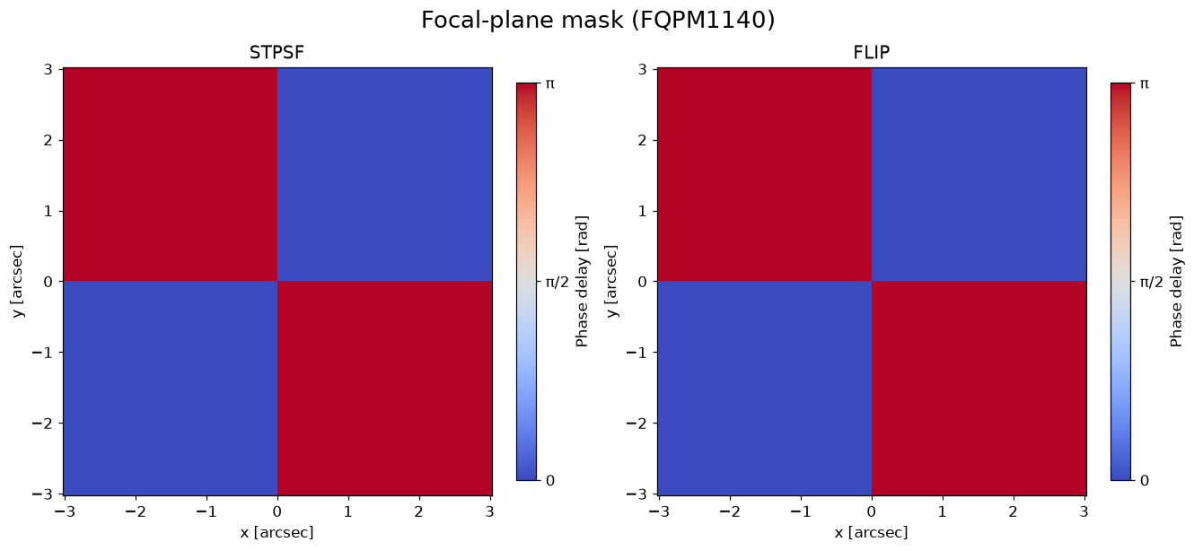
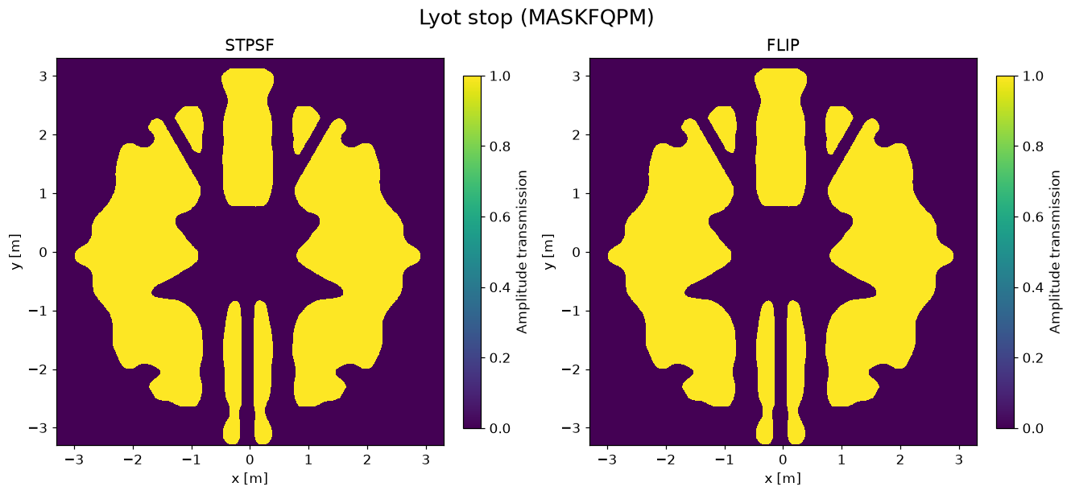
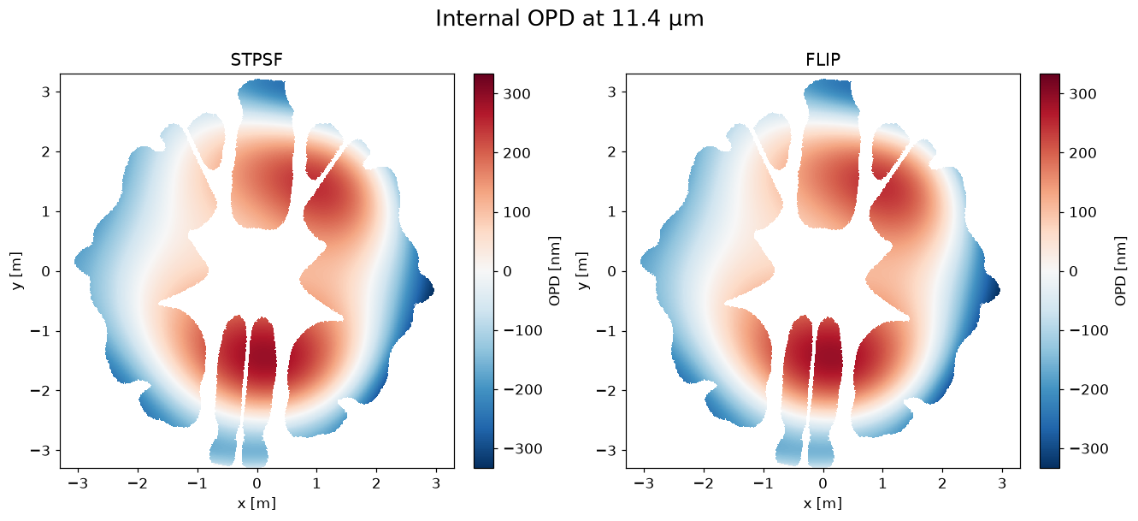
Optical component checks
Aperture
Telescope OPD
Focal-plane mask
Lyot stop (MASKFQPM)
Internal OPD at 11.4 μm

Slide 12
Questions
Why do we flip the OPD for FLIP?
If broadband, which source spectrum and number of wavelength samples should we use? Should the comparison use OVERSAMP or detector-sampled PSFs?
Todo
Run the full optimization for Miri !

