Slide 1


TrueLearn: A Python Library for Personalised Informational Recommendations with (Implicit) Feedback
YUXIANG QIU, KARIM DJEMILI, DENIS ELEZI, AANEEL SHALMAN, MARÍA PÉREZ-ORTIZ AND SAHAN BULATHWELA
UCL Centre for Artificial Intelligence

Slide 2
Educational Recommendation
Matching relevant educational materials to the right learner at the right time
Goes beyond prepared curriculum
Can leverage a large collection of educational materials to personalise
Need to account for informational novelty that goes beyond content similarity [Bulathwela et al., AAAI'20]
Need transparency to build trust [Bull & Kay, Adv. In ITS'2010]

Slide 3
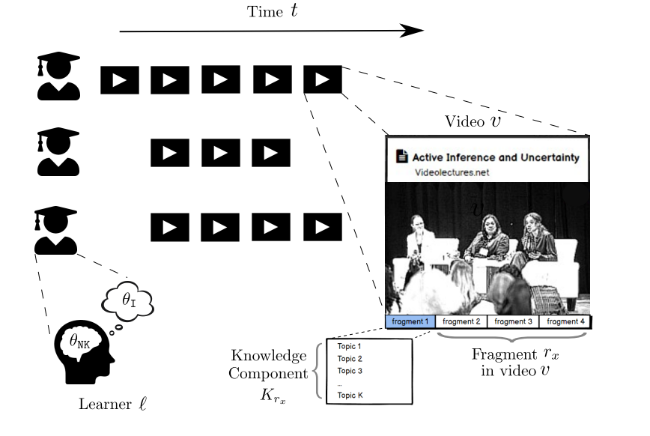
Problem Setting
[Bulathwela et al., MDPI Sustainability 2022].

Slide 4

Related Work
Main task of focus, personalise exercises. Python library PyBKT [Bulut et al., MDPI Psych 2023] available.
Two main approaches for personalising education
Bayesian Knowledge Tracing (HMM of Learner State)
Item Response Theory (A function of Learner State and Exercise Difficulty)
Training is expensive and only focuses on a small number of exercises and learners

Slide 5
Related Work
TrueLearn, one of the first models to predict video engagement with educational videos [Bulathwela et al., AAAI'20]
Has multiple models to recover a knowledge and interest representation [Bulathwela et al., MDPI Sustainability 2022]
Also, can formulate a transparent learner state representation
There is no software that allows evaluation and implementation of educational recommenders

Slide 6
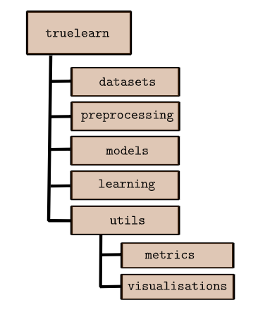
TrueLearn Library
Can be used to access datasets, use personalisation models, visualise user states and for offline evaluation
Inspired by API design of scikit-learn, a well-tested ML library
API is designed for usability and extensibility

Slide 7
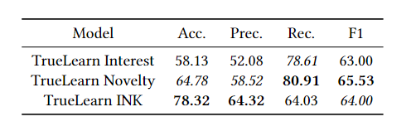
Experimental Results
Validate the implementation accuracy by aligning our results with prior work results
The PEEK dataset was used to fit the models [Bulathwela et al., ORSUM'21]
Classification metrics are used to evaluate performance

Slide 8
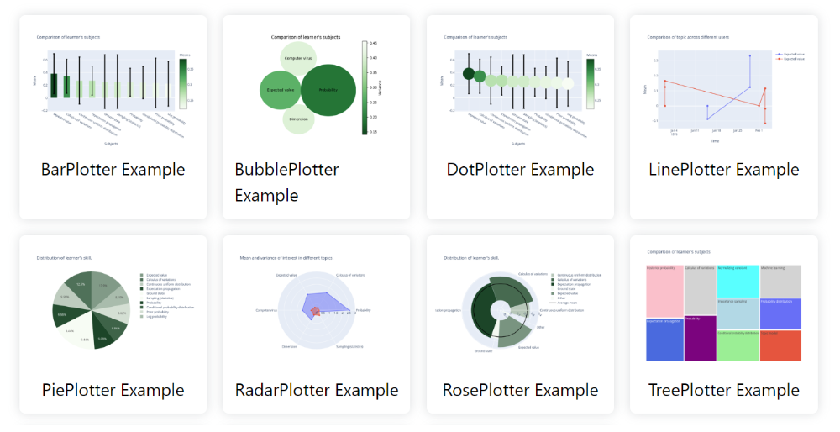
Visualization Capabilities

Slide 9
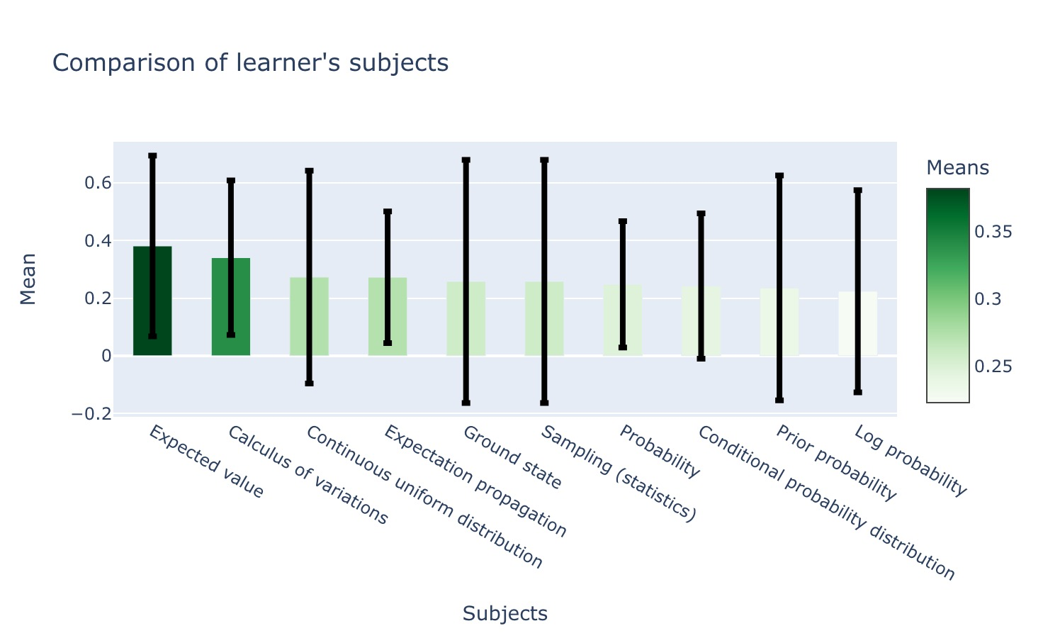
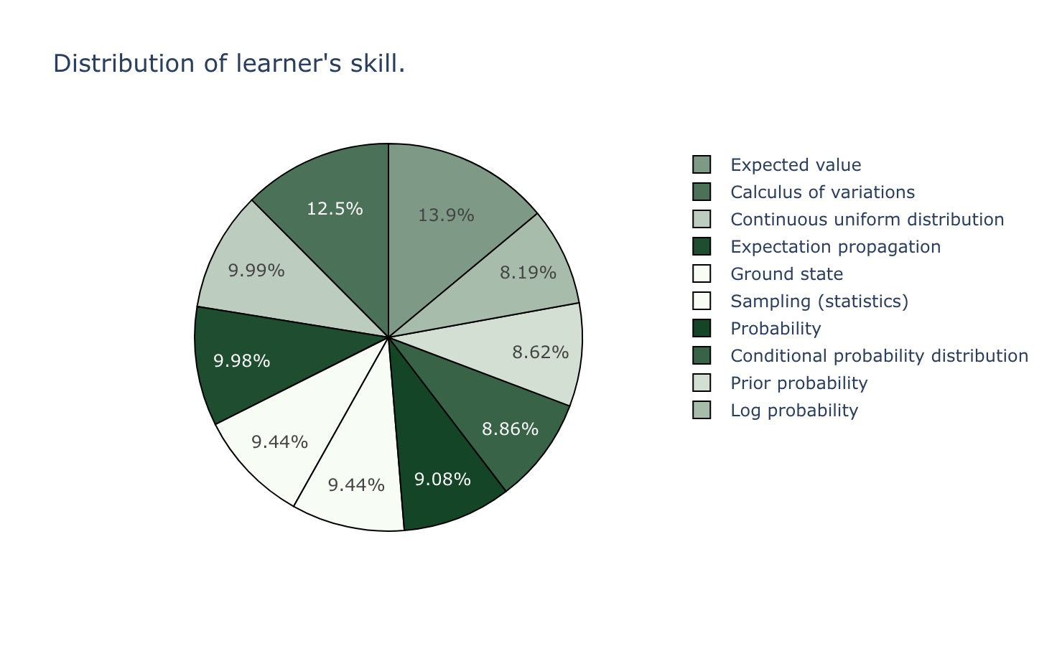
Visualization Capabilities

Slide 10
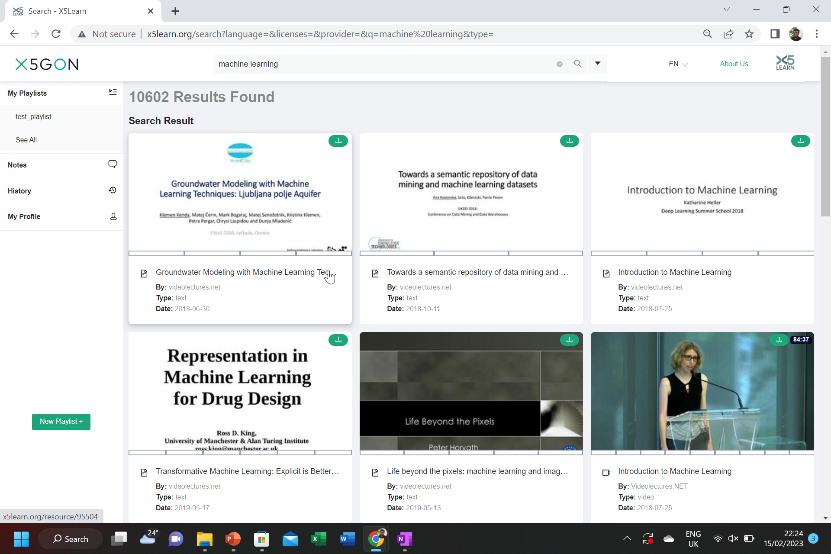
Impact
A scalable library to model learner engagement for real-world educational videos and to carry out offline evaluation of learner modelling algorithms with datasets and metrics
Extensive documentation, examples and specific instructions for contributors
Currently being integrated to https://x5learn.org/

Slide 11
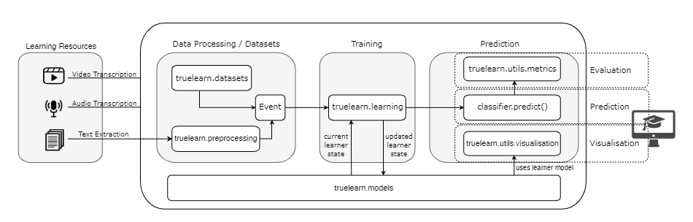
Impact

Slide 12
Future Work
Incompatibility
Extend Classifier
Empirical Study on Visualizations
Generalisability

Slide 13
Department of Computer Science
TrueLearn: A Python Library for Personalised Informational Recommendations with (Implicit) Feedback
https://github.com/TrueLearnAI/truelearn
https://truelearn.readthedocs.io/en/latest/
YUXIANG QIU, KARIM DJEMILI, DENIS ELEZI, AANEEL SHALMAN, MARÍA PÉREZ-ORTIZ AND SAHAN BULATHWELA
UCL Centre for Artificial Intelligence
m.bulathwela@ucl.ac.uk

Slide 14
References
Lars Buitinck, Gilles Louppe, Mathieu Blondel, Fabian Pedregosa, Andreas Mueller, Olivier Grisel, Vlad Niculae, Peter Prettenhofer, Alexandre Gramfort, Jaques Grobler, Robert Layton, Jake VanderPlas, Arnaud Joly, Brian Holt, and Gaël Varoquaux. 2013. API design for machine learning software: experiences from the scikit-learn project. CoRR abs/1309.0238 (2013). arXiv:1309.0238 http://arxiv.org/abs/1309.0238
Sahan Bulathwela, María Pérez-Ortiz, Emine Yilmaz, and John Shawe-Taylor 2020. TrueLearn: A Family of Bayesian Algorithms to Match Lifelong Learners to Open Educational Resources. In AAAI Conf. on Artificial Intelligence,
Sahan Bulathwela, Maria Perez-Ortiz, Erik Novak, Emine Yilmaz, and John Shawe-Taylor. 2021. PEEK: A Large Dataset of Learner Engagement with Educational Videos. In Proc. of RecSys Workshop on Online Recommender Systems and User Modeling (ORSUM’21). https://arxiv.org/abs/2109.03154
Bulathwela, Sahan and Pérez-Ortiz, María and Yilmaz, Emine and Shawe-Taylor, John. 2022. Power to the Learner: Towards Human-Intuitive and Integrative Recommendations with Open Educational Resources. Sustainability 14, 18 (2022). https://doi.org/10.3390/su141811682
Susan Bull and Judy Kay. 2010. Open Learner Models. Vol. 308. 301–322. https://doi.org/10.1007/978-3-642-14363-2_15
Okan Bulut, Jinnie Shin, Seyma N. Yildirim-Erbasli, Guher Gorgun, and Zachary A. Pardos. 2023. An Introduction to Bayesian Knowledge Tracing with pyBKT. Psych 5, 3 (2023), 770–786.

