Slide 1

Type of program
I think we should keep more comedies, science fictions, and reality shows
in terms of program types because these three categories are the most popular in terms of
popularity of the top programs

Slide 2
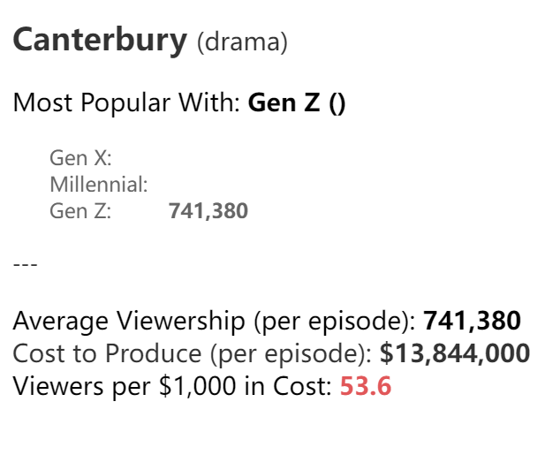
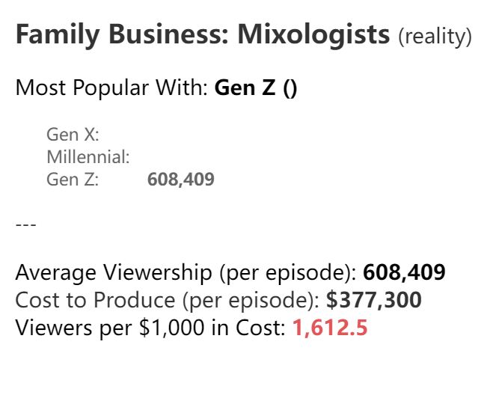
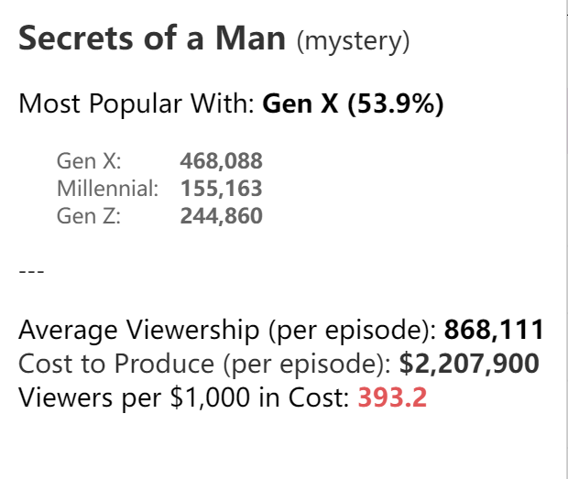
Select Program
from the perspective of programs, I think Canterbury, Secrets of a Man, and
two series about family business must be kept

Slide 3
Reasons to choose Canterbury
The reason for keeping Canterbury is that it is extremely popular in all age groups, with
18-49 being the most popular and 50-64 being the second. Although the production cost of
this program is very high, the extremely high audience rate also corresponds to an
extremely high box office total, and it can also serve as the theater's iconic program. After
calculation, we know that if the ticket price is 3 yuan, the investment cost can be earned
back, so this program must be a highly profitable project.

Slide 4
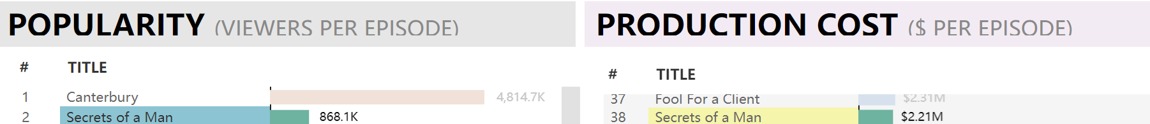
Reason for choosing Secret of a Man
The reason for choosing Secret of a Man is that although its audience is far behind
Canterbury, it is still ranked second, and its production cost is ranked 38th, which is a
low-investment and high-return work. It can make a profit through this program
without losing customer traffic.

Slide 5
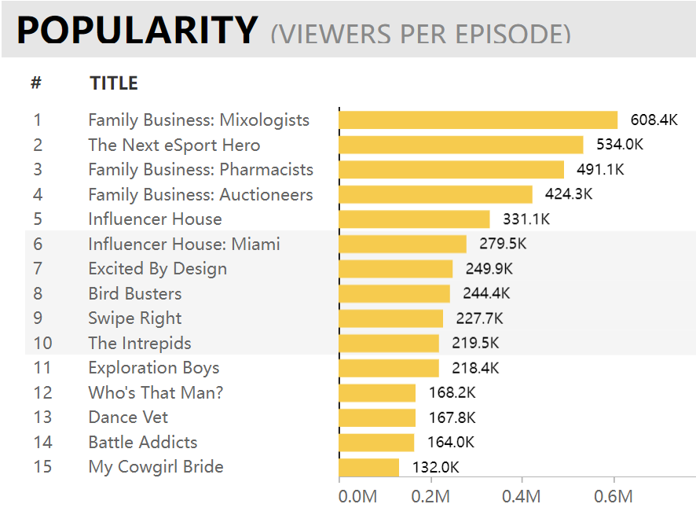
Reasons to choose the family business series
Similar to Family Business: Auctioneers, it is in a similar situation, with the audience
rate ranked seventh, the production cost
ranked 68, and it is also a very popular reality film, which is a good choice. It seems that it is a series about family business with Family Business: Mixologists, which can better retain long-term guests. And this series is the most
popular among reality films

