Slide 1

Factors and patterns affecting employment rate
Producer: Xiong Shaoxuan
Editor: Richard Feng

Slide 2



1
2
3

Slide 3


1
Age
2
3

Slide 4


1
Education
2
3

Slide 5

1
Gender
2
3

Slide 6
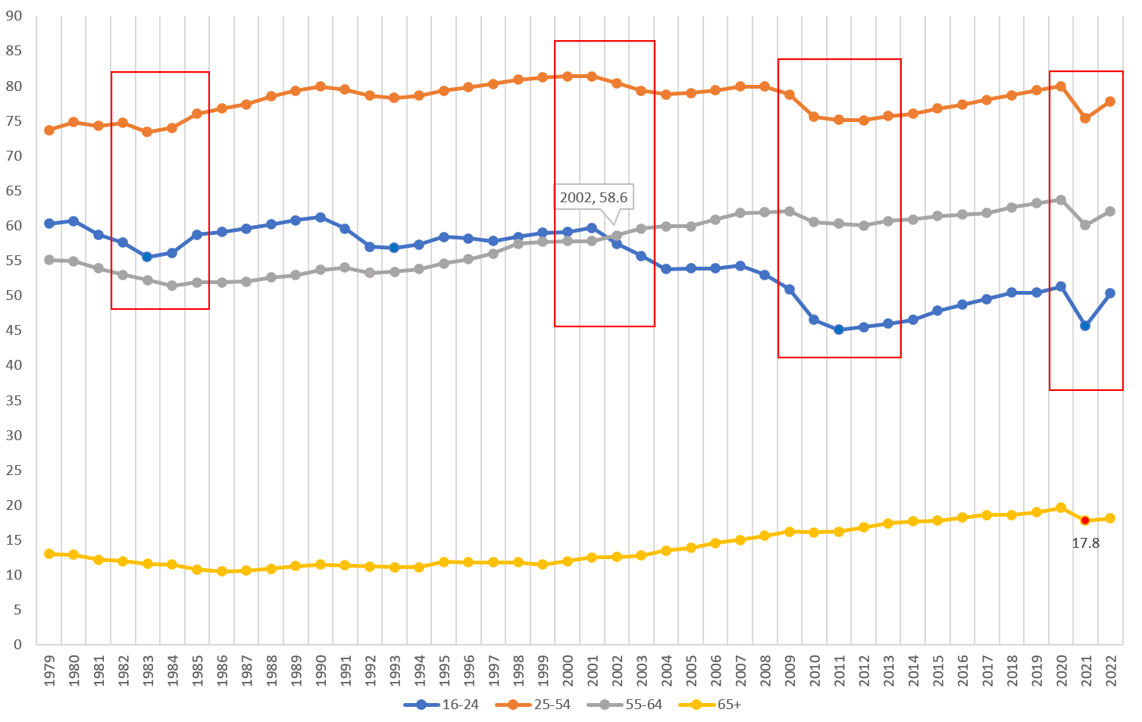
Source: kaggle
Age
The red boxes mark
key economic events and employment fluctuations.
The chart covers four age groups:
16-24, 25-54, 55-64, and 65 and over.
Therefore, we can analyze the employment trends of different age groups through the broken line trend in the red box and draw some conclusions.
Line chart of age and employment rate from 1979 to 2022
Employment rates vary significantly by age group, reflecting changes in the economy, society and policies.

Slide 7

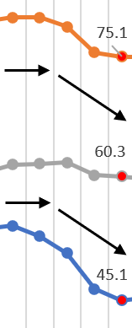
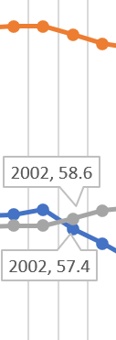
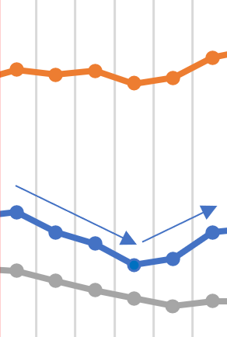
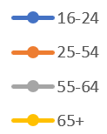
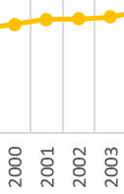
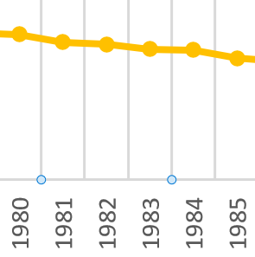




Socioeconomic Background:
Double recession：
The United States experienced two recessions (1980 and 1981-1982), mainly due to high inflation and the energy crisis in the late 1970s, when the Federal Reserve System responded by sharply raising interest rates to curb inflation, leading to a slowdown in economic activity.
Unemployment reached 10.8% in 1982, the highest level since the Great Depression.
Employment impact:
①Population aged 16-24（ ）
The figure shows a significant downward trend, indicating that this age group is prone to unemployment during economic downturns. It is speculated whether this phenomenon is related to the lack of work experience and skills among the 16-24 age group
②People aged 25-54（ ）
Although the employment rate of the core labor group has fluctuated due to external influences, it is still at a relatively high data level and overall stable

Slide 8

Socioeconomic Background:
①Internet foam burst
In 2000, the stock market crash of the Internet industry in the United States led to the bankruptcy of a large number of technology companies.
The sharp decline in job demand in the IT industry has made it more difficult for young people who have just graduated or entered the workforce to find employment.
② The 2001 economic recession:
Affected by the bursting of the dot-com bubble, 9/11, and corporate financial scandals (such as Enron incident), the unemployment rate reached 6% in 2003
③ Intensifying globalization:
Manufacturing outsourcing, especially in China and Mexico, has affected the number of blue collar jobs available
Employment impact:
From 2000 to 2003, the employment rate of the younger group decreased more significantly, and in 2002, the employment rate of the 55-64 age group exceeded that of the 16-24 age group. From the social context, it can be inferred that during this period, technology and emerging technology companies experienced a decline, and it may be speculated that young people took on the majority of technology positions

Slide 9
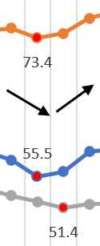
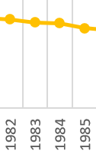
Socioeconomic Background:
①Global Financial Crisis (2008)
The subprime mortgage crisis in the United States triggered a global economic crisis. The unemployment rate reached 10% in 2009, the highest level since the 1980s.
②Property foam burst:
Industries related to the real estate industry (construction, finance, retail) have experienced severe layoffs.
Policy impact:
①The American Recovery and Reinvestment Act (2009)： economic stimulus and infrastructure investment to restore employment.
②Monetary easing policy: The Federal Reserve stimulates economic recovery, but actual improvement takes time.
Employment impact：
①During this period, the employment rate of all age groups has decreased.
②as before, the 16-24 age group faced the most significant impact.
③The high proportion of the 25-54 age group as the core labor force in the job market has led to a significant decline in employment rates during economic downturns.

Slide 10
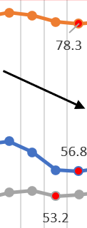
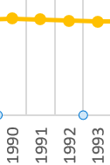
Socioeconomic Background:
COVID-19:
In 2020, the United States implemented extensive lockdown measures, causing a large number of service industries (such as tourism, catering, and retail) to come to a standstill.
Employment impact：
After the impact of the epidemic, the employment rates of four age groups have all experienced a sharp decline, and the degree of decline is still reflected in the younger group, who have been more affected, with (16, 24)>(25, 54)>(55, 64)>(65+)
Policy impact：
①Fiscal stimulus:
Large scale cash subsidies and unemployment benefits have maintained consumption capacity, but some people choose not to return to the labor market in the short term due to government subsidies.
②Vaccination:
After 2021, the promotion of vaccines will drive the restart of economic activities, and the labor participation rate will gradually increase. However, the recovery of service industry jobs will be relatively slow

Slide 11
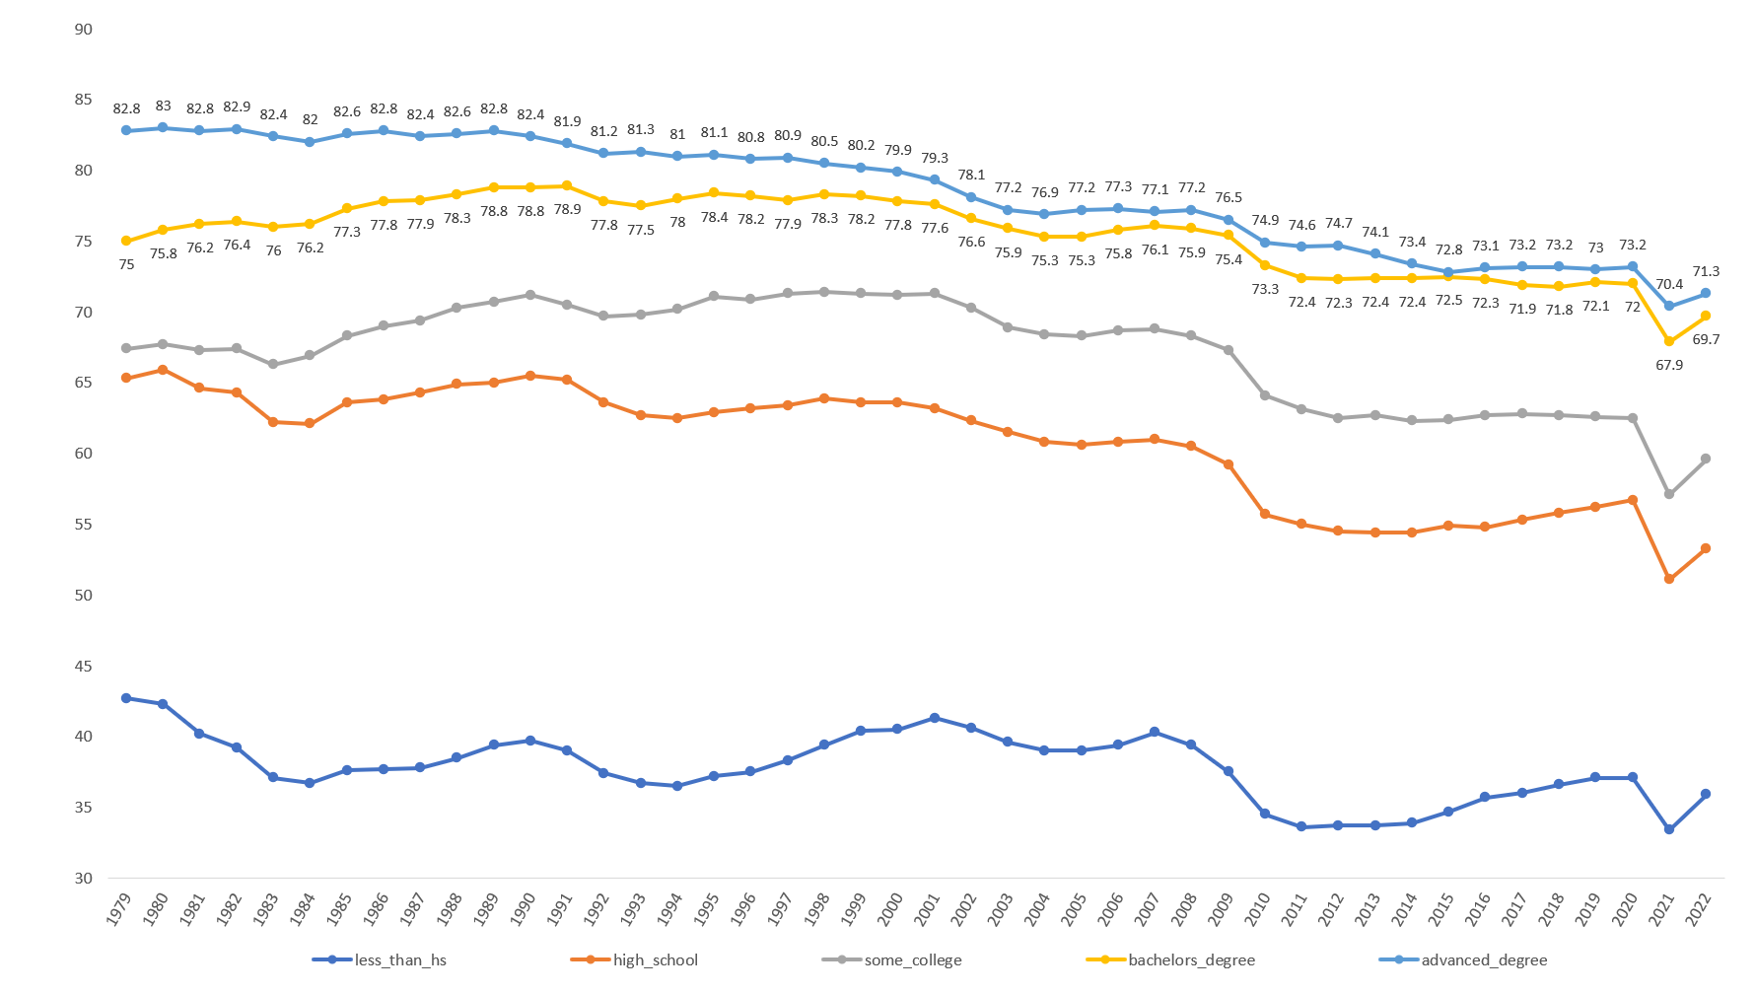
Source: kaggle
Education
The right graph depicts the employment rates of different educational backgrounds from 1979 to 2022
We can compare the social background depicted in the first section (age) to discover the employment stability exhibited by different educational backgrounds during economic downturns.

Slide 12
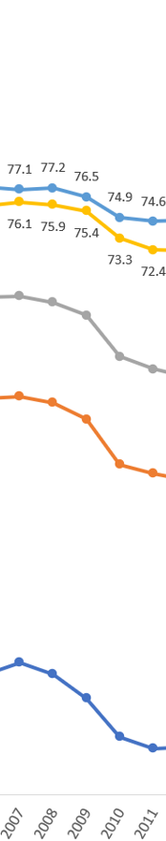
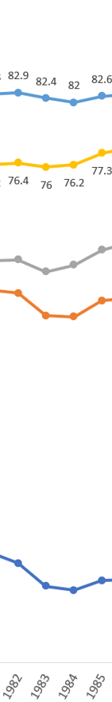
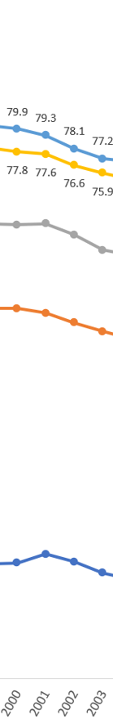


Slide 14
Compare the distance between a bachelor's degree and an advanced degree, and calculate the annual gap between the two degrees

Slide 15
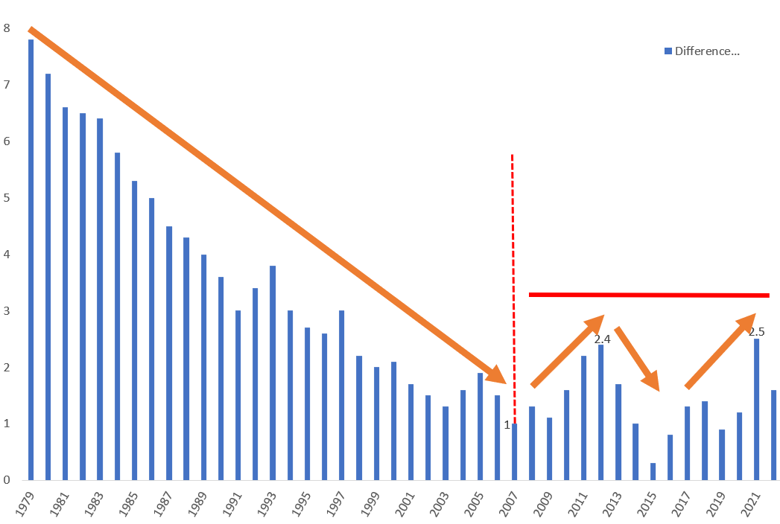
Overall downward trend:
From 1979 to 2006, the employment rate gap (advanced degree holder employment rate minus bachelor degree holder employment rate) showed an overall downward trend, indicating that over time, the employment advantage gap between bachelor‘s and advanced degrees gradually narrowed.
After 2006, the employment rate gap fluctuated and formed multiple local highs (2.4 in 2012; 2.5 in 2021), but the fluctuation range remained relatively stable, approximately between 1-2.5, a significant decrease compared to 1979.
The popularization of education has led to a decrease in the value of high academic qualifications.

Slide 16
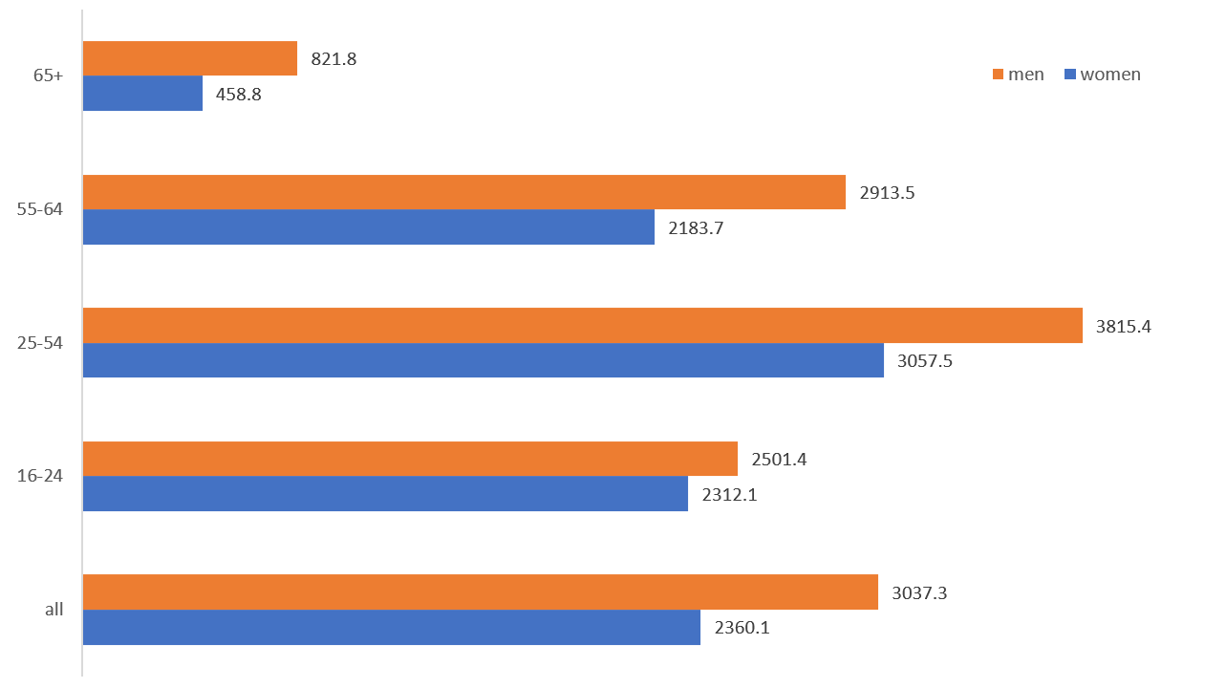
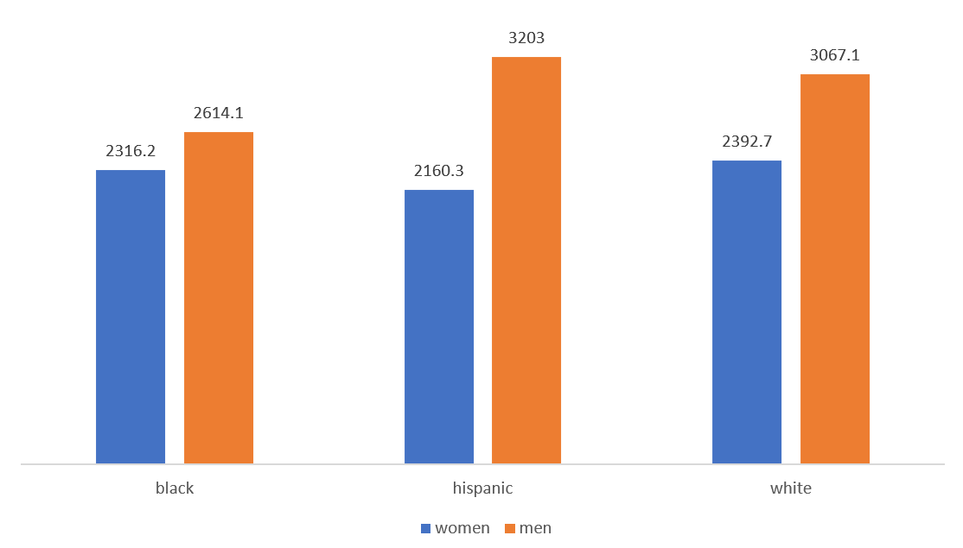
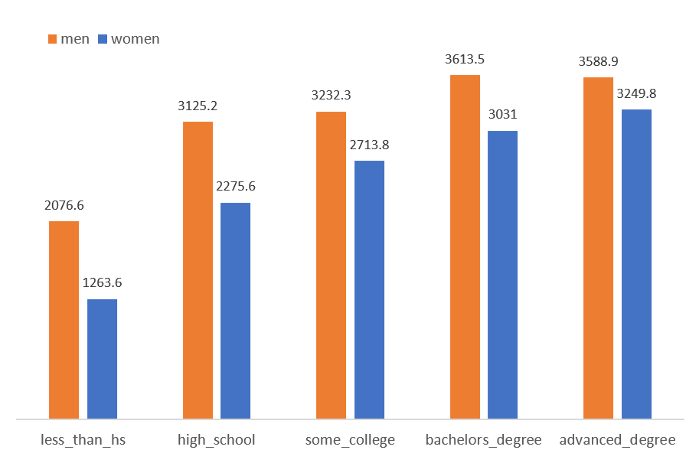
Gender
These charts show the comparison of employment rates between men and women of different ages, educational backgrounds, and ethnicities. From the comparison of three perspectives, it can be clearly seen that the employment rate of men is generally higher than that of women. Has the progress of human civilization not improved the phenomenon of gender inequality?

Slide 20
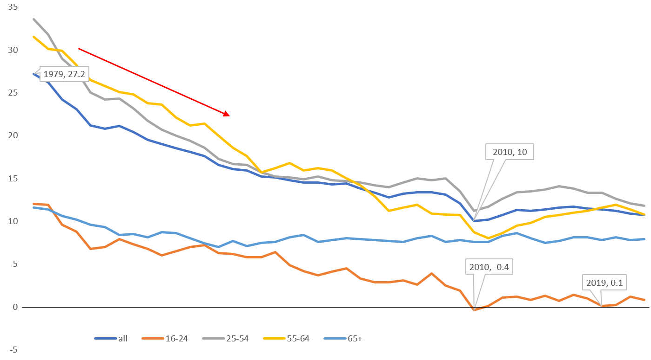
This chart is a line graph of the difference in employment rates between men and women of different ages (male employment rate minus female employment rate), which reflects the changes in the difference in employment rates between men and women of different ages from 1979 to 2022. It can be seen that although most of the values are still positive, the overall trend (blue line) is downward, indicating that men and women are stepping towards equality in employment.

Slide 21
Conclusion
① Changes in social conditions and economic policies may have a significant impact on the employment of different groups
② The younger the group, the greater they are impacted during economic recession
③ The 25-54 age group, as the core labor force, has the highest employment rate data; 65+years old is the lowest, but the data is stable and the ability to resist risks is the strongest
④ Young people account for a significant proportion in emerging technologies and technology positions
⑤ The higher the education level, the higher the employment rate, and the stronger the ability to resist risks during economic downturns, resulting in more stable data
⑥ The gap in employment rates between bachelor's and advanced degrees is decreasing year by year, possibly due to the popularization of education
⑦ Men and women are moving towards equality in employment, and the gap in employment rates between men and women is decreasing year by year, but the proportion of men in employment is still higher than that of women

Slide 22


