Slide 1

Android Network Sniffer
SS18-2A

Slide 2
Perceived functionalities
The application has to be developed for an Android device
The application has to be able to sniff packets that do not simply consist of traffic coming/going from the parent device
The application has to be able to display information captured
The application should have the ability to capture and save raw packet data for analysis on PC

Slide 3

What is a network sniffer?
“A network sniffer is just as it sounds; a software tool that monitors, or sniffs out the data flowing over computer network links in real time.”, “Network sniffers can take snapshot copies of data without redirecting or altering it.”
A NIC card in the normal mode will generally ignore all comings and goings of traffic for other devices.
https://www.lifewire.com/definition-of-sniffer-817996

Slide 4

Monitor / promiscuous mode
These refer to modes in which a Network Interface Card (NIC) can take on,
Monitor mode – A mode in which the NIC does not need to be connected to a network, enables NIC to see all packets in the vicinity.
Promiscuous mode – A mode in which the NIC card is connected to a network and enables the NIC to see all packets routed in the network

Slide 5
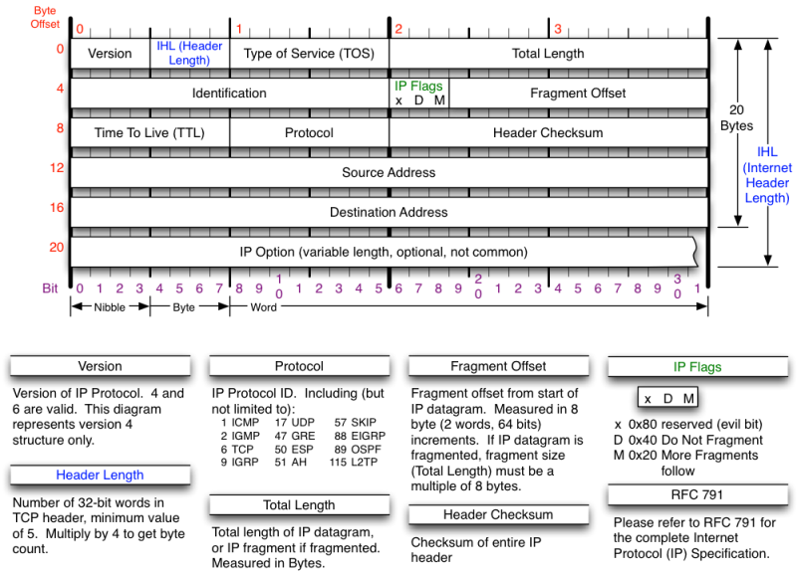
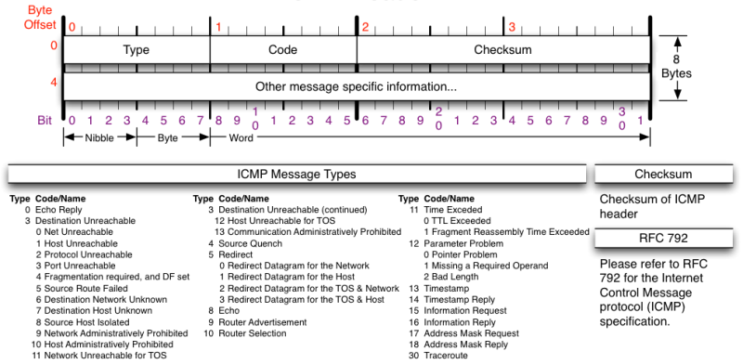
What are packets?
A packet is the unit of data that is routed between an origin and a destination, on the internet or any other packet-switched network.

Slide 6
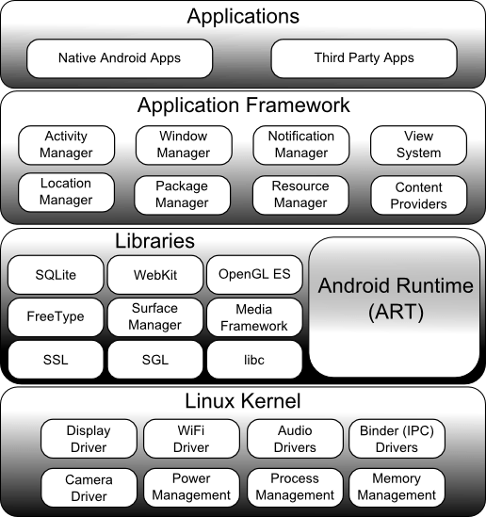
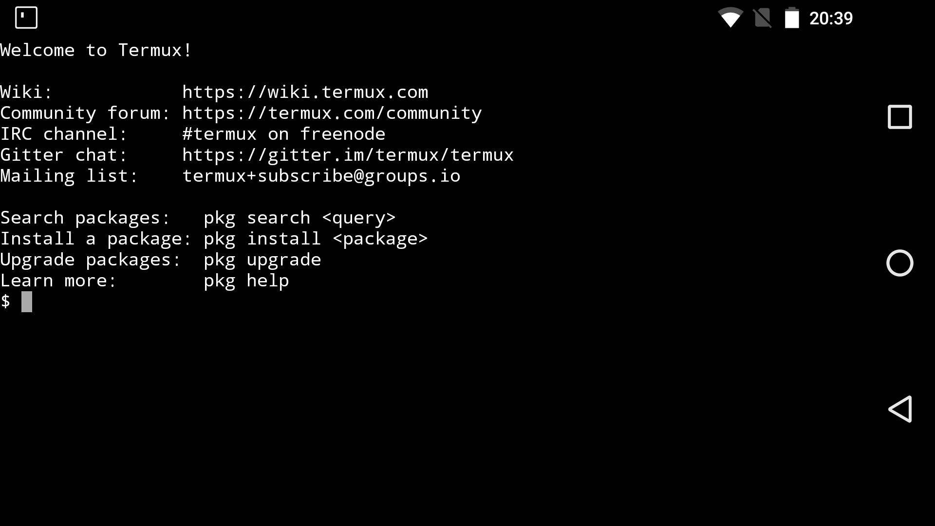
Android v. Linux architecture
Android’s kernel is derived from Linux, not the same but very similar
Android permissions are far different from Linux (configurability wise) as more emphasis is given for ease of use. (Why would normal users want a shell for their Android device?)
Termux is a command line interface application and is used as we test and develop NetSniffer

Slide 7
Android Hardware Requirements
Most PCs have NIC cards that can be set to promiscuous or monitor mode without much hassle.
On Android devices however, it may range from difficult, to impossible. Manufacturers do not support fiddling with hardware, with only enthusiasts working on related projects at their own risk.
NIC cards require drivers to update their firmware to allow monitor / promiscuous mode. On PC it is easy and can be done in a few clicks. On Android, the Linux kernel has to be extracted via binary dump, have the drivers installed in the correct locations, and recompile the entire OS, then the device has to be re-flashed with the new OS.

Slide 8
What are binaries? Why use binaries?
Binary executables are compiled with their required libraries and can be executed without any other interpretation or file.
Binaries for NetSniffer have to be compiled with their required libraries for the ARM architecture (for Android).
Instead of binaries, executables can be written into an apk file itself. Libraries such as Libpcap and Jnetpcap can be integrated with the application, however, it is impossible to grant an application root user privileges
Therefore, binaries have to be used, then executed within the application

Slide 9

TCPDump & Libpcap
TCPDump is a free software designed by Van Jacobson, Sally Floyd Vern Paxson and Steven McCanne in 1988. It is built with libpcap library in C to read packets from a network interface card.
wget http://www.tcpdump.org/release/libpcap-1.8.1.tar.gz
tar -xf libpcap-1.8.1.tar.gz
sudo apt-get update
sudo apt-get install flex
sudo apt-get install bison
cd libpcap-1.8.1
./configure –prefix=/usr
make
sudo make install

Slide 10
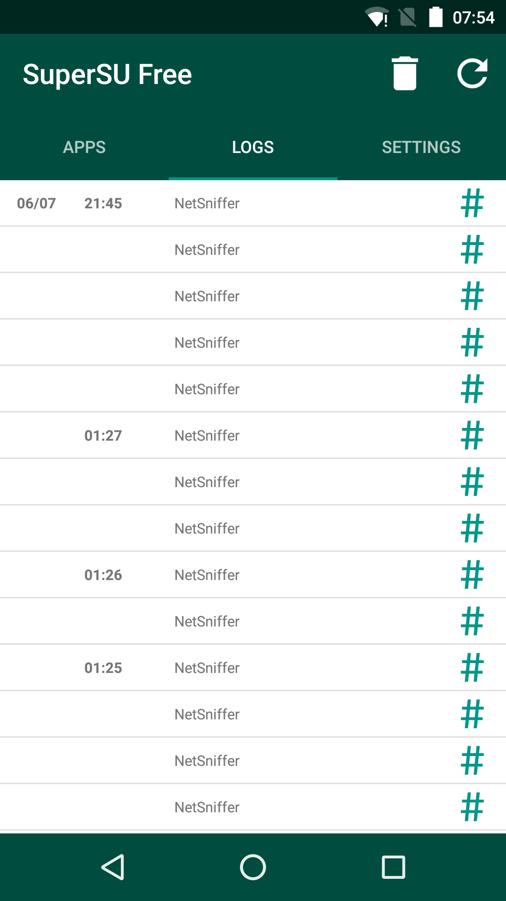
Rooting an Android device
Rooting of an Android device is how a user gets complete access to everything in the OS, which adds the command “su” or superuser to Android
On Android, enthusiasts would find ways to escalate their privileges to superuser, which is NOT supported by their manufacturers and results in voiding of warranty
As such, rooting of devices differ and there is no surefire or standard way to root a device, and attempts to root a device may result in a “bricked” device, breaking the device.
We have attempted multiple attempts to root our chosen device, the Nexus 5 with several solutions, but finally achieved root with “CF-Auto-Root”
Permissions are managed with the external application SuperSU

Slide 11
Difficulties faced
HW has to be compatible (NIC)
Only specific devices can be used
Root privileges
Unable to debug / test on emulator
Unsupported and experimental
Process has to be used, and managed, not much support available

Slide 12
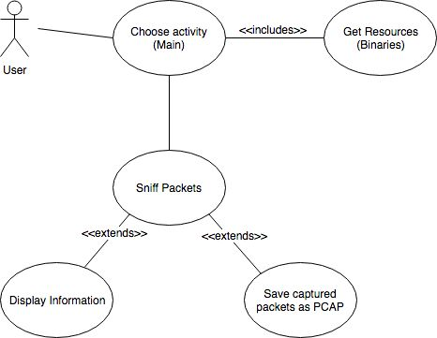
Diagrams (Overall – Usecase)

Slide 13
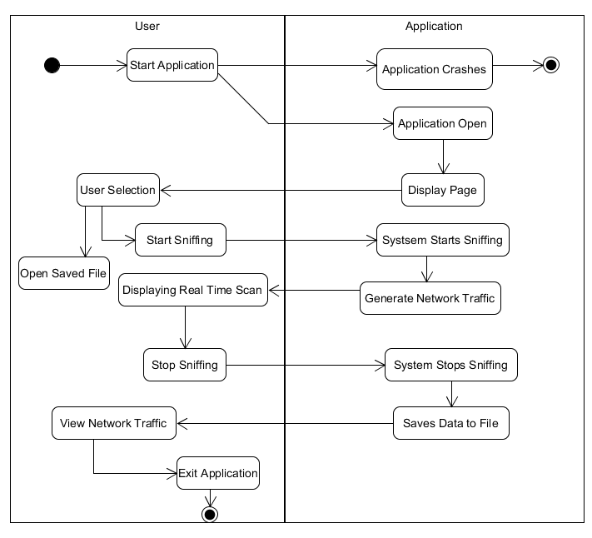
Diagrams (Overall – Activity)

Slide 14
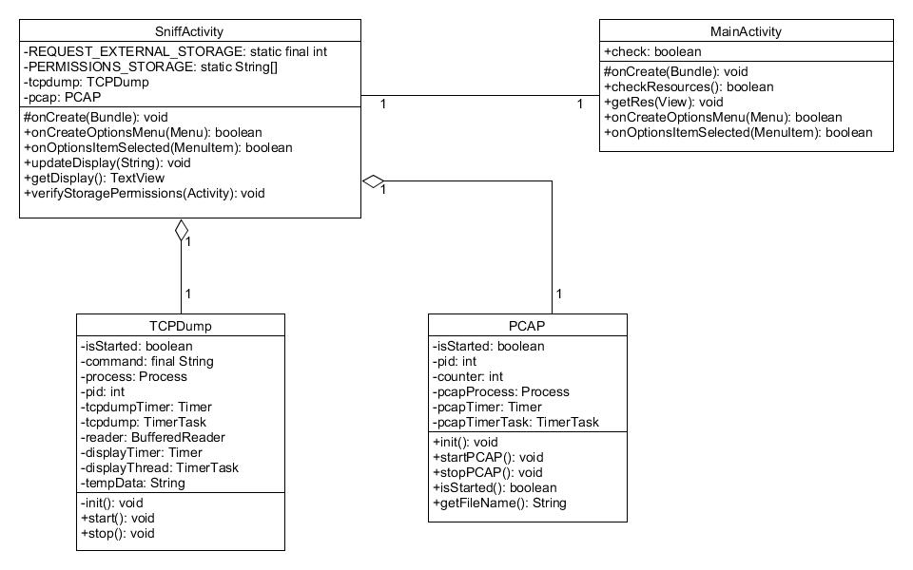
Diagrams (NetSniffer)
Class Diagram

Slide 15
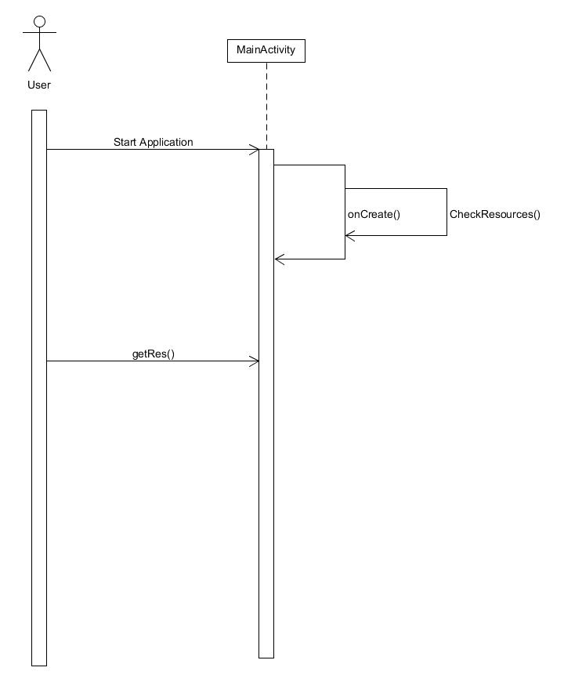
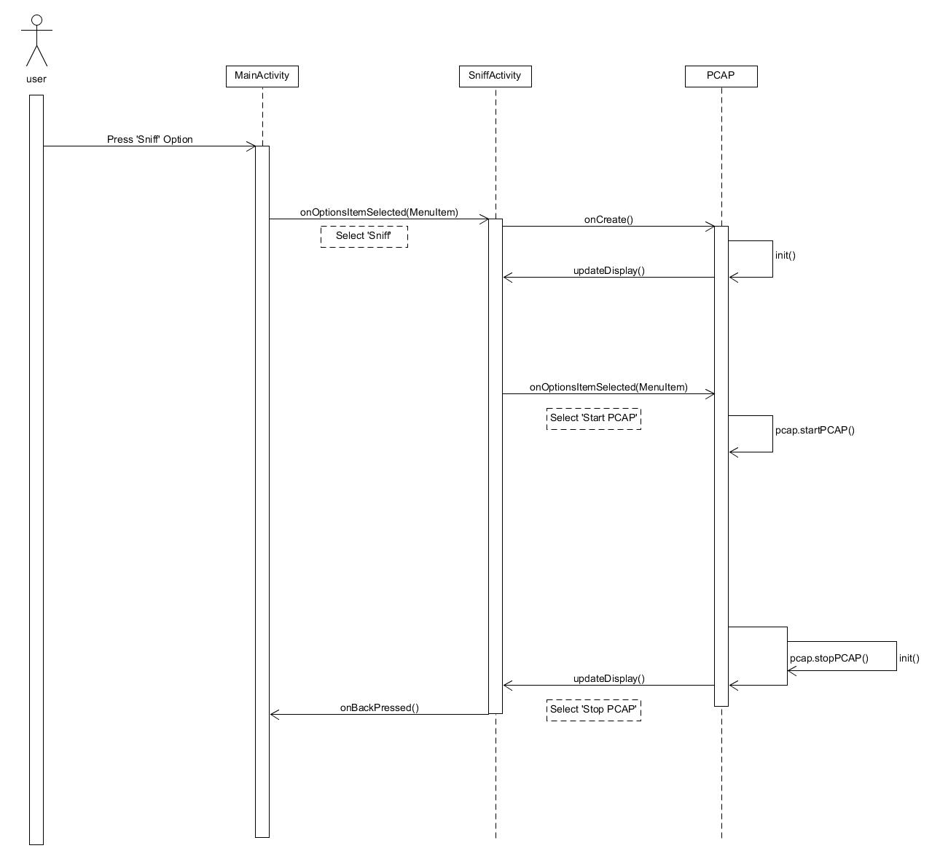
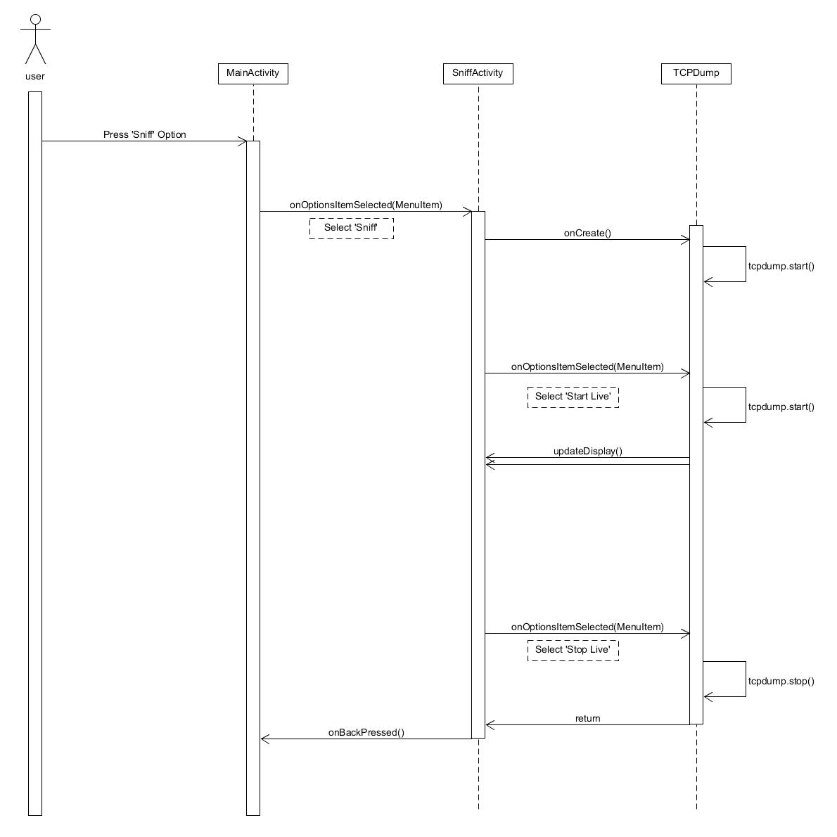
Diagrams (NetSniffer)
Sequence - Main
Sequence – Save Pcap
Sequence – Sniff live

Slide 16
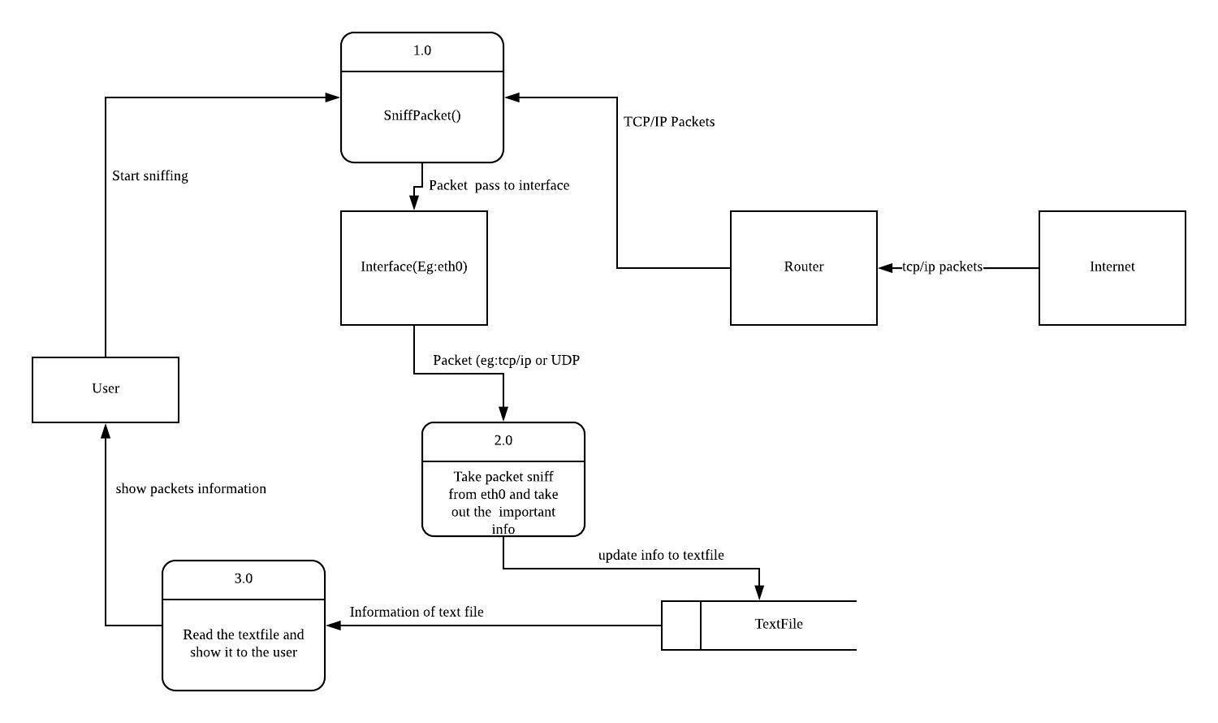
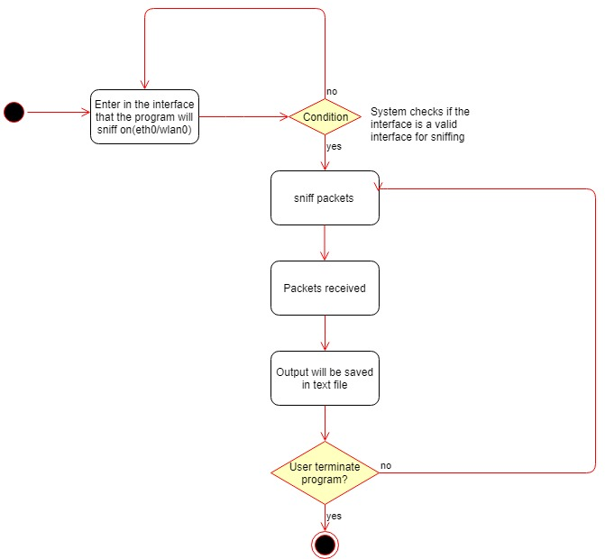
Diagrams (pcbin)
Activity
Data Flow

Slide 17
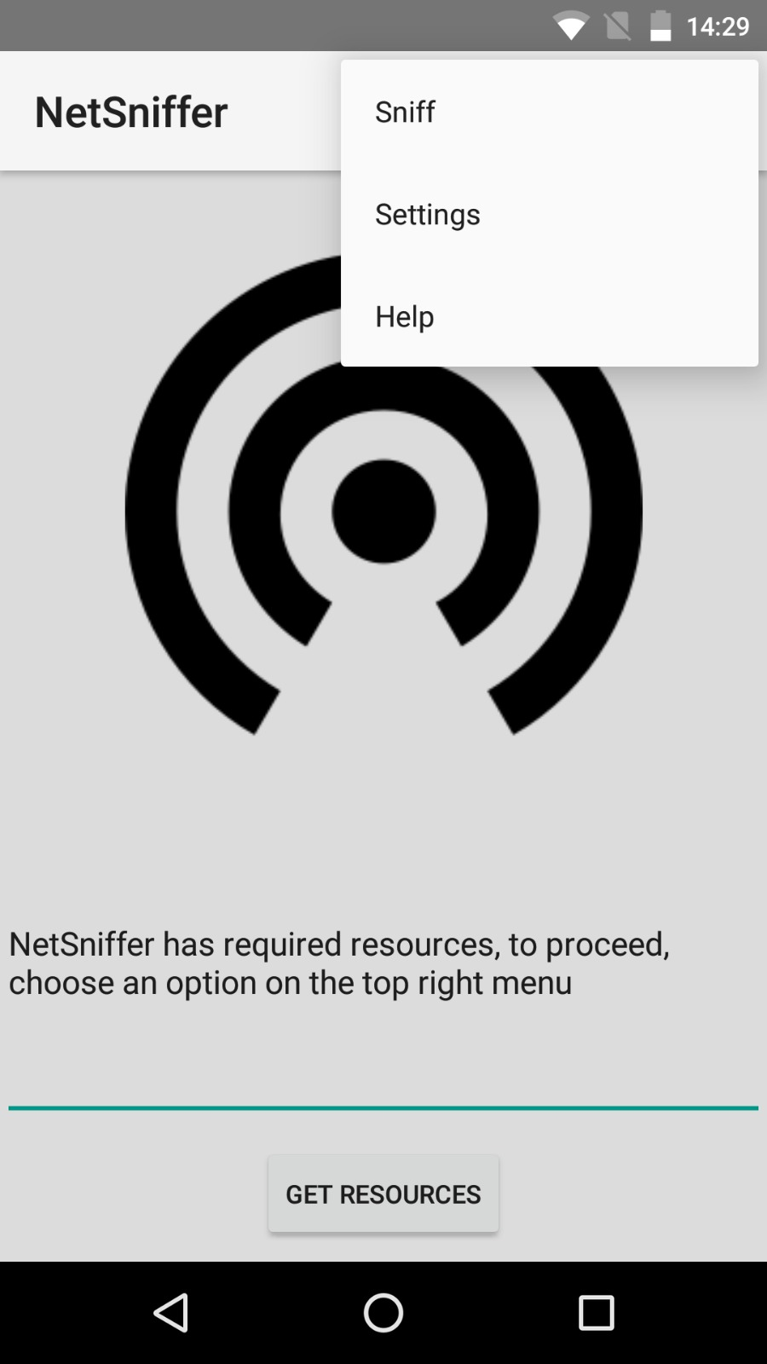
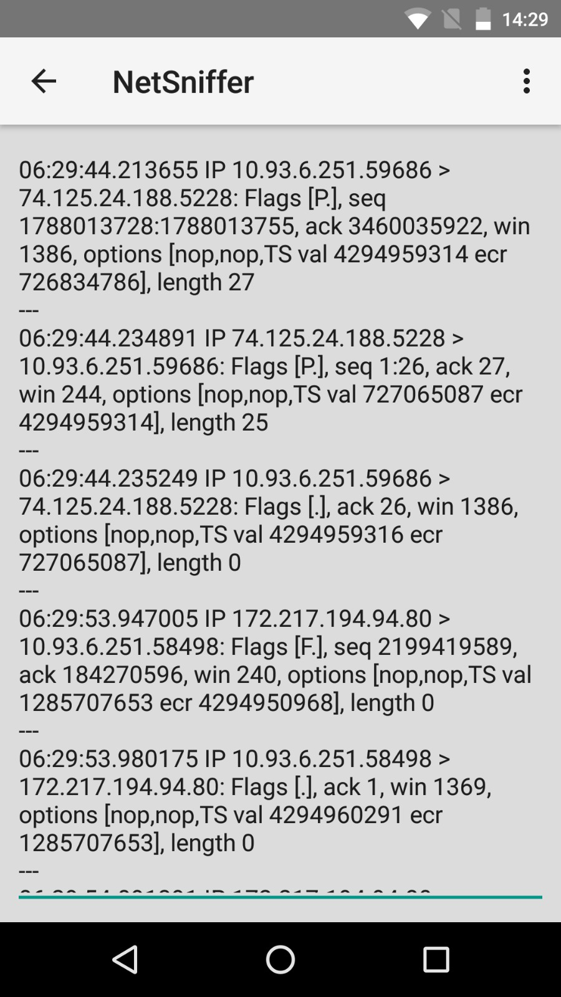
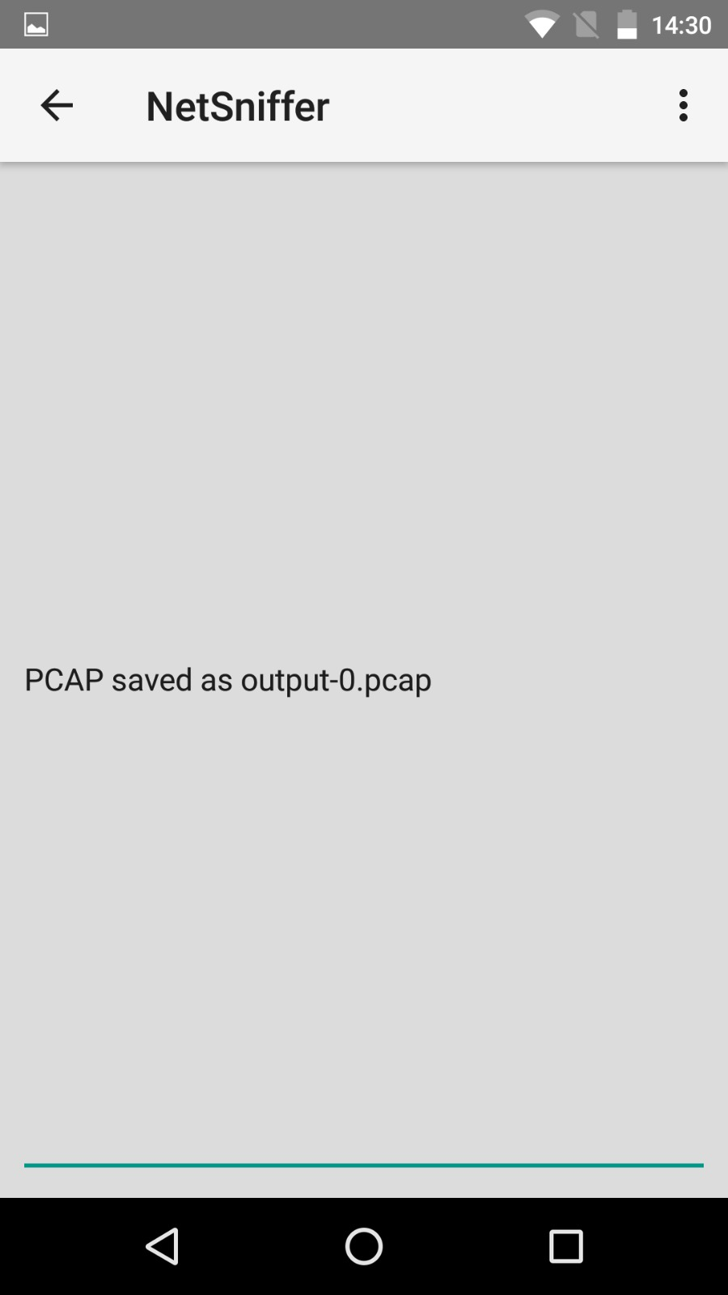
Screenshots (NetSniffer)

Slide 18
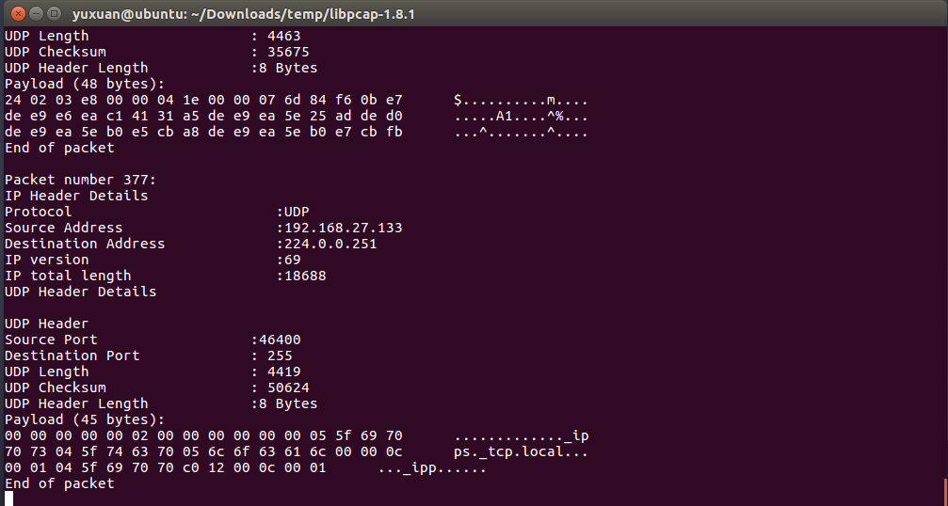
Screenshots (pcbin)

Slide 19
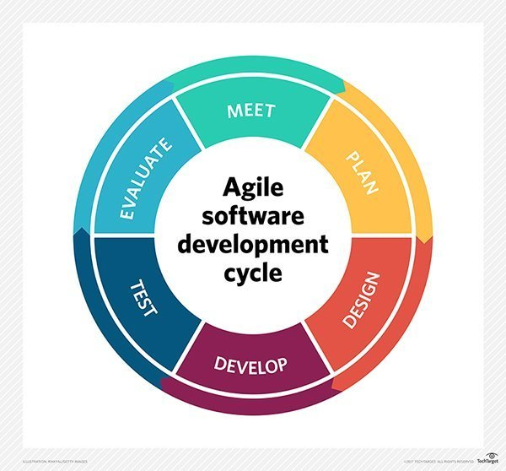
AGILE
We decided AGILE development was the most appropriate.
AGILE software development describes an approach to software development in which the requirements and solutions continually evolve.
AGILE is most appropriate as these variations of software were not prevalent in Android, with mostly experimental support
Our solutions change often with heavy emphasis on prototyping and continual programming to find solutions that satisfy our stipulated functionalities

Slide 20
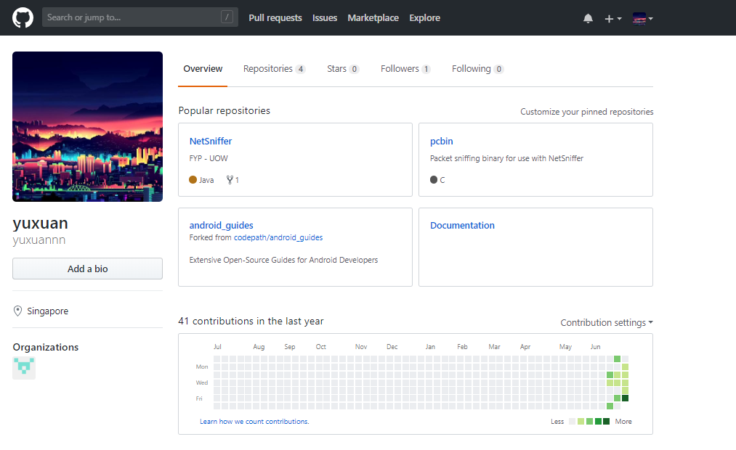
VCS & Documentation
The version control we chose was GitHub

Slide 21

What’s next?
Libnet – A way to construct a packet or frame and send it to a destination, the opposite of a sniffer, which only passively listens
UI changes to make information more user friendly
Integrate pcbin and replace TCPDump binaries

Slide 22
End
SS18/2A
Soh Yu Xuan 5498636
Timothy Chin 5498399
Kenneth Huang 5498442
Kendrick Tan 5026556

