Slide 1
Heart failure detection
Association analysis & SVM based machine learning model
Notes:
Because this disease has become the no 1 cause of death globally, accounting for 31% of all death worldwide. In this dataset, I got 11 features from nearly 300 traced patients and I would like to identify the most associated factors with the death event and create a machine learning model for early detection.

Slide 2
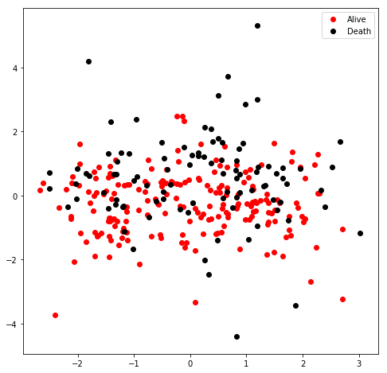
PCA dimension reduction
Scattered, Chaos
Feature selection required
Linear / RBF SVM could not determine
Choose linear SVM for convenience

Slide 3
Association analysis
Correlation matrix & feature contribution plot
Notes:
Heart failure is the no 1 cause of death globally, accounting for 31% of all death worldwide. In this dataset, I got 11 features from nearly 300 traced patients and I would like to identify the most associated factors with the death event and create a machine learning model for early detection.

Slide 4
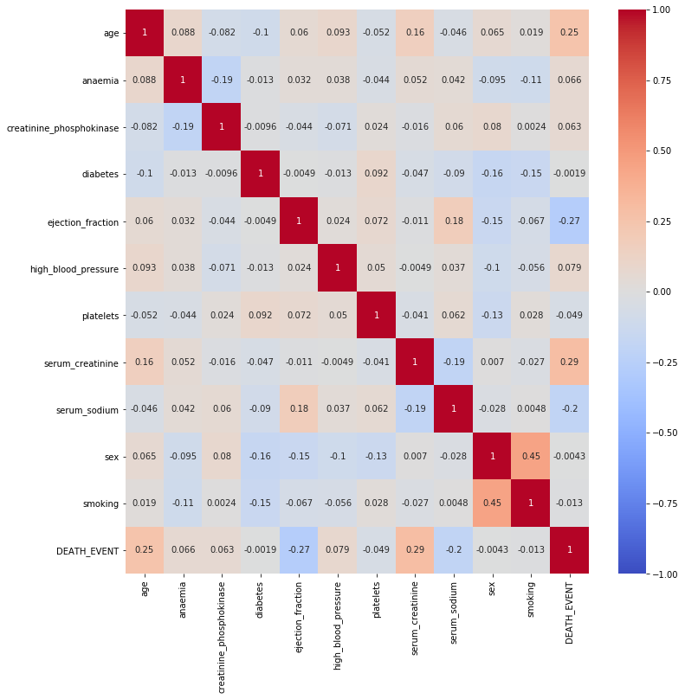
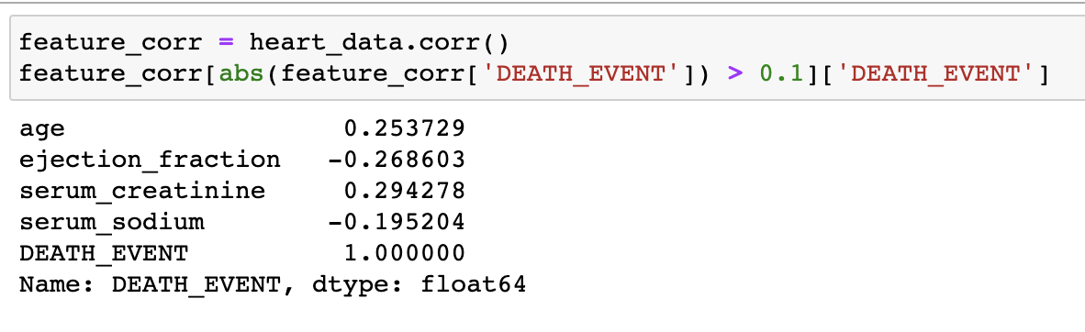
Correlation matrix
Filter out feature has absolute correlation coefficient > 0.1 with death event

Slide 5
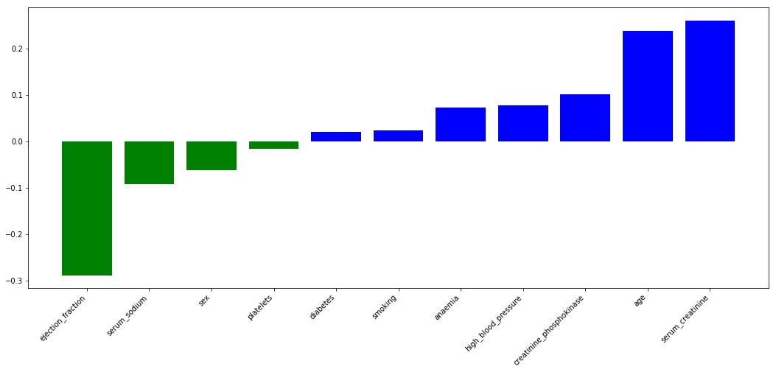
Linear SVM model feature contribution plot

Slide 6
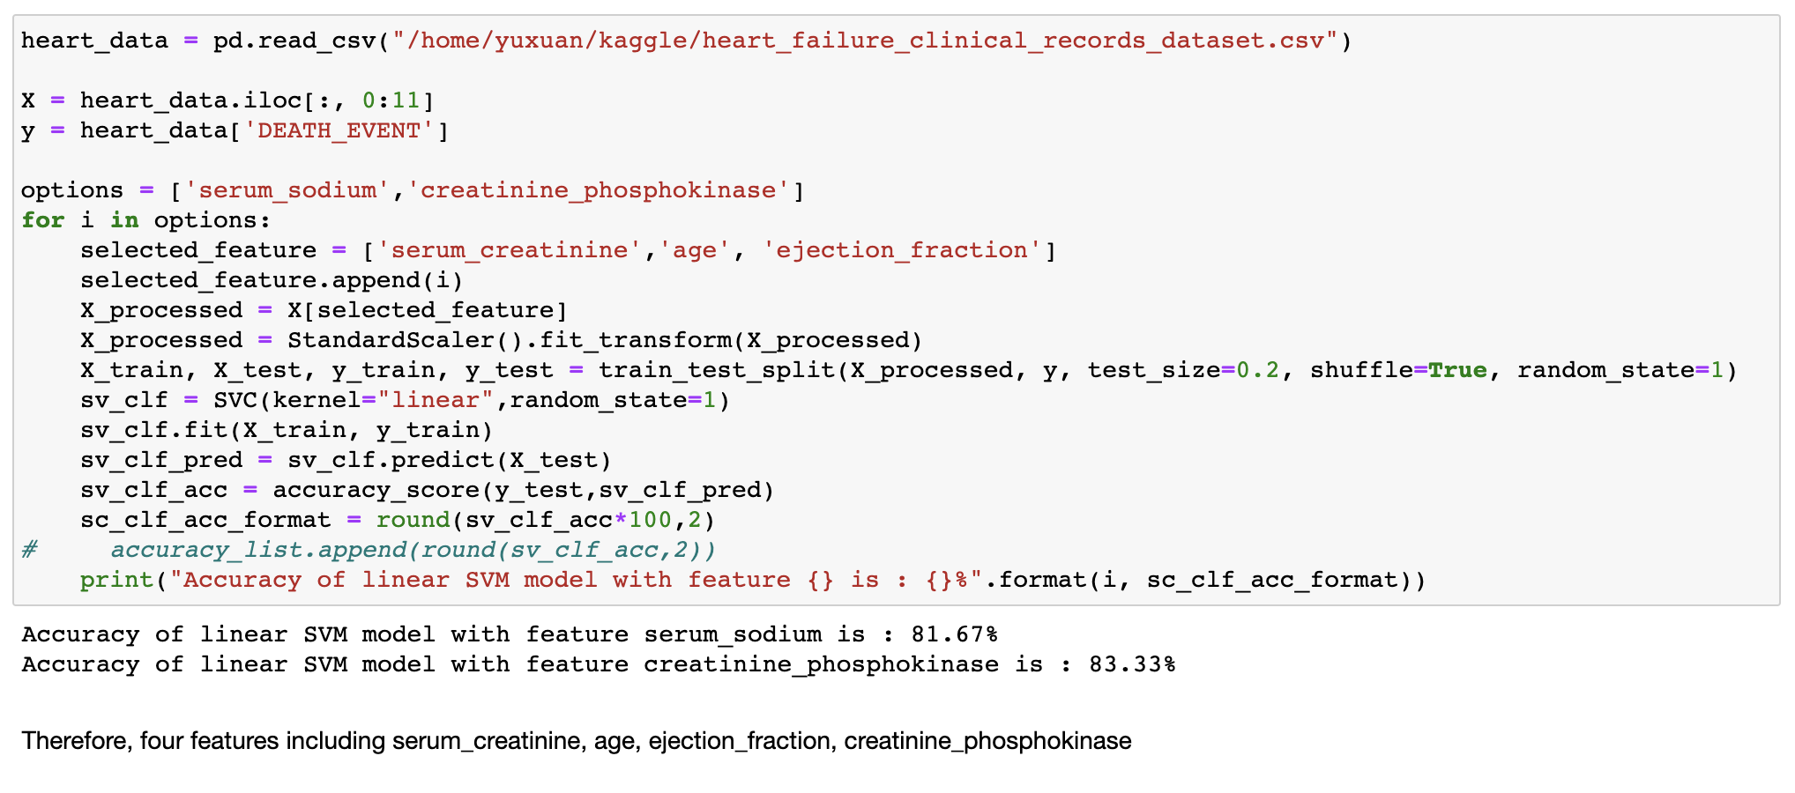
Comparison of selected performance

Slide 7
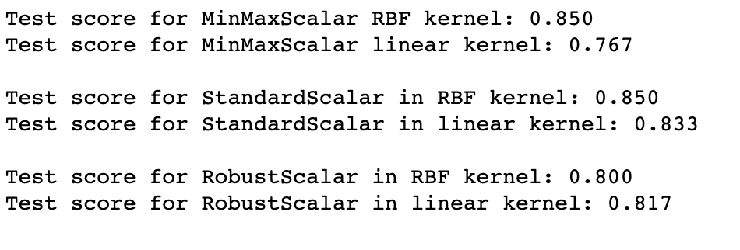
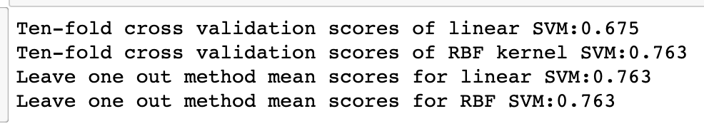
Normalization & Model validation techniques
StandardScalar as normalization
No significant difference in model validation techniques
Choose ten-fold cross validation due to the computational efficiency

Slide 8
Grid search
Hyperparameters:
Linear
C: [0.01,0.1,1,10,100]
RBF
C: [0.01,0.1,1,10,100] gamma:[0.01,0.1,1,10,100]
Results:
Best cross validation accuracy: 0.75
Test set score: 0.87
Best parameters: {'gamma': 0.1, 'C': 1, 'kernel': 'rbf'}

Slide 9
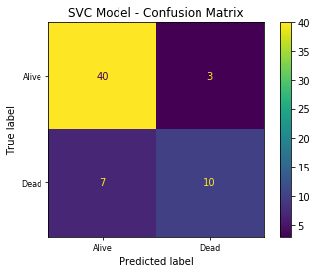
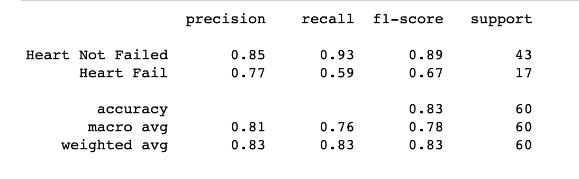
Final selected model performance

Slide 10
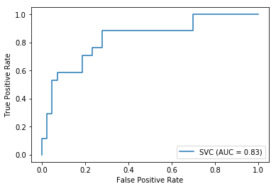
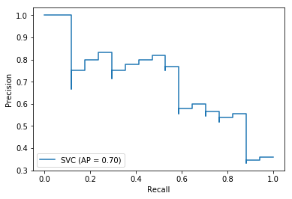
ROC & PR-curve

