Slide 1
Heart failure detection
Association analysis & SVM based machine learning model

Slide 2
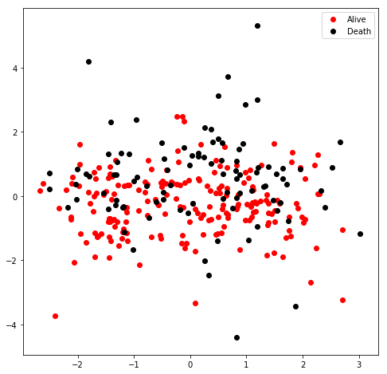
PCA dimension reduction
Scattered, Chaos
Feature selection required
Linear / RBF SVM could not determine
Choose linear SVM for convenience

Slide 3
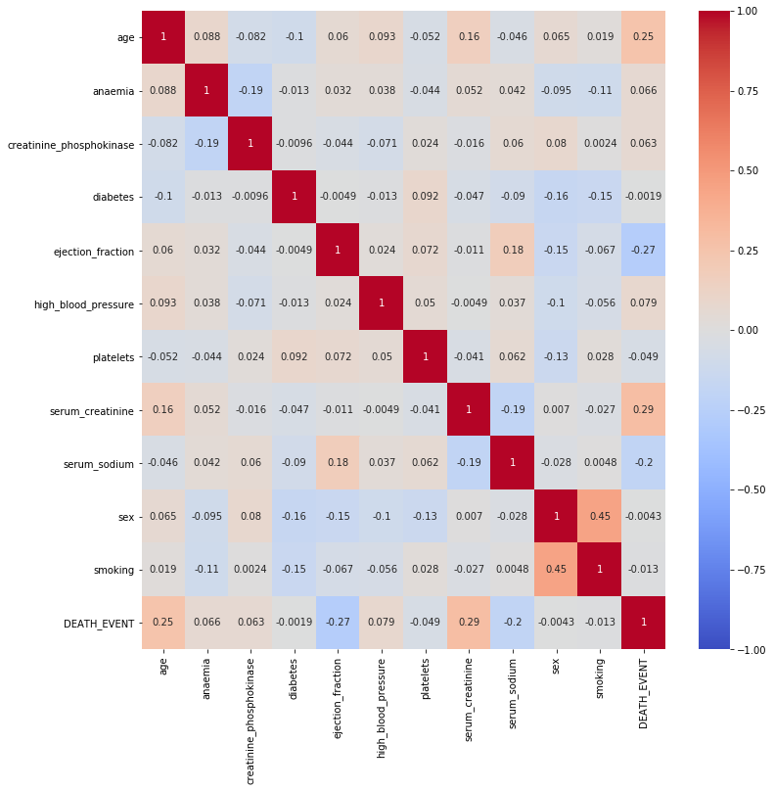
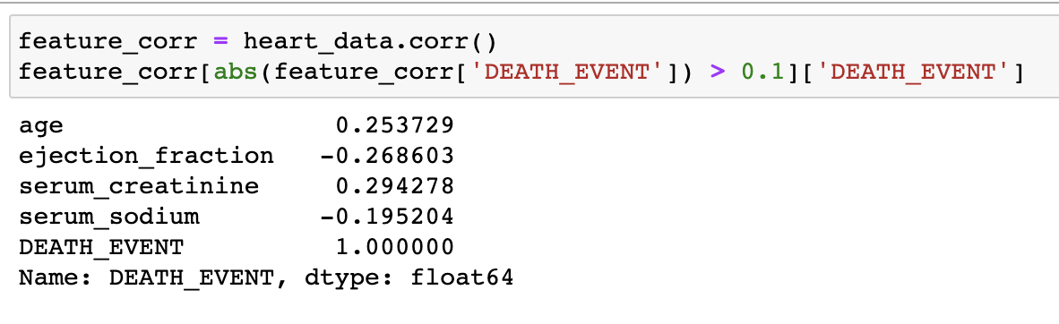
Association analysis
Filter out feature has absolute correlation coefficient > 0.1 with death event

Slide 4
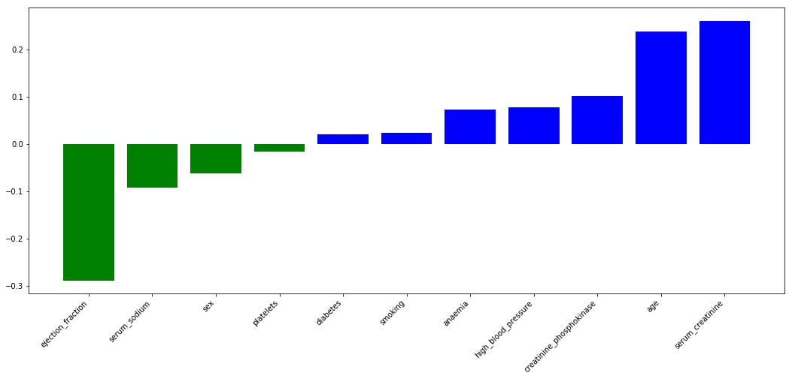
Linear SVM model feature contribution plot

Slide 5
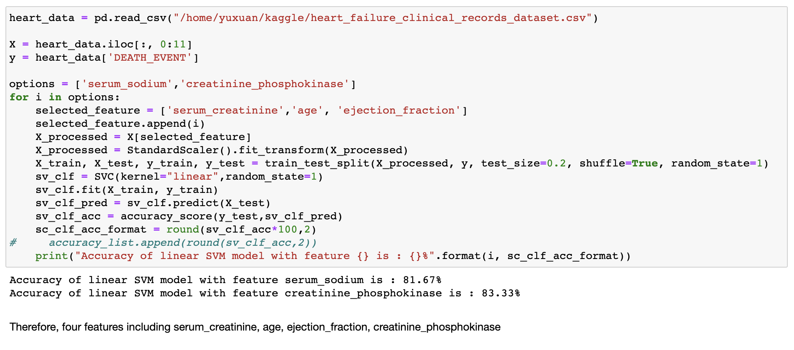
Comparison of selected performance

Slide 6
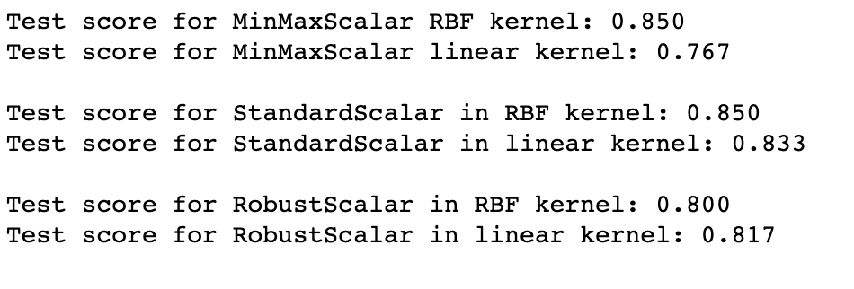
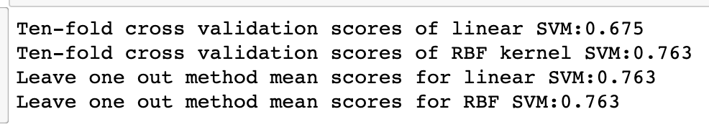
Normalization & Model validation techniques
StandardScalar as normalization
No significant difference in model validation techniques
Choose ten-fold cross validation due to the computational efficacy

Slide 7
Grid search
Hyperparameters:
Linear
C: [0.01,0.1,1,10,100]
RBF
C: [0.01,0.1,1,10,100] gamma:[0.01,0.1,1,10,100]
Results:
Best cross validation accuracy: 0.75
Test set score: 0.87
Best parameters: {'gamma': 0.1, 'C': 1, 'kernel': 'rbf'}

Slide 8
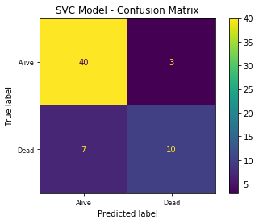
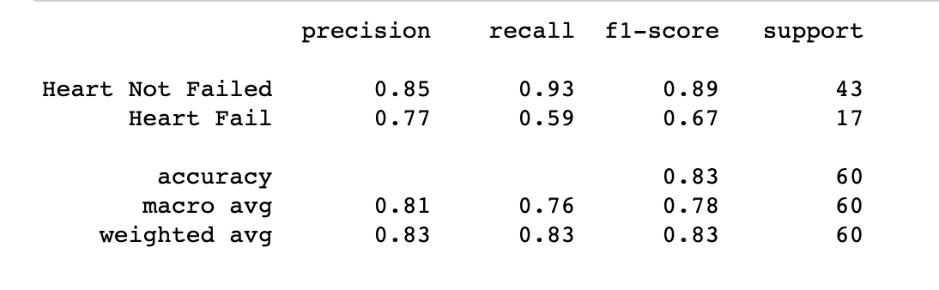
Final selected model performance

Slide 9
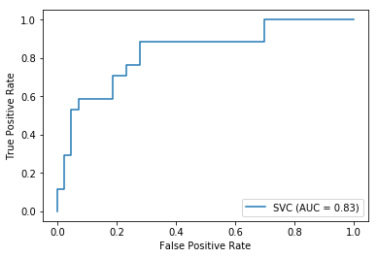
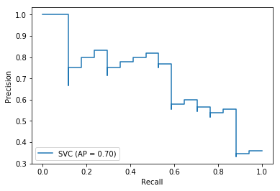
ROC & PR-curve

