Slide 1
How to Calculate Effect Sizes for Meta-analysis in R

Slide 2


Slide 3
Load, Prep, and Check
library(ggplot2)
library(metafor)
#load the data
marine <- read.csv("marine_meta_short.csv",
na.strings=c("NA", ".", ""))
#check variable types
summary(marine)

Slide 4
Load, Prep, and Check
N_Poly N_Avg_Mono Y_Avg_Mono SD_Avg_Mono LR VLR
Min. : 2.000 Min. : 1.0 Min. : 0.001 Min. : 0.0005 Min. :-Inf Min. :0.000028
1st Qu.: 4.000 1st Qu.: 15.0 1st Qu.: 0.091 1st Qu.: 0.0518 1st Qu.: 0 1st Qu.:0.013405
Median : 5.000 Median : 16.0 Median : 1.785 Median : 0.8323 Median : 0 Median :0.045711
Mean : 6.328 Mean : 28.9 Mean : 104.299 Mean : 46.1341 Mean :-Inf Mean :0.144216
3rd Qu.: 6.000 3rd Qu.: 28.0 3rd Qu.: 17.463 3rd Qu.: 8.0472 3rd Qu.: 0 3rd Qu.:0.151159
Max. :32.000 Max. :256.0 Max. :3225.600 Max. :873.1538 Max. : 3 Max. :5.976395
NA's :5 NA's :5 NA's :6
Y_Hedges V_Hedges
Min. :-3.2847 Min. :0.03516
1st Qu.:-0.1709 1st Qu.:0.23034
Median : 0.2469 Median :0.28101
Mean : 0.5169 Mean :0.31921
3rd Qu.: 0.8405 3rd Qu.:0.31712
Max. : 8.3140 Max. :2.32007
NA's :6 NA's :6

Slide 5
Calculating Effect Sizes by Hand
#Log Ratio
marine$LR <- log(marine$Y_Poly) –
log(marine$Y_Avg_Mono)
marine$VLR <- with(marine, {
SD_Poly^2 / (N_Poly * Y_Poly^2) +
SD_Avg_Mono^2 / (N_Avg_Mono * Y_Avg_Mono^2)
})

Slide 6
Plotting
#plot results
ggplot(marine, aes(x=Entry, y=LR,
ymin=LR-sqrt(VLR),
ymax=LR+sqrt(VLR))) +
geom_pointrange(size=1.4) +
geom_hline(yintercept=0, color="red",
lty=2, lwd=2)+
theme_bw(base_size=24)

Slide 7
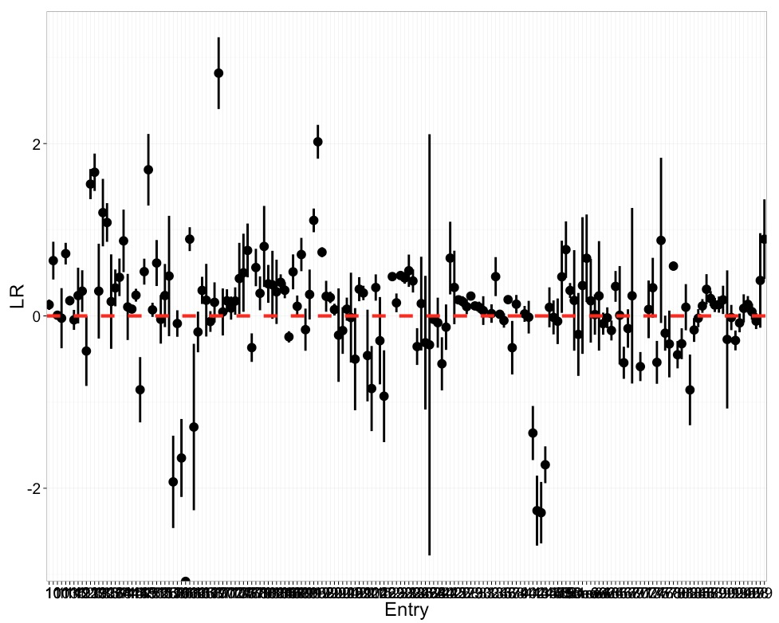

Slide 8
Introducing escalc
escalc {metafor} R Documentation
Calculate Effect Sizes and Outcome Measures
Description
The function can be used to calculate various effect sizes or outcome measures (and the corresponding sampling variances) that are commonly used in meta-analyses.
Usage
escalc(measure, formula, ...)
## Default S3 method:
escalc(measure, formula, ai, bi, ci, di, n1i, n2i, x1i, x2i, t1i, t2i,
m1i, m2i, sd1i, sd2i, xi, mi, ri, ti, sdi, ni, data, slab, subset,
add=1/2, to="only0", drop00=FALSE, vtype="LS",
var.names=c("yi","vi"), append=TRUE, replace=TRUE, digits=4, ...)

Slide 9
Lots of Effect Size Measurements
"RR" for the log relative risk.
"OR" for the log odds ratio.
"RD" for the risk difference.
"AS" for the arcsine transformed risk difference (Ruecker et al., 2009).
"PETO" for the log odds ratio estimated with Peto's method (Yusuf et al., 1985).
"PBIT" for the probit transformed risk difference as an estimate of the standardized mean difference.
"OR2D" for transformed odds ratio as an estimate of the standardized mean difference.
"IRR" for the log incidence rate ratio.
"IRD" for the incidence rate difference.
"IRSD" for the square-root transformed incidence rate difference.

Slide 10
Lots of Effect Size Measurements
"MD" for the raw mean difference.
"SMD" for the standardized mean difference.
"SMDH" for the standardized mean difference without assuming equal population variances in the two groups (Bonett, 2008, 2009).
"ROM" for the log transformed ratio of means (Hedges et al., 1999).
"D2OR" for the transformed standardized mean difference as an estimate of the log odds ratio.
…and many more

Slide 11
Using escalc
hedges <- escalc(measure="SMD", data=marine, append=F,
m1i = Y_Poly,
n1i = N_Poly,
sd1i = SD_Poly,
m2i = Y_Avg_Mono,
n2i = N_Avg_Mono,
sd2i = SD_Avg_Mono)

Slide 12
Check your Errors!
Warning message:
In escalc.default(measure = "SMD", data = marine, append = F, m1i = Y_Poly, :
Some yi and/or vi values equal to +-Inf. Recoded to NAs.
>#what's wrong with row 18?
marine[18,]
…
N_Poly N_Avg_Mono Y_Avg_Mono
7 42 NA

Slide 13
escalc Generates Funny Objects
> class(hedges)
[1] "escalc" "data.frame"

Slide 14
So, be Careful in Combining
Either use append=T and overwrite your data frame, or..
marine <- cbind(marine,
as.data.frame(hedges))

Slide 15
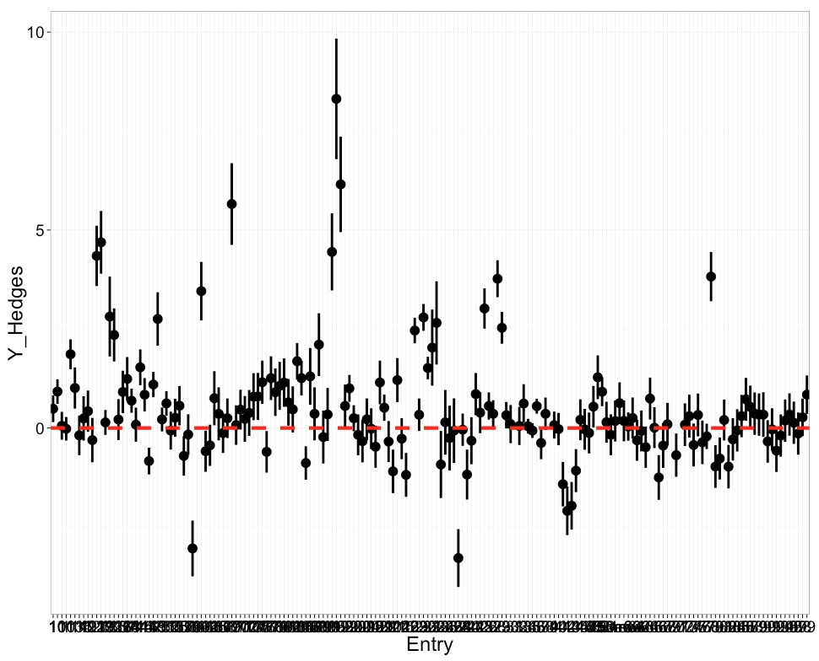

Slide 16
Compare the Metrics!

