Slide 1
Push
Pick&Place
Flip
Drop
Roll
Pick&Place

Slide 2
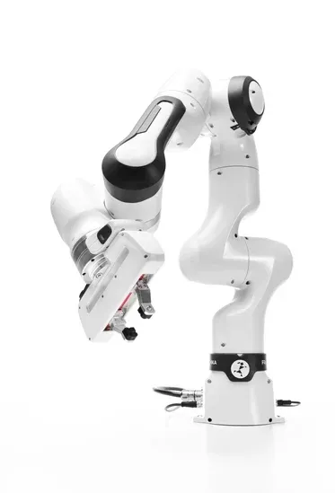

Slide 3
Medical Diagnosis

Slide 4
ICU Mortality Prediction

Slide 5
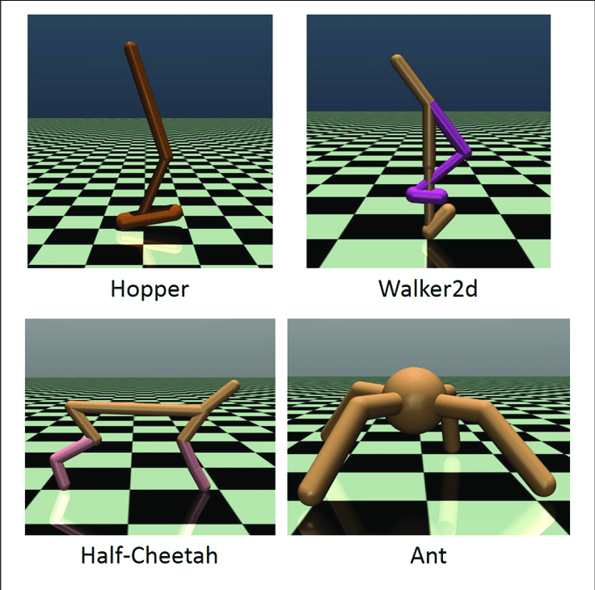

Slide 6

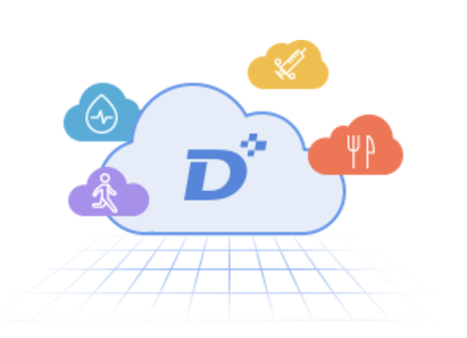

Slide 7
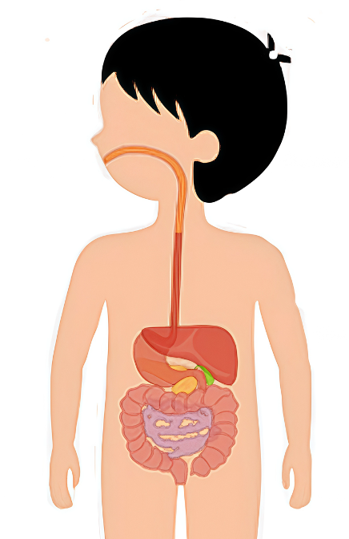
Meal
🍚
Medicine
💉 💊
Dynamic models
Dynamic Treatment Regimes
(Closed-Loop Control)

