Slide 1
Push
Pick&Place
Flip
Drop
Roll
Pick&Place

Slide 2
Medical Diagnosis

Slide 3
ICU Mortality Prediction

Slide 4
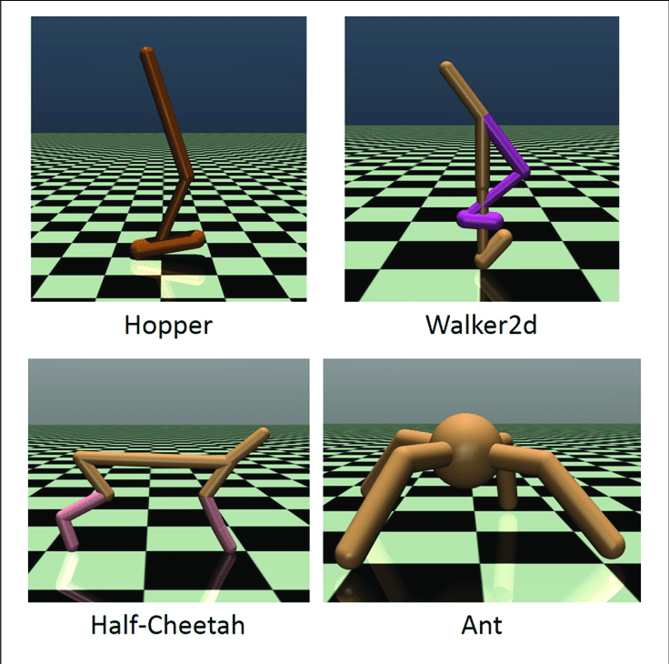

Slide 5

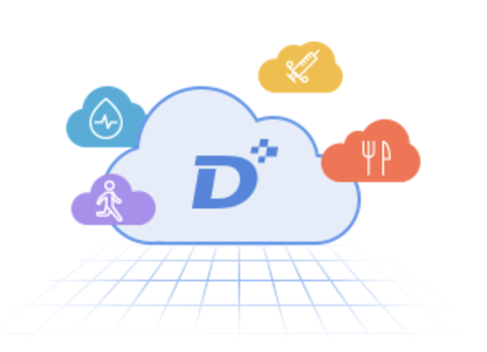

Slide 6
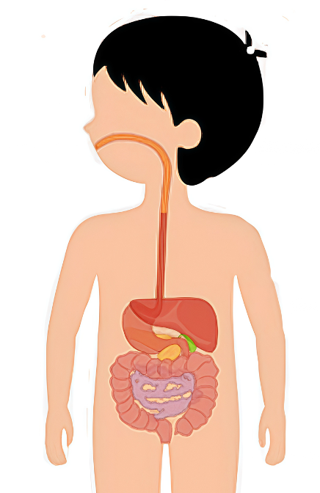
Meal
🍚
Medicine
💉 💊
Dynamic models
Dynamic Treatment Regimes
(Closed-Loop Control)

