Slide 1
Assignment 2
Diabetes Prediction using Decision Tree and Random Forest
Bao-Hsuan Huang
Po-Chih Kuo

Slide 2
Introduction
Diabetes mellitus is a common chronic disease, and it may cause many complications. According to statistics, the morbidity of diabetes has been on the rise in recent years.
In about 20 years, the world’s diabetic patients will reach 642 million, which means that one in every ten adults will have diabetes in the future.
Therefore, in this assignment, we need to analyze the given ICU dataset and predict whether the patient suffers from diabetes.

Slide 3
Dataset
GOSSIS dataset (The Global Open-Source Severity of Illness Score)
Real Data
The real data collected by GOSSIS consortium
A database contains a large amount of critical care data from many different intensive care units (ICUs) worldwide
Basic Part : We extract 30 cases with 9 attributes and 1 label (‘diabetes_mellitus’)
Advanced Part : We extract 8379 cases with 24 attributes and 1 label

Slide 4
Goal
Implement a decision tree with GOSSIS dataset
Implement a random forest by using your decision tree model
Predict the patients’ diabetes (‘diabetes_mellitus’) from real data
Fine-tune the model for better performance

Slide 5
Grading Policy
Item | Score
Basic Implementation (Decision Tree) | 60%
Advanced Implementation (Random Forest) | 35%
Report | 5%

Slide 6
Basic Implementation (60%)
Given information on several patients and whether they have diabetes
Build a decision tree in following steps with diabetes detection dataset
Step 1 : calculate the entropy (10%)
Step 2 : calculate the information gain (10%)
Step 3 : search for the best split (10%)
Step 4 : split data into 2 branches (10%)
Step 5 : build the decision tree (10%)
Step 6 : make predictions by decision tree (10%)
Please use hw2_input_basic.csv as your input data
You don’t need to use hw2_input_test.csv in the basic part
Please save your answer in hw2_basic.csv

Slide 7
Advanced Implementation (35%)
Build a random forest by using at least 3 decision trees
Please use hw2_input_advanced.csv as the input data
Please use hw2_input_test.csv as the test data and make the predictions
Make predictions with the test data
Please save the predictions in hw2_advanced.csv

Slide 8
Advanced Grading Policy
Make predictions with Random Forest on the test data in hw2_input_test.csv
Baseline – 20%
F1-Score >= 0.55
Ranking – 15%
We will calculate F1-Score to compete with the whole class

Slide 9
You will have the following items
Template : hw2.ipynb
Input file :
hw2_input_basic.csv
hw2_input_advanced.csv
hw2_input_test.csv (without label data)
Sample output file :
sample_basic.csv
sample_advanced.csv

Slide 10
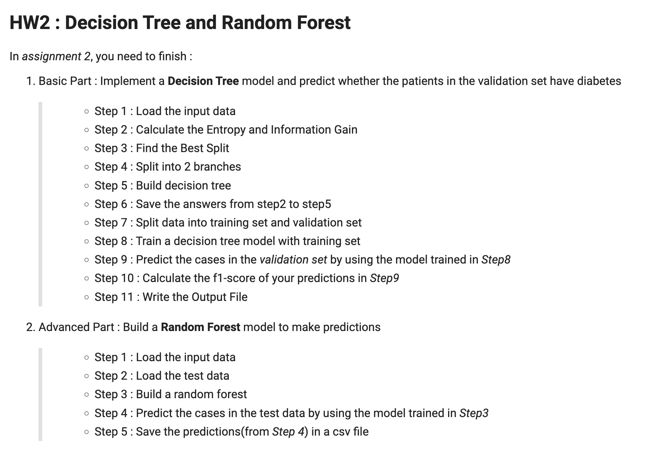
Template
You must use the given file hw2.ipynb to build the model
Except for the imported packages in the template, you cannot use any other packages

Slide 11
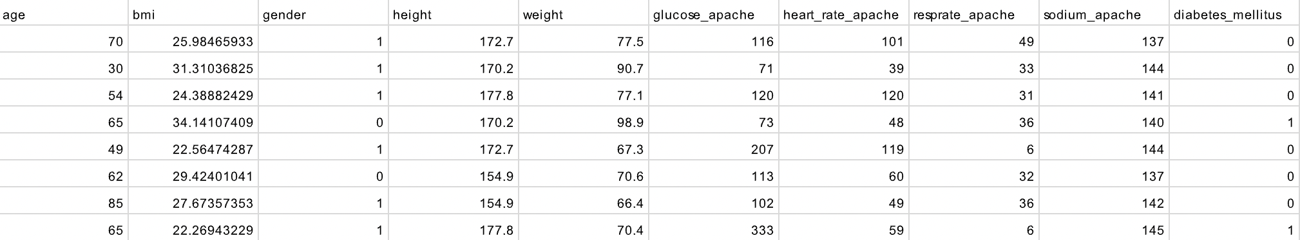
Basic Input File Format
Named “hw2_input_basic.csv”
30 instances in total
Each instance has 9 features and 1 class label
9 features
Class label

Slide 12
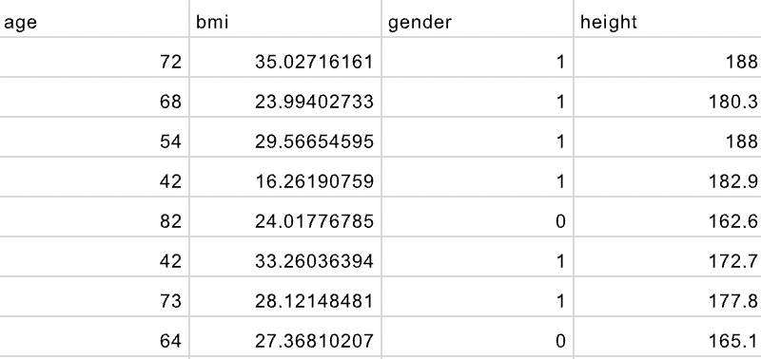
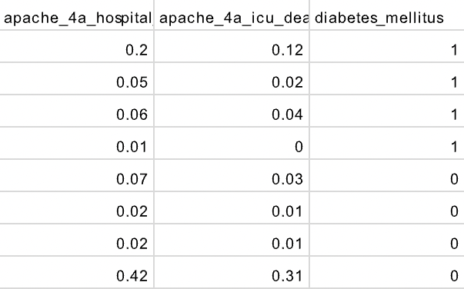
Advanced Input File Format
Named “hw2_input_advanced.csv”
8379 instances in total
Each instance has 24 features and 1 class label
24 features
Class label
……. …….

Slide 13
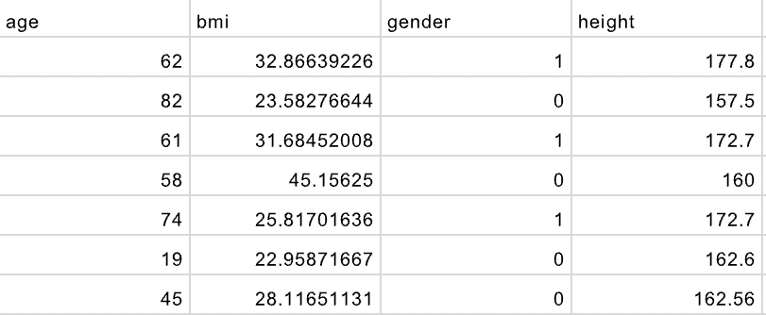
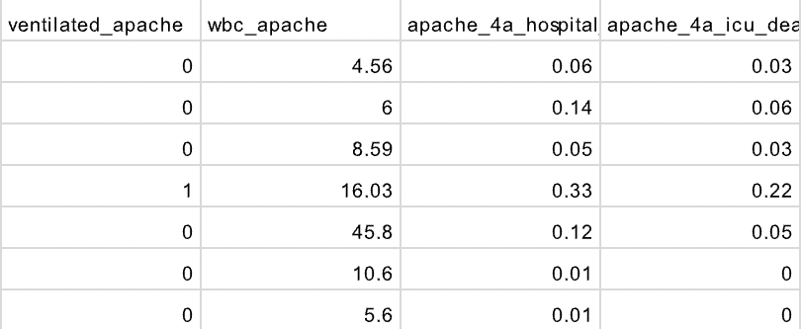
Advanced Input Test File Format
Named “hw2_input_test.csv”
840 instances in total
Each instance has 24 features
Without class label
24 features
……. …….

Slide 14
Basic Output File Format
Named as hw2_basic.csv
There should be (7+2n) rows in your csv file:
row number | description | variable
Row 1 | entropy | ‘ans_entropy’
Row 2 | information gain | ‘ans_informationGain’
Row 3~5 | best split information gain, value, feature | ‘ans_ig’, ‘ans_value’, ‘ans_name’
Row 6 | number of instances in the left subtree | ‘ans_left’
Row 7 ~ 7+(n-1) | n features you used | ‘ans_features’
Row 7+n, 7+(2n-1) | the threshold corresponding to each feature | ‘ans_thresholds‘
Row 7+2n | F1-score | ‘ans_f1score’

Slide 15
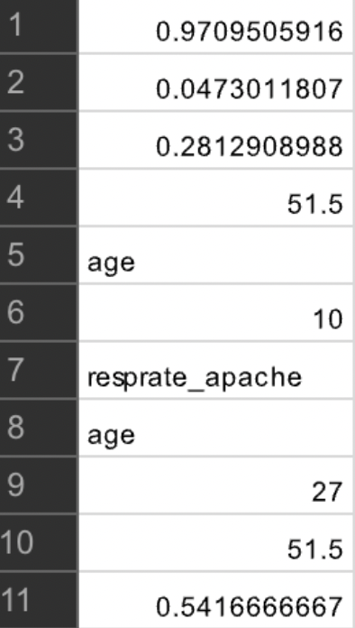
Basic Output File Format
ans_entropy
Example:
Please make sure that your output format is correct
You can refer to the output format of sample_basic.csv
ans_informationGain
ans_ig
ans_value
ans_name
ans_left
ans_features
ans_thresholds
ans_f1score

Slide 16
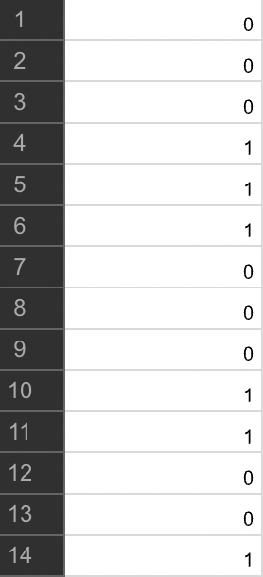
Advanced Output File Format
Named as hw2_advanced.csv
y_test contains 840 instances
There should be 840 rows in your csv file
Without header
Your prediction answer should be either 0 or 1
Please make sure that your output format is correct
You can refer to the output format of sample_advanced.csv

Slide 17
Report
Named as “hw2_report.pdf”
Briefly describe the attributes setting of the random forest model (2%), including:
The number of trees you used
The number of features you used
The number of instances you used to build each tree
(optional) any other settings
Briefly describe the difficulty you encountered (1%)
Summarize how you solve the difficulty and your reflections (2%)
No more than one page

Slide 18
Assignment 2 Requirement
Do it individually! Not as a team! (The team is for final project)
Announce date: 2022/10/20
Deadline: 2022/11/2 23:59 (Late submission is not allowed!)
Hand in your files in the following format (Do not compressed!)
hw2_basic.csv
hw2_advanced.csv
hw2.ipynb
hw2_report.pdf
Assignment 2 would be covered on the exam next time

Slide 19
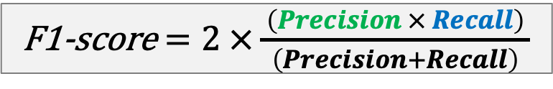
The Evaluation Metric
F1-score
For example
The class you predicted:
ŷ = [1, 1, 0, 0, 0, 0, 1]
Actual values:
y = [0, 0, 0, 0, 0, 1, 1]
F1-score = 0.4
F1-score $=2 ×\frac{ \left(Precision × Recall\right) }{ \left(Precision+Recall\right) }$
 |  | Actual/True value
 |  | positive | negative
Predicted value | positive | TP | FP
 | negative | FN | TN
 |  | Actual/True value
 |  | positive | negative
Predicted value | positive | TP | FP
 | negative | FN | TN

Slide 20
Penalty
0 points if any of the following conditions happened
Plagiarism
Late submission
Not using a template or importing any other packages in this assignment
Incorrect prediction format
Incorrect submission format

Slide 21

Questions?
TA: Bao-Hsuan Huang (thebhhuang@gmail.com)
Do not ask for debugging.

