Slide 1
Assignment 4
Convolutional Neural Network
Yun-Yang Huang
Po-Chih Kuo

Slide 2
Goal
Build your own convolutional neural network step by step
Extend your previous NN to “C”NN
Implement certain functions required to build a convolutional neural network
Understand the how convolution layer and max pooling layer work, including forward propagation, backward propagation and update.
Build a convolutional neural network to predict the pulmonary disease of patients from their chest X-ray (CXR) images.
Be familiar with existing DL tools (TensorFlow)

Slide 3
Grading Policy
Item | Score
Basic Implementation | 65%
Advanced Implementation | 25%
Basic & Advanced Report | 10%

Slide 4
Overview
Layer with parameters
Layer without parameters
convolution layer
Max pooling layer, flatten layer
forward
forward
backward
backward
update

Slide 5
Overview
Model
Convolution layer
model_initialize_parameters
*Activation function layer
model_forward
Max pooling layer
compute_cost
…
Flatten layer
*model_backward
*Dense layer
model_update_parameters
*Activation function layer
*: you don’t need to implement in this assignment

Slide 6
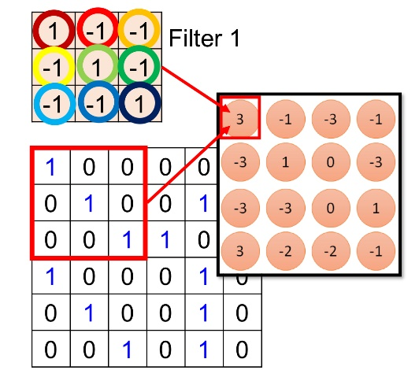
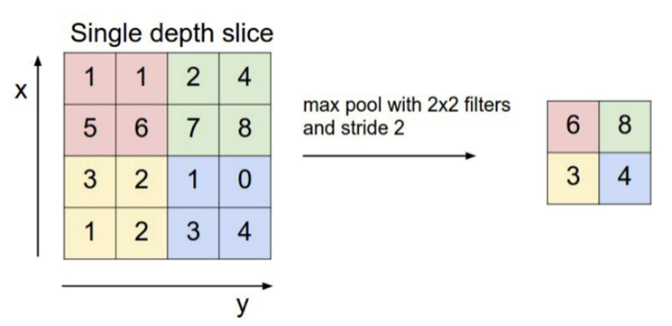
Basic Implementation (65%)
Convolution layer
Initialize the weight of the layer (1%)
Implement Zero-Padding function. (3%)
Implement conv_single_step() function. (5%)
Implement forward pass. (15%)
Implement convolution update parameters. (1%)
Max pooling layer
Implement forward pass. (15%)
Flatten layer
Forward pass (5%)
Backward pass (5%)

Slide 7
Basic Implementation (65%)
Model
Implement model forward, backward and update. (5%)
Designing a binary classifier (10%)
Implement a binary classifier and try to get a good performance.
You can only use the functions you implement in the previous step.
You will get all 10% if your prediction achieves accuracy greater than 0.55 in the testing set.

Slide 8
Basic Implementation (65%)
For the basic part, if you want to use any other packages that are used for speeding up your training, you must ensure that the final output you submitted must match the output format we specify in the ppt, or otherwise, zero marks will be given for that code implementation.
If you use any other packages, you must write the reason why you want to do so in the report, where you use them and the result of using these packages.
Although you don’t need to implement the backward pass of the convolutional neural network, you still can try to understand it. It will give you a deeper understanding of deep learning.

Slide 9
Advanced Implementation (25%)
Designing a binary classifier in TensorFlow
Build a convolutional neural network in TensorFlow.
You can import any packages in this part.
You will get 15 % if your prediction achieves accuracy greater than 0.7 in the testing set.
The rest 10 % will be graded by your rank.
Some TensorFlow tutorials:
There is no limitation!!!
https://www.tensorflow.org/tutorials/images/cnn
https://www.tensorflow.org/tutorials/images/data_augmentation
https://www.tensorflow.org/tutorials/images/transfer_learning

Slide 10
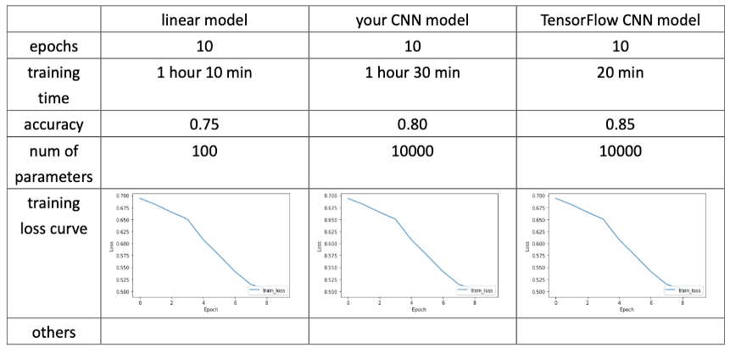
Report (Basic and Advanced) (10%)
Do a simple experiment to find out whether your convolutional neural network exceeds your linear model (under the same number of epochs). And below are some evaluation metrics you need to finish:
- epochs(2%)
- training time (1%)
- accuracy (both training and valid) (1%)
- number of parameters (2%)
- training loss curve (2%)
- others(optional)
For the advanced part: Describe how you design or choose your own model architecture, and how you choose loss function and optimizer. (2%)
Do not exceed 2 pages!

Slide 11
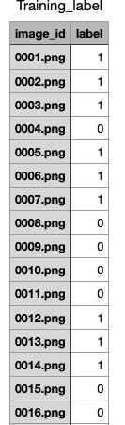
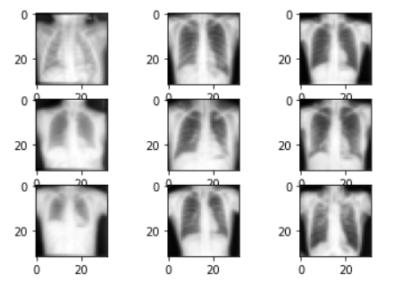
Data (Basic and Advanced)
Binary classification: Chest X-rays images
You will get 600 samples as training data. (300 normal and 300 abnormal) and 60 samples as testing data.
Use the training data to predict whether the patient in test data is normal or not.
0:normal; 1:abnormal
The first column of the Traing_lable.csv file corresponds to the file name of the images.
The shape of X_train: (600, 32, 32, 1); shape of y_train: (600, 1)
X_test(60, 32, 32, 1)

Slide 12
Items for you
Template: hw4_template.ipynb
Some files: Dense.py, Activation.py, Loss.py, Predict.py. You can paste the code you wrote in HW3 into these py files and import these files to ipynb file. Bellows are the functions you need to copy-and-paste:
Training data: Training_data.zip, Testing_data.zip, Training_label.csv
Sample output: sample_output.npy
Dense.py class Dense(): | Activation.py class Activation(): | Loss.py | Predict.py
initialize_parameters() | forward() | compute_BCE_cost()
forward() | backward()
backward()
update()

Slide 13
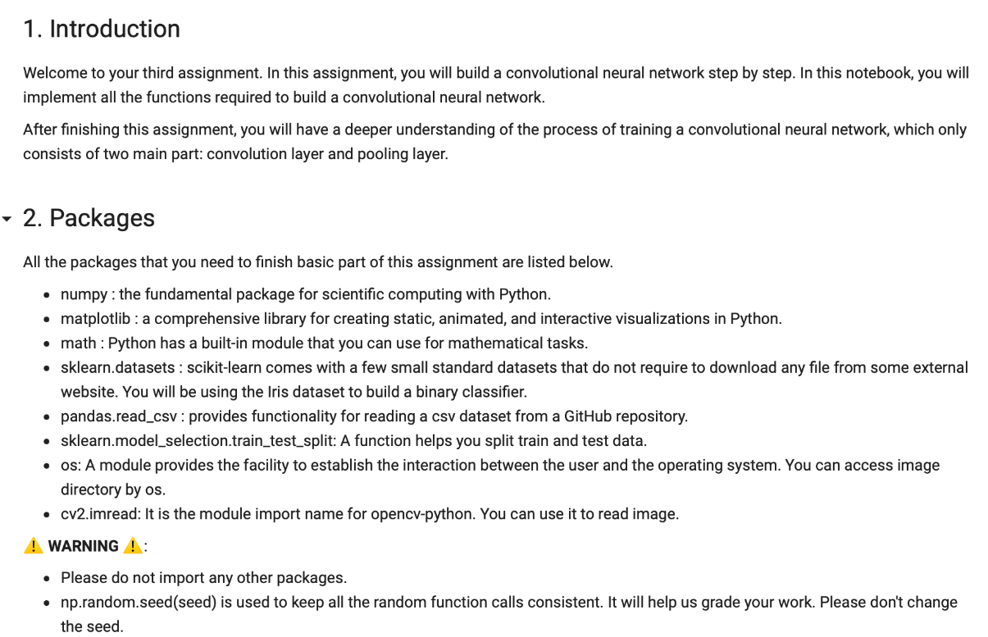
Template
Except for the imported packages in the template, you cannot use any other packages (ex: tqdm).
Remember to save the code file to hw4.ipynb

Slide 14
Output NPY File Format
Named as “hw4_output.npy”
This file is a dictionary that stores your output for each function. Note that the hyperparameter and weights of classifier in basic part will also be stored in the output file to check whether your predictions come from the same classifier you submitted.
The dictionary should have the following keys: 'conv_initialization', 'zero_padding', 'conv_single_step', 'conv_forward_1', 'conv_forward_2', 'conv_forward_3', 'conv_update_1', 'conv_update_2', 'maxpool_forward', 'flatten_forward', 'flatten_backward', 'model_1', 'model_2', 'model_3', 'model_4', 'basic_pred_test', 'basic_model_layers', 'basic_model_parameters', 'advanced_pred_test'

Slide 15
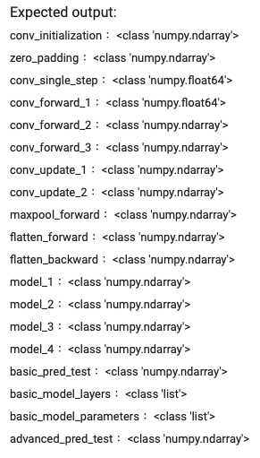
Output NPY File Format

Slide 16
The Evaluation Metric
In the basic implementations, you will get a full score if your output is exactly the same as our answer, or otherwise you will get a zero mark for each function implementation.
For the binary classifier, we will use accuracy to evaluate your model.
Basic part: If your accuracy reaches 0.55, you will get all 10%.
Advanced part: If your accuracy reaches 0.7, you will get 15%. You will be compared with others who submit the advanced prediction to get the rest 10%.

Slide 17
Requirement
Do it individually! Not as a team! (team is for final project)
Announce date: 2022/12/1
Deadline: 2022/12/14 23:59 (Late submission is not allowed!)
Hand in your files in the following format (Do not zip the files!) - hw4.ipynb (Please keep your execution output) - hw4_output.npy
- hw4_report.pdf
Assignment 4 will be covered on the next exam.

Slide 18
Penalty
0 points if any of the following conditions:
Plagiarism
Late submission
Not using template or import any other packages
Incorrect input/output format
Incorrect submission format
Predictions mismatch (your predictions did not come from the same classifier you submitted)

Slide 19
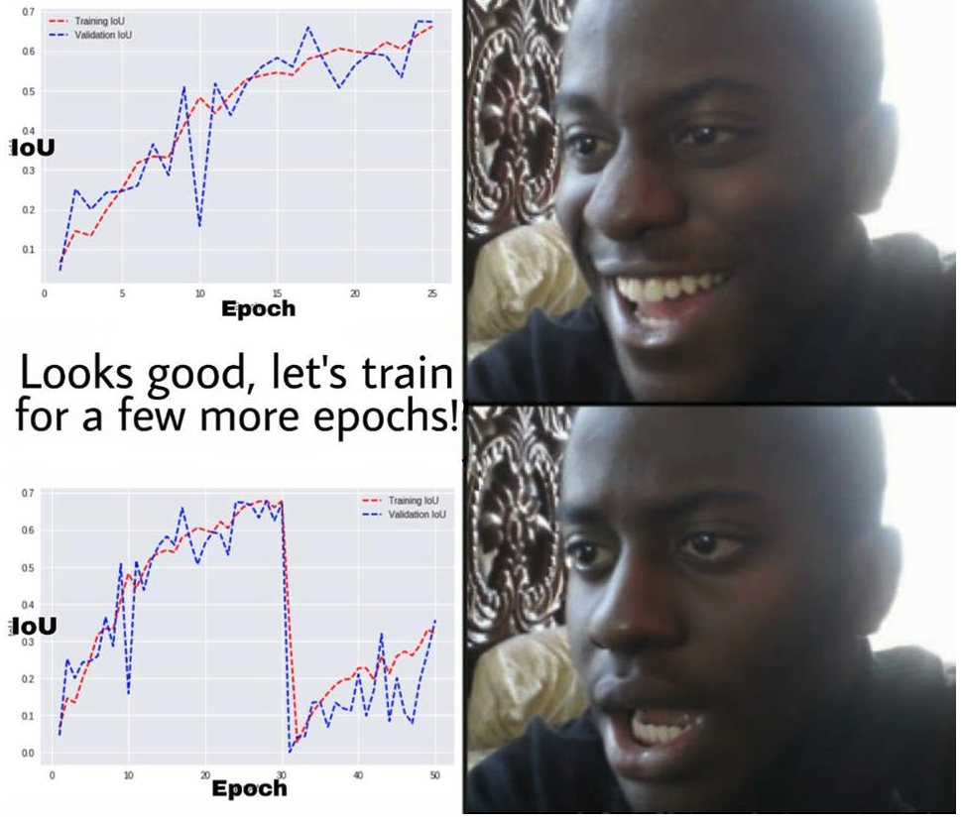
Questions?
TA: Yun-Yang Huang (dan89092989@gmail.com)
No debugging service

