Slide 1
Assignment 3
Neural Network
Jia He Lim
Po-Chih Kuo

Slide 2
Goal
Build your own deep neural network step by step
Implement all the functions required to build a deep neural network
Understanding forward propagation, backward propagation and update
Implement Binary Cross-Entropy loss (basic part) and Categorical Cross-Entropy loss (advanced part)
Implement binary classifier (basic part) and multi-class classifier (advanced part)

Slide 3
Grading Policy
Item | Score
Basic Implementation | 65%
Advanced Implementation | 30%
Basic & Advanced Report | 5%

Slide 4
Overview
Layer with parameters
Layer without parameters
Dense layer
Activation function layer
initialize_parameters
forward
forward
backward
backward
update

Slide 5
Overview
Model
Dense layer
model_initialize_parameters
Activation function layer
model_forward
Dense layer
compute_cost
Activation function layer
…
model_backward
Dense layer
model_update_parameters
Activation function layer

Slide 6
Basic Implementation (65%)
Dense layer
Create and initialize parameters of a linear layer with Glorot uniform initialization. (5%)
Implement linear forward. (5%)
Implement linear backward. (5%)
Implement linear update parameters. (5%)
Activation function layer
Implement activation forward. (5%) (Sigmoid and ReLU)
Implement activation backward. (5%) (Sigmoid and ReLU)

Slide 7
Basic Implementation (65%)
Model
Implement model initialize parameters. (5%)
Implement model forward. (5%)
Implement model backward. (5%)
Implement model update parameters. (5%)
Compute the binary cross-entropy cost. (5%)
Implement a binary classifier and tune hyperparameter to get a good rank. (10%)

Slide 8
Advanced Implementation (30%)
Activation function layer
Implement activation forward. (5%) (Softmax)
Implement activation backward. (5%) (Softmax+CCE_loss)
Model
Compute the categorical cross-entropy cost. (5%)
Implement a multi-class classifier and tune hyperparameter to get a good rank. (15%)

Slide 9
Basic & Advanced Report (5%)
Describe what problems you encountered and how did you solve them when implementing the basic and advanced functions. (2%)
Briefly describe the structure of your binary and multi-class classifiers. (2%)
Describe effort you put to improve your model (e.g., hyperparameter finetuning). (1%)
Do not exceed 1 page!
Name your report file as “report.pdf”.

Slide 10
Data
Binary classification: Breast Cancer Data Set
The data set consists of 569 samples (357 benign and 212 malignant). Ten real-valued features are computed for each cell nucleus: radius, texture, perimeter, area, smoothness, compactness, concavity, concave points, symmetry, and fractal dimension. The mean, standard error, and "worst" or largest (mean of the three largest values) of these features were computed for each image, resulting in 30 features. The details of the training set and validation set are shown below:
shape of X: (500, 30); shape of y: (500, 1)
shape of X_train: (400, 30); shape of y_train: (400, 1)
shape of X_val: (400, 30); shape of y_val: (100, 1)

Slide 11
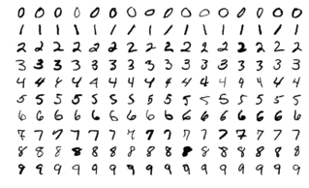
Data
Multi-class classification: MNIST handwritten digit dataset
The MNIST dataset is an acronym that stands for the Modified National Institute of Standards and Technology dataset. It is a dataset of 70,000 small square 28×28 pixels grayscale images of handwritten single digits between 0 and 9.
The details of the training set and testing set:
shape of X_train: (60000, 28, 28)
shape of y_train: (60000,)
shape of X_test: (10000, 28, 28)

Slide 12
Items for you
Template: HW3_Neural_Network.ipynb (basic input data inside) (You are encouraged to use Colab!)
Advanced data: advanced_data.npz
Sample output: sample_output.npy

Slide 13
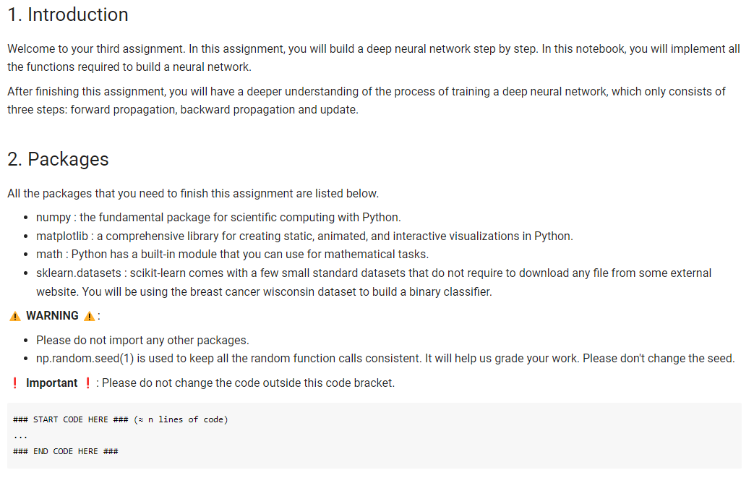
Template
Except for the imported packages in the template, you cannot use any other packages.
Remember to save the code file to HW3_Neural_Network.ipynb

Slide 14
Output NPY File Format
Named as “output.npy”
This file is a dictionary that stores your output for each function and the binary and multi-class classification prediction. Note that the hyperparameter and weights of both classifiers will also be stored in the output file to check whether your predictions come from the same classifier you submitted.
The dictionary should have the following keys: 'linear_initialize_parameters', 'linear_forward', 'linear_backward', 'linear_update_parameters', 'sigmoid', 'relu', 'softmax', 'sigmoid_backward', 'relu_backward', 'softmax_CCE_backward', 'model_initialize_parameters', 'model_forward_sigmoid', 'model_forward_relu', 'model_forward_softmax', 'model_backward_sigmoid', 'model_backward_relu', 'model_update_parameters', 'compute_BCE_cost', 'compute_CCE_cost', 'basic_pred_val', 'basic_layers_dims', 'basic_activation_fn', 'basic_model_parameters', 'advanced_pred_test', 'advanced_layers_dims', 'advanced_activation_fn', 'advanced_model_parameters'

Slide 15
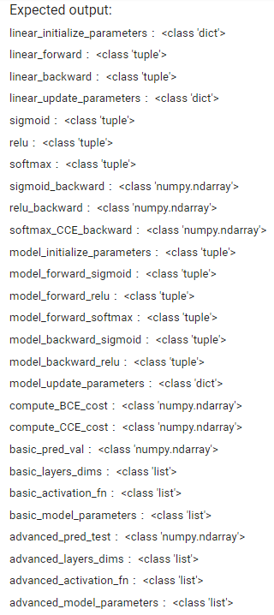
Output NPY File Format

Slide 16
Requirement
Do it individually! Not as a team! (team is for final project)
Announce date: 2022/11/10
Deadline: 2022/11/23 23:59 (Late submission is not allowed!)
Hand in your files in the following format (Do not compressed!) - HW3_Neural_Network.ipynb (Please keep your execution output) - output.npy - report.pdf
Assignment 3 will be covered on the next exam.
Note that Assignment 4 will be based on Assignment 3; it is recommended to put much effort into this assignment so you will have a good start for your next assignment.

Slide 17
The Evaluation Metric
In the basic and advanced function implementations, you will get a full score if your output is exactly the same as the standard answer, or else you will get a zero mark for each function implementation.
For the binary classifier and multi-class classifier, we will use accuracy to evaluate your classifier.
Binary classification: You will be compared with others who submit the basic prediction.
Multi-class classification: You will be compared with others who submit the advanced prediction.

Slide 18
Penalty
0 points if any of the following conditions:
Plagiarism
Late submission
Not using template or import any other packages
Incorrect input/output format
Incorrect submission format
Predictions mismatch (your predictions did not come from the same classifier you submitted)

Slide 19
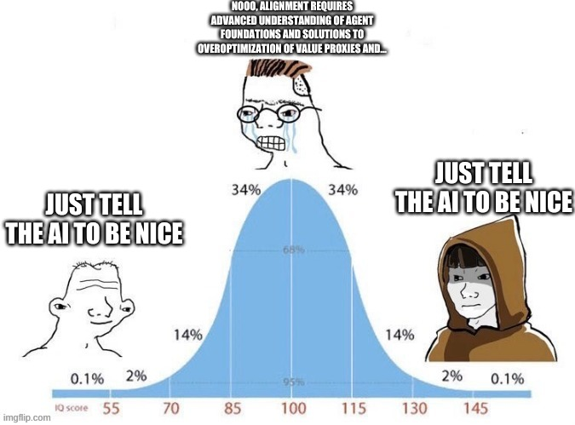
Questions?
TA: Jia He Lim (ivanljh123@gmail.com)
No debugging service

