Slide 1
Assignment 5
Brain Signal Classification
Chia-Yun Lee
Po-Chih Kuo

Slide 2
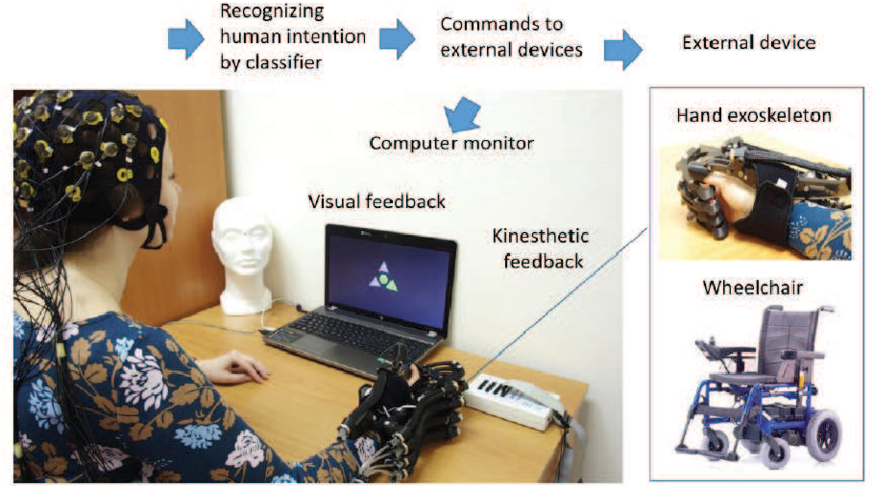
Introduction
Motor imagery describes the mental process in which a person merely imagines performing a certain action, such as extending or retracting the left or right hand without performing the left or right hand in actuality.
For patients with reduced mobility, motor imagery may be used to assist in communication and control some external instruments.

Slide 3
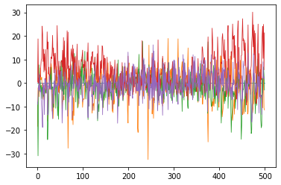
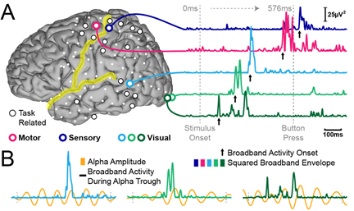
Introduction
EEG is a method to record an electrogram of the spontaneous electrical activity of the brain.
Motor imagery can be monitored by EEG signal via the electrodes placed above the motor areas.
In this assignment, we use the recorded EEG data in a motor imagery experiment to train models.

Slide 4
Introduction
There are six classes of motor imagery class in our dataset, including left/right-hand movement, left/right leg movement, tongue movement and passive imagery.
Predict motor imagery class based on the given EEG data.
Use RNN-based and CNN-based models to model time series data and compare the different performance between them.

Slide 5
Grading Policy
Item | Score
Model Implementation | 70%
Model competition | 20%
Report | 10%

Slide 6
Model Implementation (70%)
Design two models in TensorFlow or Pytorch to predict the class:
(35%) LSTM: Build your own LSTM model to reach a baseline. If your test accuracy reaches 0.6, you will get all 35%
(35%) EEGNet: Build a model reproducing EEGNet architecture in the attached paper (hw5_paper.pdf) to reach a baseline. If your test accuracy reaches 0.6, you will get all 35%.
You can import any packages.

Slide 7
Model competition (20%)
Ranking (20%) : We will use your test accuracy to compete with others.
You can redesign a new model with any state-of-the-art architecture or directly use one of the predictions in the model implementation part!
There is no any limitation!

Slide 8
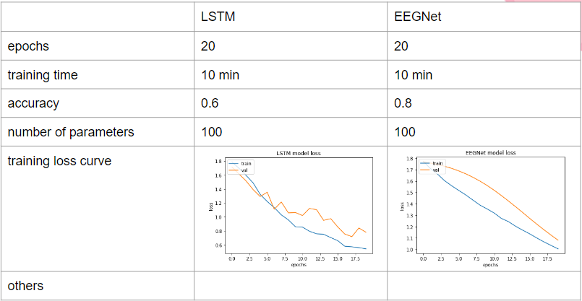
Report (10%)
Below are some elements you need to address in the Model Implementation Part:
- epochs(2%)
- training time (1%)
- accuracy (training and valid) (1%)
- number of parameters (2%) - training loss curve (2%) - others (optional)
For the Model Competition Part : Describe which model you use in competition. If you use other model architecture, explain how you design or choose the model. (2%)
Do not exceed 2 pages!

Slide 9
Dataset
You will get 604 samples as training data, 152 samples as validation data and 190 samples as testing data.
Each sample data contains 22 channels x 200 time points
The corresponding label is as below: 0 : left hand, 1 : right hand, 2 : passive, 3 : left leg, 4 : tongue, 5 : right leg
Use the training data and validation data to train and tune your model.
Predict the class of each samples in test data. The shape of the prediction of X_test is (190, 1).
The shape of the given data:
X_train : (604, 22, 200) Y_train : (604, 1)
X_val : (152, 22, 200) Y_val : (152, 1) X_test : (190, 22, 200)
The output format of your prediction should be the same as the sample_output.csv file.

Slide 10
Files for you
Template: hw5_template.ipynb
Training, validation and testing data: data.npz, label.npz
Sample output: sample_output.csv
Paper: hw5_paper.pdf
Remember to save the code file to hw5_template.ipynb!
We recommend you use google colab to do your homework.
Reference: https://www.tensorflow.org/api_docs/python/tf/keras/layers/LSTM

Slide 11
Requirement
Do it individually! Not as a team! (team is for final project)
Announce date: 2022/12/22
Deadline: 2023/1/9 23:59 (Late submission is not allowed!)
Hand in your files in the following format (Do not zip the files!) - hw5_template.ipynb (Please keep your execution output) - lstm_output.csv - eegnet_output.csv - competition_output.csv
- hw5_report.pdf

Slide 12
Penalty
0 points if any of the following conditions:
Plagiarism
Late submission
Incorrect prediction format
Incorrect submission format

Slide 13
Questions?
TA: Chia-Yun Lee (ss111062529@gapp.nthu.edu.tw)
Do not ask for debugging!

