Slide 1
Assignment 1 Dengue Case Prediction
Yi-Ju Chen
Po-Chih Kuo

Slide 2
Introduction
Millions of people suffer from the mosquito-borne disease dengue, whose primary habitat and breeding place is natural and artificial still-water bodies, which are directly related to environmental variables like temperature, precipitation, and so on.
Early prediction, detection, and subsequent action may reduce the risk of mass infection and save lives.
So in this assignment, we need to analyze the given dataset and predictive models to predict weekly dengue cases based in different cities in South America.

Slide 3
Dataset
True Data
From the cities in South America
Parts of data have been manipulated
Outliers and missing values were added
Dates were shifted
Time-dependent data
Case number
Temperature
Precipitation
Time-independent data
Elevation
Socio-economic variables

Slide 4
Goal
Predict weekly dengue cases based in different cities.
Combine temperature, precipitation, elevation, or other socio-economic variables to predict the weekly dengue cases
Implement the regression model to achieve the prediction
Preprocess/Split the data for model training/testing

Slide 5
Grading Policy
Item | Score
Basic Implementation | 60%
Advanced Implementation | 35%
Report | 5%

Slide 6
Basic Implementation (60%)
Given the average temperature and dengue fever cases in three cities in the past 94 weeks
Build a regression model for each city/all cities using temperature as an input variable to predict the number of cases in the next 10 weeks
Number of cases could be another input variable
Please use the file we provide as your input
Print the coefficients of your model (5%)

Slide 7
Basic Grading Policy
Baseline (including printing coefficients 5%) – 40%
Get all if average MAPE across all cities <= 35%
Ranking – 20%
Average MAPE across all cities to compete with the whole class (only those above baseline)

Slide 8
Advanced Implementation (35%)
Combined with other conditions or in a different way than the basic part to help your predictions for dengue cases in the next 10 weeks
You can finish this part in any other way you like
Using only temperature (same approach as basic model) will not get points.

Slide 9
Advanced Grading Policy
Baseline – 25%
Average MAPE across all cities <= 30%
Ranking – 10%
Average MAPE across all cities to compete with the whole class (only those above baseline)

Slide 10
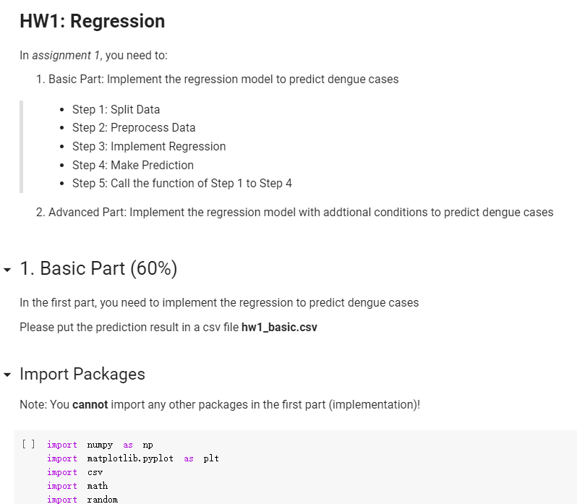
Template
You must use the given file “hw1_template.ipynb” to build the model
Except for the imported packages in the template, you cannot use any other packages in the basic part
There is no restriction on the format of the advanced part

Slide 11
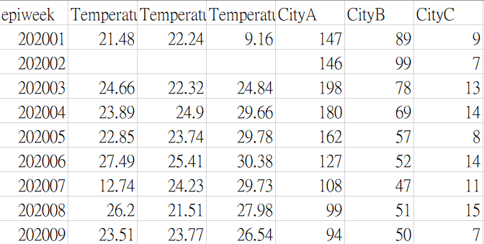
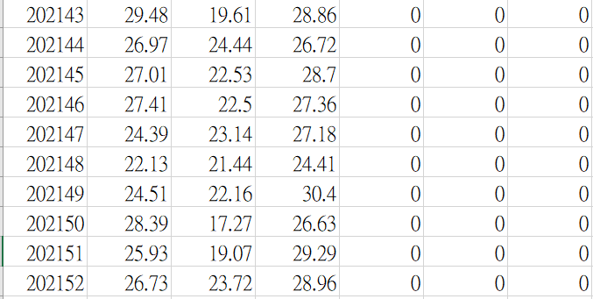
Basic Input File Format
Named “hw1_basic_input.csv” and containing a (n+1) * 7 matrix, n means the number of weeks
Each row represents “epiweek , TemperatureA, TemperatureB, TemperatureC, CityA, CityB, and CityC
CityA is the number of dengue case, and so are CityB, and CityC
TemperatureA is the average temperature of CityA, and so are TemperatureB,and TemperatureC
The part to be predicted (202143 ~ 202152 of CityA, CityB, and CityC) is filled with 0
We will use this format of csv file to test your model with n = 10 (202143 ~ 202152)
Please make sure your model can be correctly input into this format of csv file

Slide 12
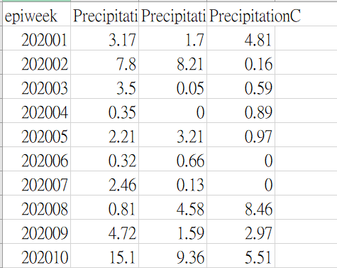
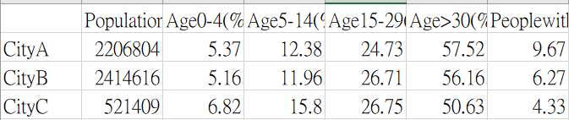
Advanced Input File Format
Named “hw1_advanced_input1.csv” and “hw1_advanced_input2.csv”
“hw1_advanced_input1.csv” is the precipitation data, which contains a (n+1) * 4 matrix, n means the number of weeks
“hw1_advanced_input2.csv” is the sociodemographic data, which contains a (n+1) * 26 matrix, n means the number of cities

Slide 13
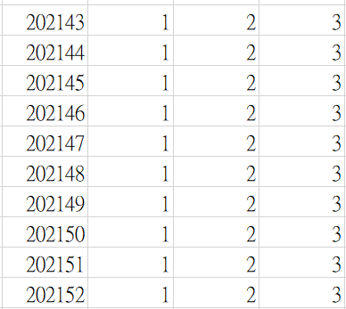
Output File Format
The prediction of both basic and advanced you turned in must follow this format
Named as “hw1_basic.csv” and “hw1_advanced.csv”, both contain a 10 * 4 matrix
Each row represents “epiweek, CityA, CityB, and CityC” without header
Please make sure your model can correctly output this format of csv file

Slide 14
Report
Named as “hw1_report.pdf”
Write down your regression equation in basic part (1%)
Briefly describe the variables you used in the advanced part (1%)
No point would be given for the advanced part if you do not clearly point out the difference between the basic part and the advanced part
Briefly describe the difficulty you encountered (1%)
Summarize how you solve the difficulty and your reflections (2%)
No more than one page

Slide 15
Assignment 1 Requirement
Do it individually! Not as a team! (The team is for final project)
Announce date: 2022/9/29
Deadline: 2022/10/12 23:59 (Late submission is not allowed!)
Hand in your files in the following format (Do not compressed!)
hw1_basic.csv
hw1_advanced.csv
hw1.ipynb
hw1_report.pdf
Assignment 1 would be covered on the exam next time

Slide 16
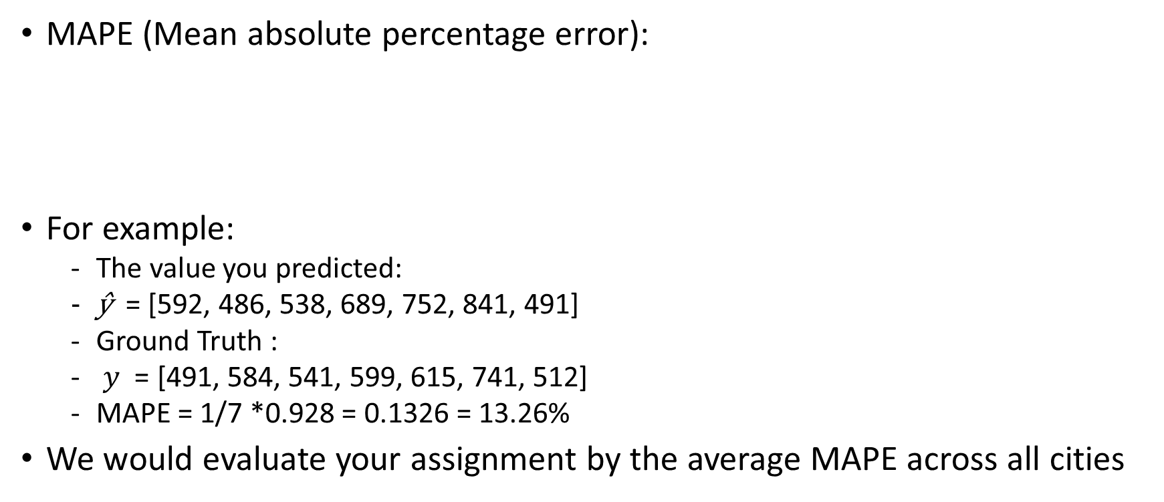

The Evaluation Metric

Slide 17
Penalty
0 points if any of the following conditions happened
Plagiarism
Late submission
Not using a template or importing any other packages in the basic part
Incorrect prediction format
Incorrect submission format

Slide 18

Questions?
TA: Yi-Ju Chen (ss111062511@gapp.nthu.edu.tw)
Do not ask for debugging.

