Slide 1
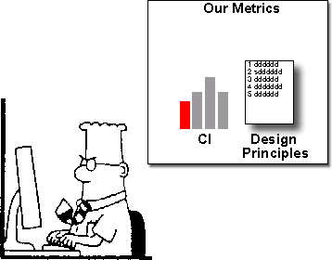
Object-Oriented Metrics
CSC 326

Slide 2
OO Metrics
Used to evaluate and predict the quality of software
Validation of a metric implies that
The metric measures what is purports to measure
Metric is associated with an external metrics like reliability
Used as an in-process measure of some external measure (like reliability) that cannot be measured until after the product is released
Not a “silver bullet” to measure in-process quality – may be other factors that can change metrics

Slide 3
Basic Code Metrics
Lines of Code
More lines of code = more maintenance.
Of two programs of “equal functionality,” it is better to have fewer lines of code.
But not at a cost of maintainability/readability
How do you count?
Number of Classes
To a point, more classes are preferred over fewer classes.
One class, one responsibility – better abstraction of project
No “Master” classes
Notes:
Exercise 15.01: Report your LOC and MLOC for the src/ folder in your iTrust.
Considerations of counting. Most if not all LOC tools will remove empty lines & comments from LOC counts. A closing } may be counted or not. LOC counts may be inflaited depending on how you do your open curly braces.
Metrics 1.3.6 counts any line that is not blank or that is not a comment.
Method LOC counts non-blank and non-comment lines in method bodies (headers, fields, etc. are not counted – this is more of a measure of executable portions of the code base.

Slide 4
Complexity
Cyclomatic complexity – estimate of the minimum # test cases that are needed to test a method comprehensively
Measured at the method level
Number of decisions in a method + 1
Weighted Methods Per Class – essentially # methods
Measured at the class level
May be the sum of the cyclomatic complexity of methods.

Slide 5
What is its Cyclomatic Complexity?
Notes:
Exercise 15.02
What is the cyclomatic complexity of this control flow graph?
What is the most complex class and method in the iTrust project? PatientValidator.validate().
What type of action would you consider taking with this information?

Slide 6
Complexity
Number of Methods
Historically, more methods is discouraged
More complex
Greater potential impact on child classes (more method to override)
More likely to be application specific and limiting reuse.
Currently, more, smaller methods are considered more prudent
Reduced complexity (lower cyclomatic complexity)
Increased readability
Improved understanding
Problems if a class with lots of methods is in a large inheritance tree

Slide 7
Cohesion
Degree to which the tasks performed by a single module are functionally related to state
The object represents a single object-oriented abstraction
Evaluates the design implementation and reuseability
Cohesiveness of methods within a class is desirable
Promotes encapsulation
Indicates good class subdivision
Lack of cohesion implies classes should probably be split into two or more subclasses.
Low cohesion
Increases complexity
Thereby increases the likelihood of faults

Slide 8
Lack of Cohesion
Measures the number of disjoint or non-intersection sets of local methods
Calculate for each data field in a class what percentage of the methods use that data. Average the percentages, then subtract from 100%. Lower percentages mean greater cohesion of data and methods.
Methods are more similar if they operate on the same attributes. Count the number of disjoint sets produced from the intersection of the sets of attributes used by the methods.
Notes:
From Metrics 1.3.6 page:
A measure for the Cohesiveness of a class. Calculated with the Henderson-Sellers method (LCOM*, see page 147). If (m(A) is the number of methods accessing an attribute A, calculate the average of m(A) for all attributes, subtract the number of methods m and divide the result by (1-m). A low value indicates a cohesive class and a value close to 1 indicates a lack of cohesion and suggests the class might better be split into a number of (sub)classes.I'm unsure of the usefullness of this metric in Java since it penalizes the proper use of getters and setters as the only methods that directly access an attribute and the other methods using the gettter/setter methods. Perhaps I could alter the implementation to take this into account, assuming standard JavaBean naming conventions.

Slide 9
Coupling
Measure of interdependence between two objects
Two classes are coupled, when methods declared in one class use methods or attributes of the other class
Excessive coupling
Detrimental to modular design and prevents reuse
Larger number of couples
Higher sensitivity to changes in other parts of the design
Thereby make maintenance more difficult

Slide 10
Coupling Factor
Numerator: number of non-inheritance couplings
Denominator: maximum number of couplings in a system
Includes both inheritance and non-inheritance related coupling
Inheritance related coupling are when subclasses inherit methods and attributes from a superclass
Notes:
Afferent Coupling (Ca)
The number of classes outside a package that depend on classes inside the package.
Efferent Coupling (Ce)
The number of classes inside a package that depend on classes outside the package.
Instability (I)
Ce / (Ca + Ce)
From Robert Martin book

Slide 11
Encapsulation
Encapsulation means that all that is seen of an object is its interface
namely the operations we can perform on the object
Attribute Hiding Factor
Measure of the proportion of attributes that are “invisible” from other classes or objects
Method Hiding Factor
Measure of the proportion of methods that are “invisible” from other classes or objects

Slide 12
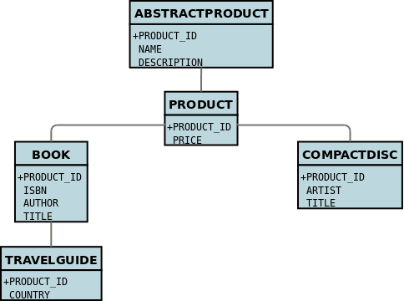
Inheritance- Depth of Inheritance Tree
Max length from the class node to the root of the class hierarchy tree, measured by # ancestor classes.
When involving multiple inheritance, the max length from the node to the root of the tree
Tradeoff: Deep trees ➔
conceptual integrity problem (hard to understand, so more complex) ☹
but greater reuse (of inherited methods) ☺

Slide 13
Inheritance- Number of Children
# direct descendants (subclasses) for each class.
Classes with large number of children
difficult to modify ☹
require more testing ☹
(due to the effects on changes on all the children)
more complex and fault-prone ☹
(due to the need of providing services in a larger number of contexts and therefore must be more flexible)
but greater reuse (of the defined methods) ☺

Slide 14
Metric | Desirable Value
Coupling Factor | Lower
Lack of Cohesion of Methods | Lower
Cyclomatic Complexity | Lower
Attribute Hiding Factor | Higher
Method Hiding Factor | Higher
Depth of Inheritance Tree | Low (tradeoff)
Number of Children | Low (tradeoff)
Weighted Methods Per Class | Low (tradeoff)
Number of Classes | Higher
Lines of Code | Lower

Slide 15
Measuring OO Metrics
Software to measure metrics!
Used a as a guideline on where you may want to improve your design or focus refactorings
Notes:
Exercise 15.03: Look at classes related to office visit functionality. Are there any metrics that concern you? If so, how would you address during Part 2? If not, how will you maintain approximately the same values?

