Slide 1
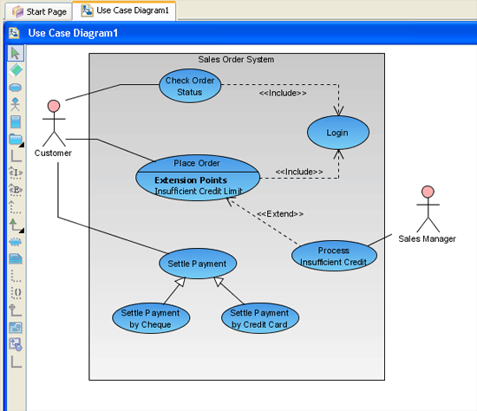
Requirements Engineering
CSC 326

Slide 2
Scope of Software Project Failures
WHY PROJECTS FAIL %
1. Incomplete Requirements 13.1
2. Lack of user involvement 12.4
3. Lack of resources 10.6
4. Unrealistic Expectations 9.9
5. Lack of executive support 9.3
6. Changing requirements 8.7
7. Lack of planning 8.1
8. Didn’t need it any longer 7.5
9. Lack of IT management 6.2
10. Technology illiteracy 4.3
Jim Johnson, The Standish Group International Project Leadership
Conference, May 1995, Chicago

Slide 3
Relative Cost to Fix an Error
Boehm’s analysis of 63 s/w development projects (IBM, GTE, TRW, etc.) to
Determine ranges in cost for errors created by false assumptions in req’ts phase
But not detected till later phases

Slide 4
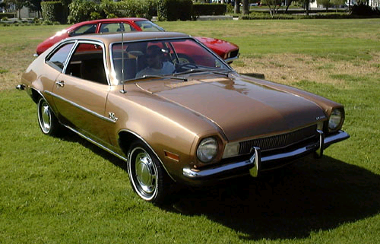
Ford Pinto
Manufactured in the 1970s
The position of the fuel tank mounting bolts was a good design based on an assumption:
There will be no rear impact collisions!
Assumption proved to be false.
Ford spent $100 million in litigation & recall services

Slide 5
Requirements
Software Requirement: condition or capability needed by a user to solve a problem or achieve an objective that must be met or possessed by a system or system component to satisfy a contract, standard, specification, or other formally imposed document
Description of what the customers want
May be buried beneath layers of assumptions, misconceptions, and politics

Slide 6
Requirements Engineering
Systematic way of developing requirements through an iterative process
Results in a specification of the system that stakeholders understands
natural language
easy to understand pictures (UML Diagrams)
A stakeholder is a key representative of the groups who have a vested interest in your system and direct or indirect influence on its requirements.

Slide 7
Requirements Engineering (2)
Analysis: studying user needs to generate system definition that users understand
Fact-finding
Communication
Fact-validation
Modeling: translating requirements the user understands to a form that software engineers understand
Representation
Organization

Slide 8
Types of Requirements
Functional requirements: requirements that specify a function that a system or system component must be able to perform
The watch shall display the time.
Non-functional requirements: not specifically concerned with the functionality of a system but place restrictions on the product being developed
User visible aspects of the system not directly related to functional behavior
Usability; reliability; privacy; security; availability; performance
Best to translate non-functional to measurable.
The response time must be less than 1 second
Constraints (“Pseudo requirements”): not user-visible; imposed by the client that restricts the implementation of the system or the development process
The implementation language must be Java.
Unit tests must be written in JUnit.
Notes:
Fixing problems or missing non-functional requirements may require a complete redesign of the system and can be expensive to fix. Make sure that you elicit non0functional requirements:
Are data sensitive – should it be protected?
What is the transaction time?
Check lists are useful.

Slide 9
Requirements Elicitation
Need to understand why not just what
Techniques
Interviews
Observation
Examining Documents and Artifacts
Join Application Design Sessions (JAD)
Groupware
Questionnaires
Prototypes
Focus Groups
On-Site Customer

Slide 10
Requirements Validation
Critical step in the development process,
Usually after requirements engineering or requirements analysis. Also at delivery
Requirements validation criteria:
Correctness:
The requirements represent the client’s view.
Completeness:
All possible scenarios through the system are described, including exceptional behavior by the user or the system
Consistency:
There are no functional or nonfunctional requirements that contradict each other
Clarity:
There are no ambiguities in the requirements.
Concise

Slide 11
Requirements Validation Criteria (continued)
Feasible:
Requirements can be implemented and delivered
Traceability:
Each system function can be traced to a corresponding set of functional requirements
Understandable
Non-prescriptive
everything about what the customer wants and nothing about how the programmer(s) will do it.
Consistent language
Shall, should, may
“the physician” vs. “the doctor”
Testable

Slide 12
Requirements Validation Criteria (continued)
Shall (== is required to): used to indicate mandatory requirements strictly to be followed in order to conform to the standard and from which no deviation is permitted: must or will is obsolete
Should (== is recommended that): used to indicate
among several possibilities one is recommended as particularly suitable, without mentioning or excluding others
or that a certain course of action is preferred but not necessarily required;
or that (in the negative form) a certain course of action is deprecated but not prohibited
May (== is permitted to): used to indicate a course of action permissible within the limits of the standard
Can (== is able to): used for statements of possibility and capability, whether material, physical, or causal
https://development.standards.ieee.org/myproject/Public/mytools/draft/styleman.pdf
See Section 11.2.2

Slide 13
Types of Requirements Statements
Traditional
“The system shall”
See Course Pack for an Example in Requirements Engineering Chapter
Use case based (a.k.a. iTrust)
User story – married with acceptance test to supply the detail
Agile requirements
Next class
Notes:
Traditional requirements
More contractual
Focus on what system does in small chunks
Best for large projects with fairly stable requirements
UseCases
Helps identify use ful classes
Helps with writing user manual
Think in scenarios
Start with scenarios

Slide 14
Traditional Requirements
FR2.4 Go to Jail
When the player lands on the Go to Jail cell, the player shall be sent to the Jail cell. The player shall not receive $200 if she or he passes the Go cell on the way to the Jell cell.
FR2.5 Buy Property
When the player lands on a tradable cell, including properties, railroads, and utilities, she or he shall have a chance to buy that cell given that the cell is available. If the player clicks on the Buy button, the cell shall be sold to the player. See FR3 for the price rules on the properties, railroads, and utilities.

Slide 15
Traditional Requirements
NR1.1 User Response
The system shall respond to any user input within 0.01 seconds.
Constraints
All code development shall be done with the Java programming language
All testing shall be done using JUnit and FIT
Notes:
Exercise 18.01

Slide 16
iTrust Spec: Use Case Based
See http://agile.csc.ncsu.edu/iTrust/wiki/doku.php?id=requirements#use_case_diagram_and_flow_of_events

Slide 17
Use Case-Based Requirement Elicitation
UML focuses on scenario-based requirements elicitation
Scenario:
sequence of actions that illustrates behavior.
A scenario may be used to illustrate an interaction or the execution of a use case instance

Slide 18
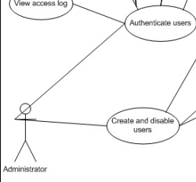
External System Behavior: Use Case Model
Complete course of events in the system, from the user’s perspective
Use Cases Model: Illustrates
(use cases) the system’s intended functions
(actors) surroundings – external to the system
(use case diagrams) relationships between use cases and actors
The collection of all use cases is everything that can be done to/with the system

Slide 19
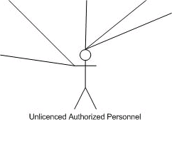
Actors
Are NOT part of the system – they represent anyone or anything that must interact with the system
Only input information to the system
Only receive information from the system
Both input to and receive information from the system
Represented in UML as a stickman, even when they are not “people”, such as a billing system

Slide 20
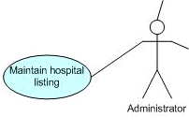
Use Case
A sequence of transactions performed by a system that yields a measurable result of values for a particular actor
A use case typically represents a major piece of functionality that is complete from beginning to end. A use case must deliver something of value to an actor.
Use cases that an actor “wants” begin with verbs.

Slide 21
Template for Flow of Events
X Flow of Events for the <name> Use Case
X.1 Preconditions
What needs to happen (in another use case) before this use case can start?
X.2 Main Flow
X.3 Subflows
Break “normal” flow into pieces
“called” by Main Flow or another subflow
X.4 Alternative Flows
Things that happen outside of the “normal” flow
“called” by Main Flow or a subflow
➔ Covers multiple related scenarios!!!

Slide 22
Clear Intersection Example
User wants to drive through an intersection. The user can only clear through the intersection if the traffic light is green and there are no cars in the intersection. Otherwise, the car needs to join a queue.

Slide 23
1. Flow of Events for the Clear Intersection Use Case
1.1 Preconditions
Traffic light has been initialized
1.2 Main Flow
This use case begins when a car enters the intersection. The car checks its status [S1]. The use case ends when the car clears the intersection [S4].
1.3 Subflows
S1 Check Status:
Check status [S2, S3]. If the light is green, and the queue is empty, the car clears the intersection [S4]. Otherwise, it joins a queue [S5].
S2 Check Light:
Send information on whether the light is red, yellow, or green.
S3 Check Queue:
Send information on whether the queue is empty or not
S4 Go:
The car clears the intersection and the use case ends.
S5 Join a Queue:
Car is added to queue

Slide 24
Scenario: Car approaches intersection with green light and no queue
1.1 Preconditions
Traffic light has been initialized
1.2 Main Flow
This use case begins when a car enters the intersection. The car checks its status [S1]. The use case ends when the car clears the intersection [S4].
1.3 Subflows
S1 Check Status:
Check status [S2, S3]. If the light is green, and the queue is empty, the car clears the intersection [S4]. Otherwise, it joins a queue [S5].
S2 Check Light:
Send information on whether the light is red, yellow, or green.
S3 Check Queue:
Send information on whether the queue is empty or not
S4 Go:
The car clears the intersection and the use case ends.
S5 Join a Queue:
Car is added to queue

Slide 25
Scenario: Car approaches intersection with red light and no queue
1.1 Preconditions
Traffic light has been initialized
1.2 Main Flow
This use case begins when a car enters the intersection. The car checks its status [S1]. The use case ends when the car clears the intersection [S4].
1.3 Subflows
S1 Check Status:
Check status [S2, S3]. If the light is green, and the queue is empty, the car clears the intersection [S4]. Otherwise, it joins a queue [S5].
S2 Check Light:
Send information on whether the light is red, yellow, or green.
S3 Check Queue:
Send information on whether the queue is empty or not
S4 Go:
The car clears the intersection and the use case ends.
S5 Join a Queue:
Car is added to queue

Slide 26
1. Flow of Events for the Clear Intersection Use Case
1.1 Preconditions
Traffic light has been initialized
1.2 Main Flow
This use case begins when a car enters the intersection. The car checks its status [S1]. The use case ends when the car clears the intersection [S4].
1.3 Subflows
S1 Check Status: Check status [S2, S3, E1, E2]. If the light is green, and the queue is empty, the car clears the intersection [S4]. Otherwise, it joins a queue [S5].
S2 Check Light: Send information on whether the light is red, yellow, or green.
S3 Check Queue: Send information on whether the queue is empty or not
S4 Go: The car clears the intersection and the use case ends.
S5 Join a Queue: Car is added to queue
1.4 Alternative Flows
E1 Light Out: The light is not red, yellow, or green. Wait for clear intersection and gun it.
E2 Accident: An accident is blocking the intersection. Rubber neck and slowly drive around it.

Slide 27
Flow of Events vs Scenario
Flow of events enumerates all subflows and exception flows.
Scenario is one path through your flow of events
When you’re testing, make sure you cover a reasonable (80%??) set of scenarios.

Slide 28
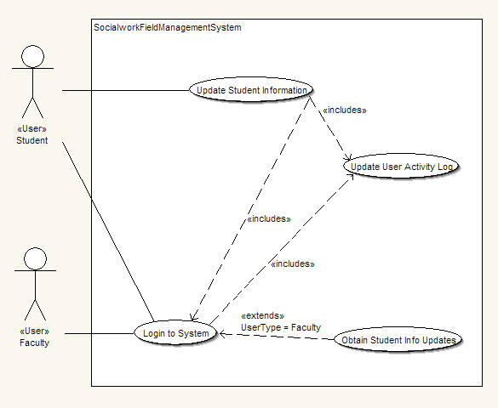
Stereotypes
Use Case X (Login to System) includes Use Case Y (Update User Activity Log):
X has a multi-step subtask Y. In the course of doing X or a subtask of X, Y will always be completed.
Use Case X (Obtain Student info Updates) extends Use Case Y (Login to System):
Y performs a sub-task and X is a similar but more specialized way of accomplishing that subtask. X only happens in an exception situation. Y can complete without X ever happening.

