Slide 1
WELCOME
START GAME

Slide 2

WELCOME
User presses on this button
START GAME

Slide 3
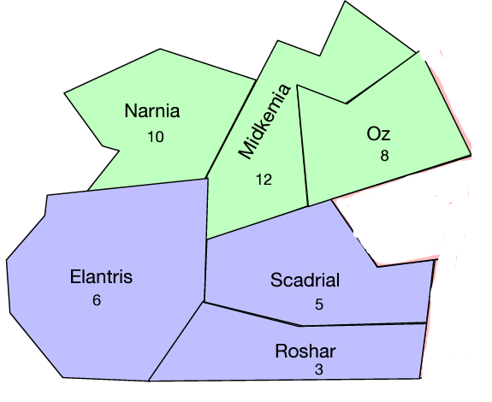
Player: Green
Choose Turn
—------------------------------------
Turn Status:
No turn yet!
Done with Turn! Commit!
Game Status:
Ready for turn!

Slide 4
Player: Green
Choose Turn
—------------------------------------
Selected Turn:
User clicks on this box
Turn Status:
No turn yet!
Done with Turn! Commit!
Game Status:
Ready for turn!

Slide 5
Player: Green
Choose Turn
—------------------------------------
Move
Attack
Upgrade
Turn Status:
No turn yet!
Done with Turn! Commit!
Game Status:
Ready for turn!

Slide 6
Player: Green
Choose Turn
—------------------------------------
Move
Attack
Upgrade
Turn Status:
No turn yet!
User clicks on the move
Done with Turn! Commit!
Game Status:
Ready for turn!

Slide 7
Player: Green
Choose Turn
Attack
From Territory
—-----------------------------------
To Territory
—------------------------------------
A units
Enter here
B units
Enter here
Cunits
Enter here
Turn Status:
No turn yet!
D units
Enter here
E units
Enter here
F units
Enter here
Game Status:
Ready for turn!
Add order!
Done with Turn! Commit!

Slide 8
Player: Green
Choose Turn
Attack
From Territory
—-----------------------------------
To Territory
—------------------------------------
A units
Enter here
B units
Enter here
User clicks on this box
Cunits
Enter here
Turn Status:
No turn yet!
D units
Enter here
E units
Enter here
F units
Enter here
Game Status:
Ready for turn!
Add order!
Done with Turn! Commit!

Slide 9
Player: Green
Choose Turn
Attack
From Territory
—-----------------------------------
—--------------------------------
Narnia
Midkemia
Oz
To Territory
—------------------------------------
A units
Enter here
B units
Enter here
Cunits
Enter here
Turn Status:
No turn yet!
D units
Enter here
User clicks on the text
E units
Enter here
F units
Enter here
Game Status:
Ready for turn!
Add order!
Done with Turn! Commit!

Slide 10
Player: Green
Choose Turn
Attack
From Territory
Narnia
To Territory
—------------------------------------
A units
Enter here
B units
Enter here
Cunits
Enter here
Turn Status:
No turn yet!
D units
Enter here
E units
Enter here
F units
Enter here
Game Status:
Ready for turn!
Add order!
Done with Turn! Commit!

Slide 11
Player: Green
Choose Turn
Attack
From Territory
Narnia
To Territory
—------------------------------------
Elantris
Scandrial
Roshar
A units
Enter here
B units
Enter here
Cunits
Enter here
Turn Status:
No turn yet!
D units
Enter here
User clicks on the text
E units
Enter here
F units
Enter here
Game Status:
Ready for turn!
Add order!
Done with Turn! Commit!

Slide 12
Player: Green
Choose Turn
Attack
From Territory
Narnia
To Territory
Elantris
A units
Enter here
B units
Enter here
Cunits
Enter here
Turn Status:
No turn yet!
D units
Enter here
E units
Enter here
F units
Enter here
Game Status:
Ready for turn!
Add order!
Done with Turn! Commit!

Slide 13
Player: Green
Choose Turn
Attack
From Territory
Narnia
To Territory
Elantris
A units
Enter here
B units
Enter here
Cunits
Enter here
Turn Status:
No turn yet!
D units
Enter here
User clicks on this box
E units
Enter here
F units
Enter here
Game Status:
Ready for turn!
Add order!
Done with Turn! Commit!

Slide 14
Player: Green
Choose Turn
Attack
From Territory
Narnia
To Territory
Elantris
A units
5
B units
Enter here
Cunits
Enter here
Turn Status:
No turn yet!
D units
Enter here
User enters a number
E units
Enter here
F units
Enter here
Game Status:
Ready for turn!
Add order!
Done with Turn! Commit!

Slide 15
Player: Green
Choose Turn
Attack
From Territory
Narnia
To Territory
Elantris
A units
5
B units
Enter here
Cunits
Enter here
Turn Status:
No turn yet!
D units
Enter here
User clicks this button
E units
Enter here
F units
Enter here
Game Status:
Ready for turn!
Add order!
Done with Turn! Commit!

Slide 16
Player: Green
Choose Turn
—-------------------------------------
User clicks this button
Turn Status:
Green: Attack order from Narnia to Elantris with 0 ALEVEL units - successful
Game Status:
Attack order from Narnia to Elantris added!
Add order!
Done with Turn! Commit!

Slide 17
Player: Green
Choose Turn
—-------------------------------------
Turn Status:
No turn yet!
Updated map will be displayed
Game Status:
Ready for turn!
Add order!
Done with Turn! Commit!

Slide 18
UX Principles
Figure-Ground
Focal Point
Similarity
Proximity
Common Region
Continuity
Common Fate
Closure

