Slide 1
Self-organising Contraption for Automatic Task-distribution
Topic 4
Student Yuyan Zhao

Slide 2

01
Introduction
02
Model Design
03
Implementation on Netlogo
04
Results and Evaluation

Slide 3
Introduction
Task-distribution Distribute a set of tasks of different types among a set of agents in the system.
This process is self-organised and decentralized No single centralised entity manipulating directly the distribution
Simulation via a 2D contraption

Slide 4
Model Design
Tasks -> Balls of different colours
Targets -> Buckets with the corresponding colour
Goal -> Allow balls to be automatically distributed to the target bucket
Laws -> “Physical” laws for balls -> Self-assembly laws for contraption

Slide 5


Model Design
“Physical” laws for balls
Free fall when not hitting an obstacle
Rolling on sloping or horizontal obstacles with the acceleration
Self-assembly Laws for Contraption
Balls can observe the nearest obstacles and buckets
And send messages to the obstacle to make it move
Obstacles can share information with each other to reconnect or prevent conflicts.

Slide 6
Implementation on Netlogo
Turtles
breed [balls ball], breed [slashes slash], breed [obstacles obstacle]
Patches
backgrounds, buckets
set-up
color settings, make-ball, make-bucket, make-slash, make-obstacle
go
check-bucket, check-dead, check-slash, check-obstacle
do-fall, do-roll, move obstacles

Slide 7
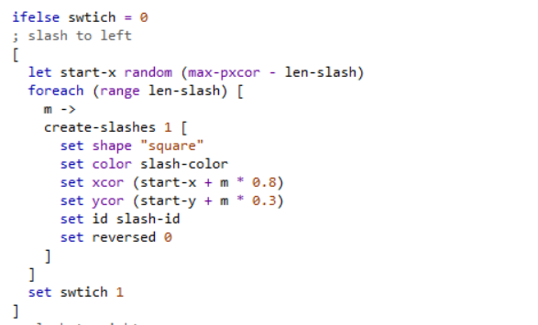
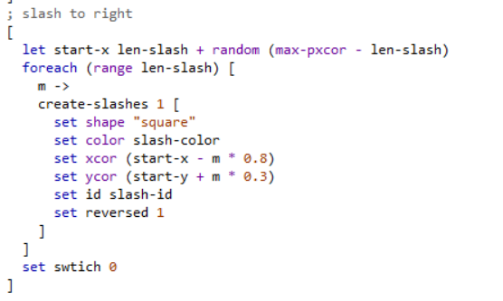

Implementation on Netlogo
create-slashes
Consists of set of squares with the same id
Linked and tied together in order to move as an entirety

Slide 8
Implementation on Netlogo
do-roll
check the kind of the obstacle met
If it is a slash, the ball will roll downwards with the same direction and get an acceleration
If it is a horizontal obstacle, the ball will roll horizontally according to the acceleration

Slide 9
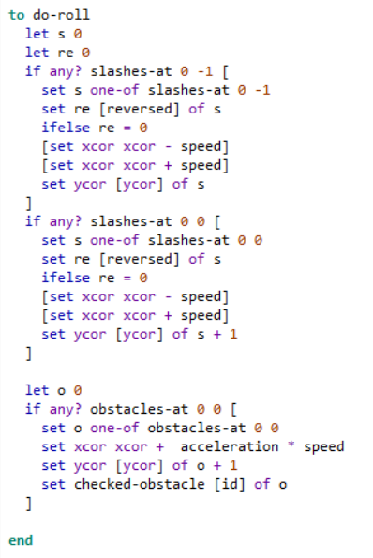
Implementation on Netlogo
do-roll

Slide 10
Implementation on Netlogo
move-obstacles
Observe the nearest obstacle: min-one-of obstacles [distance myself]
Observe the nearest buckets: let buckets patches with [pcolor = ball-color]; let bucketl-x min [pxcor] of buckets
The nearest obstacle was moved towards the ball depending on the length and direction of the obstacle
It will check other obstacles with conflicting positions and then makes them move

Slide 11
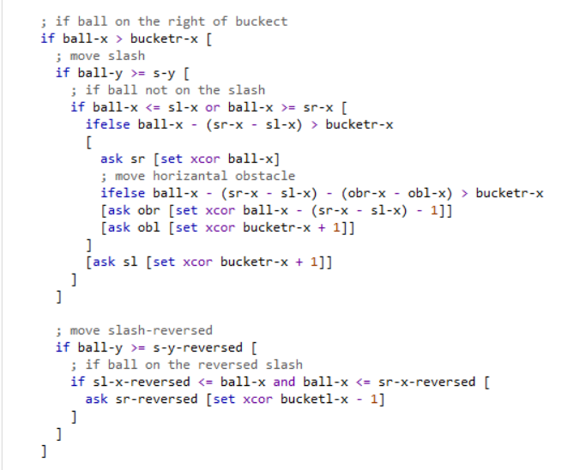
Implementation on Netlogo
move-obstacles

Slide 12
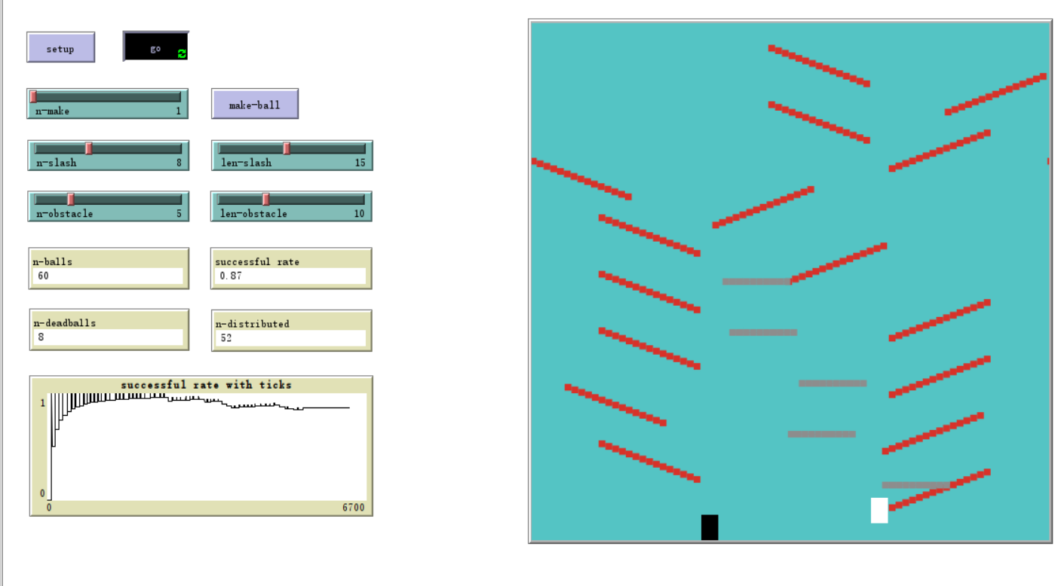
Results and Evaluation

Slide 13
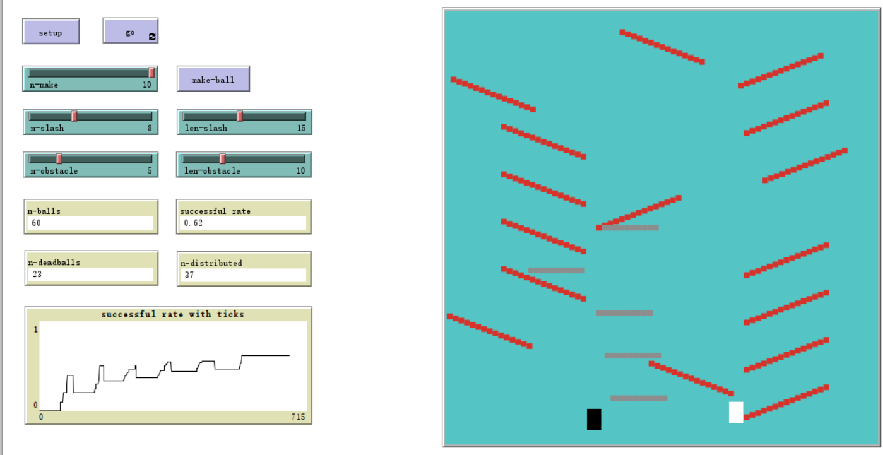
Results and Evaluation

Slide 14
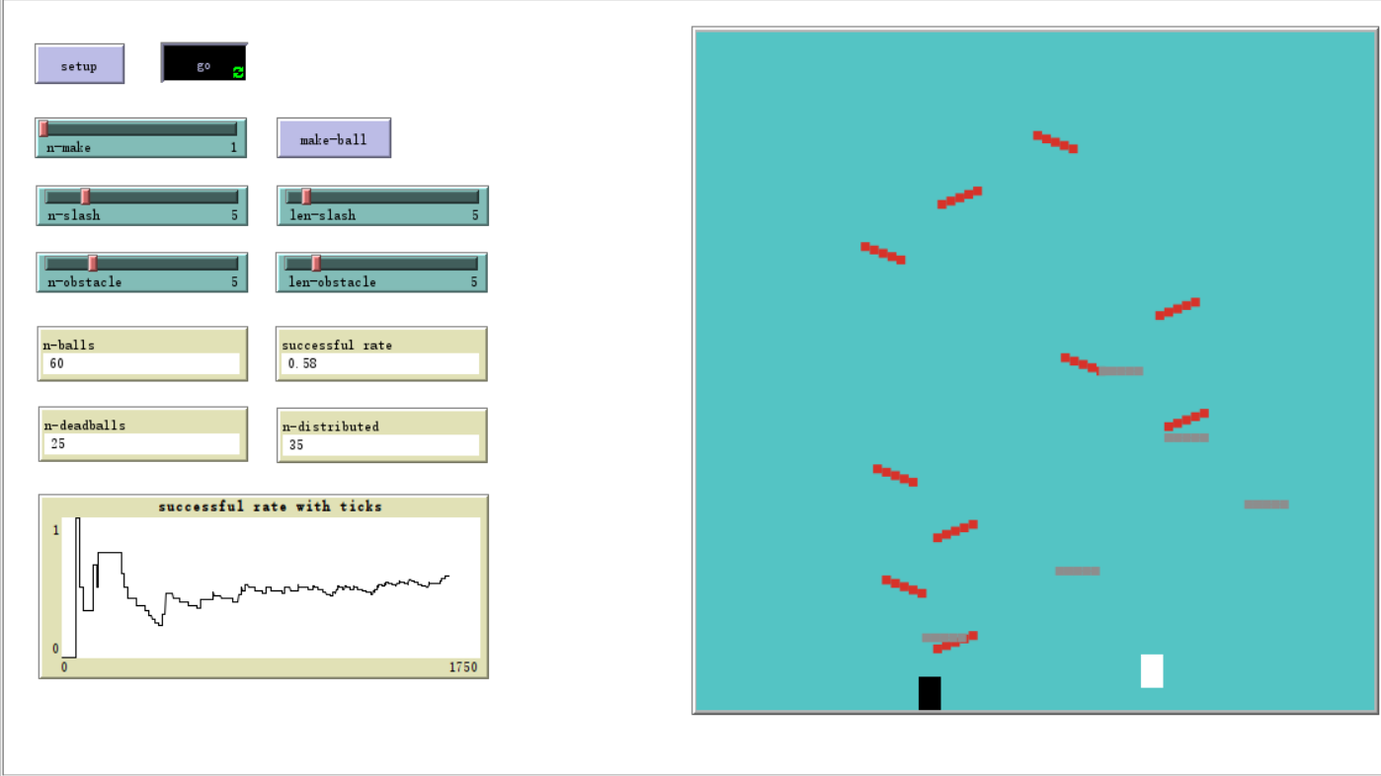
Results and Evaluation

Slide 15
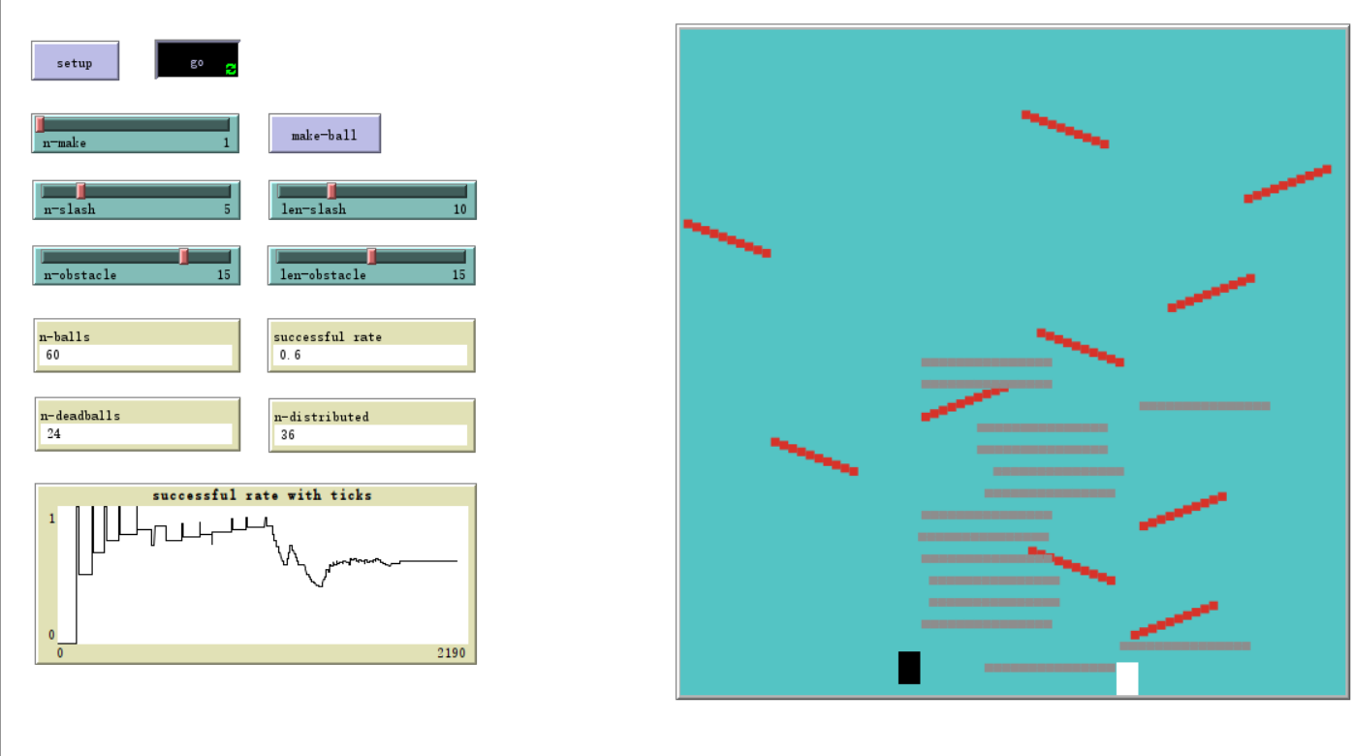
Results and Evaluation

Slide 16
Conclusions
The more balls to be distributed in the same time, the successful rate is lower.
If the number and length of obstacles is too small (< 10), the contraption will be incompetent to distribute balls with long distance.
While if it’s too big, it will be difficult to handle the conflicts between obstacles.
If there are too many horizontal obstacles, the ball is possible to die on them without the acceleration.

