Slide 1
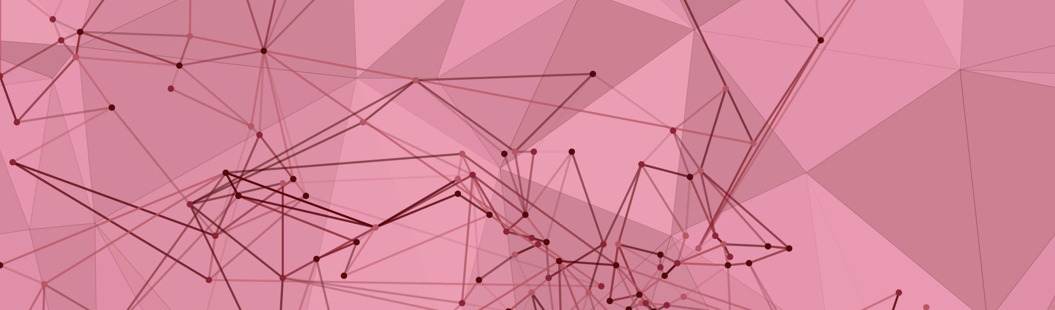
Generative Adversarial Network GAN CA2
Name: Khor Yu Yang
Class: DAAA/FT/2B/01

Slide 2
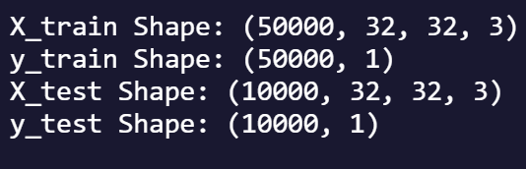
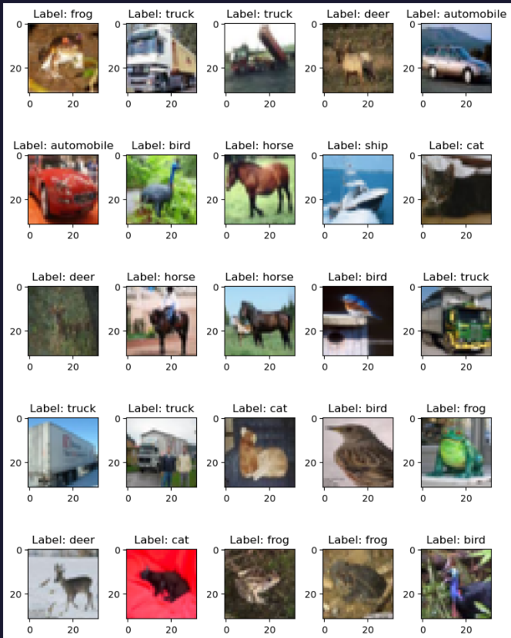
Cifar10 DATASET
60000 32x32 colour images in 10 classes
6000 images per class
50000 images and labels in training data, 10000 images and labels in test data

Slide 3
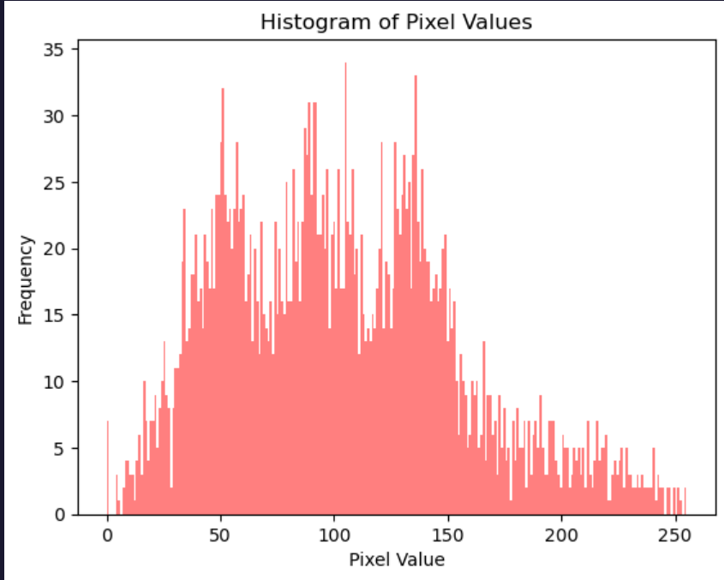
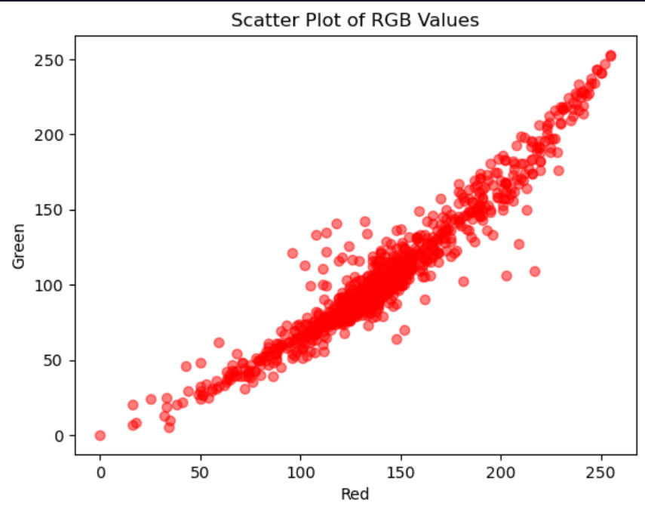
Exploratory Data Analysis
Pixel values of the image are close to normally distributed, with slightly skewed to the right.
Scatterplot shows a strong positive relationship between the RGB values
Strong correlation

Slide 4
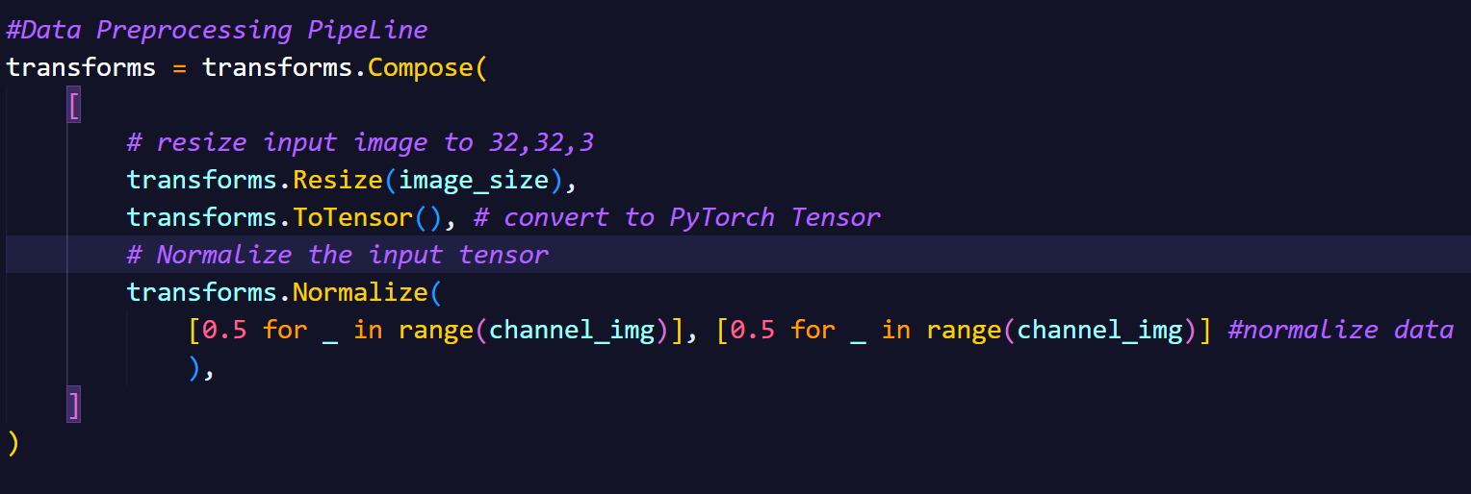
Data Preprocessing
Start by creating a preprocessing pipeline using torchvision transform
Resize, transforms input image to (32,32,3)
Convert input image to Pytorch tensor
Normalize the input tensor by subtracting the mean and dividing by the standard deviation
The normalized data are now in the range of [-1, 1]
Apply the transformation to Cifar10 dataset when we called it using torchvision datasets

Slide 5
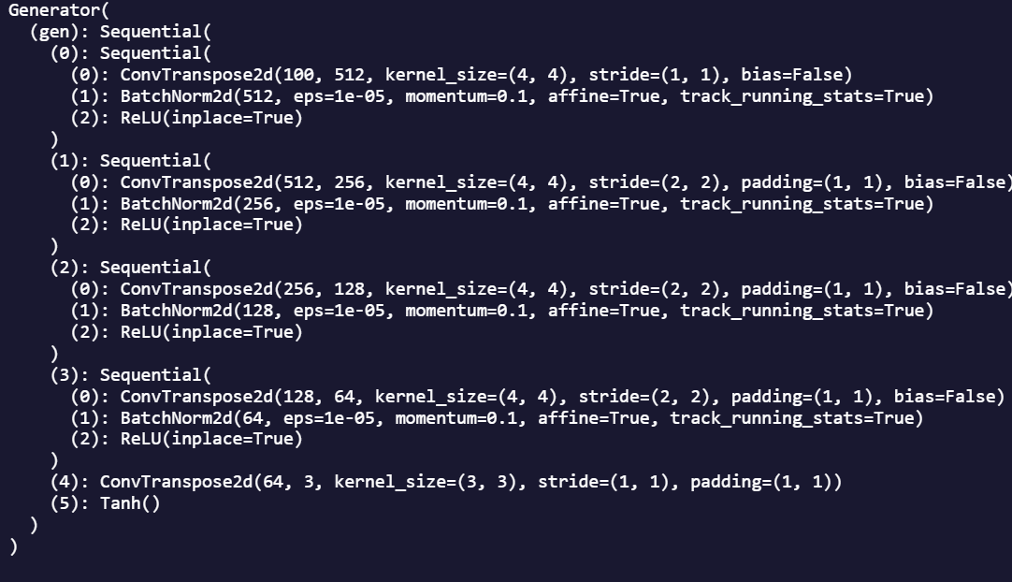
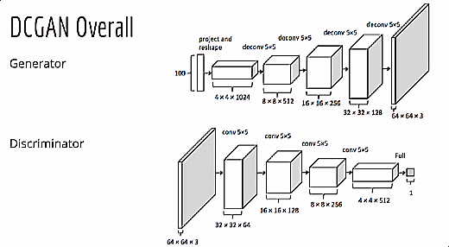
Deep Convolutional GAN
Modified Generator Architecture
Generator
Convolutional Networks (CNN) using PyTorch, with ConvTranspose instead of Conv2d for Upsampling
Generator takes in input size of 100, latent dimension, with output size of cifar10 image size, (32,32,3)
From the baseline generator, BatchNormal2d layers were added to stabilize and speed up the training process
ReLU activation functions chosen among all other activation functions through experiments
Activation function for output layer to be Tanh

Slide 6
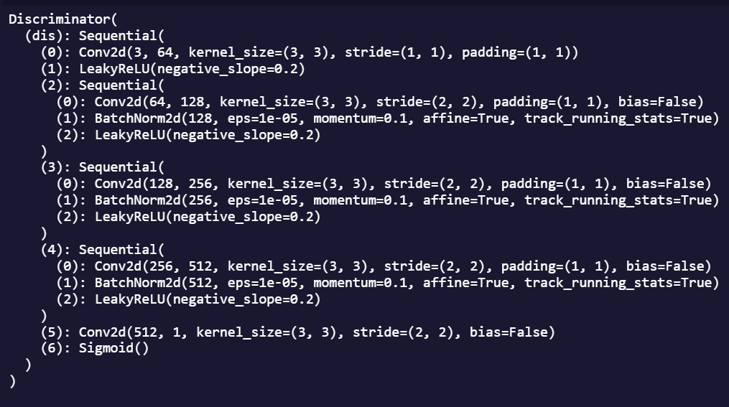
Deep Convolutional GAN
Modified Discriminator Architecture
Discriminator
Convolutional Networks(CNN) using PyTorch
Discriminator takes input value of image channels, 3, and output size of (1,1,1)
With the baseline discriminator, BatchNormal2d layers are added to stabilize the training process
Dropout layers added to reduce overfitting and improve the stability of the training process
Activation function also chosen to be LeakyReLU after experimenting with different activation functions
Output layer activation function being Sigmoid

Slide 7
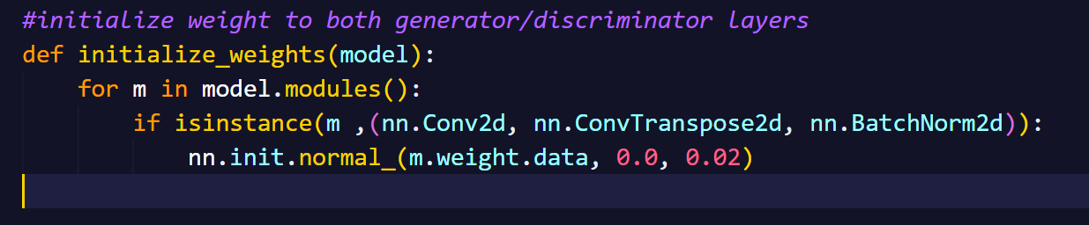
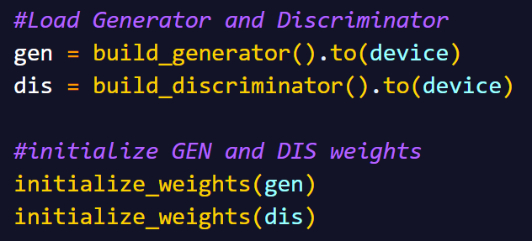
GAN
Initialization of Weights
Function to initialize weights for Generator and Discriminator
Important to allow the model to converge and learn the desired distribution
Loop the layers of the model and check if there are any conv2d, convtranspose2d or batchnorm2d layer
If found, initializes their weight data using the normal distribution with mean 0.0 and standard deviation 0.02.
Initialize the models’ weights right after calling them

Slide 8
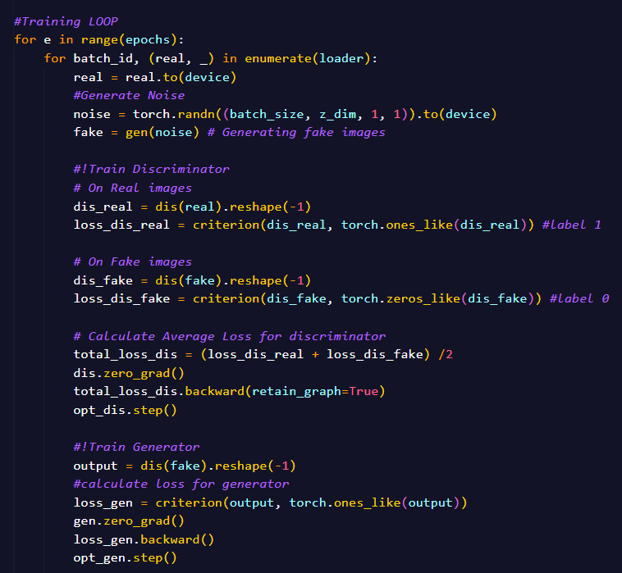
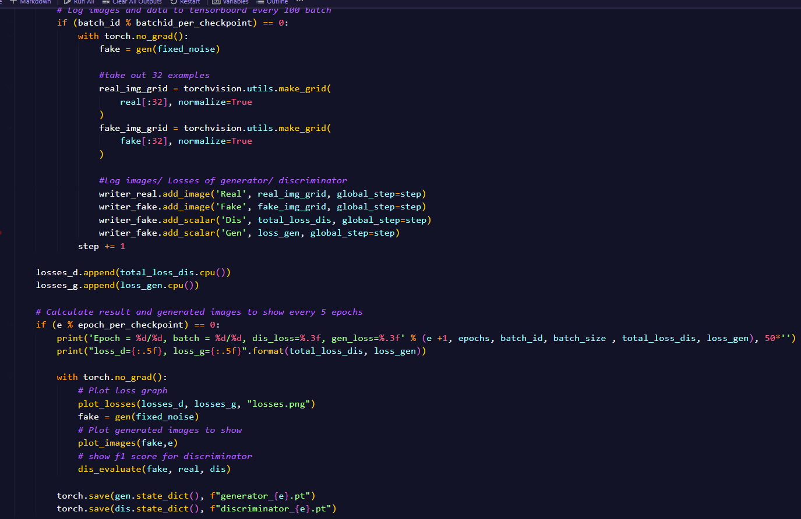
Deep Convolutional GAN
Training Loop
Training Generator/Discriminator
Create training for loop to train generator/discriminator on number of epochs =40, optimizer being Adam
Generate fake images using generator with noise, and use it together with real images to train discriminator
Calculate loss for both generator & discriminator
Repeat the process until number of epochs reached
Log the result onto tensorboard to observe every 100 batch_id
Print the fake images generated, plot the loss graph for generator & discriminator every 10 epochs to see how the model is performing

Slide 9
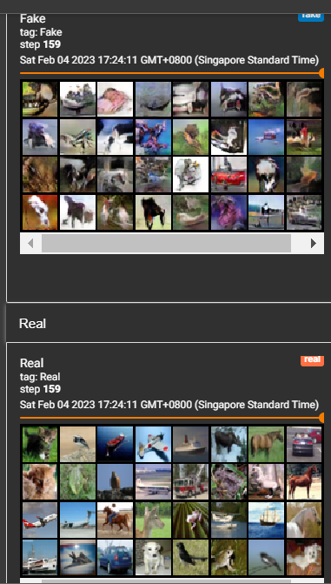

Deep Convolutional GAN
Evaluating DCGAN
Comparing the generated images against the real image, we can see that images generated looks similar, having brilliant colours as well as shape, showing good performance of the generator
The auc-roc & f1 score for discriminator is at around 0.92 & 0.88, showing a good performance
Each coloured images are easy to distinguish its label and what it is showing when comparing to the real images

Slide 10
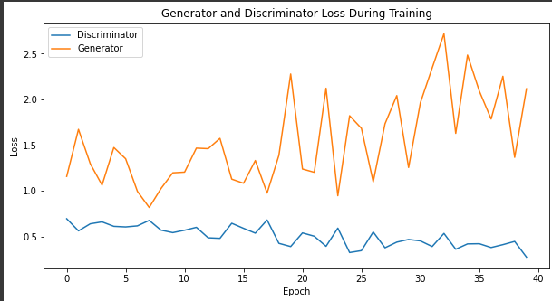
Deep Convolutional GAN
Evaluating DCGAN
Loss for generator & discriminator is the lowest at around epoch 25 and 40 respectively, at values around 0.9 and 0.4
Saved model at epochs 25 and 35 for generator & discriminator respectively for further evaluation
Discriminator loss shows a constant smooth trend, without any huge jumps
Generator loss shows more inconsistency, with many jumps from low to high

Slide 11
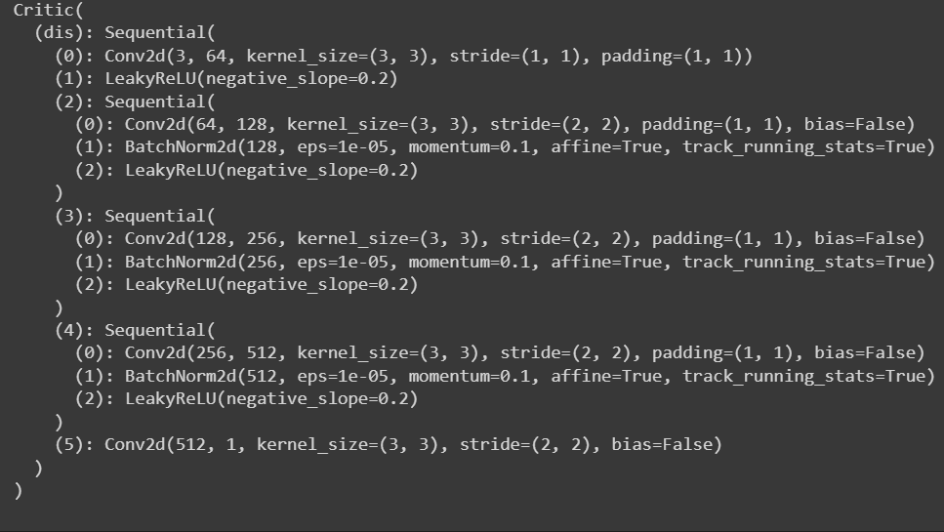
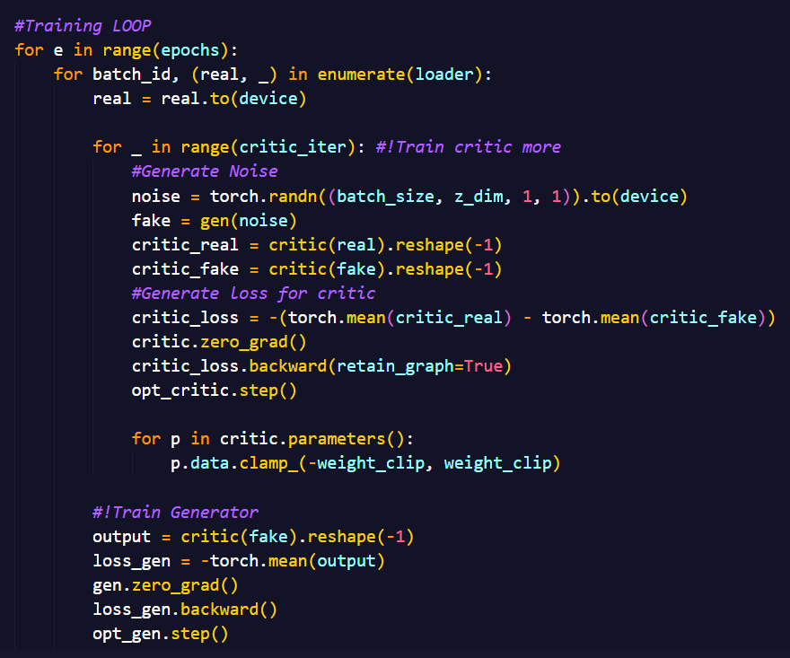
Wasserstein GAN
Critic Model
Generator & Critic Model
Different from DCGAN, WGAN called it critic model instead of discriminator. Both model architecture stays the same
Optimizer for training being RMSprop instead of Adam
Training Loop differ from DCGAN in that it trains critic more in iterations within each epoch
Run the model at 60 epochs to see its performance, since it will require longer time for WGAN to train
Training Loop

Slide 12
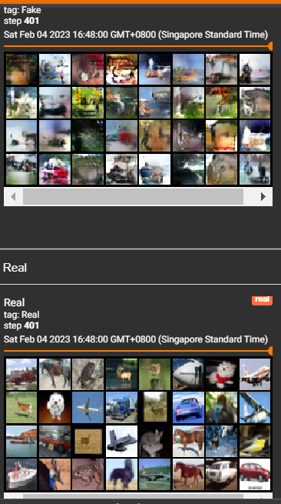
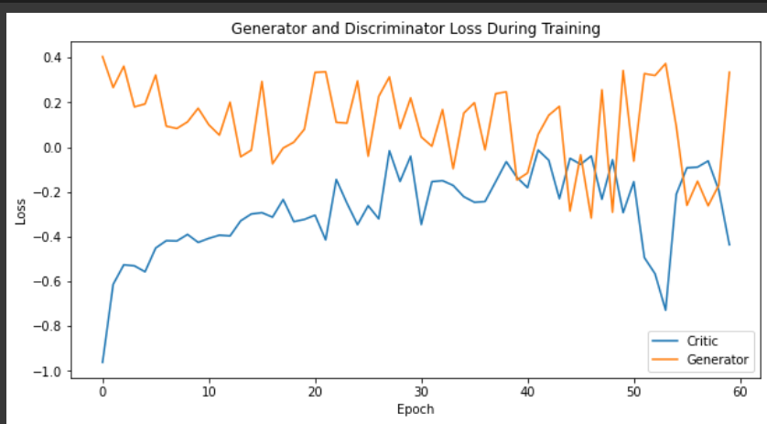
Wasserstein GAN
Evaluation of WGAN
Comparing generated images against real images
Generated images are still quite blurry, although it shows some distinct color and briefly tell what it is trying to represent
Both generator & critic model have very inconsistent trends, with a lot of jumps, having very low or negative loss for both
Lowest loss for the generator is -0.3 at around epoch 40, while the critic is at -0.7 at epoch 52
Save both generator and critic at both epochs 40 & 50 respectively for further evaluation

Slide 13
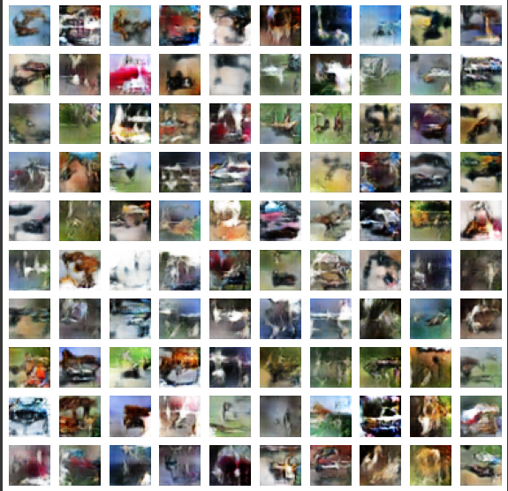
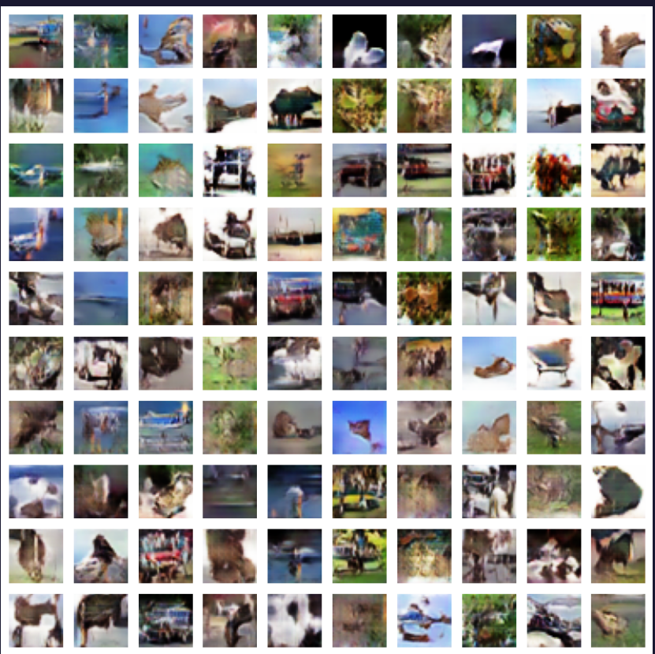

WGAN vs DCGAN
WGAN
DCGAN
Example of 100 images generated
Example of 100 images generated
Images are slightly more blurry than DCGAN
Inception score at around 3.1412, lower than DCGAN
No mode collapse shown from the image
Images are slightly clearer than WGAN
Inception score at around 4.2677, higher than WGAN
FID score at around 31.218
No mode collapse shown from the image

Slide 14
Conclusion
Inception Score for DCGAN is higher than WGAN, showing that it is able to produce higher-quality images
DCGAN performs slightly better than WGAN in terms of images generated, providing higher-quality images. However, it might suffer from mode collapse
WGAN provides a more stable training process, less prone to mode collapse. However, the images generated are of lower quality
WGAN requires a longer time to train, and also produces much lower loss than DCGAN, reaching negative values
In conclusion, DCGAN will be slightly better to use in this case, generating the 1000 small coloured images, since it provides better quality images

Slide 15
References
https://www.youtube.com/watch?v=IZtv9s_Wx9I&t=1662s
https://github.com/sbarratt/inception-score-pytorch/blob/master/inception_score.py
https://pytorch.org/tutorials/beginner/dcgan_faces_tutorial.html
https://www.kaggle.com/code/shwetagoyal4/dcgan-using-pytorch/notebook
https://www.youtube.com/watch?v=pG0QZ7OddX4&t=1266s

