Slide 1
h
 | h | N’ | d
Dependency: | Batch | Reuse | NonPara
 | h | N | c=1
Dependency: | Batch | Batch | NonPara
h
h
h
N
d
d
N’
 | h | N’ | d
Dependency: | Batch | Reuse | NonPara
N
Reduce
N
h
MatMul
Reduction Dimension
N’
Reduction Dimension
c
N
 | h | N | N’
Dependency: | Batch | Reuse | Reuse
 | h | N | N’
Dependency: | Batch | Batch | NonPara
N’
(a) Dependency for Reduce
(b) Dependency for Batched MatMul

Slide 2
Reduce Dependency
h | N | c=1
Batch | Batch | NonPara
Reduce dependency
h | N’ | d
Batch | Reuse | NonPara
h
h
h
N
h
Reduce dependency | N’ | d
h | N’ | d
Batch | Reuse | NonPara
N
d
N’
N
Reduce
d
Reduction
Dimension
c
h
MatMul
Reduction Dimension
N’
Reduce dependency | N | N’
h | N | N’
Batch | Reuse | Reuse
Reduce Dependency
h | N | N’
Batch | Batch | NonPara
N
(a) Dependency for Reduce
N’
(b) Dependency for Batched MatMul

Slide 3













For Loop
Reduce Init
?
Mask
$$0$$
Reduce 0
?
?
$$−∞$$
$$0$$
Add
Exp
Div
$$0$$
?
$$−∞$$
$$0$$
Reduce 1
MatMul 1
$$0$$
$$0$$
For Loop: 0 $→$ N
Mask
Reduce 0
?
Div
$$0$$
?
$$−∞$$
$$−∞$$
$$0$$
$$0$$
?
$$0$$
Add
Exp
MatMul 1
For Loop: 0 $→$ N
Mask
Reduce 0
?
Div
$$0$$
?
$$−∞$$
$$−∞$$
$$0$$
$$0$$
?
$$0$$
Add
Exp
MatMul 1

Slide 4
h
h
Broadcasted
h
h
Broadcasted
c
c’
N
N
Broadcasted
N
N’
N’
c’
Mul
 | h | c=1 | c’=1
Broadcast: | No | Yes | Yes
Mul
 | h | N | c’=1
Broadcast: | No | No | Yes
(a) Two Broadcasted Dimensions
(b) One Broadcasted Dimension
h
h
h
h
c’
d
N’
c
N
N
d
MatMul 0
d
Mul
d
Mul
Valid Reorder
MatMul 0
Reduction Dim
Aligned
on the 3rd Dim!
Broadcasted Dim
h
h
h
h
c’
Dependency:
h | N | d
… | … | NonPara
Broadcast:
h | c=1 | c’=1
… | … | Yes
d
c
N
N’
N
(c) Reorder MatMul 0 and Mul based on alignment of Broadcast and Reduce Dependency on the same dimension
d
MatMul 0
d
Mul
d
Mul
Valid Reorder
MatMul 0
Reduction Dim
Aligned!
Broadcasted Dim
 | h | N | d
Dependency: | Batch | Reuse | NonPara
 | h | c=1 | c’=1
Broadcast: | No | Yes | Yes

Slide 5
h
h
Broadcasted
h
h
Broadcasted
c
c’
N
N
Broadcasted
N
N’
N’
c’
Broadcast
h | N | c’=1
No | No | Yes
Mul
Broadcast
h | c=1 | c’=1
No | Yes | Yes
Mul
(a) Two broadcasted dimensions
(b) One broadcasted dimension
h
h
h
h
c’
d
N’
c
N
N
d
MatMul 0
d
Mul
Reduce Dependency
h | N | d
… | … | NonPara
Mul
Valid
MatMul 0
Broadcast
h | c=1 | c’=1
… | … | Yes
Aligned
on the 3rd Dim!
Broadcasted Dim
Reduction Dim
(c) Reorder MatMul 0 and Mul based on alignment of broadcast and reduce dependency on the same dimension

Slide 6
h
h
Broadcasted
h
h
Broadcasted
c
c’
N
N
Broadcasted
N
N’
N’
c’
Broadcast
h | N | c’=1
No | No | Yes
Mul
Broadcast
h | c=1 | c’=1
No | Yes | Yes
Mul
(a) Two broadcasted dimensions
(b) One broadcasted dimension
h
h
h
h
c’
Reduce Dependency
… | d
… | NonPara
d
N’
c
Broadcast
… | c’=1
… | Yes
N
MatMul 0
Valid
N
Mul
d
Mul
d
MatMul 0
Broadcasted Dim
Reduction Dim
Aligned
on the 3rd Dim!
(c) Reorder MatMul 0 and Mul based on alignment of broadcast and reduce dependency on the same dimension

Slide 7
h
h
Broadcasted
h
h
Broadcasted
c
c’
N
N
Broadcasted
N
N’
N’
c’
Mul
 | h | c=1 | c’=1
Broadcast: | No | Yes | Yes
Mul
 | h | N | c’=1
Broadcast: | No | No | Yes
(a) Two Broadcasted Dimensions
(b) One Broadcasted Dimension

Slide 8
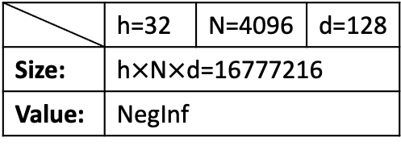
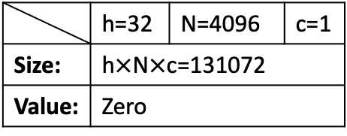
h
N
 | h=32 | N=4096 | c=1
Size: | h$×$N$×$c=131072
Value: | Zero
ZeroOp
c
(a) Zero-valued tensor produced by ZeroOp
Condition
h
 | h=32 | N=4096 | d=128
Size: | h$×$N$×$d=16777216
Value: | NegInf
Mask
N’
d
(b) Mask may produce NegInf in some Condition

Slide 9
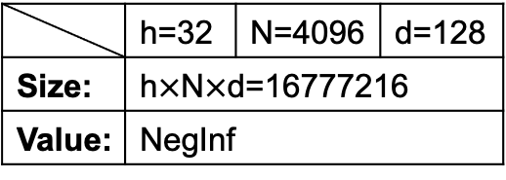
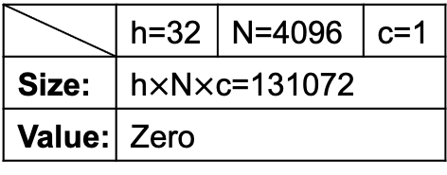
h
N
c
Condition
h
N
d
ZeroOp
Mask
 | h=32 | N=4096 | c=1
Size: | h$×$N$×$c=131072
Value: | Zero
 | h=32 | N=4096 | d=128
Size: | h$×$N$×$d=16777216
Value: | NegInf
(a) Zero-valued tensor produced by ZeroOp
(b) Mask may produce NegInf in some Condition

