Slide 1
MyApp presentation
Yuyang Chen
chenyuyang0122@gmail.com

Slide 2

Background for every single page

Slide 3
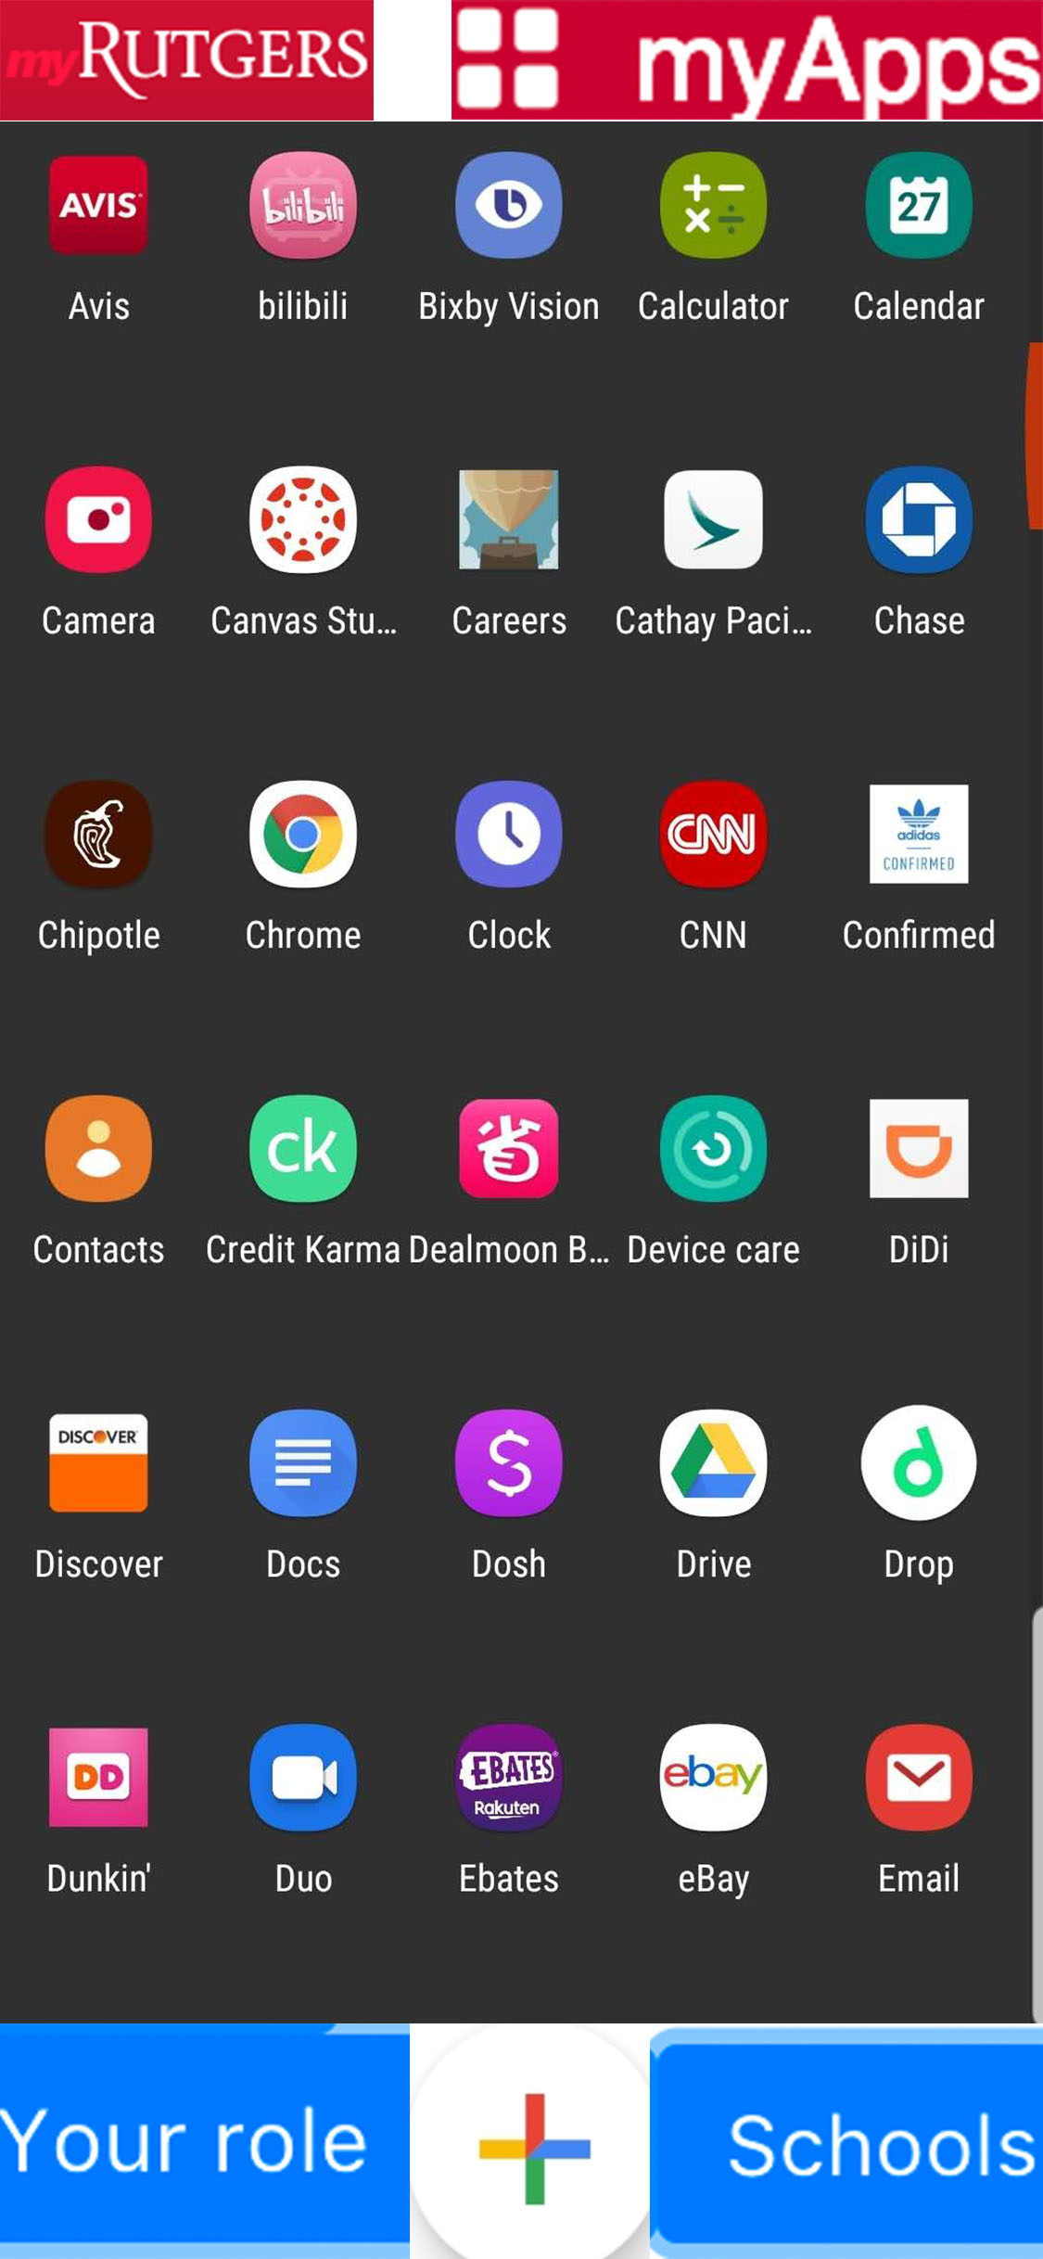
Main Page
Left button: Profile
Right button: Notification

Slide 4
Default main page
We can display some of the most commonly used apps by students in the campus according to the user's campus, maybe 10 or maybe 20.
In alphabetical order.

Slide 5
App name word limit problem
We can use floating text method to fix this problem.
Floating text Video demo:
https://www.youtube.com/watch?v=8RdmM-dTWOE
Jump to 4:07 too see the demo

Slide 6
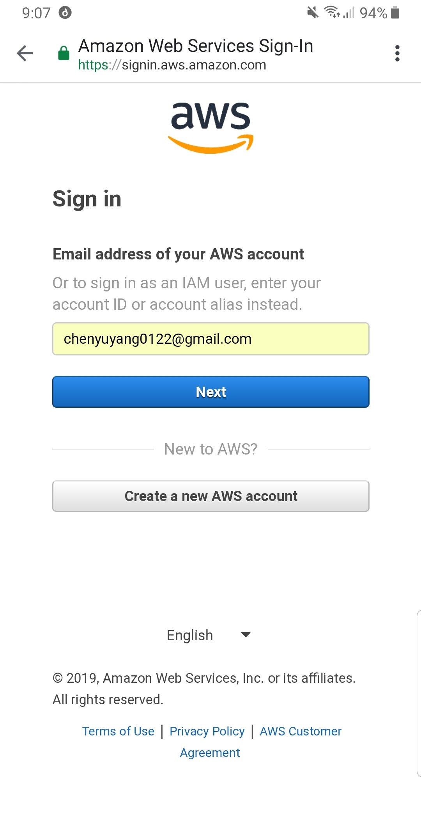
Built-in browser
Most of our app today is in the form of web pages. I don‘t want users clicking on an app to jump to the browser that comes with their phone. I would prefer our app to have a browser built into it. This will make it easier for users to use. Just like the gmail app.

Slide 7
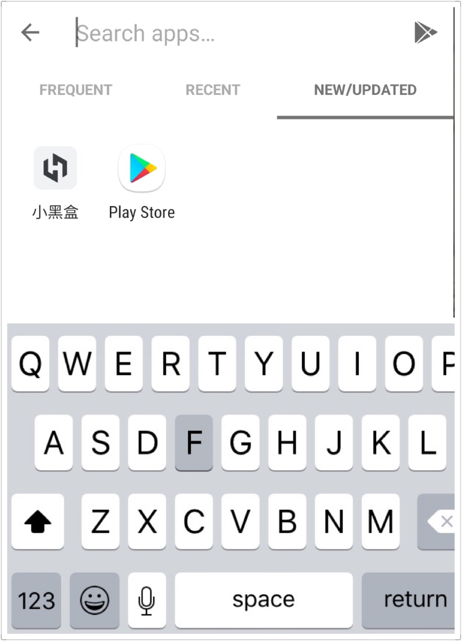
Search Page

Slide 8
Profile Page
I'm not sure about the specific content of this page. I hope users can change some information, but I don't know which information can be changed and which information can't be changed.
I guess they can't change their netid, password or their school at all. But I think we can provide a selection box for them to choose what kind of app they like. When they enter the app store, the system can first recommend some apps they like.

Slide 9
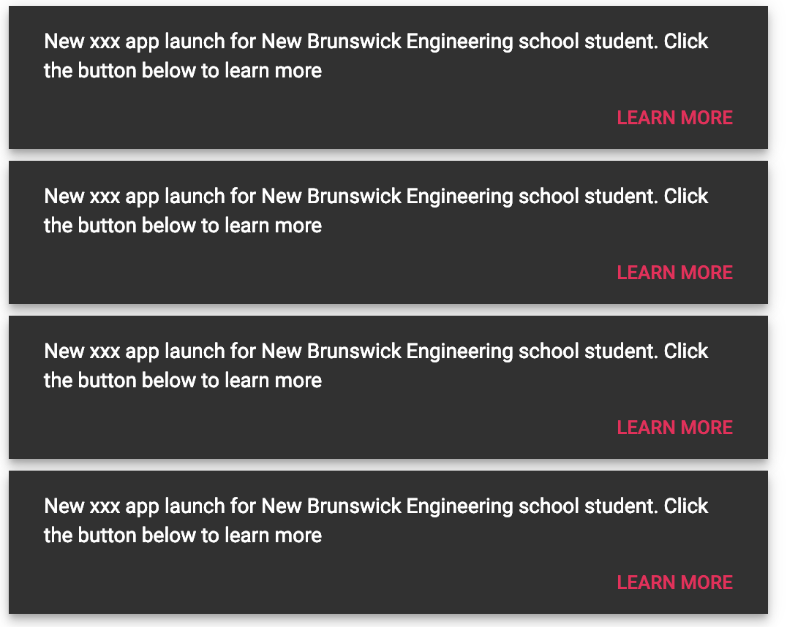
Notification Page

Slide 10
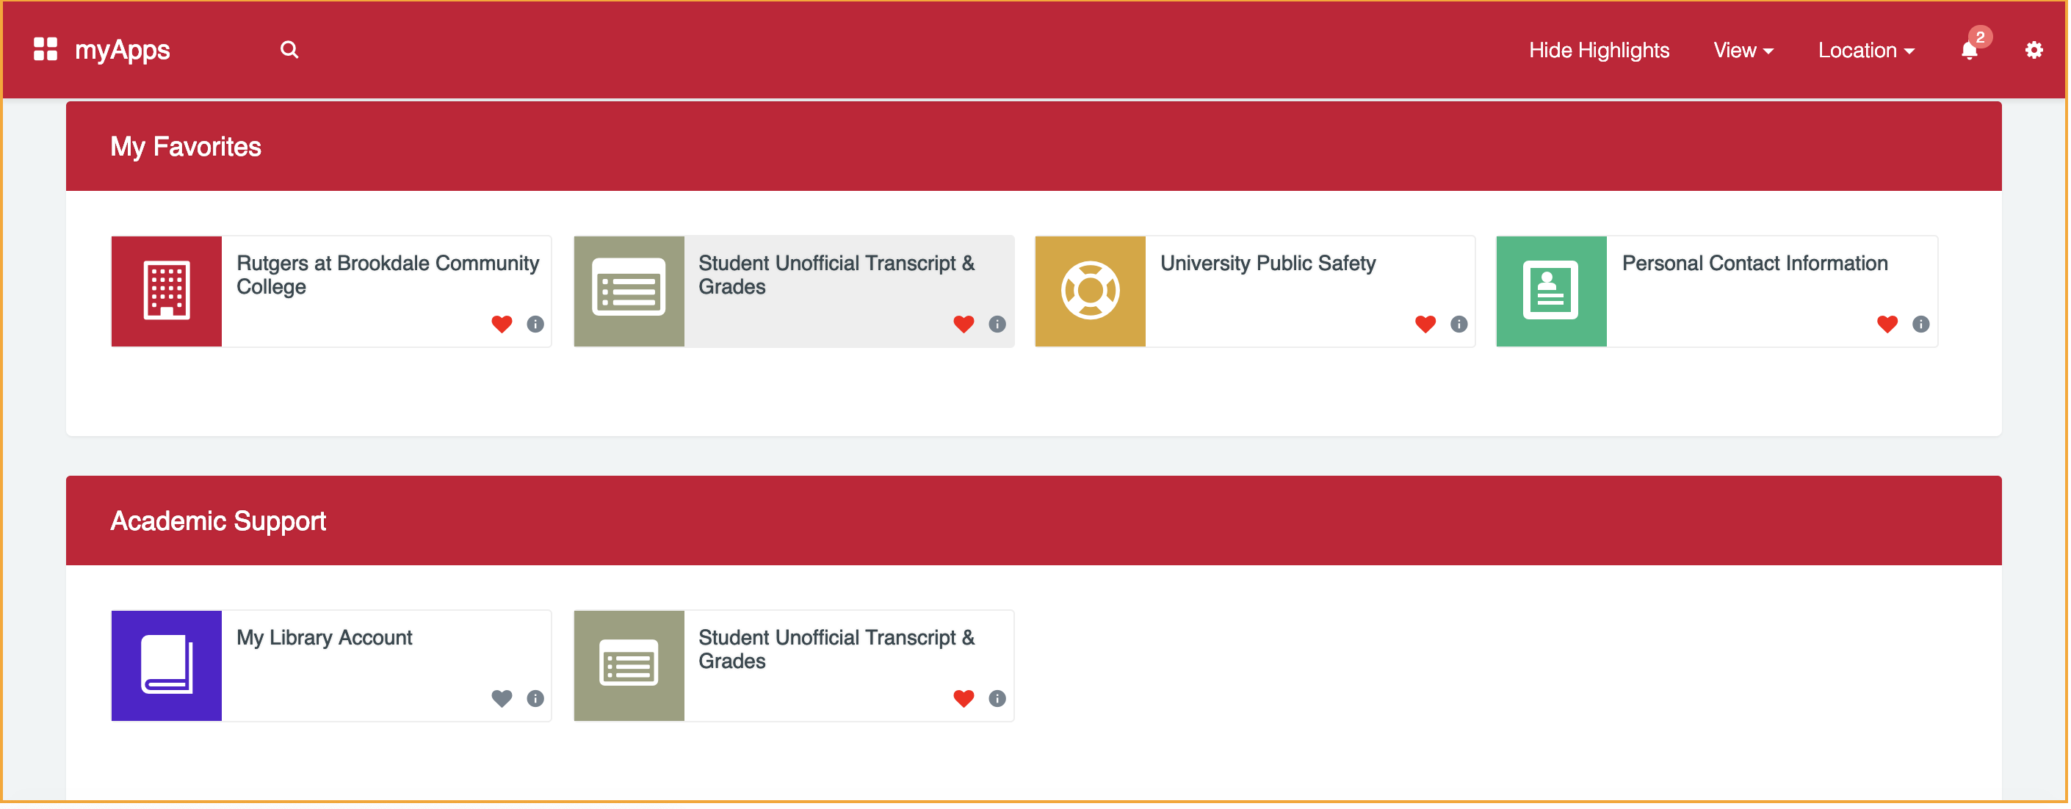
App page idea 1

Slide 11
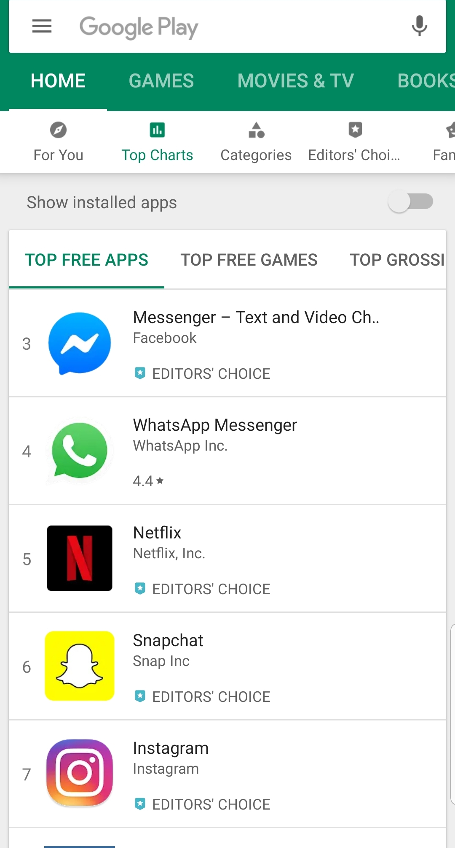
App Store Page idea 2

Slide 12
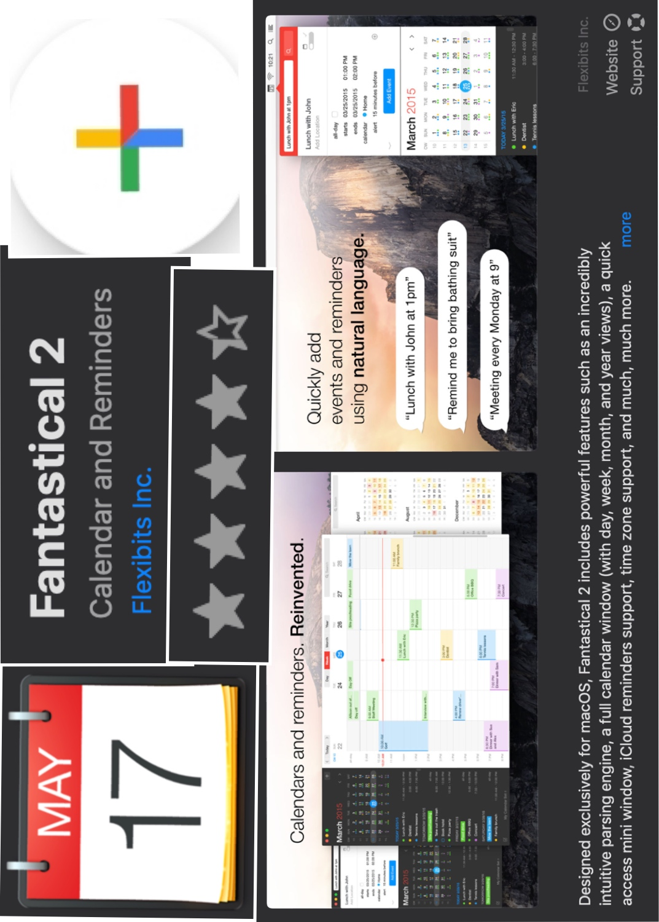
App Page
Images can be viewed by swiping left and right

