Slide 1
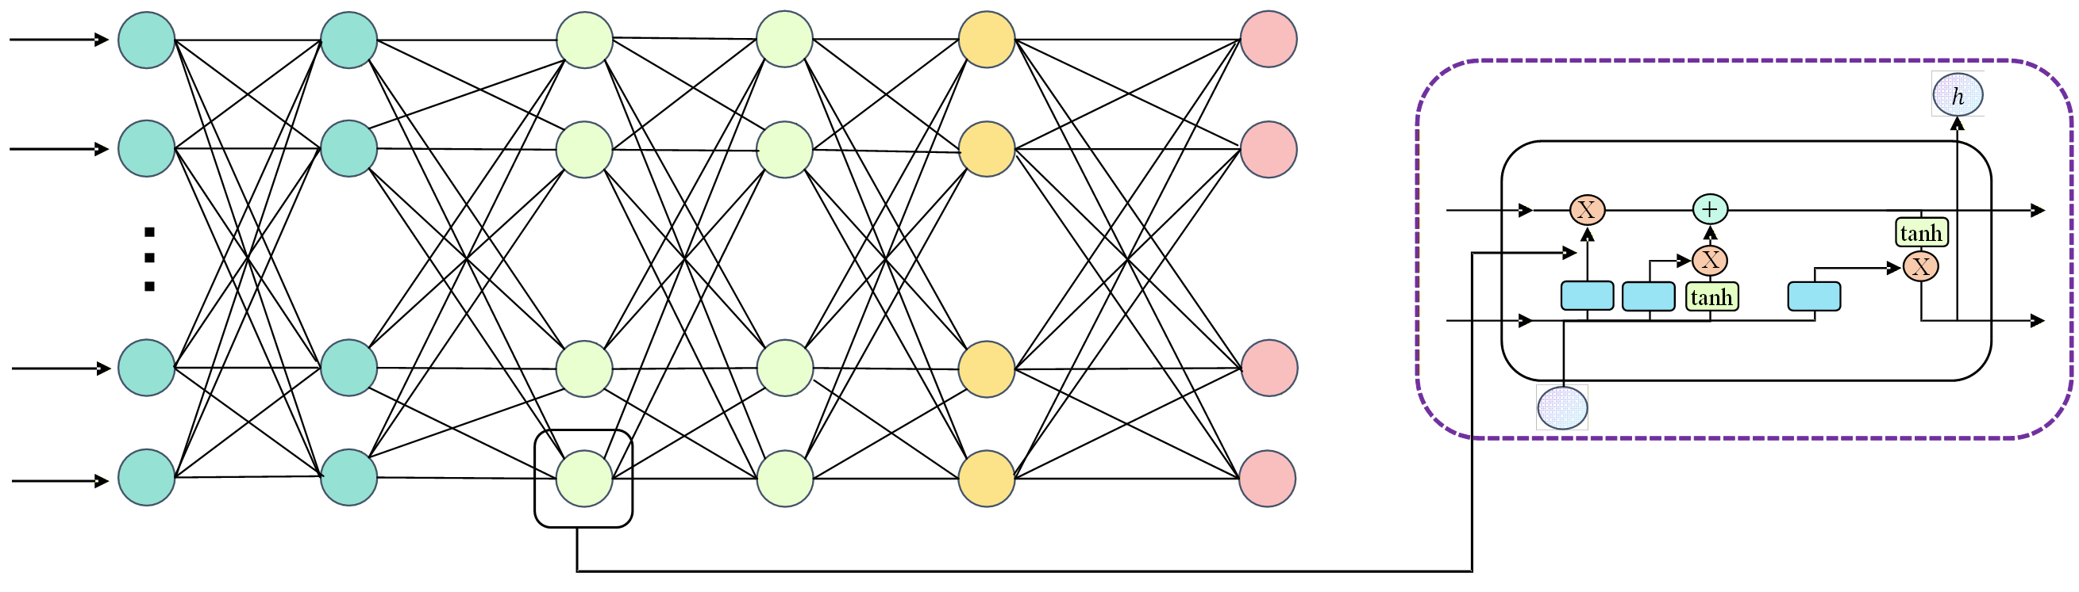
32units
32units
64units
64units
32units
32units
RNN
layer
RNN
layer
LSTM
layer
LSTM
layer
Dense
layer
Dropout
layer

Slide 2

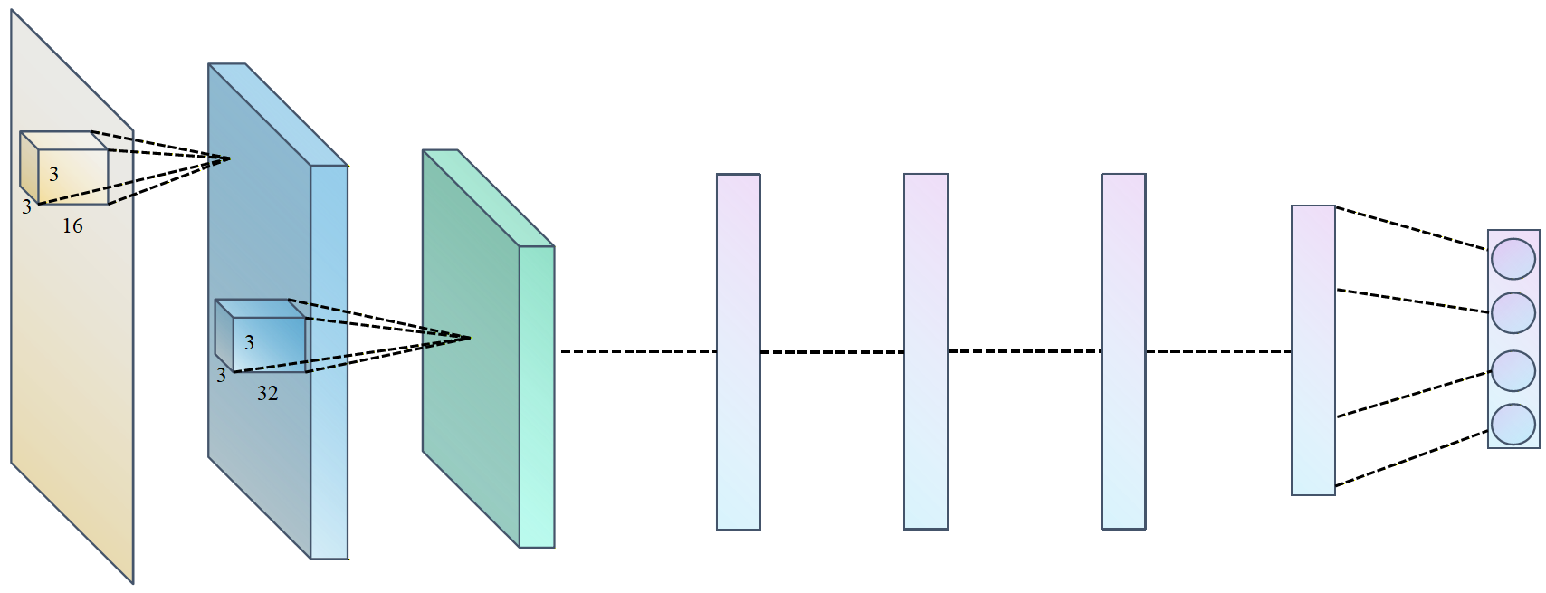
32units
Input
64units
64units
64units
64units
RNN
RNN
Dense
32unit
Dropout
Softmax
output

Slide 3
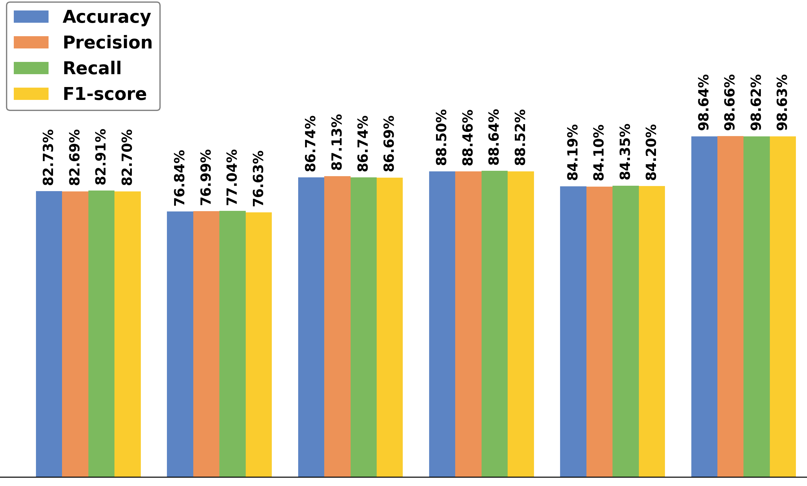
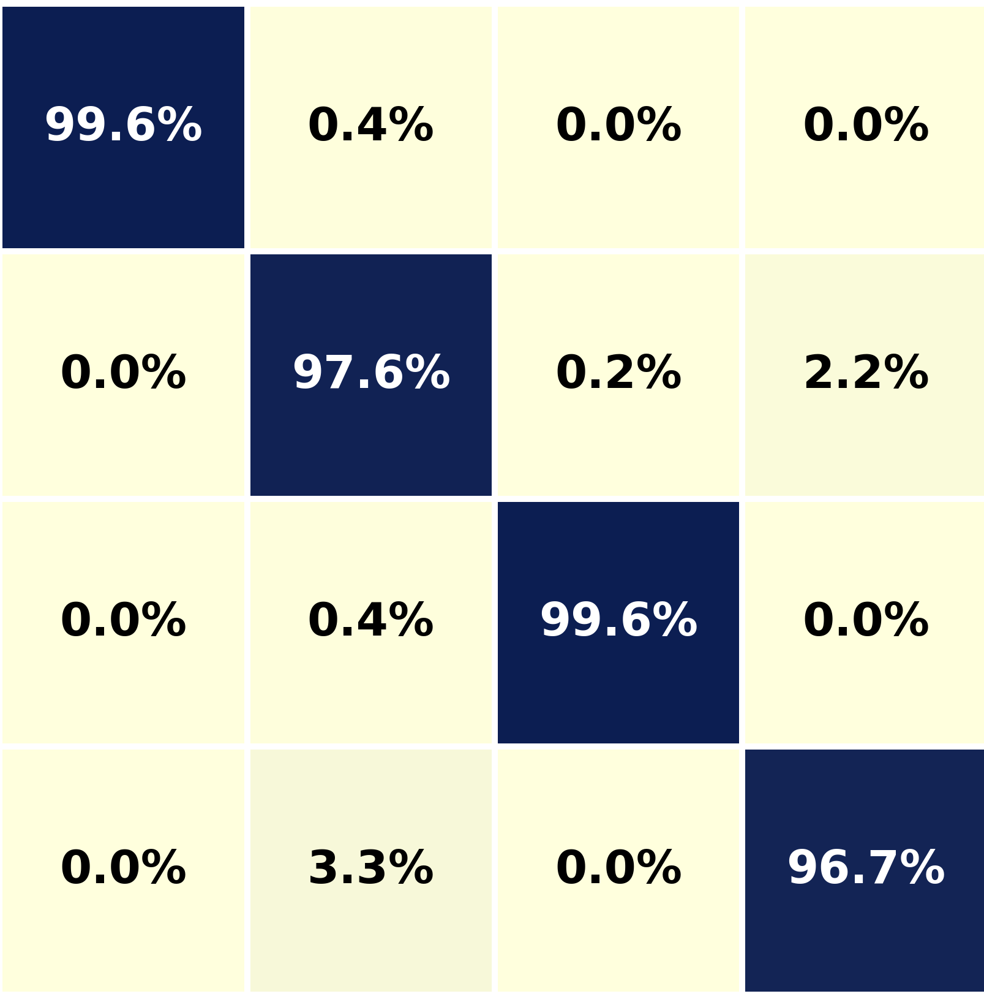
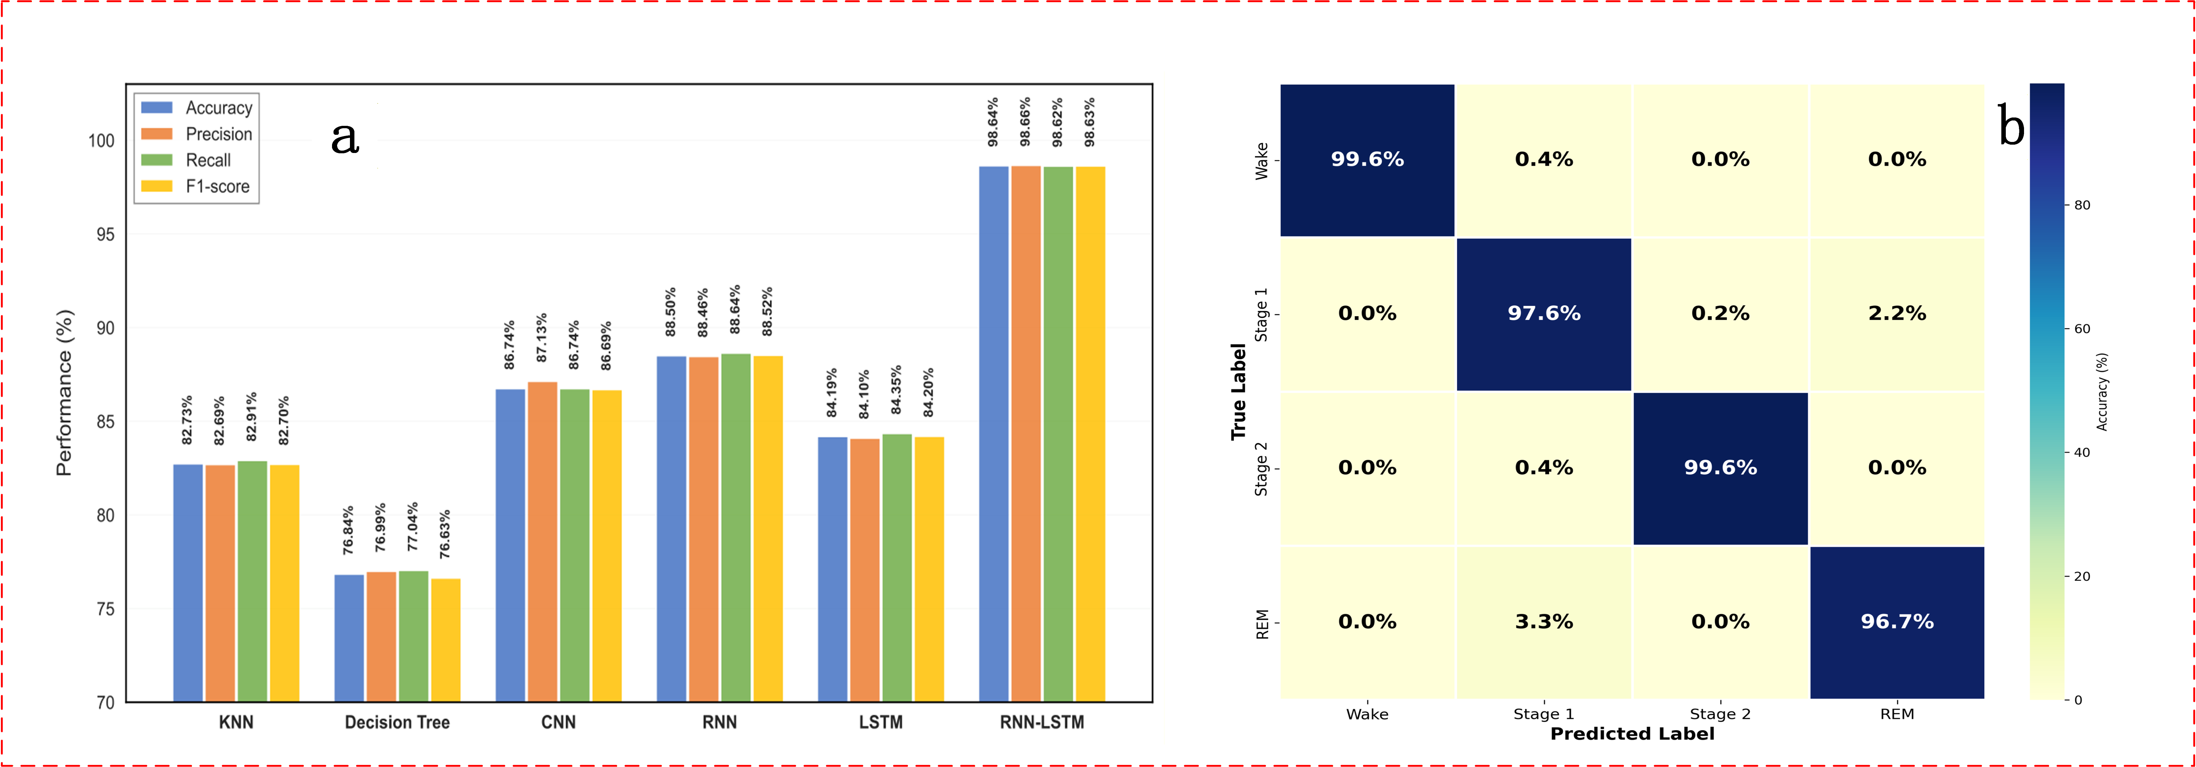
(a)
(b)
Wake
Light Sleep
Performance (%)
Deep Sleep
REM
KNN
Decision Tree
CNN
RNN
LSTM
RNN-LSTM
Wake
Light Sleep
Deep Sleep
REM

Slide 4
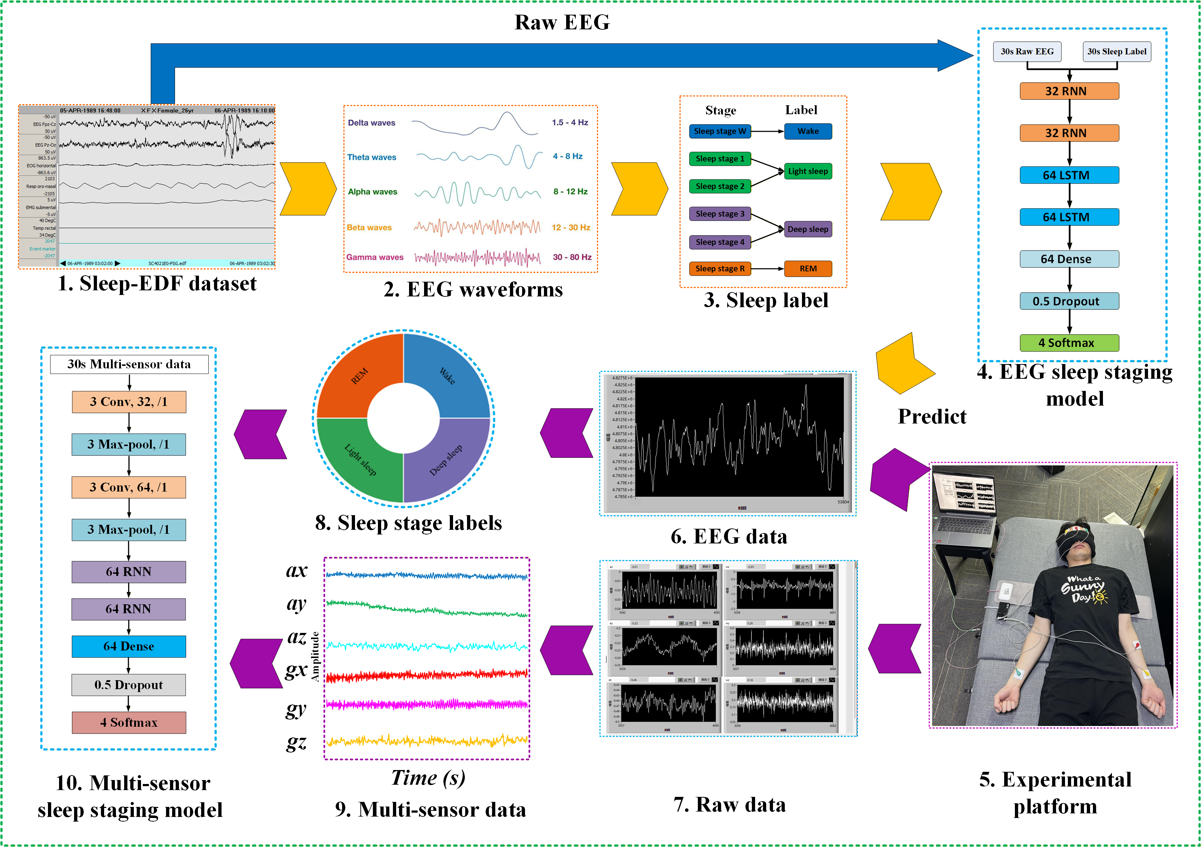
(a)
(b)
(c)
(d)
(j)
(h)
(f)
(g)
(i)
(e)

