Slide 1
New York Times API Survey #7
@author Rita Lo <rital@cnyes.com>
@since 2017/04/27

Slide 2

New York Times 紐約時報
成立時間：
1851/09/18 美國
提供服務：
對讀者提供有關全球時事、商業及文化的高水準報導。
享有可靠新聞來源的聲譽，社論較為偏向自由主義的立場。

Slide 3
NYTimes API -Resource Name
Only GET methods
Base URL : http://api.nytimes.com/svc
MEHOD | ENDPOINT | USAGE
GET | /search/v2/article | Search articles from Sept. 18, 1895 to today
GET | /archive/v1/{year}/{month}.json | Get list of articles by month going back to 1851
GET | /books/{version}/lists/names{.format} | GET best seller list name

Slide 4
NYTimes API -HTTP Status Code -Success
STATUS SODE | DESCRIPTION
200 | OK – The request has succeeded. The client can read the result of the request in the body and the headers of the response.

Slide 5
NYTimes API -HTTP Status Code -Error
STATUS SODE | DESCRIPTION
400 | Bad Request- The request could not be understood by the server due to malformed syntax.
401 | Unauthorized - The request requires user authentication or, if the request included authorization credentials, authorization has been refused for those credentials.
403 | Forbidden – The server understood the request, but is refusing to fulfill it.
404 | Not Found – The requested resource could not be found. This error can be due to a temporary or permanent condition.

Slide 6
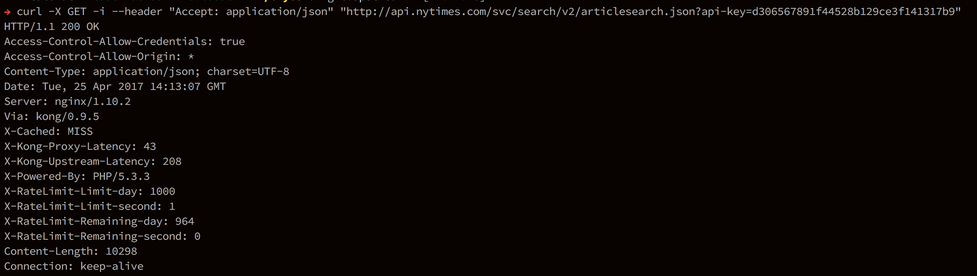
NYTimes API - 200 OK GET /search/v2/article
HTTP Status
Notes:
沒帶任何 q=? 有一千六百一十一萬比左右筆資料（16117711）
Access-Control-Allow-Credentials-> response 是否能夠回應出去
Access-Control-Allow-Origin-> response 是否能夠回應給特定的 URL (ex:* or https://developer.mozilla.org)
Via-> proxy 加的 header, 通常是 proxy 用來追蹤訊息, 避免 request-loop 用的

Slide 7
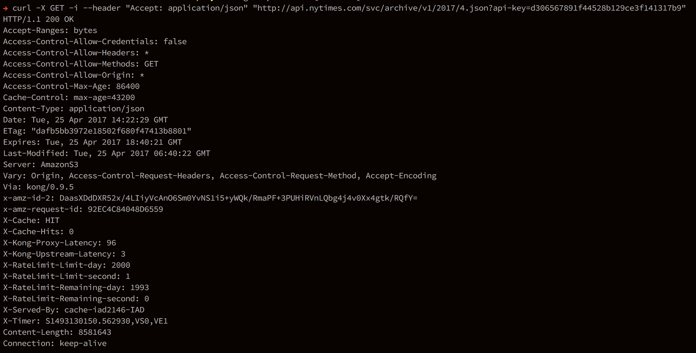
NYTimes API -200 OK -GET archive/v1/{year}/{month}.json
HTTP Status
{year}=2017
{month}=4

Slide 8
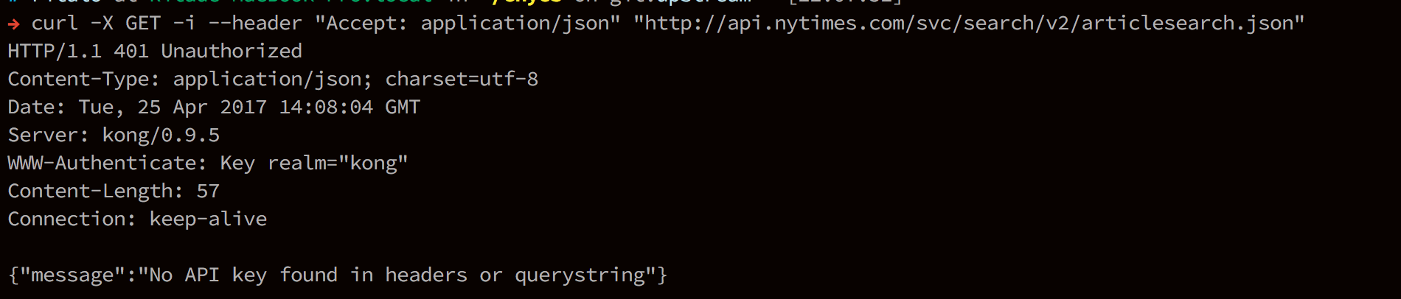
NYTimes API -401 Unauthorized GET /search/v2/article
HTTP Status
401 Response payload

Slide 9
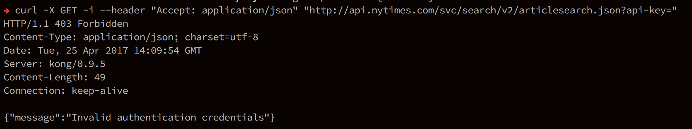
NYTimes API -403 Forbidden -GET /search/v2/article
HTTP Status
403 Response payload

Slide 10
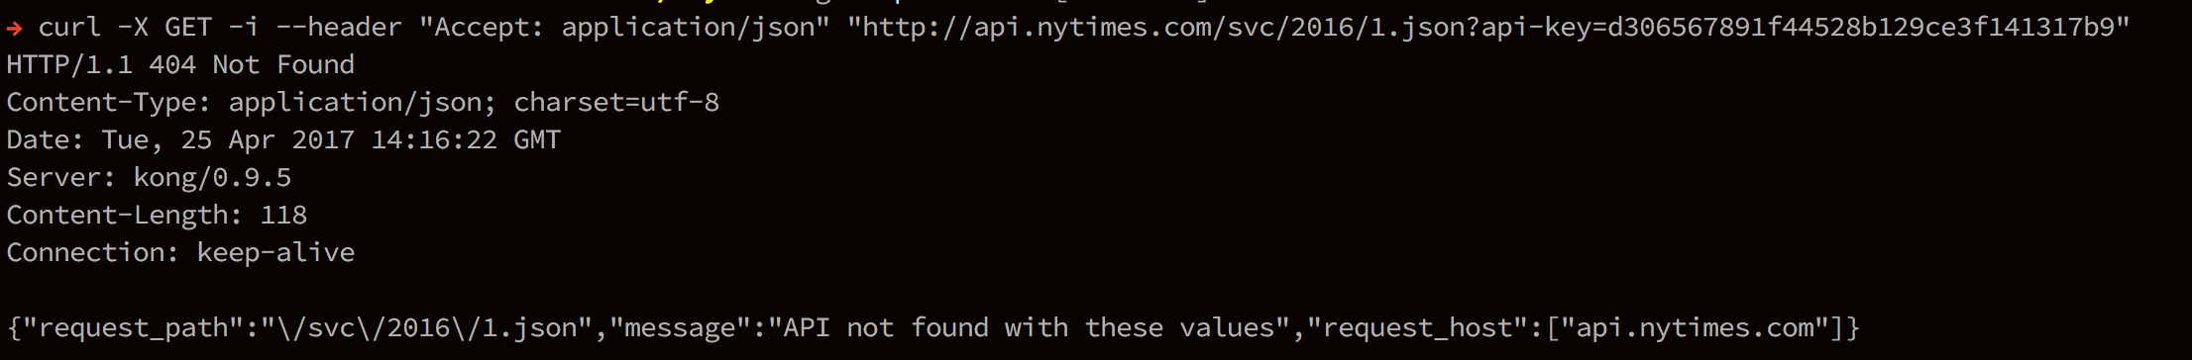
NYTimes API -404 Not Found -GET /archive/v1/{year}/{month}.json
HTTP Status
404 Response payload

Slide 11
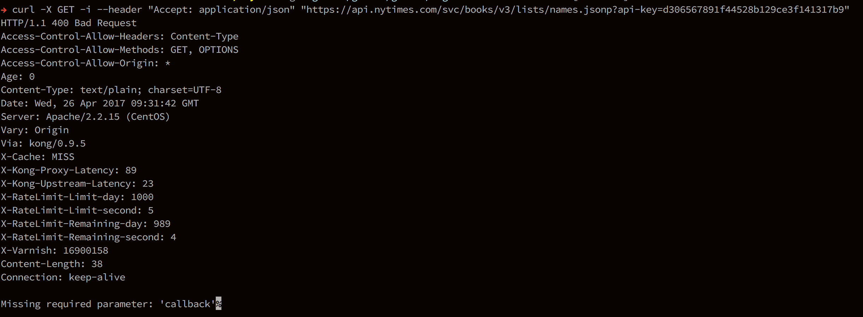
NYTimes API -400 Bad Request -GET books/{version}/lists/names.{format}
HTTP Status
400 Response payload

Slide 12
NYTimes API -Pros
遵循 RESTful 原則
Resource 有按照階層分級
依照 RESTful HTTP method CRUD 設計
使用 HTTP status code 做溝通
{year}/{month}
Resource 呈現的方式有 HTML Doc. Json, XML…, 而 NYTimes 以 Json 格式回應

Slide 13
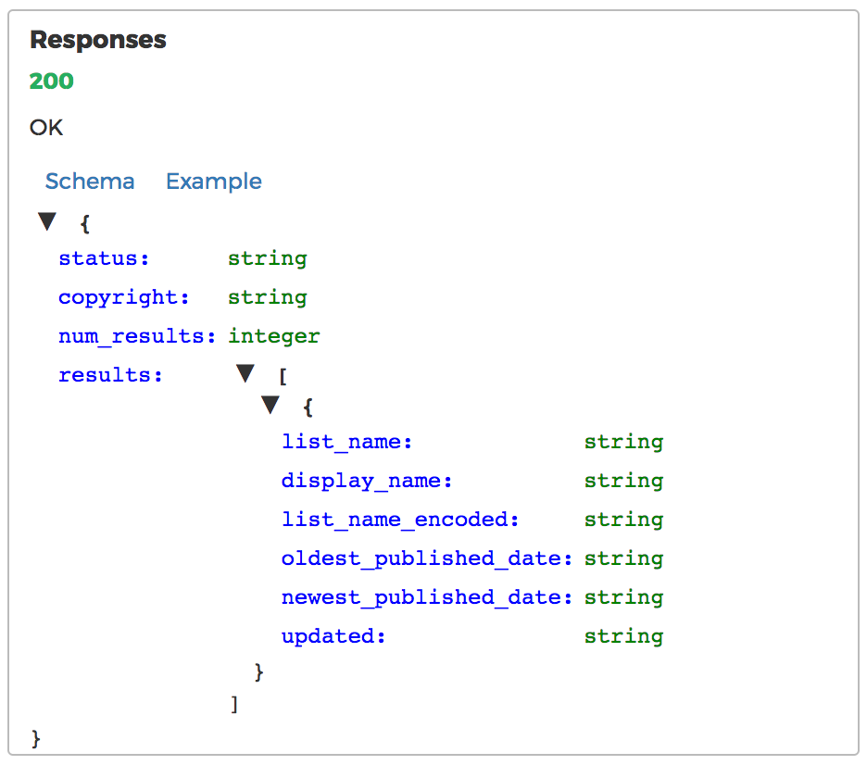
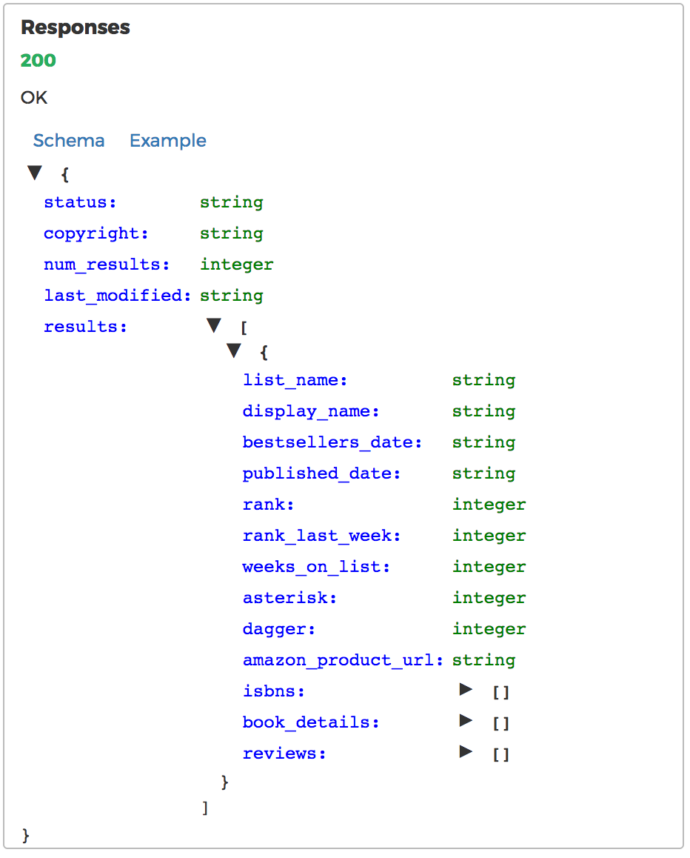
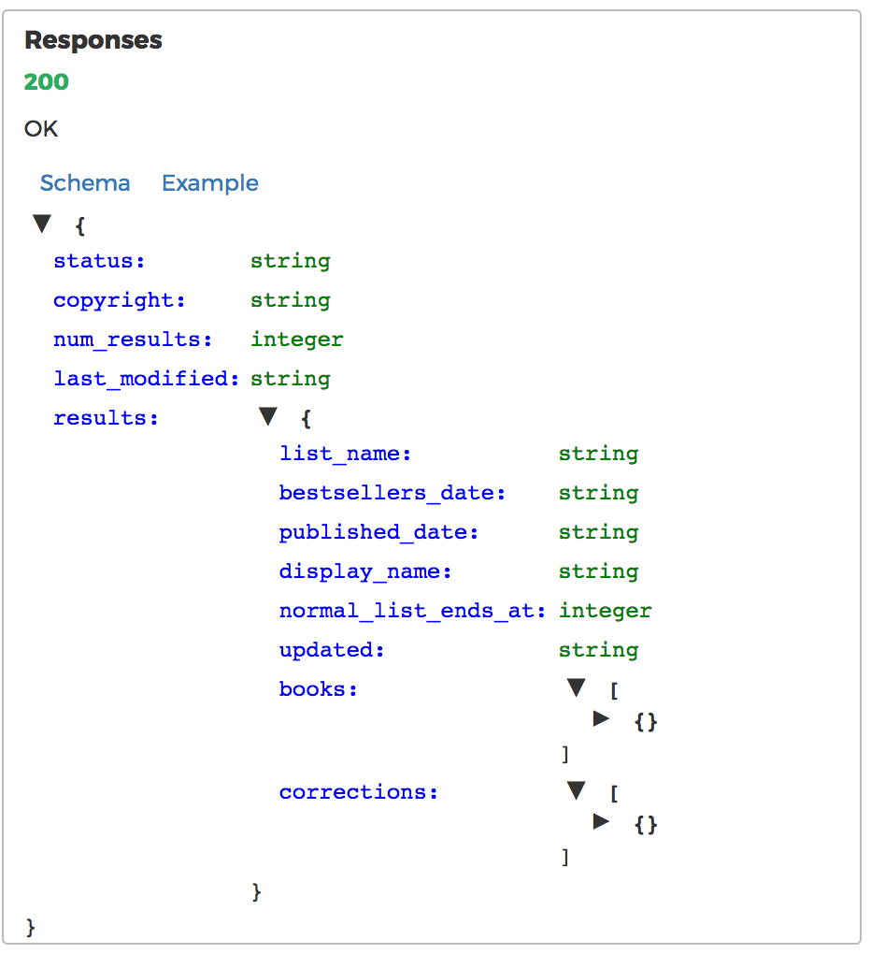
NYTimes API -Pros
The same Response payload (Success)
GET /lists/names.{format} Best Seller List Names | GET /lists.{format} Best Seller List | GET /lists/{date}/{list}.json Best Seller List by Date
Notes:
三個API意思？

Slide 14
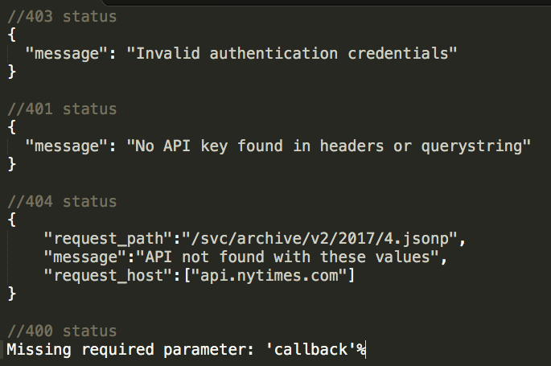
NYTimes API -Cons
Not the same Response payload (Error)

Slide 15
NYTimes API -Cons
經由 NYTimes 授權取得的 API Key 皆需要帶進 API PATH 當作參數,
這樣的做法會比較危險, API Key 容易被冒用。
Path parameter (required)

Slide 16
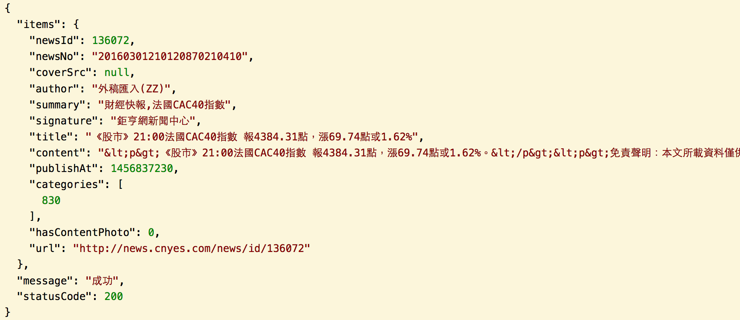
NYTimes API -Cons
Request 成功時，
從 header 才能得知 HTTP status, Response payload 看不出來狀態
NYTimes API | Cnyes API
HTTP Status??
但我們的API可從 payload 得知
HTTP Status: 200 OK

Slide 17
NYTimes API -Pros? Cons? Discussion?
JSON key 的命名方式不同
習慣差異，但各自統一
NYTimes API | Cnyes API
camelCase
snake_case

Slide 18
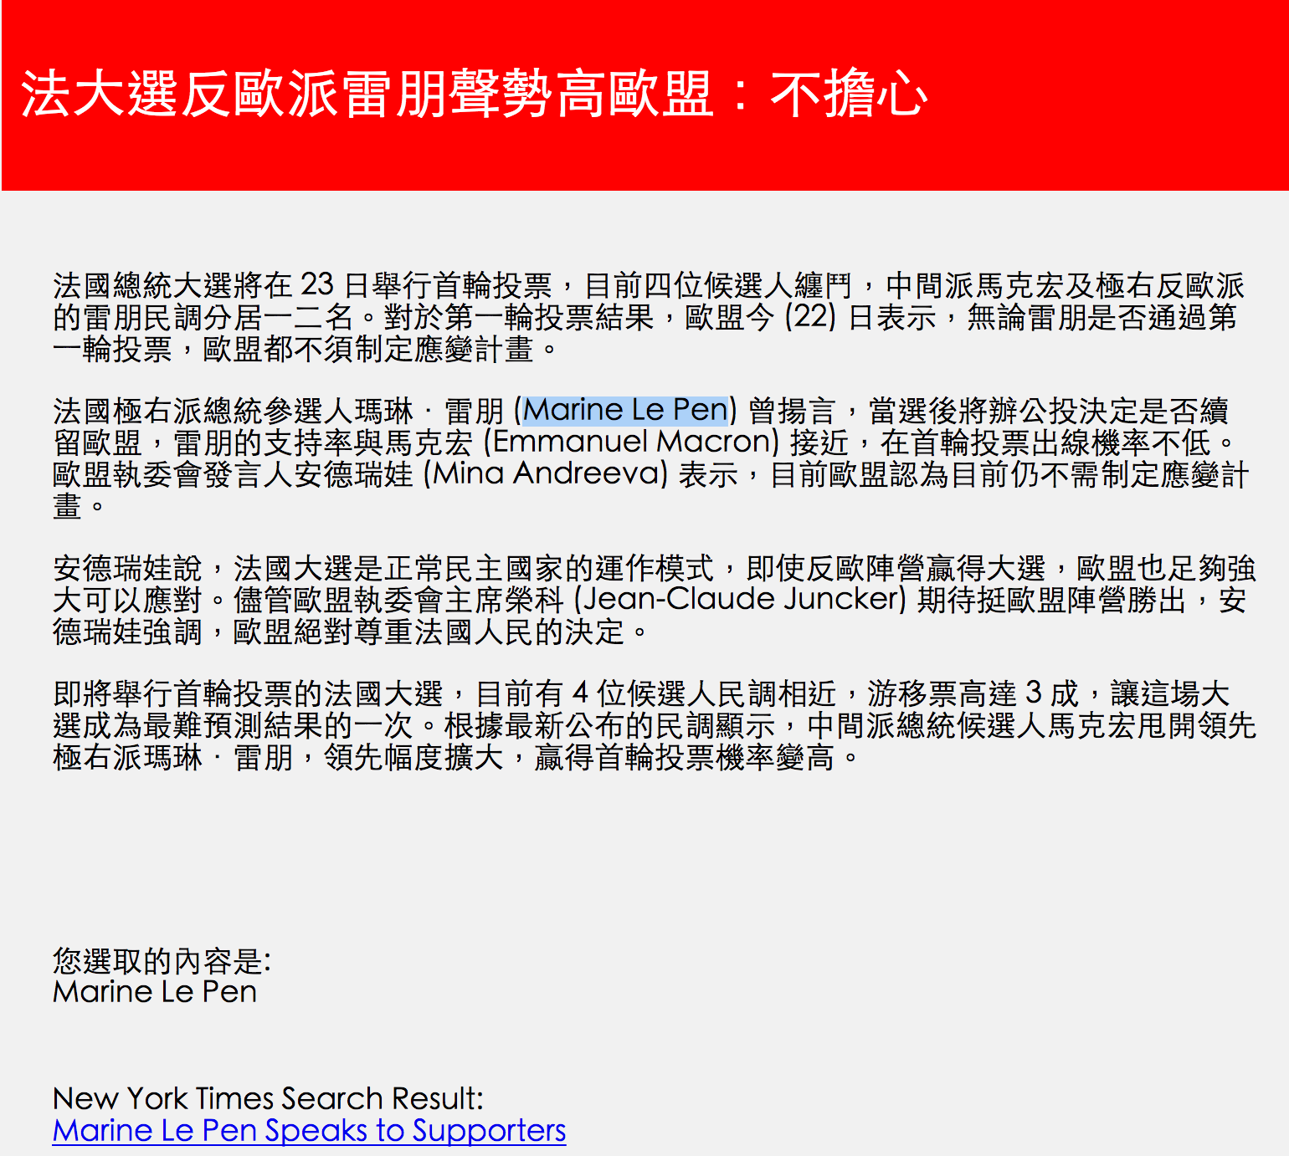
NYTimes API -DEMO
Source

Slide 19

NYTimes API -Q&A

