Slide 1

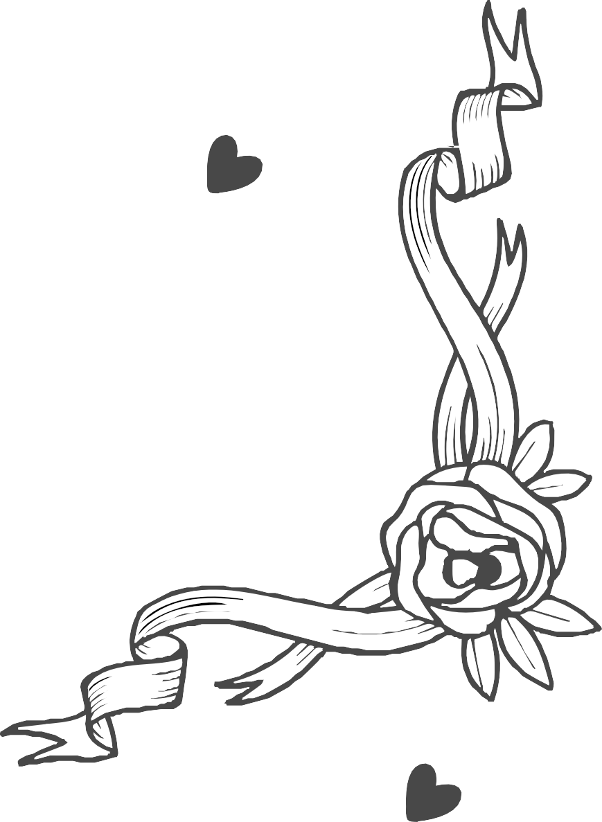
Mary
PLEASE JOIN US FOR THE WEDDING
And
Richard
4:00 PM
15 December 2020
White Church, Your Street

