Slide 2
1
0
MIN
MAX

Slide 3
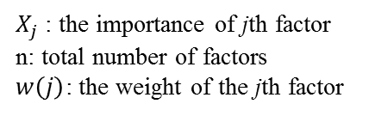

$$w\left(j\right)=\frac{X_{j}}{\sum_{i}^{n}{X_{i}}}$$
$X_{j}$ : the importance of jth factor
n: total number of factors
$w\left(j\right)$: the weight of the jth factor

Slide 4
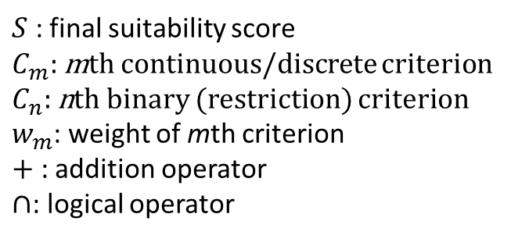
$$S=\left({w_{1}C}_{1}+{w_{2}C}_{3}+…+{w_{m}C}_{m}\right)×({C^{′}}_{1}∩{C^{′}}_{2}∩…∩{C^{′}}_{n})$$
$S$ : final suitability score
$C_{m}:$ mth continuous/discrete criterion
$C_{n}:$ nth binary (restriction) criterion
$w_{m}$: weight of mth criterion
$+$ : addition operator
$∩$: logical operator

