Slide 1
15-213 Recitation 5 Attack Lab and Stacks
Your TAs
Monday, October 5th, 2020

Slide 2
Agenda
Attack Lab Overview
Stacks Review
Activity 1
Procedure Calling Review
Activity 2

Slide 3
Learning objectives
By the end of this recitation, we want you to know:
Stack discipline and calling conventions
How to perform a simple buffer overflow attack
More discussion in lecture on Tuesday: Machine-Level Programming V: Advanced Topics

Slide 4
Reminders and Lab Overview

Slide 5
Reminders
Bomb Lab is due Tuesday, Sept. 29 at 11:59pm ET!
Attack Lab will be released the same day, and is due the Thursday, Oct. 8

Slide 6
Attack Lab overview
Attack programs by crafting buffer overflow attacks that hijack the control flow
Provide inputs to the rtarget and ctarget programs that cause them to call certain functions
Unlike in bomblab, the targets don't explode!

Slide 7
Stacks Review

Slide 8
Manipulating the stack
What instructions do we typically use to change the stack pointer, %rsp?
Growing the stack:
Shrinking the stack:

Slide 9
Manipulating the stack`
What instructions do we typically use to change the stack pointer, %rsp?
Growing the stack:
sub $0x28, %rsp
push %rbx
callq my_function
Shrinking the stack:

Slide 10
Manipulating the stack
What instructions do we typically use to change the stack pointer, %rsp?
Growing the stack:
sub $0x28, %rsp
push %rbx
callq my_function
Shrinking the stack:
add $0x28, %rsp
pop %rbx
retq

Slide 11
x86-64 Stack Frames
What kinds of data are stored on the stack?

Slide 12
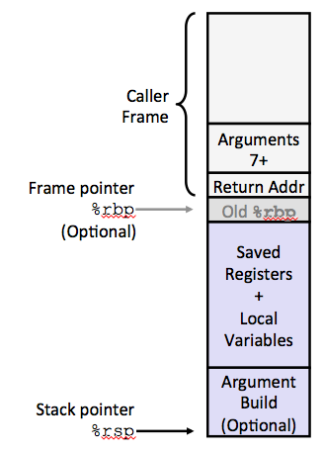
x86-64 Stack Frames
What kinds of data are stored on the stack?
Saved registers
Local variables
Arguments (7+)
Saved return address
Notes:
Arg 7 would have lower address than arg 8

Slide 13
Which way does the stack grow?
Up?
Down?
Left?
Right?

Slide 14
Which way does the stack grow?
Up?
Down?
Left?
Right?
It depends on how you draw it!
The stack always grows towards lower addresses in x86-64.
(Informally, this usually means "down".)
Be aware of this possible ambiguity when reading diagrams.

Slide 15
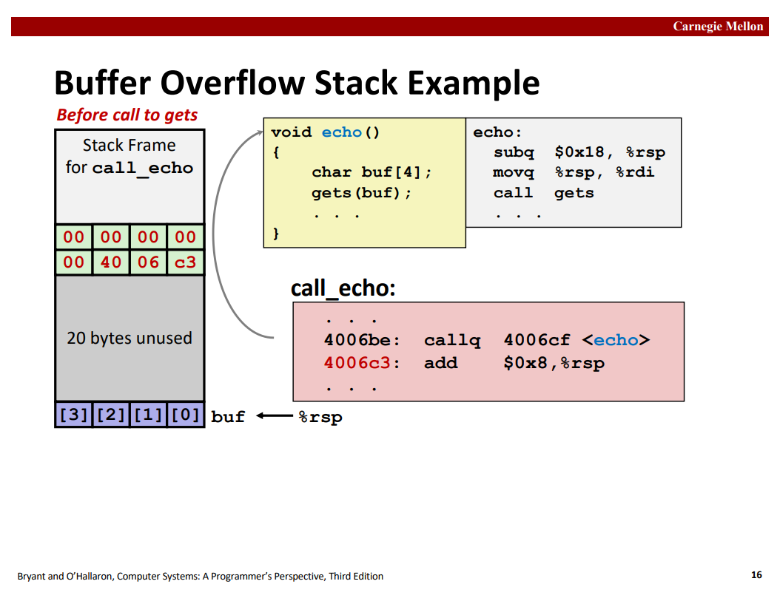
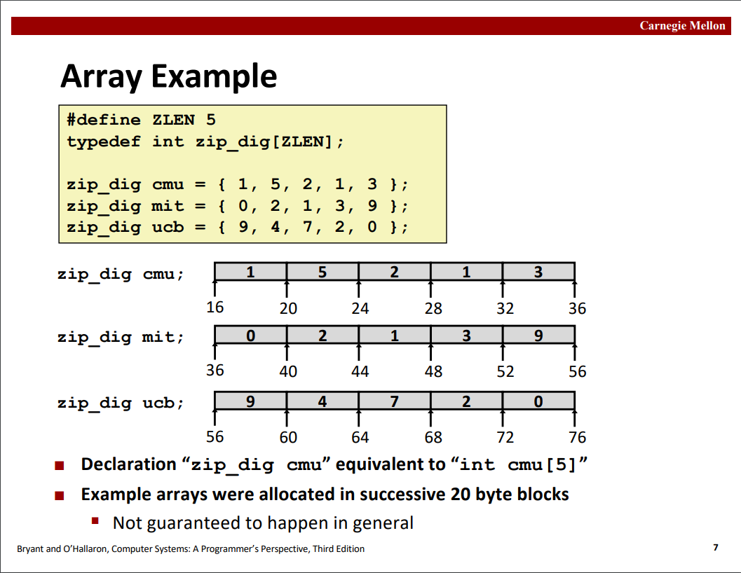
Drawing memory
Stack diagrams
Everything else
Addresses are displayed increasing to the left, and then upwards.
Addresses are displayed increasing to the right, and then downwards.

Slide 16
Endianness
Describes how integers are represented as bytes.
Little-endian means that the least-significant 8 bits of an integer are stored at the lowest address.
A[0] A[1] A[2] A[3]
32-bit integer
Little-endian
0x01020304
Big-endian
"Big end"
"Little end"
Middle-endian

Slide 17
Endianness
Describes how integers are represented as bytes.
Little-endian means that the least-significant 8 bits of an integer are stored at the lowest address.
A[0] A[1] A[2] A[3]
32-bit integer
Little-endian
0x04 0x03 0x02 0x01
0x01020304
Big-endian
0x01 0x02 0x03 0x04
"Big end"
"Little end"
Middle-endian
0x02 0x01 0x04 0x03

Slide 18
Activity 1

Slide 19
Part 1: Introduction to solve()
Let's look at solve() in the src/activity.c file.
What is it doing?
Is it possible for the program to call win()?
void solve(void) {
long before = 0xb4;
char buf[16];
long after = 0xaf;
Gets(buf);
if (before == 0x3331323531)
win(0x15213);
if (after == 0x3331323831)
win(0x18213);
}

Slide 20
Part 1: The gets() function
char *gets(char *s);
gets() reads from standard input and writes characters into s until it reaches a newline.
Since it has no information about the size of the buffer s, its design is fundamentally flawed. Never use gets() yourself!
Gets() is a CS:APP wrapper function that checks for errors, and exits if it encounters any.

Slide 21
Part 1: Activity setup
Split up into groups of 2-3 people
One person needs a laptop
Log in to a Shark machine, and type:
$ wget https://www.cs.cmu.edu/~213/activities/rec5.tar
$ tar xvf rec5.tar
$ cd rec5
Take a look at the code in src/activity.c.

Slide 22
Part 1: Diving into assembly
Look at the disassembly of solve().
Try drawing a stack diagram.
How large is the stack frame?
Where is the saved return address?
Where are before, buf, and after?
Which variable will be overwritten if we perform a buffer overflow, before or after?

Slide 23
Part 1: Drawing the stack diagram
=> 0x4006b5 <+0>: sub $0x38,%rsp
return address
rsp+0x38
rsp
Addresses increase towards the top of the slide

Slide 24
Part 1: Drawing the stack diagram
0x4006b5 <+0>: sub $0x38,%rsp
=> 0x4006b9 <+4>: movq $0xb4,0x28(%rsp)
return address
rsp+0x38
Addresses increase towards the top of the slide
rsp

Slide 25
Part 1: Drawing the stack diagram
0x4006b5 <+0>: sub $0x38,%rsp
0x4006b9 <+4>: movq $0xb4,0x28(%rsp)
=> 0x4006c2 <+13>: movq $0xaf,0x8(%rsp)
return address
rsp+0x38
before
rsp+0x28
Addresses increase towards the top of the slide
rsp

Slide 26
Part 1: Drawing the stack diagram
0x4006b5 <+0>: sub $0x38,%rsp
0x4006b9 <+4>: movq $0xb4,0x28(%rsp)
0x4006c2 <+13>: movq $0xaf,0x8(%rsp)
0x4006cb <+22>: lea 0x10(%rsp),%rdi
=> 0x4006d0 <+27>: callq 0x40073f <Gets>
return address
rsp+0x38
before
rsp+0x28
Addresses increase towards the top of the slide
after
rsp+0x8
rsp

Slide 27
Part 1: Drawing the stack diagram
0x4006b5 <+0>: sub $0x38,%rsp
0x4006b9 <+4>: movq $0xb4,0x28(%rsp)
0x4006c2 <+13>: movq $0xaf,0x8(%rsp)
0x4006cb <+22>: lea 0x10(%rsp),%rdi
0x4006d0 <+27>: callq 0x40073f <Gets>
=> 0x4006d5 <+32>: mov 0x28(%rsp),%rdx
return address
rsp+0x38
before
rsp+0x28
buf
Addresses increase towards the top of the slide
buf
rsp+0x10
after
rsp+0x8
rsp

Slide 28
Part 1: Comparing with GDB output
Let's compare the stack diagram we drew with the actual values on the stack after Gets() returns.
0x4006d0 <+27>: callq 0x40073f <Gets>
=> 0x4006d5 <+32>: mov 0x28(%rsp),%rdx
(gdb) break *0x4006d5
(gdb) run
Starting program: act1
abcdefgh12345678
(gdb) x/8gx $rsp
(gdb) x/64bx $rsp
return address
rsp+0x38
before
rsp+0x28
buf
buf
rsp+0x10
after
rsp+0x8
rsp

Slide 29
Part 1: Comparing with GDB output
(gdb) x/8gx $rsp
0x602020: 0x0000000000000000 0x00000000000000af
0x602030: 0x6867666564636261 0x3837363534333231
0x602040: 0x0000000000000000 0x00000000000000b4
0x602050: 0x0000000000000000 0x0000000000400783
(gdb) x/64bx $rsp
0x602020: 0x00 0x00 0x00 0x00 0x00 0x00 0x00 0x00
0x602028: 0xaf 0x00 0x00 0x00 0x00 0x00 0x00 0x00
0x602030: 0x61 0x62 0x63 0x64 0x65 0x66 0x67 0x68
0x602038: 0x31 0x32 0x33 0x34 0x35 0x36 0x37 0x38
0x602040: 0x00 0x00 0x00 0x00 0x00 0x00 0x00 0x00
0x602048: 0xb4 0x00 0x00 0x00 0x00 0x00 0x00 0x00
0x602050: 0x00 0x00 0x00 0x00 0x00 0x00 0x00 0x00
0x602058: 0x83 0x07 0x40 0x00 0x00 0x00 0x00 0x00
return address
rsp+0x38
before
rsp+0x28
buf
buf
rsp+0x10
after
rsp+0x8
Addresses
increase towards bottom of the slide
rsp
Addresses increase towards top of the slide
Notes:
can also mention use of “x/s address” to see the string in the expected spot
use print (void*) before to see how the variable has changed after printing address values

Slide 30
Part 1: Exploitation
Try to find an input string that wins 1 cookie!
What do we need to overwrite before with if we want to have before == 0x3331323531?
Constructing an exploit
gets() stops reading once it sees a newline. In the buffer, it replaces the newline with a null terminator.
gets() does not stop reading at a null terminator.

Slide 31
Part 1: Recap
Buffer overflows can overwrite parts of the stack frame, including other local variables
Stack frames may include padding, so looking at the assembly is crucial to drawing a correct diagram
GDB prints output starting at the lowest address, whereas our stack diagrams start at the highest

Slide 32
Procedure Calling Review

Slide 33
Call and return instructions
Which registers do callq and retq change?
%rax
%rdi
%rbx
%rsi
%r12
%rdx
%r13
%rcx
%r14
%r8
%rbp
%r9
%rsp
%r10
%rip
%r11

Slide 34
Call and return instructions
Which registers do callq and retq change?
%rax
%rdi
%rbx
%rsi
%r12
%rdx
%r13
%rcx
%r14
%r8
%rbp
%r9
%rsp
%r10
%rip
%r11

Slide 35
Stack/Procedure Review
•
•
•
0x130
0000000000400540 <multstore>:
•
•
=>400544: callq 400550 <mult2>
400549: mov %rax,(%rbx)
•
•
0x128
0x120
%rsp
0x120
%rip
0x400544
0000000000400550 <mult2>:
400550: mov %rdi,%rax
•
•
400557: retq

Slide 36
Stack/Procedure Review
•
•
•
0x130
0000000000400540 <multstore>:
•
•
=>400544: callq 400550 <mult2>
400549: mov %rax,(%rbx)
•
•
0x128
0x120
%rsp
0x120
%rip
0x400544
0000000000400550 <mult2>:
400550: mov %rdi,%rax
•
•
400557: retq
What happens next?

Slide 37
Stack/Procedure Review
•
•
•
0x130
0000000000400540 <multstore>:
•
•
400544: callq 400550 <mult2>
400549: mov %rax,(%rbx)
•
•
0x128
0x120
0x118
0x400549
Return addr pushed onto stack
%rsp
0x118
%rip
0x400550
%rip set to arg
0000000000400550 <mult2>:
=>400550: mov %rdi,%rax
•
•
400557: retq
Notes:
0x120-0x118 = 8

Slide 38
Stack/Procedure Review
•
•
•
0x130
0000000000400540 <multstore>:
•
•
400544: callq 400550 <mult2>
400549: mov %rax,(%rbx)
•
•
0x128
0x120
0x118
0x400549
%rsp
0x118
%rip
0x400557
0000000000400550 <mult2>:
400550: mov %rdi,%rax
•
•
=>400557: retq

Slide 39
Stack/Procedure Review
•
•
•
0x130
0000000000400540 <multstore>:
•
•
400544: callq 400550 <mult2>
=>400549: mov %rax,(%rbx)
•
•
0x128
0x120
0x118
0x400549
%rsp
0x120
Stack pop to %rip
%rip
0x400549
0000000000400550 <mult2>:
400550: mov %rdi,%rax
•
•
400557: retq

Slide 40
Let’s Rewind…
•
•
•
0x130
0000000000400540 <multstore>:
•
•
400544: callq 400550 <mult2>
400549: mov %rax,(%rbx)
•
•
0x128
0x120
0x118
0xbadbad
%rsp
0x118
%rip
0x400557
0000000000400550 <mult2>:
400550: mov %rdi,%rax
• ?????
• ?????
=>400557: retq
What if we mess up the return address?

Slide 41
Activity 2

Slide 42
Part 2: Exploitation
Hijacking control flow
Is it possible to overwrite after? If not, what parts of the stack frame can we overwrite?
Is there anywhere we could jump to call win(0x18213)?
Constructing an exploit
inputs/input2.txt
48 65 6c 6c 6f 20 31 35
32 31 33 21 # comment
inputs/input2.bin
Hello 15213!
make
(runs hex2raw)

Slide 43
Part 2: Recap
retq always jumps to the saved return address, which it pops off the stack (at rsp).
Overwriting the saved return address on the stack allows us to "fool" retq, and transfer control to an arbitrary instruction.

Slide 44
Attack Lab Tools
$ gcc –c test.s $ objdump –d test.o Compiles the assembly code in test.s, then shows the disassembled instructions along with the actual bytes.
$ ./hex2raw < exploit.txt > exploit.bin
Convert hex codes into raw binary strings to pass to targets.
(gdb) display /12gx $rsp (gdb) display /2i $rip
Displays 12 elements on the stack and the next 2 instructions to run
GDB is also useful to for tracing to see if an exploit is working.

Slide 45
If you get stuck
Please read the writeup carefully. Not everything will make sense on the first read-through.
Other resources you can make use of:
CS:APP Chapter 3
Lecture slides and videos
x86-64 and GDB cheat sheets under Resources

